Slide 1
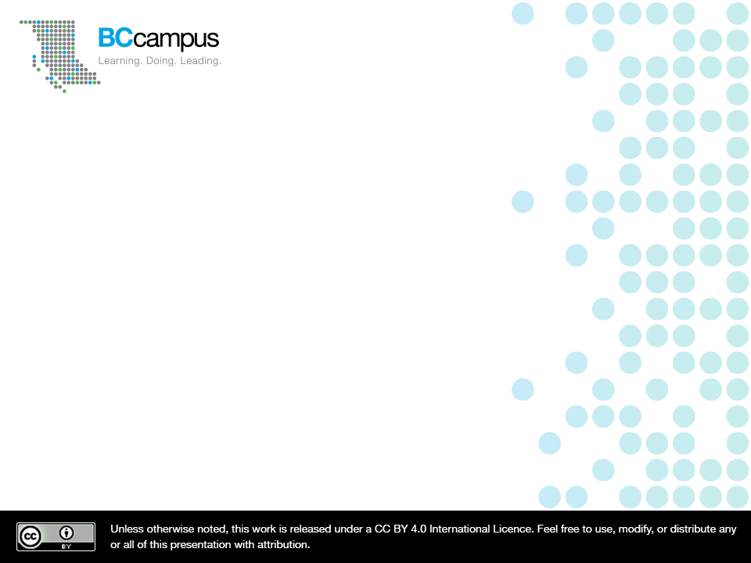
Inaccessibility
BCcampus Inclusive Design Webinar Series
Josie Gray
Coordinator of Collection Quality
@josiea_g / jgray@bccampus.ca
February 26, 2019
Notes:
Hello all. Just so you know, this session will be recorded and shared and I am starting the recording now.
Before we begin, I’d like to acknowledge that I am speaking to you today from the traditional, unceeded territories of the Esquimalt, Songhees and WSÁNEĆ First Nations, who continue to be in rich relationships with this land.
Thank you for joining me for BCcampus’s final webinar on inclusive design. My name is Josie Gray, and I work as the Coordinator of Collection Quality at BCcampus Open Education in Victoria, B.C. Today, I want to highlight what inaccessibility may look like to different people in order to expand our conceptions of accessibility and illustrate why inclusive design is so important.
As this is the last session in the series, I want to encourage you all to be open and forthcoming with questions. There is no need to wait until the end. I want us to be able to engage with each other on these different topics. I know that discussion is hard in this kind of webinar format, but I will do what I can to facilitate. And Amanda Coolidge will be helping me monitor the chat.

Slide 2
How can we ensure an OER is inaccessible?
Notes:
I want to start our discussion today with n activity. I would like you all to think about all of the things you could do to make sure that your students have problems accessing the learning materials. How can we make sure that the OER that we design and create are inaccessible?
Try to think of it from your own context. If you are an instructor creating your own materials, think of it that way. If you are someone who supports others who are doing the creation, what would encouraging the creation of inaccessible OER look like in that context?
To give you some extremes, I might say that I would print a textbook with light grey text on a white background, or I would delete the Accessibility Toolkit published by BCcampus.
I will give you three minutes to brainstorm some ideas, and then I will ask for people to share some things that you come up with. Think big and think small. Feel free to have some fun with it.

Slide 3
What are some ways we could design inaccessible OER?
Notes:
Now, I’d like it if people could share their ideas on how to make inaccessible open educational resources. At the top of the window, you should see a text button. If you click that, you should be able to write your ideas on the slide for everyone to see. Or you can put ideas in the chat and I will copy them over. Or, you can turn on your micophone and read them out and I will copy them down. Let’s see if we can put up 10 ideas.
Now let’s look over these ideas. Is there anything that we are doing right now that resembles any of these practices?
Despite our best intentions, we don’t always get accessibility right.

Slide 4
What might barriers look like?
Notes:
Thank you everyone for your participation. There are a few reasons why I wanted to do that activity. One was to get us thinking critically about our current practices. And the other reason was because I wanted to get an idea of what comes to your mind when you are thinking about what may make something inaccessible.
Generally, the responses in the activity focused on “inaccessibility” in the technical sense. For example…
In this webinar, I want to spend some time unpacking how we understand and define accessibility and illustrate how only considering technical accessibility requirements doesn’t ensure that the resources we create are free of all barriers.

Slide 5
Understanding Accessibility
“Accessibility” is more of a technical word signifying that something meets defined criteria
WCAG 2.0, checklists (minimum standards, somewhere to start)
Notes:
When people talk about accessibility, it’s usually very technical. At BCcampus, when we label a resource as “Accessible,” we mean that it meets our required accessibility criteria.
Accessibility criteria in the digital landscape is generally based off of WCAG – or the web content accessibility guidelines provided by W3C. This includes things like using headings, providing captions for video, and creating descriptive link text and more. All of these things are things that can be checked off, and as such there are a lot of accessibility checklists out there to help people make web content accessible.

Slide 6
BCcampus Accessibility Checklist
Content uses headings and subheadings that are used sequentially
Images have alternative text descriptions
Images do not rely on colour alone to convey information
Link text is meaningful when read out of context
Tables include row/column headers with correct scope, captions, and do not have merged or split cells
Multimedia has transcripts or captions
Font size can be increased
Notes:
Here is an except from the Accessibility Checklist included in the BCcampus Accessibility Toolkit. You can look at your resource and go through this checklist to make sure it is accessible.
For example, does your resource use headings and subheadings throughout your document? This is important to ensure that people using a screen reader can navigate through your document and get an idea of what topics are covered and how information is structured. Headings also makes it easy to apply a consistent style to your file, and maybe automatically generate a table of contents – depending on the format you are working in.
Does your resource have alternative text descriptions? Students who are blind or have low vision rely on alternative text descriptions to access information conveyed in images. Text descriptions can be provided in the surrounding text, in alt tags, or in a long description. Alt tags will also display if a student has a poor Internet connection.
Do your images not rely on colour alone to convey information? For students who have problems differentiating between colours, it is vital that you do not rely on colour to convey information. Colour should be used in combination with patterns, labels, or symbols. The use of colour also affects students who select to have their resource printed in black and white, which is much cheaper than printing in colour.
Is link text meaningful when read out of context of the rest of the sentence? Someone using a screen reader can have their screen reader navigate through all of the links on a page. If you don’t use descriptive link text, it will be impossible for that person to tell where a link is going to take them unless they read through the complete page.
Do your tables have row and column headers with the correct scope assigned, caption, and no merged or split cells? This insures that someone using a screen reader can navigate through a table and understand how the data relates to each other. Without this, someone using a screen reader will have a hard time telling what row and column a data cell belongs to.
Does your audio and video have transcripts or captions? All audio content should have a text alternative for students who are deaf.
Can your text be increased?
Checklists don’t cover everything, but they give you an idea of the things you have to do to make sure your digital resource is accessible. Being able to check off everything in this checklist is great and absolutely vital in order to ensure that students with disabilities will have equal access to learning materials. It is also a good place to start for people learning about digital accessibility. But meeting accessibility criteria will not guarantee inclusion or ensure that students will not experience barriers when trying to access your material. And this is why moving beyond this checklist-understanding of accessibility to be more inclusive of individual difference can be really powerful.

Slide 7
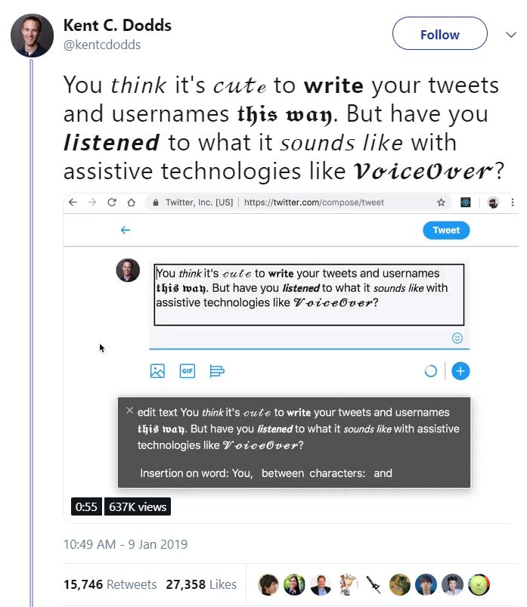
Limits of checklists
Notes:
For example, a checklist doesn’t ensure that your image descriptions are useful or good, and they don’t ensure that link text is accurate. In addition, although accessibility checklists are meant to make sure content can be perceived and navigated with a screen reader, there are lots of barriers that people who use screen readers face that we take for granted. In this example is a screenshot of a tweet that reads: “You think it’s cute to write your tweets and usernames this way. But have you listened to what it sounds like with assistive technologies like VoiceOver.” The tweet replaces a lot of the letters with special characters to make some of the text bold, italicized, cursive, or in a fancy font. Included in this tweet is the audio of VoiceOver Reading the tweet. Instead of reading the word, the screen reader reads out the name of each special character. For example, the word “cute” is read, “Mathematical script small c, mathematical script small u, mathematical script small t, mathematical script small e.”
This is an extreme example, and one that is probably not applicable to educational resources. But I bring it up to highlight that barriers are easily created, and following a checklist doesn’t ensure accessibility. And in the case of screen readers, it is easy for people used to navigating the web visually to take forgranted how a screen reader presents information. In the context of educational resources, this may mean keeping in mind that how a screen reader will present acronyms, symbols, and math equations may not be how a visual user would interpret them.
Image attributions
Kent C. Dodds tweet screenshot is not under an open licence.

Slide 8
Inclusive Design is…
“… design that considers the full range of human diversity with respect to ability, language, culture, gender, age, and other forms of human difference.”
- Inclusive Design Research Centre
Notes:
Once we recognize the limits of accessibility checklists, it becomes easy to appreciate the power of Inclusive Design. In the first webinar of this series, Jess Mitchell from the Inclusive Design Research Centre spoke to us about Inclusive Design. She defined Inclusive design as design that considers the full range of human diversity with respect to ability, language, culture, gender, age, and other forms of human difference.
This approach to design helps us move pass the focus on accessibility and address the diverse barriers that students may be facing.

Slide 9
Disability as mismatch
Disability is a mismatch between an individual and their goals and the tools they have available to them in their environment or context.
Disability is
Relative
Subjective
Context dependent
Notes:
Implied in this definition of inclusive design is a movement away from a focus on the medical modal of disability. Instead, we can think about disability as a mismatch between an individual and their goals and the tools they have available to them in their environment or context. When defining disability this way, it is no longer a personal trait. Instead, it is something that is relative, it is context dependent, and it can affect basically everyone. But most importantly, this understanding of disability recognizes that barriers to access are created and imposed – they are not absolute. Everyone can experience mismatch, and mismatch is something we solve for.
I would like to use this webinar as an opportunity to highlight the many ways students may experience mismatch.
One thing that I took from Jess’s presentation was her emphasis that all decisions are design decisions and nothing is netural. Every decision we make when creating educational resources, we need to be considering how that decision will affect people. When we change something, who are we breaking it for? Who does this exclude?
Over the next few slides, I will be highlighting different barriers that students may have that are not covered by accessibility checklists. However, these barriers can be addressed by applying inclusive design principles.

Slide 10

Cost
Notes:
Cost is a big barrier to education not covered by an accessibility checklist. The price of post-secondary education is a huge barrier for so many students, and the price of textbooks just makes that worse. Fortunately, the use of open educational resources is making a difference here. For classes with expensive textbooks, students often put off buying the textbook or don’t buy it at all. But using an open textbook ensure that students have access to the material from the first day of classes without having to determine if they can afford that extra cost.
Image Attributions
Money (https://flic.kr/p/SgH7Ej) by Got Credit (www.gotcredit.com) is under a CC BY Licence.

Slide 11
Limited Access to Digital Devices
This may apply to:
Things to consider:
A student with no computer
A student with no smart phone
A student with limited access to the Internet
Provide a print
Provide an eBook format that someone can access on their phone
Notes:
Students with limited access to digital devices also may experience barriers when trying to access digital resources. Although it seems like everyone has a computer and smart phone, that is not always the case.
For example, I know a student who is studying to be a fabricator at Camosun College. He has a phone, but has never owned a laptop. Instead, he borrows his girlfirends computer when he wants to watch Netflix. Because he only has class a few weeks a year, it has never been worth it for him to buy a computer. However, for his most resent semester, his textbook was all online, and he and his girlfriend were both going to school trying to share one laptop.
Another example comes from a survey of adult basic education students. In the survey, one student said they hated the online version of the text. Later in the survey, it becomes clear that the student didn’t always have a device where they could access the textbook. In this case, the "hate" for an online textbook was a problem with access, rather than a problem with the resource itself.
Here is where providing multiple formats can be beneficial. One option is to provide a print version. And another is to provide an eBook copy that can be read on a mobile device.
Image attributions:
“employees working” (https://flic.kr/p/KXg8En) by https://1dayreview.com/ is under a CC BY Licence.

Slide 12
Limited Internet Access
This may apply to:
Things to consider:
Students who spend long hours on transit
Students facing financial difficulties
Students who live in isolated communities
Students with low digital literacy
Provide a digital format they can download to read on their computer or phone
Provide assignments that can be worked on offline
Notes:
In relation to restricted access to digital devices, students may also have limited access to internet for all sorts of reasons, so limiting the time they need to be connected to the Internet for the course can be beneficial.
For example, for a student who has to travel a long distance on public transit everyday, formats that they can download to read while on the bus may be hugely beneficial. The digital format saves them from having to pack another book into their already full bag, and being able to download the PDF or eBook allows them to read their textbook on the bus without requiring Internet access.
Other students who may have limited Internet access are those facing financial difficulties, those who live in isolated communities, and students with low digital literacy. As such, it may be a good idea to think about how much of your class requires students to be online – whether that looks like accessing an online resource or completing online assignments.

Slide 13
Digital Literacy
This may apply to:
Things to consider:
Anyone.
Teach students how to use and navigate a digital resource
Highlight accessibility and customization options
Provide a print option
Notes:
Although there may be cross over between Internet access, access to digital devices, and digital literacy, they are not necessarily the same. And digital literacy is something that is very easy to over estimate. Just because someone has been on social media since they were 12, does not mean they know how to search a PDF or are aware of the different formats available in Pressbooks.
As such, it is important to teach students how to use and navigate a digital resource. Let them know how they can customize your resource and highlight features available in different formats and the ability to access a print version.

Slide 14
Language/Comprehension
This may apply to:
Things to consider:
Students learning a second language
Students whose first language is not English
Students from different cultural contexts
Students with learning disabilities
Make use of key terms/glossary lists
Avoid jargon and figures of speech
Structure topics and highlight main ideas
Provide audio to accompany text (or highlight text-to-speech tools)
Notes:
Students may also experience barriers when it comes to the language used in your resource. This will absolutely apply to classes where students are learning a language. But it may also apply to students in your class whose first language is not English, those from different cultural context, or students with learning disabilities.
To account for this, avoid jargon and create a glossary or list of key terms to help students learn technical terms that are important. Figures of speech and obscure cultural references should also be avoided as students from a different cultural background from you may not understand.
Structuring your content in an organized way and highlighting the main ideas will also help students navigate content and understand how it all relates to eachothe and what is important.
In addition, classes where you are teaching language or teaching a lot of students whose first language is not English, you may want to consider adding audio recordings to accompany text content to help with comprehension.

Slide 15
Barriers for Print Users
Videos, audio
Interactive activities
Links
Quality of images
Notes:
The primary format for OER is generally digital and so many of them are web based. While this is great, this focus on the web comes at the expense of print resources. While the digital environment opens up great opportunities for interactivity and multiple formats, we should not forget that there are student who still prefer or require print formats. In Pressbooks, that means being aware of how much of your content is embedded, interactive, or only available online as videos, audio files, and H5P will not appear in print formats. And when you do use these types of content, make it easy for students using the print copy to find them. This includes providing the web address for all links mentioned in a resource.
The quality of images may also be reduced when printed. Especially if a student has elected to print in black and white.
All of these things need to be balanced to ensure that students who prefer a print option don’t face additional barriers.

Slide 16
Strategies for creating inclusive resources
Notes:
Ultimately, accessibility and inclusion isn’t a checklist or something that can be completed, and it isn’t about perfection. Accessibility checklists do not guarantee barrier-free resources. Ensuring that your resources are as useful and inclusive of your students’ needs is an ongoing, iterative practice. Prioritize curiosity, be responsive to your students, do what you can.

Slide 17
Structure
Five Rules of Textbook Development
Rule of frameworks
Rule of meaningful names
Rule of manageable numbers
Rule of hierarchy
Rule of repetition
Notes:
When designing an OER, you should keep in mind how you are organizing and structuring the information itself. These five rules of textbook development are meant to guide this process when it comes to writing textbook content.
The rule of frameworks means maintain a consistent structure. The text can best aid understanding by making this framework visible early on.
The rule of meaningful names means create and use consistent titles and terminologies. The names are critical to the ability to recall or retrieve the things we know and remember.
The rule of manageable numbers means limit the amount of new information introduced at one time.
Rule of hierarchy means new knowledge builds on learned knowledge. The student needs to understand the foundational knowledge before being introduced to a new concept. When new concepts are introduced, they should be explicitly connected to the foundational material.
The rule of repetition means repeat important concepts. There is a pattern of repetition that aids in promoting the elements of a subject from short-term to long-term memory.
This comes has been adapted from Wikibooks:Textbook considerations and is used under a CC BY-SA 3.0 Licence.

Slide 18
Multimodal Presentation
Offer flexibility and choice, and educate students about that flexibility and choice
Highlight format options
Offer help with using different formats
Suggest tools and strategies to customize resources (e.g., text to speech tools, expand font, annotation, formats)
Mix ways of presenting information - text, visual, audio, and interactive content
Print and digital options (avoid over-reliance on web content)
Notes:
Another goal is to offer flexibility and choice. Can you offer your resource in multiple formats? If so, let your students know what their options are and the strategies and tools they can use to navigate and customize that resource. For example, there are text to speech tools, the ability to expand font size, and PDFs are easy to annotate.
In accessibility, the goal is not a text-only resource, so try to use multiple ways of presenting information. This can include text, images, video, audio, and interactive content. However, keep in mind that some students way still prefer a print copy, so try to avoid an over reliance on web content.

Slide 19
Work with your students
Who are they?
Ask for feedback
“Start from a place of curiosity” – how do students feel about your resource? What would make it more useful to them?
Co-create resources with students
Notes:
I think the biggest thing I can suggest is to design for the students you have. What are their needs? Students trying to learn French will probably have different needs than Math students.
Be open with your students and welcome their feedback. Ultimately, they are who will be using the resource from the day to day. They should have a pretty good idea of what works for them and what doesn’t. Start from a place of curiosity. How are students using your resource? How do they feel about it? What would make it more useful to them?
This is where open pedagogy can come in. One way to ensure your students have useful learning resources is to make them cocreators or empower them to create their own and share and build on each other’s work. This can allow them to find and identify what is important and structure and present it in a way that makes sense to them.

Slide 20
Resources
The Accessible Digital Office Document Project: A collection of resources for creating accessible office documents. (https://adod.idrc.ocadu.ca/)
Accessibiity Toolkit: A resource for creating accessible digital content, especially as it relates to Pressbooks (https://opentextbc.ca/accessibility/)
Previous inclusive design webinars in this series: Open Education channel at https://video.bccampus.ca/
Notes:
Thank you everyone for your attention today. Because this webinar focused more on conceptual things rather than how-tos, I wanted to end by highlighting accessibility and inclusive design resources.
The first is the Accessible Digital Office Document Project by the IDRC. It contains a collection of resources for creating accessible office documents. You can find this project at adod.idrc.ocadu.ca
The second is the Accessibility Toolkit, which is a resources created by BCcampus providing guidance for creating accessible digital content, especially as it relates to Pressbooks. You can access that at opentextbc.ca/accessibility
And the third is where you can find the recordings for all four webinars in the inclusive design series. Just go to video.bccampus.ca and search the open education channel for Inclusive Design.
And now I’d like to open the room up for more people to participate and see if we can get a discussion going. Do you have any questions? Are there any takeaways from any of the previous webinars that stood out for you? Do you have examples, successes, or struggles from your experience that you would be willing to share? What have you done to make your teaching practices or educational resources more accessible and inclusive? What barriers do you face?

