Slide 1
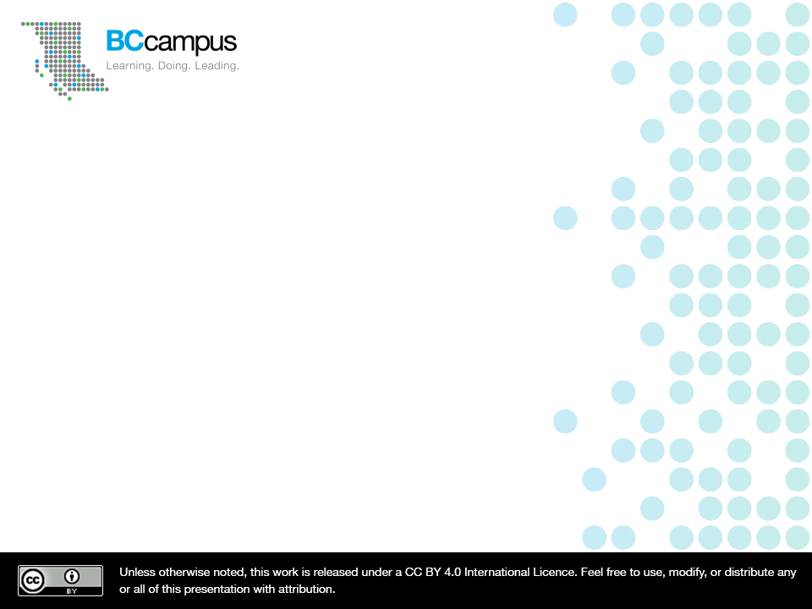
Pressbooks
BCcampus Inclusive Design Webinar Series
Josie Gray
Coordinator of Collection Quality
@josiea_g / jgray@bccampus.ca
February 19, 2019
Notes:
Hello all. Just so you know, this session will be recorded and shared and I am starting the recording now.
Before we begin, I’d like to acknowledge that I am speaking to you today from the traditional, unceeded territories of the Esquimalt, Songhees and WSÁNEĆ First Nations, who continue to be in rich relationships with this land.
Thank you for joining me to talk about accessibility and inclusive design in open textbooks created in Pressbooks. My name is Josie Gray, and I work as the Coordinator of Collection Quality at BCcampus Open Education in Victoria, B.C. This webinar is part three of 4-part webinar series on inclusive design. In our previous two webinars, we talked about what is Inclusive Design as well as how to create accessible presentations. In the webinar on inclusive design, Jess Mitchell from the Inclusive Design Research Centre defined inclusive design as “Design that considers the full range of human diversity with respect to ability, language, culture, gender, age, and other forms of human difference” and that definition is something that I’d like for you to keep in mind today as we talk about the different design decisions that you can make when authoring a textbook in Pressbooks.
I have been working in web accessibility for two and a half years now, and I have spent a lot of time doing accessibility remediation work on books in Pressbooks, and I’d like to share that knowledge today in order to help make the books you create inclusive and accessible from the start.
This webinar is scheduled for one hour, but the presentation will only be a portion of that. Once done, I will open up the room for discussion and questions. This will give us a change to clarify points, exchange ideas, and think about what am inclusively designed open textbook may look like in Pressbooks. And if you have questions while we go, feel free to put them in the chat.

Slide 2
Resources
Accessibility Toolkit: opentextbc.ca/accessibilitytoolkit/
Pressbooks Guide: opentextbc.ca/pressbooks/
Pressbooks Tutorial Video Series: video.bccampus.ca (Navigate to the “Pressbooks Tutorial” channel)
Notes:
Throughout this presentation, I am going to point to resources for future reference. They are things that you will probably want to go back to, and they are likely able to provide more detail than I can in this presentation, so I want to highlight them early.
The first is the BCcampus Accessibility Toolkit. The toolkit outlines how to make different kinds of content accessible. This includes considerations for headings, images, links, tables, colour contrast, font, formulas, and multimedia. You can find the toolkit at opentextbc.ca/accessibilitytoolkit
The second is the BCcampus Pressbooks Guide. The Pressbooks Guide provides Pressbooks help for faculty working specifically in the BCcampus instance of Pressbooks at pressbooks.bccampus.ca. This guide has been designed to complement the more comprehensive Pressbooks User Guide published by Pressbooks. You can find the Pressbooks Guide at opentextbc.ca/pressbooks/
The third is the BCcampus Pressbooks Tutorial Video Series, a collection of over 30 short tutorial videos to help new and advanced users of Pressbooks alike. These videos are captioned, organized by topic, and integrate accessibility principles when demonstrating how to create content like tables, images, and links. You can find all videos in this series in the “Pressbooks Tutorials” channel at video.bccampus.ca. These videos are also embedded in relevant sections in the Pressbooks Guide.

Slide 3
Pressbooks’ Accessibility Policy
Pressbooks’ Accessibility Policy (https://pressbooks.org/accessibility/)
Partnership with the Inclusive Design Research Centre
New/updated code to conform to WCAG 2.0 AA
Pressbooks user interface elements to comply with WCAG 2.0 AA
Accessibility and Inclusive Design incorporated in development roadmap
Notes:
Since we are going to be talking about accessibility and Pressbooks, I want to start by addressing the accessibility of the Pressbooks platform itself.
In May 2018, Pressbooks announced its Accessibility Policy. In the policy, Pressbooks iterated their commitment to improving the Pressbooks platform to make the platform itself more accessible and to make it easier to create accessible content in Pressbooks. As part of this work, Pressbooks has established a partnership with the Inclusive Design Research Centre at OCAD University and has made regular improvements to the platform to increase its accessibility.
In this Accessibility Policy, Pressbooks has committed that all new or updated code released in Pressbooks will conform with the Web Content Accessibility Guidelines (WCAG) 2.0 at level AA and that all custom Pressbooks user interface (UI) elements will be brought into compliance with the WCAG 2.0 at level AA within 2019. These commitments will ensure that Pressbooks will conform to existing accessibility legislation, including the Americans with Disabilities Act (ADA) in the United States and the Accessibility for Ontarians with Disabilities Act (AODA) in Ontario.
Pressbooks also has included plans to increase the inclusiveness and accessibility of the platform in its development roadmap, but there are a few features in place already that help make the platform more inclusive.

Slide 4
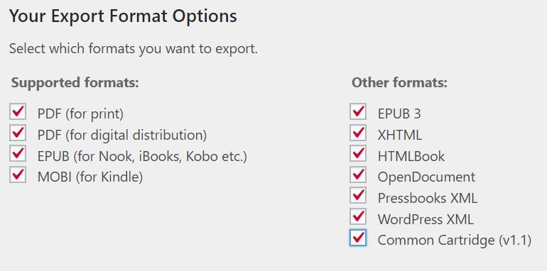
Multiple Formats
Notes:
The first is in the ability to export a book into multiple formats.
In the first webinar of this series, Jess Mitchell highlighted the importance of multimodal design in inclusive design. Pressbooks makes this possible as it allows you to create one copy of a book and export it into multiple formats including a webbook, digital and print PDF files, EPUB and MOBI files, and various editable files. Each of these files types have their own advantages, disadvantages, features, and use cases.
They also accommodate different accessibility needs. For example, a blind student cannot use a print copy of a book, but they can use a screen reader to read the webbook. A student who spends a lot of time on the bus everyday will probably appreciate the ability to download the ebook file to read on their phone or computer. And someone who isn’t comfortable with digital devices will likely prefer a print copy. And PDFs are easy to search and annotate with highlights and comments. When we make a textbook available in multiple formats, we give students a choice in how they would like to access and interact with their textbook.

Slide 5
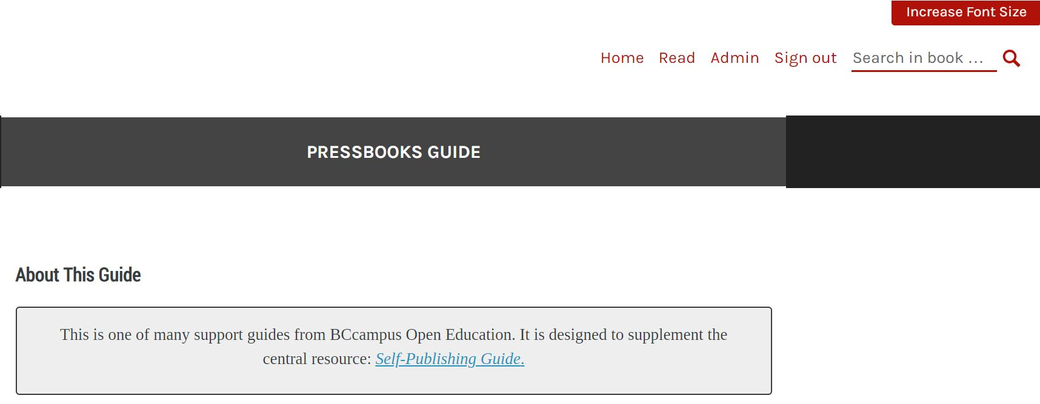
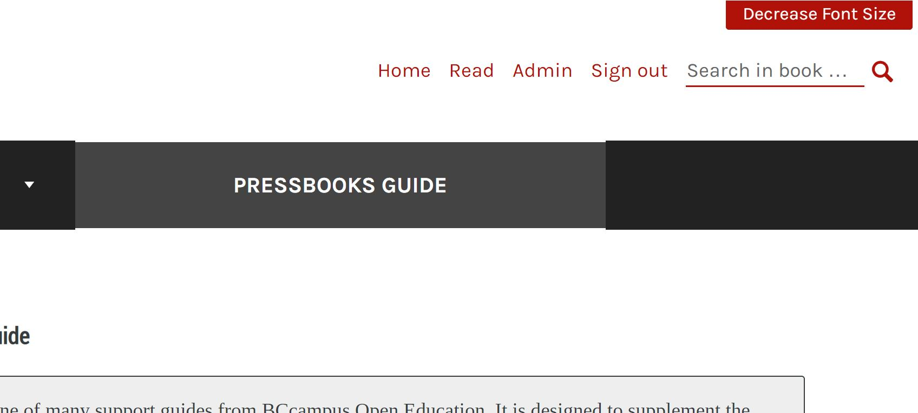
Increase Font Size
Notes:
There are a number of accessibility options available in each of these formats, but one I’d like to highlight is the ability to increase font size in the webbook. In the top-right corner of the webbook, there is an option to “Increase Font Size” which will increase the font size of all content in the book by 200%.

Slide 6
Book Structure and Navigation
Notes:
Now let’s get into design decisions that authors have control of and start by looking at the big picture. Whether you have written your book already or not, you need to have a plan on how you want the book structured before you start putting it into Pressbooks. It will save you a lot of time later and will allow you to take full advantage of Pressbooks features that will make the book easier to use and navigate for your students, regardless of the file type that they use to access your book.

Slide 7
Parts and Chapters
Parts: In Pressbooks, a Part acts as a containers for Chapters.
Chapters: In Pressbooks, Chapters are where most of your content lives. The webbook will display a chapter all on one web page.
Notes:
Pressbooks allows you to organize your content into Parts and Chapters, but you have a lot of control over what this looks like in practice. One thing I’d like to note is that the terms “parts” and “chapters” often throw people off, but try not to get hung up on them. You can call the sections in your book whatever you like, this is just how they are labelled when you are authoring content.
Parts act as containers for chapters, and chapters are what contain most of your content. In the webbook, content within a chapter would be displayed as one webpage.
Over the next few slides, I will highlight a few different options for organizing your book in to parts and chapters.

Slide 8
Short Chapters
Front Matter
  Preface and Overview
I. Main Body
  Media, Society, Culture and You
  Digital Culture and Social Media
  Media Literacy and Media Studies Research
  Film and Bricolage
Back Matter
  Glossary
  Accessibility Assessment
  Review Statement
Notes:
In a basic book layout, you would have three parts: Front Matter, Main Body, and Back Matter. In each of these parts, you can have a number of chapters. This layout is simple and works best with short books that don’t have long chapters. Here is a sample of the table of contents from a book called Media, Society, Culture and You. https://press.rebus.community/mscy/

Slide 9
Chapters Grouped by Topic
Front Matter
  About the Book
Trigonometry
  Angles
  Triangles
  Pythagoras
Vectors
  A Vector Primer
  Quadrants
  Polar v. Rectangular..
AC Generation
  Electromagnetic Induction
  The Alternator
  How a Waveform is Generated
Back Matter
  Glossary
  Versioning History
Notes:
Another option would be to use a few parts to group related chapters. This option works for books that would benefit from a thematic grouping of chapters, but the chapters themselves are still relatively short. Here is a portion of the table of contents from the Trigonometry and Single Phase AC Generation for Electricians textbook. In addition to the front matter and back matter, it groups chapters into three parts: Trigonometry, Vectors, and AC Generation

Slide 10
Long Chapters
Front Matter
  About the book
  Acknowledgements
  Dedication
Chapter 1: Introducing Psychology
  1.1 Introducing Psychology
  1.2 Psychology as a Science
  1.3 Evolution of Psychology
  1.4 Chapter Summary
Chapter 2: Introduction to Major Perspectives
  2.1 Introduction to Major Perspectives
  2.2 Biological Psychology
  2.3 Psychodynamic Psychology
  2.4 Humanist, Cognitive, and Evolutionary Psychology
  2.5 Chapter Summary
Back Matter
  About the Authors
  Versioning History
Notes:
A final option would be to create a new Part for each chapter, and to break your chapter into sections within that Part. I would recommend this option if your chapters are very long with lots of sections. Here is an excerpt of the table of contents for an Introduction to Psychology textbook. Each chapter has been made into a Part, and divided into multiple sections.
https://opentextbc.ca/introductiontopsychology/

Slide 11
Additional Navigation Options
Internal links (Digital formats)
  Link to other chapters
  Link to a specific section of a chapter using an anchor
Two-level TOC (all formats)
  Takes all H1s in your chapters and lists them in the table of contents
  Appearance > Theme Options > Global Options
Collapse sections (Webbook)
  Collapses all content under H1s (webbook only)
  Appearance > Theme Options > Web Options
Notes:
Even if you’ve organized your book using Parts and chapters really well, you may still want to provide additional navigation options, especially if you still have long web pages in the webbook. There are a few options to make your book easier to navigate:
The first option is to create Internal Links to help people move through your book. In Pressbooks, you can create links that will work in digital formats, including the webbook, digital PDF, and ebook formats. You can link to different chapters in the book, or use anchors to link to a specific spot within a chapter. One way to use this is if you mention a resource located in another chapter, or you could insert a list of links at the beginning of a long chapter to provide additional navigation options. For additional information and video tutorials on creating internal links and using anchors in Pressbooks, check out the chapter in the Pressbooks Guide called “Hyperlink Material.”
Another option would be to enable two-level table of contents. This will cause all Heading 1s in each chapter to be displayed in the Table of Contents in all export formats. To enable this feature, click Theme Options under the Appearance Tab and enable two-level table of contents under global options.
A final option is to enable Collapse sections, which will collapse sections throughout your book under heading 1s in the webbook that will expand when selected. To enable this feature, click Theme Options under the Appearance Tab and enable “Collapse Sections” under Web Options.

Slide 12
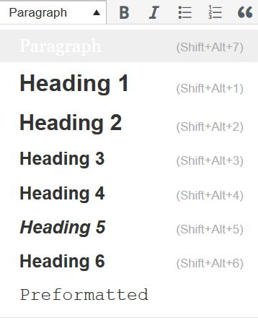
Headings
H1: 1.1 What is Sociology
  H2: What are Society and Culture?
  H2: The Sociological Imagination
    H3: Studying Patterns: How Sociologists View Society
H1: 1.2 The History of Sociology
  H2: August Comte
  H2: Karl Marx
H1: 1.3 Theoretical Perspectives
Notes:
Using headings to identify sections and subsections of a document helps readers identify the structure and content of a document. Headings provide a visual cue that helps sighted readers quickly skim through content until they find a section they are looking for. Similarly, if there are headings, non-sighted users can navigate a page or document easily using a screen reader.
A screen reader won't identify bolded or larger text as a heading. By marking up the sections and subsection of a chapter as headings, a screen-reader user can skip from heading to heading to get an idea about what the chapter is about, understand how the different sections relate to each other based on the heading levels, and skip to parts that they want to read. Without headings, a screen-reader user would be forced to read the entire chapter through from beginning to end every time they wanted to find specific information on a page.
In Pressbooks, you always want to use heading level 1 for the top-level heading in your chapter. This will allow you to take advantage of the two-level table of contents and collapse heading features that I mentioned earlier.

Slide 13
Visual Content
Notes:
Over the next two sections, I will be going over how to make different content types accessible in Pressbooks.
A big part of this is keeping in mind the many formats that students may be accessing your book in. In Pressbooks, it is very easy to focus on the webbook - I know that where I go by default to preview my changes and test new features. But students may not be using the webbook, and print formats have different design considerations than digital formats. For example, you can’t click link text in a print copy, images don’t enlarge when clicking, and interactive content is stripped out. So how do you make sure the content you include works, regardless of the file type that a student decides to use?

Slide 14
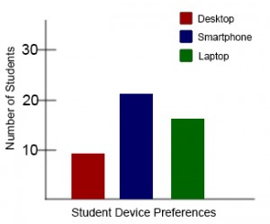
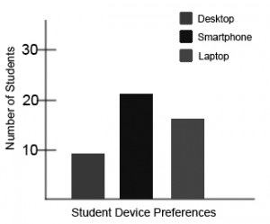
Colour and Colour Contrast
Contrast requirements:
7:1 for normal text and 3:1 for large text
Contrastchecker.com
Notes:
Something to keep in mind is the use of colour and contrast in your textbook, especially in your images. Paying attention to colour contrast and the use of colour benefits people who have poor eyesight or problems differentiating between colours
In the end, you should never use colour alone to convey information, and the higher the contrast, the easier it will be for people to perceive your content. When considering colour contrast, the minimum contrast ratio you should have is 7:1 to 1. To test the contrast for accessibility, you can use contrastchecker.com.
In relation to colour contrast, I also want to talk about how you use colour.
It’s important to never use colour alone to convey information. This means that you should not label or categorize information on in your textbook with colour alone and you should not use colour to direct people’s attention to certain points in the text or images. For example, saying “The red bar shows the number of students who prefer to use desktops” won’t work for someone who is colour blind. When viewed in grey-scale, it’s impossible to tell which bar is red.

Slide 15
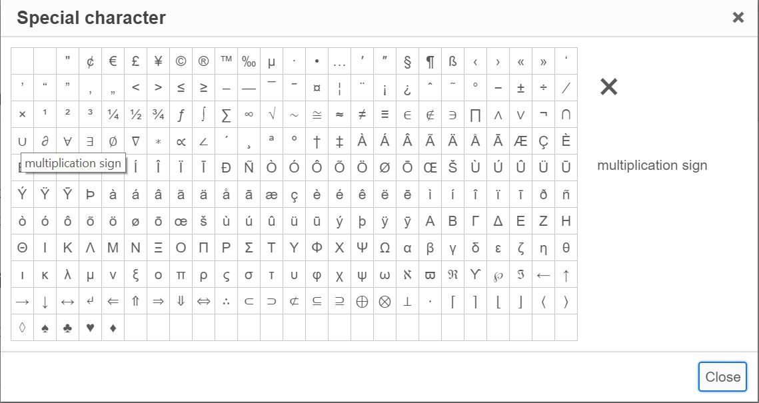
Math
Special characters in
Pressbooks: 4 x 4 = 16
Options for complex math equations:
LaTeX – Not accessible on its own
MathML – Accessible
Images with alt tags or audio files
Notes:
Let’s start with formulas.
I have never worked on a Math textbook, so I don’t have a lot to offer in terms on how to ensure math content is accessible, but there are resources out there for people wanting to learn more.
Here are a few things I can highlight.
For one, if you just need some basic formulas or equations, Pressbooks has a collection of symbols in the WYSIWYG toolbar in the Visual Editor that you can insert into your content. For example, it will allow you to insert a multiplication sign that a screen reader will recognize as a multiplication sign and not interpret as an x. This is important because it will ensure that a screen reader will read 4 times 4 equals 16 and not 4 ex 4 equals 16.
For actual math textbooks, it gets more difficult. For one, Latex, which works well with Pressbooks, is not accessible on its own. Another option would be MathML which allows equations to be stored as structured text. Another option would be to use a combination of images with alt tags or audio descriptions.
You can find additional resources for creating accessible math equations in the Formulas Chapter in the accessibility toolkit.

Slide 16
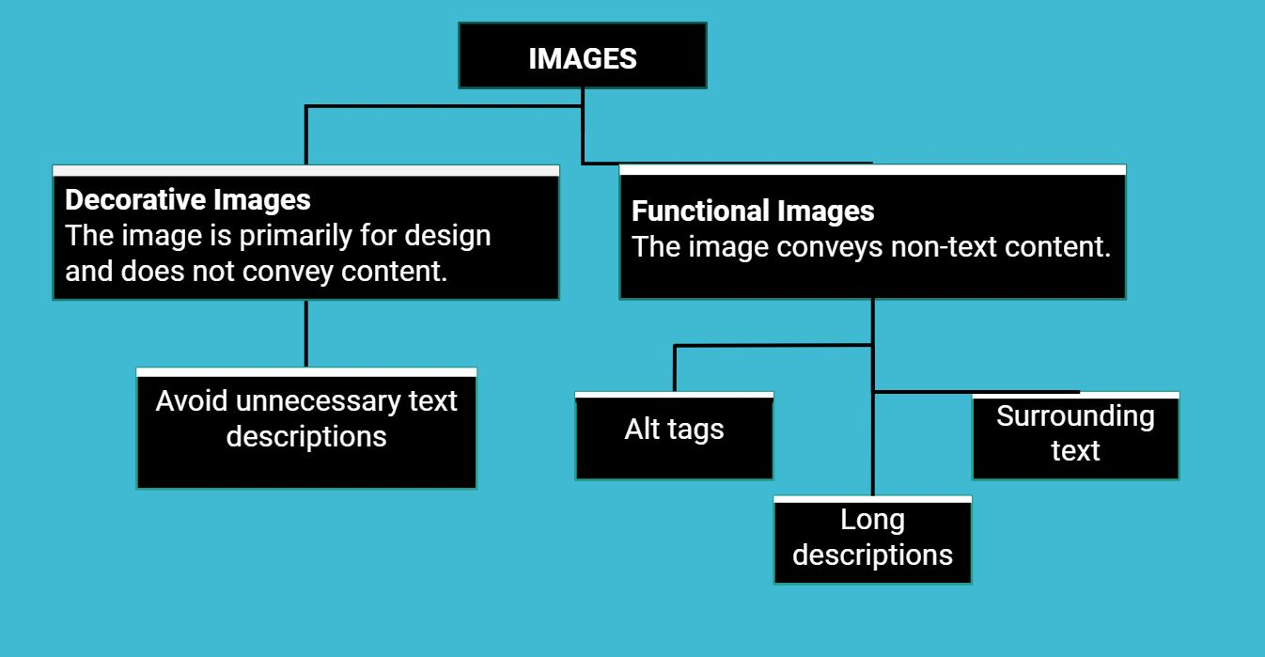
Describing Images
Notes:
When talking about making images accessible, you have to ensure that people who cannot see the image can get the information contained in it another way. As such, you first need to determine the purpose of the image. If it is a functional image, meaning it conveys information not covered in the text, it requires an alternative text description. If the image is just decorative, or if it is already described in the text, it is supplementary and does not need to be described.
Alternative text descriptions are primarily used by people using screen readers. But it is also useful to those who have a poor internet connection which prevents images from displaying.
When writing alt text, it is always best to prioritize the significance of the image and the information it conveys rather than a literal physical description. There are three ways to provide alternative text descriptions:
Describe the image in an alt tag.
If a long description is necessary, provide a link to a long description.
Or describe the image in the surrounding text or caption.

Slide 17
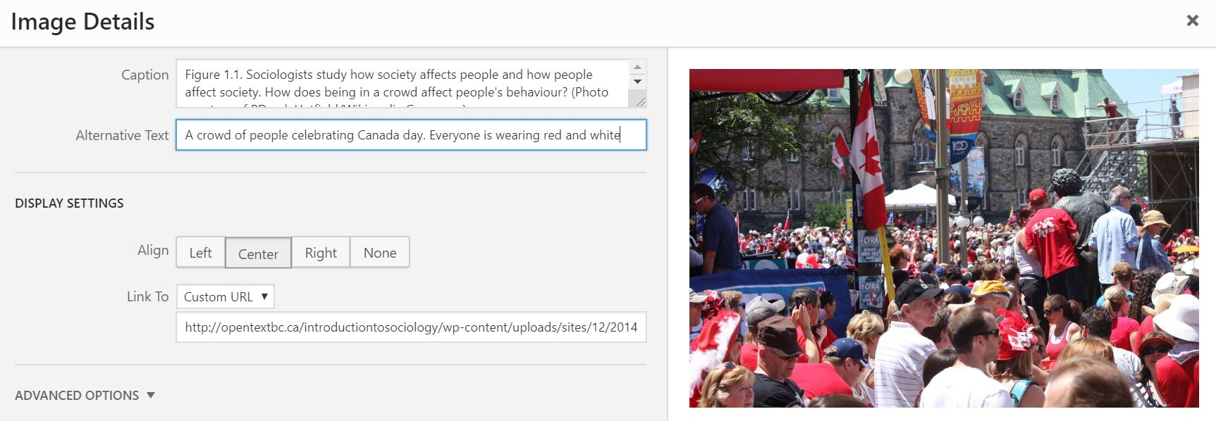
Alt tags
Alt tags should:
Address the significance of the image
Not include “Image of”
Be short (no more than 125 characters)
Notes:
An alt tag provides a short text alternative for an image that those using screen readers can access. The alt tag will also be displayed if images aren’t loading due to a weak internet connection. Pressbooks will allow you to add an alt tag via the Alternative Text box seen in the screenshot. To access this field, you select the image you want to add an alt tag to, and click “Edit”.
When creating an alt tag there are some things to keep in mind:
First, craft the description based on the significance of the image, rather than a literal description
Second, there is no need to include “image of” in the alt tag, a screen reader will announce the presence of an image before reading the content of the alt tag
And finally, alt tags are meant to be short. Keep alt tags under 125 characters, including spaces and punctuation. If an image requires a longer description, describe it in the surrounding text or add a long description.
If an image does not require an alt tag because it is only a decorative image or it is already described in the surrounding text, you do not have to include an alt tag.
You can add alt tags to images in Pressbooks when you edit them. In this example, the alt text reads “A crowd of people celebrating Canada day. Everyone is wearing red and white.”
Image attribution
“Canada Day National Capital” (https://commons.wikimedia.org/wiki/File:Canada_Day_National_Capital.jpg) by PDerek Hatfield is used under a CC BY Licence.

Slide 18
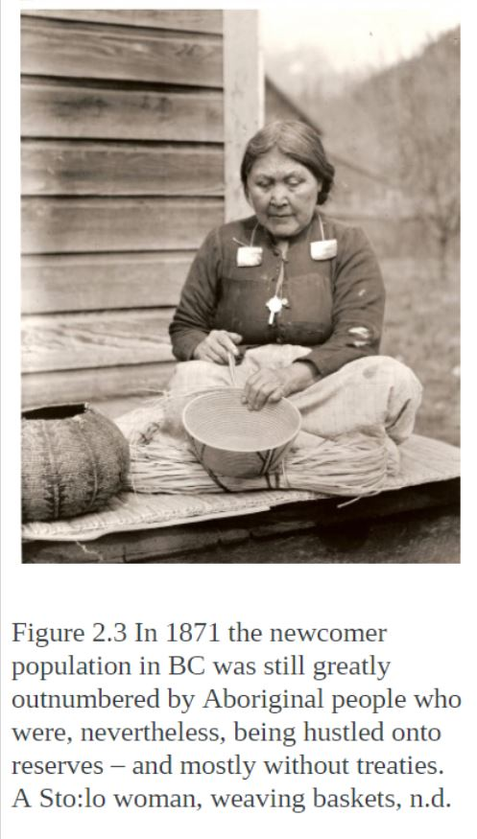
Surrounding Text
Notes:
You can also use the surrounding text to provide the same information as provided in the image. This is often the best option for complex images because it makes the information available for everyone, not just those using the alt tags. If an image has been adequately described in the caption or surrounding text, you can either provide a few-word description of the image in the alt tag or not provide an alt tag.
In this example, the caption describes the image saying “A Sto:lo woman weaving baskets.” As such, it does not require an additional text description.
Attributions
Image source: Sto:lo woman with cedar basket (PN996) by Themightyquill is in the public domain. Caption and photo taken from Canadian History: Post-Confederation (https://opentextbc.ca/postconfederation/chapter/2-3-british-columbia-and-the-terms-of-union/) by John Belshaw (CC BY 4.0).

Slide 19
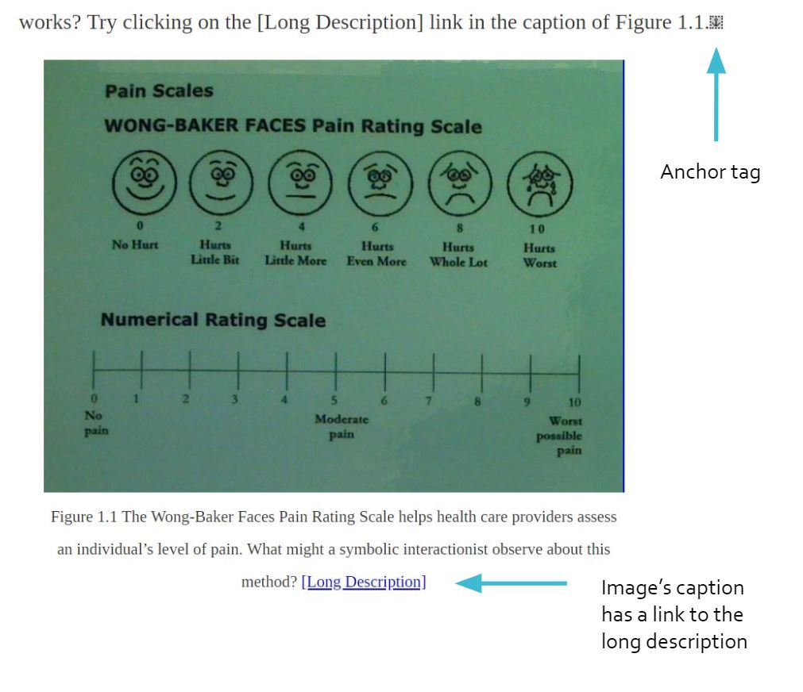
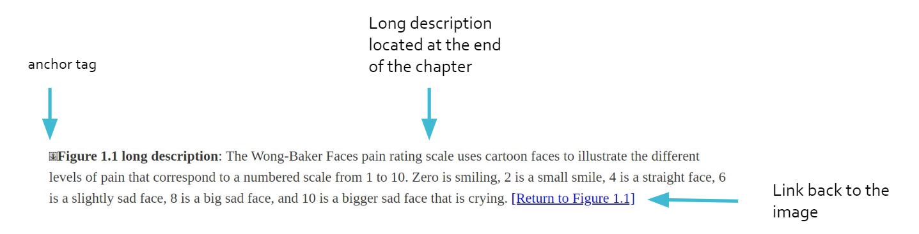
Long Descriptions
Notes:
If an image requires a description longer than 100 characters and adding an explanation to the surrounding text isn’t an option, you can provide a link to a long description instead.
This is done by using anchor tags to create a link to a description located at the end of the chapter. In the screenshots I have here, there is an image and in the image caption is a link titled “Long Description.” Clicking that link would take you to the anchor at the end of the chapter where the text description is. At the end of the text description, there is a link to take you back to the image. That link is linked to an anchor placed just before the image in the chapter.
For more information on this, you can see the Accessibility Toolkit’s chapter on Images. For assistance with creating internal links using anchor tags, I would also recommend checking out the Pressbooks tutorial video on the topic.
Image attributions:
“Pain Scales” by Juhan Sonin has been modified (cropped) by BCcampus and is used under a CC BY 2.0 Generic Licence.

Slide 20
Complex Images
Complex Images for All Learners: A Guide to Make Visual Content Accessible [PDF] (CC BY-NC-SA)
https://bit.ly/2PSpuOx
Notes:
Images are powerful because they can convey a lot of information all at once. However, they are not always easy to turn into words. In the next few slides, I will be providing a few strategies for describing complex images like charts and graphs.
If you’re looking for more assistance on this topic, you should check out this resource created by Supada Amornchat. They created a Guide for describing complex images that is very clear and thoughtful. You can find it at bit.ly/2PSpuOpx

Slide 21
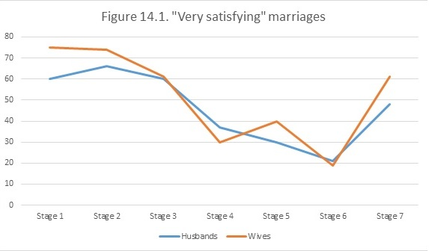
Describing Graphs (Data)
Notes:
This graph shows the number of husbands and wives in different stages of family life who described their marriage as “highly satisfying.” In this case, while the visual graph is useful for sighted users, it would be quite difficult to describe in words. Fortunately, text descriptions do not have to be paragraphs or text. In this case, a good text alternative may be to create an accessible table based on this graph and link to it as a long description.
This table’s use of colour also poses another accessibility issue. Notice how the “Husbands” and “Wives” lines are differentiated only by colour? For people who are colour blind, it may be impossible to tell which line refers to which category. This could be fixed by using different types of lines – for example one could be a dotted line. This accessibility issue would also be solved by labelling the different lines directly.
Image Attribution:
“Figure 14.1.” is based on data from Lupri and Frideres, 1981 and is under a CC BY 4.0 International Licence.

Slide 22
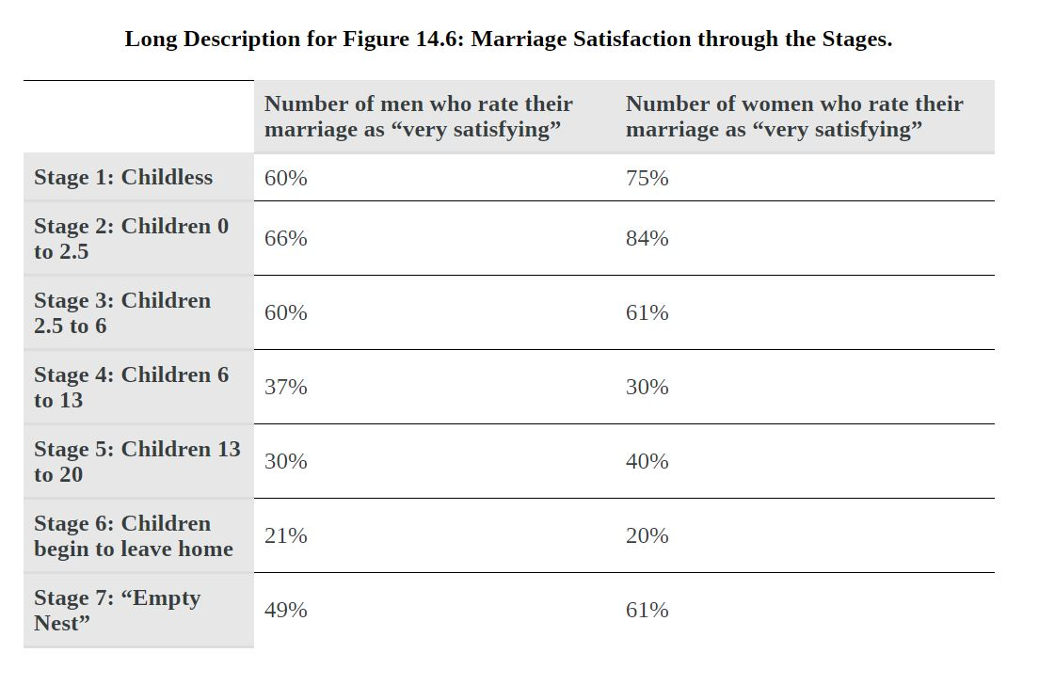
Graph Turned Table
Notes:
Here is the table I produced based on the previous image. Although it doesn’t show the trends visually, it allows someone why can’t see the images to judge the statistics for themselves and to see the differences between genders – both of which would be near impossible without a page-long text description. And by linking to this table from the original image rather than replacing the graph, visual users lose nothing.
In addition, I added what each of the Stages signify, which was omitted from the original image. The stages are described earlier in the chapter, but by putting that information right into the table, I save anyone using this table from having to go back to try to find that information.
Image Attribution:
“Long Description for Figure 14.6” is a screenshot taken from Introduction to Sociology. It is under a CC BY 4.0 International Licence.

Slide 23
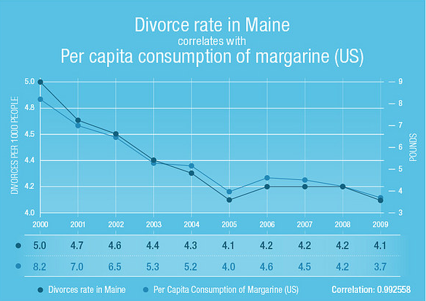
Describing Graphs (Trends)
Figure 2.7 Correlation does not imply causation.
Notes:
This image shows a graph comparing the divorce rate in Maine to the per capita consumption of margarine. The caption explains that “Correlation does not imply causation.” In this example, the visual of the graph is more important than the individual data points. The rate at which they fell from 2000 to 2005 does not matter as much as the fact that the graph shows them falling and rising again at almost exactly the same rate. Instead of replacing this image with a data table, a short description describing the point of the image is more useful.
For example, the alt tag might say: Statistics show that divorce rates in Maine and the consumption of margarine fell and rose at the same rate.
When deciding whether to represent a graph in words or as table, just consider the context of the image and what it is trying to convey. If specific data points are most important, then use a table. But if general trends are more important, then using words to describe the graph may be more effective.
Attributions:
“Mistaking Correlation for Causation” by AltimeterGroup is used under a CC BY-NC-SA 2.0 Generic Licence.

Slide 24
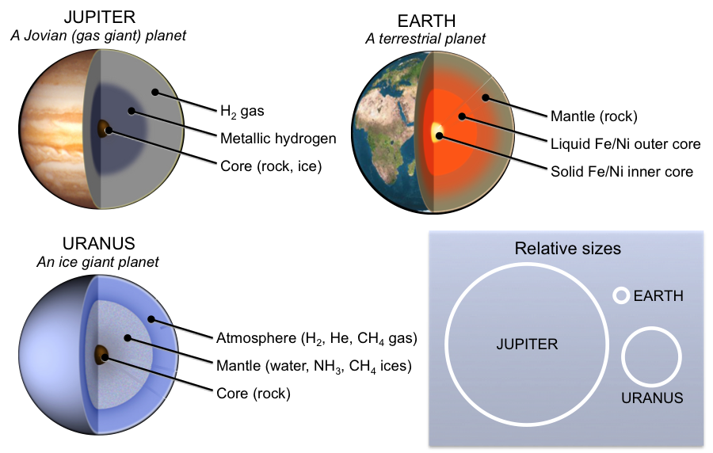
Describing with Lists
Jupiter, a Jovian (gas giant) planet
  Core: rock, ice
  Middle layer: Metalic hydrogen
  Outer layer: H2, gas
Earth, a terrestrial planet
  Inner core: Solid FE/Ni
  Outer core: Liquid FE/Ni
  Mantle: Rock
Uranus, an ice giant planet
  Core: rock
  Mantle: water, NH3, CH4 ices
  Atmosphere: H2, He, CH4 gas
Notes:
Again, I’d like to point out that you’re not restricted to paragraph format when describing images. Bulleted and numbered lists can be useful ways to organize information in complex images. Lists can also be useful for describing simple graphs, flow charts, cycles, and steps. Supada provides lots of great examples on how lists can be used in their resource on describing complex images.
Image attributions:
Planets image by KP after public domain images by FrancescoA, WolfmanSF (http://bit.ly/1eP75P4), and NASA (http://1.usa.gov/1gFVsf6, http://1.usa.gov/1M89jI3).

Slide 25
Display of Images
Image size and quality
  Webbook – smaller images can link to full size image, will expand when clicked
  Other formats – will appear as the size you have them set to in the visual editor
Captions
  Figure numbering is useful for books with lots of images and diagrams
  Keep source and attribution information out of the caption by using Pressbooks’ Media Attribution tool
Notes:
The final thing you want to keep in mind in regards to images is how they will be displayed in the different formats.
In the webbook, you can have images link to their media file. This will allow you to insert an image at a small size, but when clicked the image will open in its full size in the browser. However, this is not possible in other formats, so you will want to make sure that you make images large enough to be clear when printed. If that is not possible, you may want to consider supplying a link to where students using the print copy can look up the full size image.
In terms of captions, Pressbooks will take care of the formatting. If your book has a large number of figures and diagrams, you should implement some sort of figure numbering system. This will make it easier to refer to specific diagrams and images in activities and lectures. In addition, I would recommend keeping source and attribution information out of the caption by using Pressbooks’ Media Attributions tool. You can find more information on this tool in the Pressbooks Guide and in the video tutorials.

Slide 26
Descriptive Link Text
Not accessible
For more information on web accessibility, click here.
For more information on web accessibility, go to https://opentextbc.ca/accessibilitytoolkit/.
Accessible
For more information on web accessibility, refer to the BCcampus Open Education Accessibility Toolkit.
For more information on web accessibility, refer to the BCcampus Open Education Accessibility Toolkit [New Tab].
The BC Open Textbook Review Template [Word File] provides guidelines for completing an open textbook review.
Notes:
Screen-reader users can have their screen reader read out all of the links on the page. For this reason, the text of a link should describe the content of the link, even when read out of context of the rest of the sentence.
Here are a few example of inaccessible and accessible link text.
The first example reads: “For more information on web accessibility, click here.” and “here” is the link text. While a sighted user can see the whole sentence and understand what the “here” link is referring to, someone using a screen-reader to skip through the links would just hear “Link: here” and have no idea where that link would take them.
The second example uses the web address as the linked text. While it is better than the first example, it can still be confusing when a screen reader reads out a web address, especially if it is long and complicated.
The third example reads: “For more information on web accessibility, refer to the BCcampus Open Education Accessibility Toolkit.” In this example, “Accessibility Toolkit” is the link text. This is the most accessible as it’s clear that the link will take users to the Accessibility Toolkit.
Finally, links should not open into new windows or tabs as it can be disorienting and confusing if the user – sighted or non-sighted – is not expecting it. However, if it is important that a link open in a new tab or window, include that information in the link text. This also applies with linking to different document types, such as PDFs, Word files, or Excel files. As these formats may have different accessibility barriers and require appropriate software, it is best practice to include the file type in the link text as shown in the fourth example which has the link text as: BC Open Textbook Review Template Word File

Slide 27
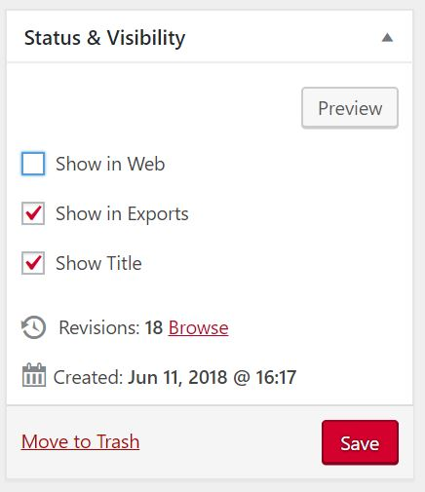
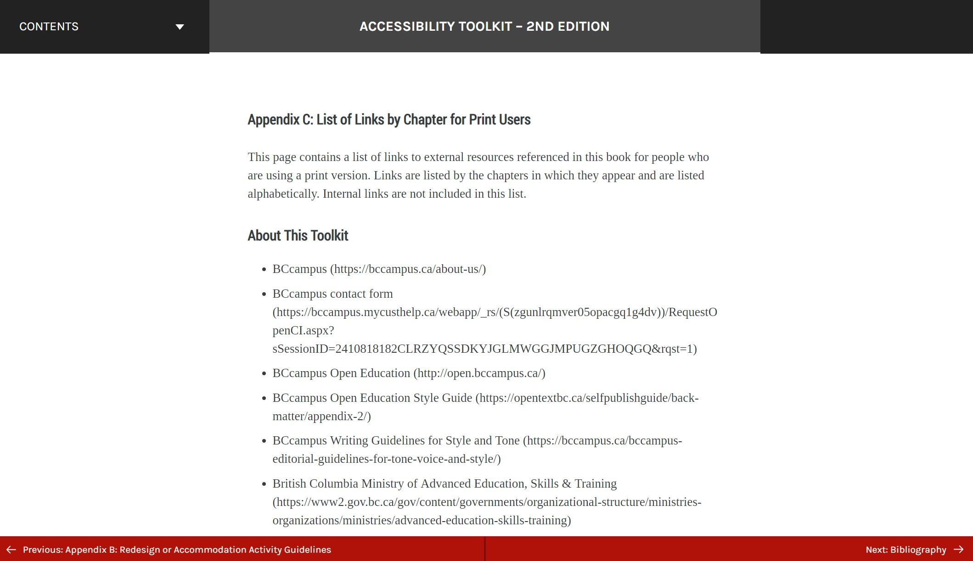
Links for Print Users
Notes:
Being able to easily link to external resources is a great feature of digital textbooks, but you also have to keep in mind that not everyone will be using a digital version and you have to provide the web address for those using print copy of your book.
There are a few options for how to do this, but the cleanest way is to provide a list of links in the back matter of your book. In this example, all links in the Accessibility toolkit have been listed alphabetically by chapter. The link text and the full web address are provided.
I have also seen people use footnotes to provide the web addresses or to put the web address in brackets in the text itself. If your book only has a few links and isn’t using footnotes for anything else, you may consider using one of those options. But if your book has a lot of links, I would recommend listing them in the back matter. And if you don’t want this chapter to display in the webbook, you can unselect “Show in web” in the “Status and Visibility” box in the Pressbooks Visual Editor for that chapter.
Image attributions
Screen Shot from the Accessibility Toolkit (https://opentextbc.ca/accessibilitytoolkit/back-matter/appendix-list-of-links-by-chapter-for-print-users/) is under a CC BY Licence.

Slide 28
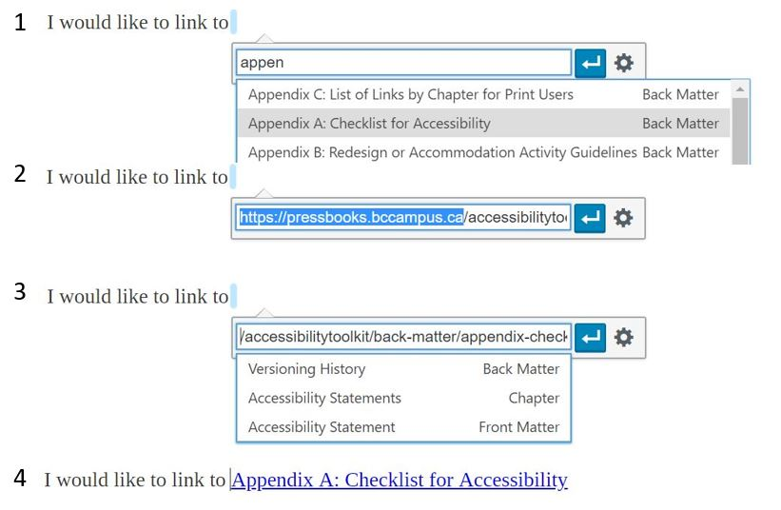
Internal Links
Notes:
I have mentioned the ability to use internal links to add navigation options to your book in Pressbooks a few times now, and I want to point out for people who don’t know that it is not as simple as using a chapter’s web address. While a full web address this will work fine in the webbook, it will not behave properly in other export formats. For example, if a chapter’s full web address is used as a link, if that link is clicked in the Digital PDF file, the webbook will open up in a browser rather than taking that person to the correct chapter in the PDF.
As such, when you are linking to different chapter in your book, be sure to delete the first part of the web address. For people using the BCcampus instance of Pressbooks, that would mean deleting the pressbooks.bccampus.ca part of the link.
Pressbooks makes it easy to link to different chapters in your book. If you’d like to link to a chapter, click where you would like to insert your link and search for the chapter you would like to link to. Select the correct chapter from the link. This will automatically insert the web address for that chapter in the link text box. From here, you can delete the pressbooks.bccampus.ca part of the link. When you click enter, link will be inserted with the chapter title as the link text.
As I mentioned before, the Pressbooks Guide contains steps on how to do this as well as additional tutorial videos on creating internal links.

Slide 29
Tables: Conditions for Success
For tables to be accessible, they need to have the following things:
Defined structure (a maximum of one row and/or column of heading cells with correct scope assigned)
Captions
No split or merged cells
Adequate cell padding
Notes:
For a table to be accessible, it needs to have the following things. It needs a defined structure. This means that cells that act as row or column headings need to be marked as header cells with the correct scope assigned. A table needs a descriptive caption, should not contain merged or split cells, and there should be adequate cell padding to make it easier to comprehend. By providing structure to your tables, you will allow people who are using screen readers to navigate through your tables and understand how the cells relate to each other. In addition, it will make formatting your tables easier.

Slide 30
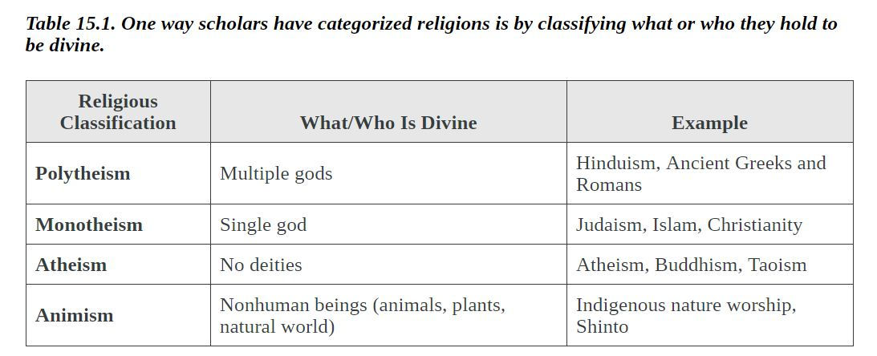
Table Properties
For resources on creating accessible tables, see the Accessibility Toolkit, the Pressbooks Guide, and the video tutorial.
Notes:
Here is an example of what an accessible table would look like in Pressbooks. The table has a descriptive caption, the top cells are marked as column headers, and there are no merged or split cells.
I won’t go into any more detail of how to do this now, but if you need specific instruction on how to do this you can find instructions in the Accessibility Toolkit’s chapter on Tables or in the Pressbooks tutorial video on tables.
Image Attributions
Table 15.1 screenshot from Introduction to Sociology 2nd Canadian Edition (https://opentextbc.ca/introductiontosociology2ndedition/chapter/chapter-15-religion/) is under a CC BY Licence.

Slide 31
Multimedia
Videos, Audio, Interactivity
Notes:
Now I will address the accessibility concerns of different types of multimedia that you may want to add to your book.

Slide 32
H5P Accessibility
For a full list of the accessibility assessments of all H5P content types, see the list found at
https://h5p.org/documentation/installation/content-type-accessibility
Notes:
As many of you may know, Pressbooks has an H5P plug in which allows you to insert interactive actives into your webbook in Pressbooks. This functionality is super cool and lots of people are taking advantage of them. But when using these activities, keep in mind that not all of them are accessible. For a full list of the accessibility status of the different H5P content types, see h5p.org/documentation/installation/content-type-accessibility

Slide 33
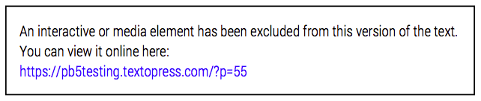
Embedded/Interactive Content
Videos
Audio files
H5P
Notes:
In Pressbooks, you can embed things like audio, videos, and H5P activities. However, this kind of content con only be viewed in the web version and will not appear in any of the other export formats. In all other formats, Pressbooks will provide a link to where that interactive element can be found instead.
For example, this notice has replaced an H5P activity in a PDF file. It says, “An interactive or media element has been excluded from this version of the text. You can view it online here:” and then it provides a web address.
Pressbooks takes care of communicating how to find multimedia for people using the other export formats, but keep in mind when including these types of resources and activities in your book that they will be harder to access for people not using the web version of your book.

Slide 34
Audio/Video
Rev.com
Transcripts
  A text transcript provides students with equivalent information to the audio content.
Captions
  Captions are the text that is synchronized with the audio in a video.
Audio Descriptions
  Audio descriptions are helpful if visual content (e.g., a chart or a map) in a video or presentation provides important context that is not available through the audio alone.
Notes:
Multimedia resources, such as videos, audio clips, and presentations also have accessibility requirements that you need to consider if including them in your textbook.
A transcript is text that conveys information equivalent to the audio content. It will include information like the speaker’s name, all speech content, relevant descriptions about the speech, descriptions of all relevant non-speech audio, and headings and subheadings where appropriate to make the transcript easy to navigate.
Captions are text that appear in a video and are synchronized with the audio. They should include all speech content as well as descriptions of relevant non-speech content.
While captions only apply to video content, transcriptions can be used for both video and audio. As a rule, if information is being conveyed auditorily, you will have to provide a text alternative, either through captions or a transcript. If information is being conveyed visually, you will have to provide either an auditory or a text alternative, such as an audio description or a transcript that can be read by a screen reader.
There are a number of captioning and transcription services available out there. I have been using rev.com for captioning the videos I create.
Attributions:
“Open Textbooks Explained” by David Wiley is used under a CC BY 4.0 International Licence.

Slide 35
Accessibility Statements
Highlight accessibility features and options
Point to where someone can find different formats
Describe known accessibility barriers and possible workarounds or timeline for getting them fixed
What accessibility standards do you conform to?
Provide contact information so people can report access problems.
Notes:
When publishing your book, the last thing I’d like to encourage is the practice of being as transparent as possible about the accessibility, design, and features of your book.
This can take many forms, but one thing that I’ve started adding to books published by BCcampus are Accessibility Statements. The Accessibility Statement appears in the front matter of the book and it includes information like
What the different accessibility features and options are in the book – for example, images have alt tags, content is designed to work with screen readers, and the webbook has the option to increase text size by 200%.
It points to where students can find different formats to download and highlights what those are
It lists known accessibility barriers and possible workaround or provides a timeline for getting those problems fixed
It highlights the accessibility standards that were considered in making the text accessible.
And it provides contact information for where people can report any access problems.
You may also consider using this section to explain how to use and navigate the webbook in Pressbooks, or to highlight certain features of your textbook.
For a sample accessibility statement that you can adapt, see the chapter on Accessibility Statements in the Accessibility Toolkit.

Slide 36
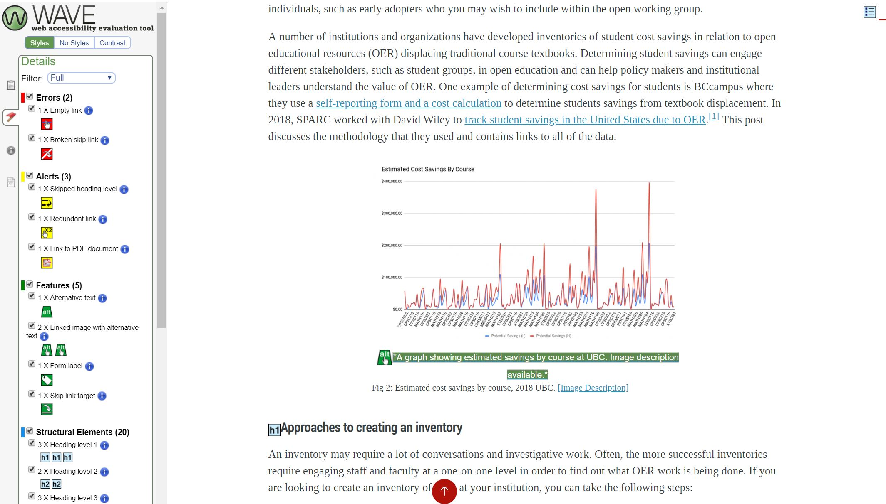
Accessibility Review
Notes:
WAVE is a tool I use to test the textbooks I am working on to help me catch things I might have missed. It is easy to use and although it not perfect, it is quite comprehensive. All it requires is a web address. In this case, I am linking to Chapter 16 of the Intro to Sociology book. Wave can be accessed at wave.webaim.org.
Here is a screen shot of what comes up immediately after providing a link. As you can see, this tool will label the page with features and problems it identifies. This makes it easy to visually evaluate the page without having to comb through the HTML markup to find things you might have missed.
On the left, WAVE provides a summary of Errors, Alerts, Features, Structural Elements and more. To see a detailed report, click the flag along the left side, to switch from the Summary to Details about specific aspects of the web page.
The details section names features and potential errors and alerts and provides links to those problems. For example, the screen shot on the right describes the features of the webpage. In this chapter, there are 8 images with alternative text. By clicking on one of those green boxes, I can quickly skip between those images.
Wave allows you to see the content of the alt tag which is normally not visible on the webpage. In this case, I can easily make sure the caption, the image, and the alt tag fit together.

Slide 37
Thank you
Notes:
The main thing I would like for you to takeaway is the importance of building accessibility practices into the writing process. Adding these practices to your style guide, writing image alt tags as you add them, and paying attention to heading levels, will save you a lot of time than if you try to do it all at once at the end. In addition creating an accessible book will also help increase the number of people likely to adopt your book. As more places adopt accessibility legislation, books that are marked as accessible have the potential to have a much higher impact.

Slide 38
References and Resources
Aesoph, Lauri. Pressbooks Guide. Victoria, B.C.: BCcampus, 2016. (CC BY)
“Accessibility.” Pressbooks. https://pressbooks.org/accessibility/. (Accessed February 15, 2019).
Amornchat, Supada. Complex Images for All Learners: A Guide to Make Visual Content Accessible [PDF]. (CC BY-NC SA)
Coolidge, Amanda, et al. Accessibility Toolkit. Second Edition. Victoria, B.C.: BCcampus, 2015. (CC BY)

