Slide 1
Quality Planning

Slide 2
Quality Planning
Definition
Grade
Statistics
  Control limits
  Normal Distribution
  Standard deviation
Quality Planning Tools
  Measurement terminology
    Tolerances
  Defining and meeting client expectations
Quality Assurance

Slide 3
Definition of Quality
Understand the quality levels expected
Ensure that the levels are met
  This includes measuring

Slide 4
Grades as a measure of quality
Pre-set standards
  Octane rating for gasoline
  Lumber graded for appearance, strength
  Steel and other commodities

Slide 5
Using statistics to measure and manage quality
Control limits
  Upper and lower standards for allowable variation
Central limit theorem
  Frequency distribution
  Discrete math— “bins” –count the number of measurements that fall in each bin
  Normal distribution– “bell-shaped curve”

Slide 6
Measuring your products
Options:
  Measure entire population
  Sampling
    Smaller amount of data to work with
    Sometimes measuring destroys the sample

Slide 7
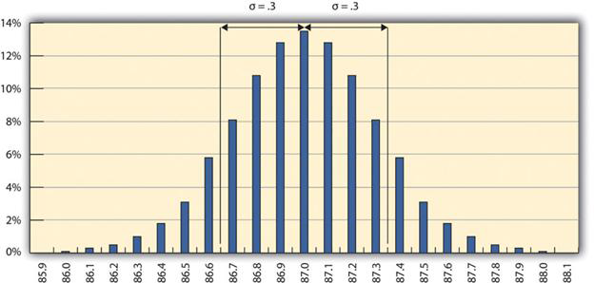
Normal Distribution
Figure 18.2.2 One Sigma Range
Source: http://pm4id.org/10/1/

Slide 8
Normal Distribution
Standard deviation
  Calculate the mean (or average value) of all measurements
  Subtract EACH measurement from the mean
  Square EACH difference
  Sum the values
  Divide the sum by ( (number of values) – 1 )
  Take the square root
Result can be thought of as the average difference

Slide 9
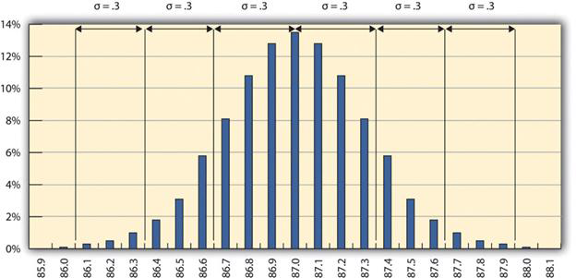
The 68-95-99.7 Rule
Figure 18.2.3 The 68-95-99.7 Rule
Source: http://pm4id.org/10/1/

Slide 10
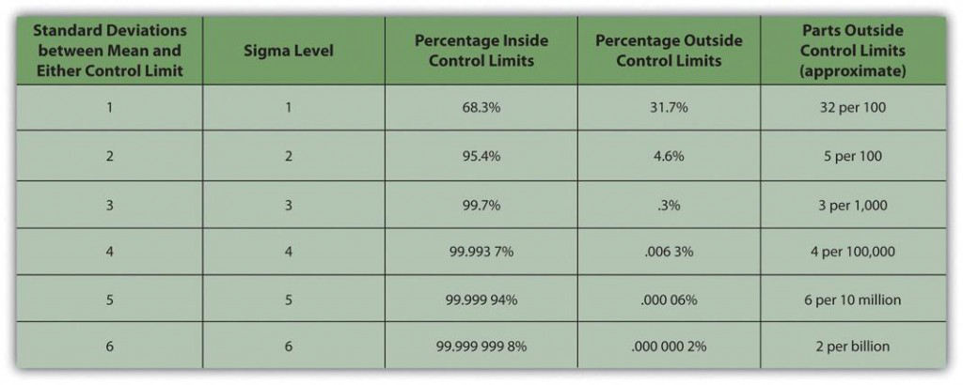
Sigma Levels
Figure 18.2.4 Meaning of Sigma Levels
Source: http://pm4id.org/10/1/

Slide 11
Quality Plan
The quality plan specifies the control limits
Often written as the mean ± the acceptable variation
The size of the range is called the tolerance.

Slide 12
Quality planning techniques
Cost-benefit analysis
Benchmarking
Experimentation design
Cost of quality
Control Charts
Cause and Effect diagrams
Histograms
  Pareto diagram

Slide 13
Quality Assurance
Process Analysis
  ISO 9000 requires this

Slide 14
Summary
Purpose of Quality Management:
  Build confidence in clients that quality standards and procedures are being followed
Ensured by
  Internal review of plan
  Testing
  Revising policies
  External Review or audit

Slide 15
Questions?

