Slide 1
Framework for Project Management

Slide 2
Framework for Project Management
Project Management as a profession
The Project Management Institute (PMI)
Project Management Knowledge Areas
Project Management Certifications
Scrum development
The Project Management Office

Slide 3
Project Management as a Profession
Body of knowledge
Standards
Professional organizations
Currently, anyone can call him or herself a project manager
Unresolved issue: to what extent can an expert PM move from one industry to another?

Slide 4
Project Management Standards
Standards organizations
PMI
Project Management Institute: http://www.pmi.org/
CAPM, PMP and other professional standards
IPMA
International Project Management Association: http://ipma.ch/
Several certifications

Slide 5
Project Management Institute (PMI)
Established in 1969
Certifications: most popular is PMP
Also offer CAPM, for novice PMs, and several specialized certifications
Currently over 590,000 PMPs in the world
Have published the Project Management Body of Knowledge or PMBOK, now in its 5th edition.

Slide 6
Project Management Professional (PMP)
Requirements:
5 years of project management experience
pass a rigorous exam
maintain ongoing professional development
Currently over 590,000 PMPs in the world
The CAPM or Certified Associate in Project Management only requires an exam and is considered to be a step along the way to a PMP

Slide 7
PMBOK Knowledge Areas
Managing Integration
Managing Scope
Managing Time/Schedule
Managing Costs
Managing Quality
Managing Human Resources
. . . continued on next slide

Slide 8
PMBOK Knowledge Areas (continued)
Managing Communication
Managing Risks
Managing Procurement
Managing Stakeholders

Slide 9
Project Integration
Very active during the startup
Coordinates all activities in all other knowledge areas

Slide 10
Project Scope
Scope generally defines what the project is all about
Forms the basis of agreement between the project SPONSOR and the project team
Changes in the scope may be proposed at any time during a project, but should follow a clearly defined approval process

Slide 11
Scope Statement
Description of the scope
Acceptance criteria
Deliverables
Exclusions
Constraints
Assumptions

Slide 12
Scope and the WBS
A Work breakdown structure or WBS is the breakdown of the deliverables into manageable units of work.

Slide 13
Schedule and Time Management
Based on the units of work defined by the WBS
Resources required are identified
Time durations are estimated
Dependencies are identified (such as, what task must be completed before another task can begin)
And a schedule can be created

Slide 14
Schedule and Time Management
Several methods are available—details in a later chapter
Software is frequently used to assist with managing the time schedule

Slide 15
Project Costs
Develop a budget
Several methods can be used to estimate
Plan for the cash flow
Track the expenditures
Explain deviations and make adjustments where required

Slide 16
Project Quality
Quality plan defines
The quality standards
The methods that will be used to achieve the standards
The methods that will be used to measure the standards

Slide 17
Human Resources
Identification of HR requirements
Selection of project team
Development of project team
Motivation and management of the project team

Slide 18
Communication
Communication includes within the team and with others outside the team
The project should have a communication plan
Who needs to be communicated with
What methods will be used
What frequency
Who within the project will be responsible

Slide 19
Risk
Risk represents the likelihood of the occurrence of an event that will negatively or positively impact the achievement of the project goals
Processes:
Identify risks
Analyze risks
Manage risks

Slide 20
Procurement
Contracting to obtain supplies or services required to carry out the project
May be extremely complex
Time schedules can be crucial
On complex projects, almost always involves additional experts such as lawyers

Slide 21
Stakeholder Management
Stakeholders are people or organizations who either will be impacted by the project or who can impact the project.
Always include: project sponsor, project team
May include: customers, suppliers, vendors, the public, land owners, voters, other departments within the organization, government, etc.

Slide 22
Stakeholder Management
Major tool is the stakeholder register
Lists stakeholder, role, all communications
Updated regularly throughout the project
New stakeholders can appear at any time

Slide 23
PMI Process Groups
Project Initiating
Project Planning
Project Executing
Project Monitoring and Controlling
Project Closing

Slide 24
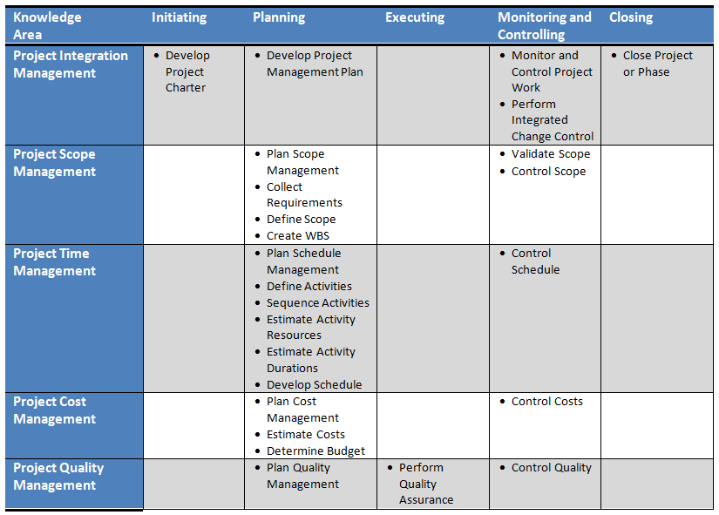
Knowledge Areas (PMBOK 5)

Slide 25
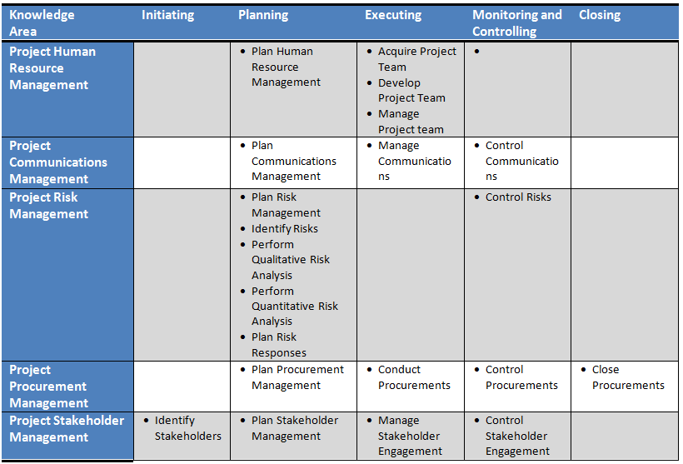
Knowledge Areas (PMBOK 5)

Slide 26
Scrum Development Overview
Known as an Agile method
Used when requirements are difficult to define or subject to rapid change
Iterative approach
Uses sprints or 2 to 4 week cycles

Slide 27
Scrum Development Overview
Roles
Product owner
Scrum Master
Development Team
May include specialist roles such as developer, subject matter expert

Slide 28
Scrum Development Overview
Priorities: stories are either on the:
Front burner (currently working on)
Back burner (next up)
Fridge (for later)
Priorities are revisited before each new sprint

Slide 29
Scrum Development Overview
Daily stand-up meeting (short meeting with fixed agenda)
What was done yesterday
What will be done today
Are there any problems the scrum master must address, such as resource issues out of the control of the team

Slide 30
Scrum Development Caveats
Requires committed, mature developers
Major work must still be done up front
Needs commitment and involvement of Product Owner
Best for products that require frequent updates
Not so good for large, totally new products that will not allow frequent updates after release

Slide 31
The Project Management Office (PMO)
Medium and large organizations
Typical objectives
Align projects with organizational objectives
Set standards for projects
Provide resources to project managers
Provide training and mentorship
Provide facilitation
Stay abreast of best practices in Project Management
Repository for project reports and lessons learned

Slide 32
Framework for Project Management
Project management as a profession
The Project Management Institute
Project Management Certifications: PMP, CAPM
PMBOK overview: ten knowledge areas; five process groups
Scrum methodology
The Project Management Office

Slide 33
Questions?

