Slide 1
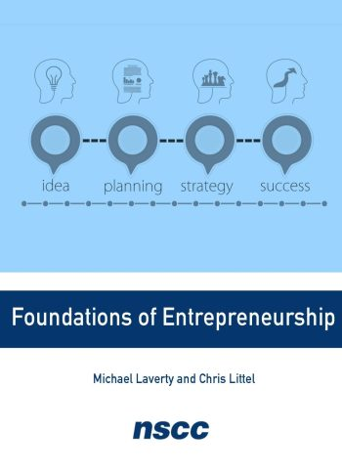
Entrepreneurship
Chapter 1 THE ENTREPRENEURIAL PERSPECTIVE

Slide 2
An Entrepreneur
An entrepreneur is someone who identifies an opportunity and chooses to act on that opportunity.
An entrepreneurial mindset: an awareness and focus on identifying an opportunity through solving a problem, and a willingness to move forward to advance that idea.
An entrepreneurial spirit allows entrepreneurs to carry a manner of thinking with them each day that allows them to overcome obstacles and to meet challenges with a can-do attitude (passion, purpose, persistent, etc.).

Slide 3
An Entrepreneur
Entrepreneurs have many different talents and focus on a variety of different areas, taking advantage of many opportunities for entrepreneurial ventures.
An entrepreneurial venture is the creation of any business, organization, project, or operation of interest that includes a level of risk in acting on an opportunity that has not been previously established.

Slide 4
Types of Entrepreneurs
Type of Entrepreneur | Approach to Venture
Innovators | Find new approaches, methods, or products that add value through solving a problem in a unique manner
Creators | Make something new or see a problem that other people have not noticed
Market makers | Innovate or reinvent their market from a future perspective by asking what the market could evolve into
Expanders and scalers | Seek out opportunities to expand upon previously created methods, processes, or products
Table 1.1

Slide 5

The Entrepreneurial Lifestyle and Career
Being an entrepreneur has become synonymous with being an innovator, a change agent, or a risk taker.
Piacquadio, A. (March 2020). People sitting near table writing. Pexels. https://www.pexels.com/photo/people-sitting-near-table-writing-3931638/.

Slide 6

The Entrepreneurial Lifestyle and Career
Choosing the path of entrepreneurship requires a willingness to take on calculated risks.
The difference between risk and calculated risk is due diligence, or conducting the necessary research and investigation to make informed decisions that minimize risk.
Nekrashevich, A. February 2021. Businessman. Pexels. https://www.pexels.com/photo/businessman-man-person-hand-6802044/

Slide 7
The Entrepreneur as a Problem Solver
Often, when we start to explore the problem, we find that it has multiple causes. Among them are:
The need for something to be better, faster, or easier
The effects of changes in world on your industry, product, or service
Market trends based on geography, demographics, or the psychology of the customers

Slide 8

Feature Box
What Can You Do?: Recognizing Problems
What problem have you identified?
What can you do to resolve that problem?
Samkov, I. (April 2020). Woman working in home office. Pexels.com. https://www.pexels.com/photo/woman-working-in-home-office-4240505/.

Slide 9
The Entrepreneur as a Problem Solver
Recognizing Problems
In your daily life, what problems do you encounter? What would make your life easier?
How would you finish this sentence: “If only ________ existed, my life would be better or easier”?
To spur your creativity, you might research global problems to find an area that interests you, that sparks your passion for living a fulfilling life. When identifying a problem, consider process-related problems as well as service-related problems.

Slide 10
Factors Driving the Growth of Entrepreneurship
Desire to control own career
Excitement of creating something new
Available time in retirement
Awareness and support of entrepreneurship as a career choice
Other factors could include:
Government policies
Employment rates
Trade issues

Slide 11
Key Characteristics that Support the Growth of Entrepreneurship
Freedom to create and innovate
Acceptance of failure
Connect with people
Advent of the internet
Entrepreneurial education

Slide 12

Social and Environmental Issues and Opportunities
A social entrepreneur has an interest in solving a social, environmental, or economic problem. Identifies a problem with:
A social or community focus
A concern for quality of life
Concern for our entire planet’s health
Vaitkevic, N. (2021). Person Holding A Globe. Pexels.com. https://www.pexels.com/photo/person-holding-a-globe-7235805/.

Slide 13

Feature Box
What Can You Do?: Social Entrepreneurship
Do you have any ideas for creating an entrepreneurial venture around the idea of building quality relationships and communities?
How would you balance a passion project with an entrepreneurial purpose?
Hart, D. (February 2020). Women sitting on chairs. Pexels. https://www.pexels.com/photo/women-sitting-on-chairs-inside-a-room-3719037/.

Slide 14

Feature Box
Every successful entrepreneur that you encounter or read about likely started with an image or idea related to something he or she felt passionate about creating.
Shvets, A. Woman holding a paper. (February 2020).Pexels.com. https://www.pexels.com/photo/woman-holding-a-paper-3727463/.

Slide 15

Feature Box
What Can You Do?: How Can You Put Your Strengths to Work?
Create a list of ideas that build off your strengths or are related to your strengths.
Then analyze this list to create another list of possible businesses that you could start that relate to your strengths.
Piacquadio, A. Woman draw a lightbulb in whoteboard.(February 2020). Pexels.com. https://www.pexels.com/photo/woman-draw-a-light-bulb-in-white-board-3758105/.

Slide 16
Entrepreneurial Vision
Many potential entrepreneurs have dreams and ideas but never develop a concrete vision.
A vision statement is the picture you have for what the venture will become in the future: what it will grow into.
The mission statement is a formal declaration about what the venture will do, what value it will provide to the end customer, and how it will accomplish this action.
The value proposition is a summary statement that conveys the benefits your product, service, or unique business process/model provides to customers.
Mentors can help you articulate your vision.

Slide 17

Figure 1.7
Finding a mentor can provide you with invaluable benefits. (attribution: Copyright Rice University, OpenStax, under CC BY 4.0 license)

Slide 18
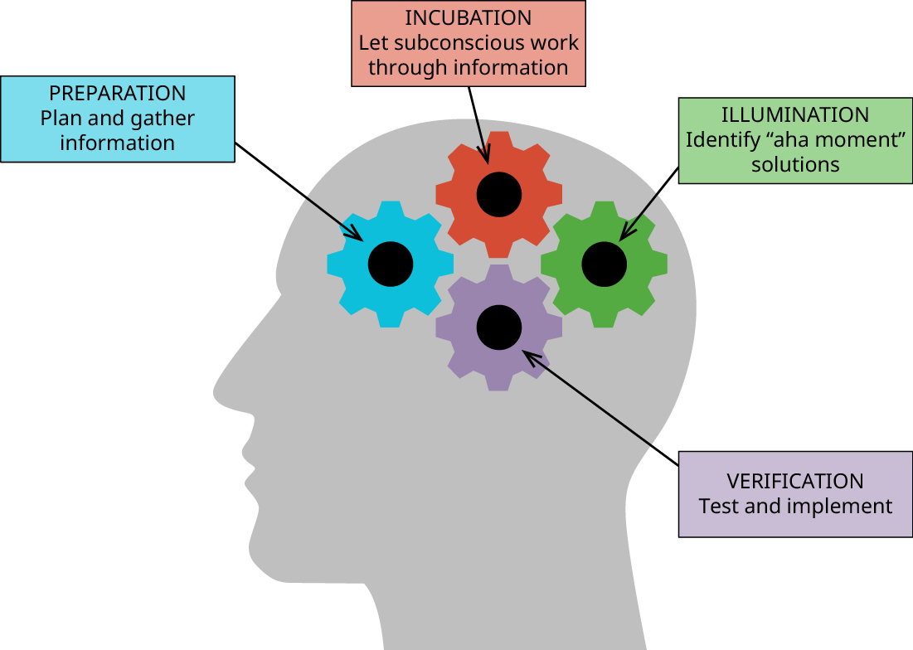
Figure 1.8
These are the four steps of the creative thinking process to help develop your vision. (attribution: Copyright Rice University, OpenStax, under CC BY 4.0 license)

Slide 19

Feature Box
Are You Ready?: A Personal Vision Statement
Where are you living?
What are you doing for a living?
What does your home look like?
Who lives in your home?
What are you doing with your life?
Chung, Z. (October 2020). Serious ethnic guy reading sticky notes. Pexels.com. https://www.pexels.com/photo/serious-ethnic-guy-reading-sticky-notes-attached-to-pinboard-5745179/.

Slide 20

Achieving Balance
Entrepreneurship comes with many challenges because the entrepreneur must wear many hats. This is especially true if the entrepreneur is the only employee in the business.
All entrepreneurs must be able to achieve balance in their lives between their dedication to growing their entrepreneurial venture and their personal life.
Kuprikov, A. Selective focused photography of balanced rocks. (January 2020).Pexels.com. https://www.pexels.com/photo/selective-focus-photography-of-balanced-rocks-3551254/.

Slide 21
Achieving Balance
Having trusted advisors and mentors for your business and personal life can also promote emotional health.
When you face a decision or challenge that you have difficulty with, it is important to have someone to talk to who knows you and knows your situation.
Being aware of your own strengths and weaknesses, as well as of your preferences and dislikes, will help you achieve and maintain balance in your life.

Slide 22

Leadership Improvement
Every businessperson should have a personal leadership improvement plan.
This plan can take form of:
Academic classes
Professional coaching
Personal commitment to improvement
Padriñán, M. Á. Paper boats on a solid surface. (October 2016). Pexels.com. https://www.pexels.com/photo/paper-boats-on-solid-surface-194094/.

Slide 23
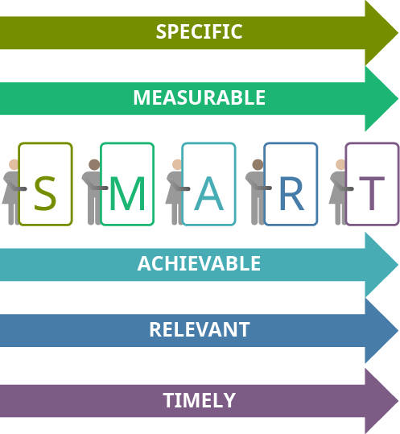
Figure 1.9
Creating SMART goals can help you realize your vision. (attribution: Copyright Rice University, OpenStax, under CC BY 4.0 license)

Slide 24
The Entrepreneurial Mindset
Entrepreneurs share a major trait in common: An entrepreneur identifies an opportunity and chooses to act on that opportunity.
The entrepreneurial mindset is the lens through which the entrepreneur views the world.
To become an entrepreneur, you need to recognize that an opportunity exists and be willing to act on it.

Slide 25

The Entrepreneurial Spirit and Passion
An entrepreneurial spirit allows entrepreneurs to carry a manner of thinking with them each day that allows them to overcome obstacles and to meet challenges with a can-do attitude.
It could mean being:
Passionate
Purposeful
Positive
Bold
Curious
Persistent.
Suhorucov, A. Successful multi - ethnic business colleagues in modern office. (January 2021).Pexels.com. https://www.pexels.com/photo/successful-multiethnic-business-colleagues-in-modern-office-6457579/.

Slide 26
Case Question
Research Miracle Messages.
Identify Miracle Messages vision statement, mission statement, and value statements.
Do not copy their statements, but rather create your own statements based on what you would create if you were the lead entrepreneur for this organization.

Slide 27
From the original slide deck:
This OpenStax ancillary resource is © Rice University under a CC-BY 4.0 International license; it may be reproduced or modified but must be attributed to OpenStax, Rice University and any changes must be noted.​

