Slide 1
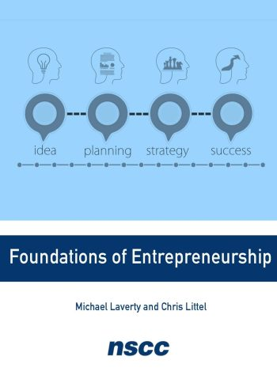
Entrepreneurship
Chapter 2 ENTREPRENEURIAL JOURNEY AND PATHWAYS

Slide 2

Feature Box
Are You Ready?: Taking the First Step
Is there a venture you’ve always thought you should start but never did?
Think about what factors are stopping you. Consider your mindset and how you might change your mindset so that your venture could become a reality.
What are some possible trigger events that could make the difference between starting your venture and waiting to start your venture?
Mont, U. (December 2020). Smiling black lady with tablet in street. Pexels. https://www.pexels.com/photo/smiling-black-lady-with-tablet-in-street-near-building-6280728/.

Slide 3

Figure 2.5
When inspired to start an entrepreneurial venture, one questions whether they can do it and identifies obstacles that might present challenges. (attribution: Copyright Rice University, OpenStax, under CC BY 4.0 license)

Slide 4
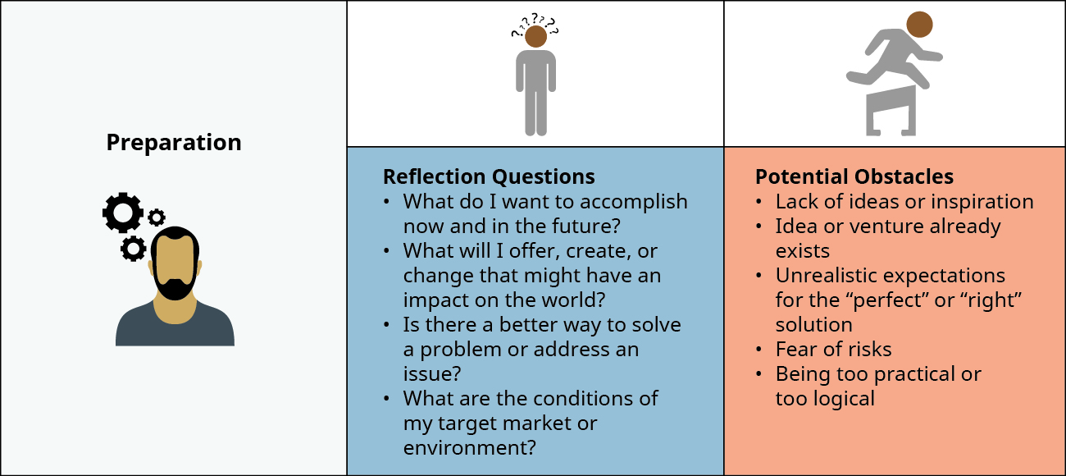
Figure 2.7
In preparing for your venture, you need to ask what you want to accomplish, what you want to offer, and who you want to target. You also need to consider what potential obstacles might present challenges. (attribution: Copyright Rice University, OpenStax, under CC BY 4.0 license)

Slide 5
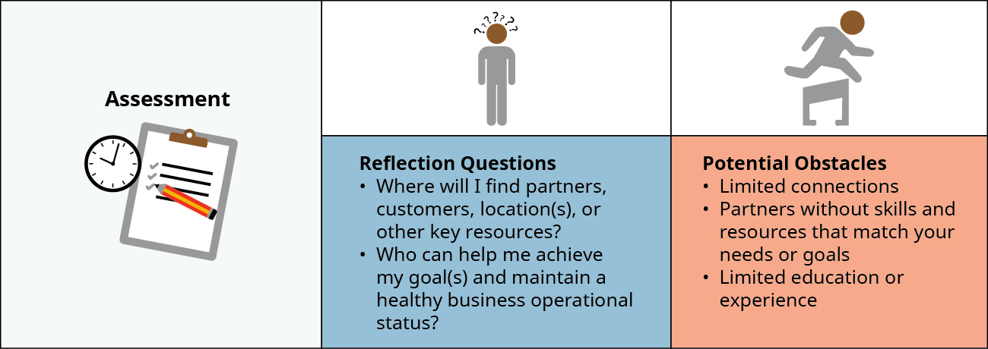
Figure 2.8
Assessing relationships and resources allows for reflection on your idea and intentions. (attribution: Copyright Rice University, OpenStax, under CC BY 4.0 license)

Slide 6
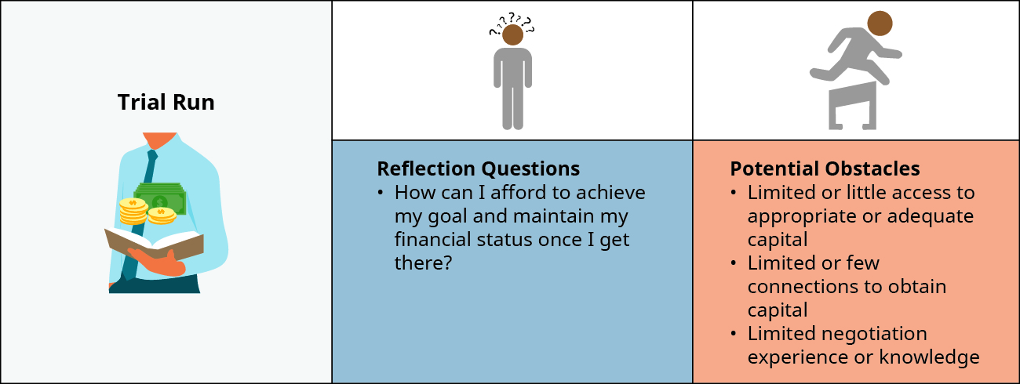
Figure 2.9
During a trial run, you can use a limited market to test your product or service. (attribution: Copyright Rice University, OpenStax, under CC BY 4.0 license)

Slide 7
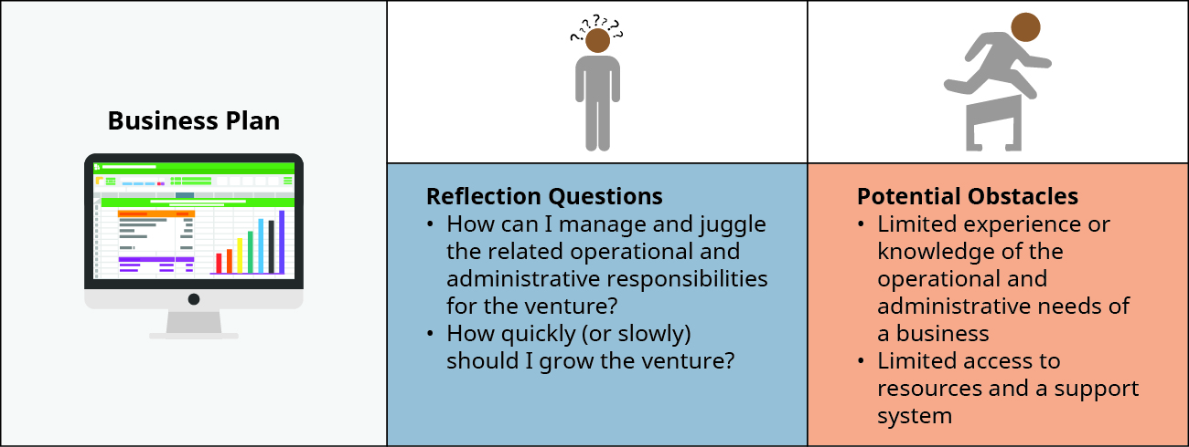
Figure 2.10
Writing a business plan before launching a venture can give you important insights into your idea and can help you modify your business before launch to give it a better chance of success. (attribution: Copyright Rice University, OpenStax, under CC BY 4.0 license)

Slide 8
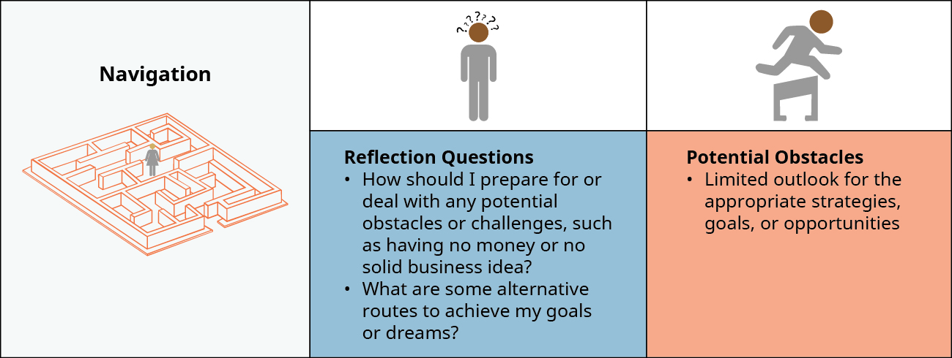
Figure 2.11
Navigation involves being prepared for and making changes when faced with obstacles. (attribution: Copyright Rice University, OpenStax, under CC BY 4.0 license)

Slide 9
Launch
The actual launch is the exciting event when you open your business.
By this point, you have made improvements to your product through feedback received in your trial run.
You’ve identified:
The value or benefits provided by your product
Your target market
The location of your launch, whether it is a geographical location or an Internet location.

Slide 10
Feature Box
Are You Ready?: Entrepreneurial Personality Test
Think about your results. Are you a generalist or a specialist?
Once you know this information, what other entrepreneurial personality types do you fit into?
How can you use this information in your pursuits as an entrepreneur?
What does this information tell you about selecting members of your startup team?

Slide 11
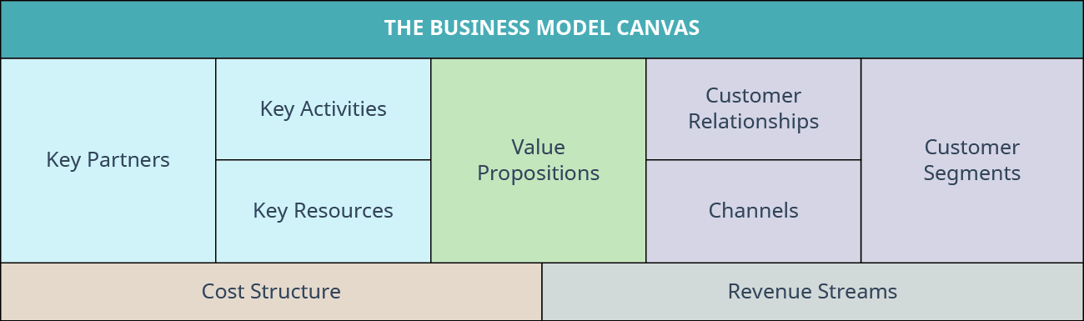
Figure 2.22
Here is an example of a Business Model Canvas with a framework to identify key components of the venture. (attribution: Copyright Rice University, OpenStax, under CC BY 4.0 license)

Slide 12
Action Plan Support Tools
Tool | Description | Use
Vision or Dream Board | A visual tool to present the ideal situation that you are working towards achieving | Wireframing
Storyboard | A scene-by-scene visual of the activity process from start to finish | Downloading method (IDEO)
Mind map | A visual tool that assists with categorizing brainstorming types of ideas | Brainstorming
Hypothesis | A proposition or statement as a basis for further testing or investigating | Interviewing
Logic Map | Visual representation of relationships between various components or variables | Questionnaires
Table 2.4

Slide 13

Case Question
What additional ideas can you think of for starting your own business, using Man Crates as a source of inspiration?
Shkraba, A. (May 2020). Photo of woman writing on tablet computer while using laptop. Pexels. https://www.pexels.com/photo/photo-of-woman-writing-on-tablet-computer-while-using-laptop-4348401/.

