Slide 1
Human Resources Management 3rd Edition
Chapter 11: Global Human Resources
Unless otherwise noted, this work is licensed under a Creative Commons Attribution-NonCommercial-ShareAlike 4.0 International (CC BY-NC-SA 4.0) license. Feel free to use, modify, reuse or redistribute any portion of this presentation.

Slide 2
Learning Outcomes
Describe political, social, economic and technological aspects for global Human Resources.
Explain the differences between domestic and global Human Resources and how recruitment and selection, training, compensation and performance management are similar and different.
Describe the various organizational structures in international companies.
Explain culture shock and coping strategies.
Discuss training requirements for expatriates for a successful overseas assignment.

Slide 3
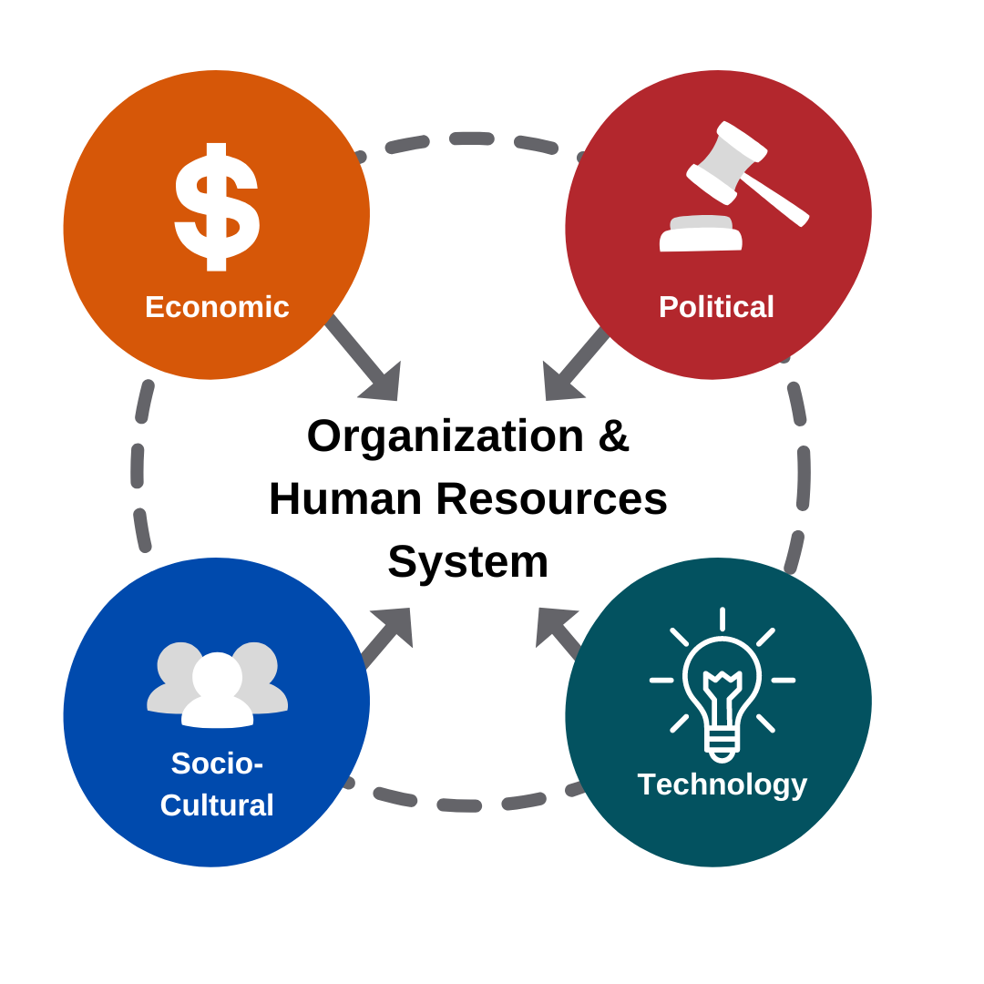
11.1 International Environments
PEST (political, economic, social, technology characteristics) analysis is often used to help companies lead and manage their companies.
PEST is a type of audit of the company’s environment a
PEST Analysis” by Fanshawe College CC-BY-SA

Slide 4
11.2 Types Of Structures Of Global Companies
International Company
Global company
Multinational company that has control of its operation where its headquarters is established.
Multi-domestic Company
Complex. Focuses on local responsiveness over global standardization
Transactional Company
Works to balance the global and local responsiveness.
A domestic company that uses its corporate office to expand into the global market.

Slide 5
11.3 Defining The Countries
International companies are different from domestic companies because of the cultural, regulatory, social, geographical, reporting, and infrastructural diversity.
Defining the Countries
Home Country and Home Country Nationals:
Host Country and Host Country Nationals
Third Country National:
This Photo by Geralt under a Pixabay License.
Notes:
Home Country and Home Country Nationals: Country where the corporate headquarters is located. The manager and, possibly the Human Resources team, would leave the home country for an international subsidiary. Example: The corporation is in Canada. The project team leaves the Canadian company and country.
Host Country and Host Country Nationals: Refers to a foreign country where the corporation invests. The manager and perhaps the team relocate to the host country (foreign country). Host country nationals are employees who are native to the country, and work and live in their home country. Example: Team goes to India from Canada to work and live. A host country national would be a team member who is native to India.
Third Country National: Manager and team who are not from the home country or the host country. However, work for the corporation. Example: Saudi Arabian manager working for a New Zealand subsidiary of a Chinese owned corporation.

Slide 6
11.3 Environmental Factors Affecting International Projects
Legal and Political
Economic
Security
Geography
Culture
Infrastructure
Notes:
Legal and Political: Expatriates need to work within the laws and regulations of the host country. The political stableness of the country affects how companies conduct themselves.
Economic: The gross national product (GDP) of a country tells the organization the level of development of a country. Financial stability is important to success. When there are risks for the company, a strong risk management plan needs to be in place.
Security: International acts of terror are a reality today. Crime is another issue. Risk management plays an important role here as well when a company expands in a foreign country. Sometimes managers experience ethical issues related to security. Two most frequent ethical issues are bribery and corruption. Security precautions need to be in place to keep all employees safe.
Geography: The planning of a company expansion in a different country needs to take into consideration the geography of the country. The organization needs to look at the weather (rain, freezing temperatures, very hot temperatures, jungles, deserts). Sleep issues can arise for employees with too much daylight, or not enough day light. Extreme weather can play havoc with equipment as well.
Culture: All employees visiting another country must respect the values, customs, traditions, social standards, and beliefs of the people of the foreign country. If these are not observed by the employees, there is a likelihood of failure. Language differences can become a problem. If a manager and team do not speak the foreign language, it is difficult to communicate; and words get lost in translation. Sometimes, managers will work with people from the foreign country. Language and cultural skills are necessary for success. Culture affects all human resources areas including recruitment and selection, training, and compensation.
Infrastructure: This pertains to the foreign country’s capacity to supply the services that are necessary for the employees. Some of these could include telecommunication, power, technology, transportation systems, and education facilities.

Slide 7
11.4 Culture Shock And Coping
Culture shock
feeling of uncertainty and being disoriented when a person is in an unfamiliar way of life in a different culture than their own culture.
The 4 phases of Culture Shock
Honeymoon
Frustration
Adjustment
Acceptance:
Dealing with Culture Shock
Team must acknowledge that they will experience culture shock.
Good stress management techniques are important
HR need to work with the team until they feel effective in their job upon return.
Notes:
According to Participate Learning (2018) the 4 phases of culture shock are :
Honeymoon: The person(s) feels overwhelmed and positive. They are excited about the new challenge in a different culture. They want to experience all the new things: food, the people, the language. The person(s) feels this has been a great decision and a great adventure. Each person is different in their response. However, everyone is affected to some degree.
Frustration: The person(s) feel fatigue because they do not understand the signs, gestures, language, and communication styles. It may be difficult to order food, shop for food, not be able to follow the transportation system. Some people begin to feel homesick and become depressed.
Adjustment: Over time, the person(s) begins to become familiar with their surroundings. They are more comfortable with the people, culture, language, and food.
Acceptance: After some weeks or months of dealing with frustration and emotional struggles, the person(s) begins to adapt and accept their new culture. They may not understand everything about the culture, however, function within it in a healthy way. They find and use resources to cope. They feel more at ease and accepted by the new community.

Slide 8
11.5 Selection Of Employees (Expatriates)
If employees are not selected with the skills and experience necessary for an international assignments, the costs are high. T
HR develops special screening processes
The term expatriates (expats for short.) is used for employees leaving their home country to work in a host country.
Family Moving with Project Team
Human Resources supports the family unit by helping the spouse or partner find a new job, find housing comparable to the one they left, assist in finding appropriate schools for the children, and providing transportation.

Slide 9
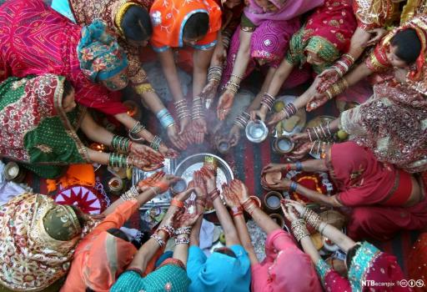
11.6 A Look at Cross-cultural Conditions & HR
Culture affects all aspects of life within a specific population of people including beliefs, values, the norms of the society, and its people’s customs. Examples of Cultural Differences include:
Canadian culture
Indian culture:
Swedish culture:
Italian culture
Employees need to not only be aware of different cultural aspects, but they also need to adjust to them when working abroad.
Women pray during the Hindu festival of Karva Chauth inside a temple in the northern Indian city of Chandigarh by Ajay Verma CC-BY-NC-SA.
Notes:
Canadian culture advocates equality between men and women, peace and safety for its citizens, being polite and friendly, and the love of hockey. Canada is a widely diverse country with many ethnic groups. It is a country of dual nationality, French Canada and English Canada, which dominates political and societal issues. It is a constitutional monarchy which means the British Monarch is the head of state, although the Monarchy has limited powers. Maple syrup and pancakes are some of the Canadian’s favourite foods (Commisceo, 2022a).
Indian culture: where its people value religion, joint family structures (entire family through generations live together), marriage and arranged marriage, symbols such as fasting, and festivals for every season. Architecture is important as symbols of culture and religion. They have a relaxed approach to timekeeping and punctuality. People remove their shoes before entering a home. Indian food many not require utensils. Southern food tends to be spicier than food from the North. Indian clothing made with colourful silks are worn that has origins of Ancient India (Zimmermann, K.A. & Gordon, J. ,2022).
Swedish culture: is very egalitarian meaning all people are equal regardless of gender, race, religion, or age. They have one of the best rights for children in the world and offer dual parental leave from work for 18 months. They are humble and believe boasting is not acceptable. They are great listeners, they speak softly and calmly, do not show emotions publicly, are not excessive or “flashy”, and competition is not encouraged (Commisceo, 2022c).
Italian culture enjoy patriotism. In other words, people remain a geographic expression. This means they identify with their own home region, rather than to the country. Being an old country, they have assimilated many other cultures into their own such as French, Austrian, Greeks, Arabs, Albanians, and Africans. Food is important and maintains ties among friends and family members. There are social classes, and big differences between the rich and poor. There are class boundaries in what people eat, what they wear, and the amount of leisure time spent. Prestige is important. Soccer is important to everyone. They tend to show outward emotion in public. They like to embrace and kiss when greeting people (Commisceo, 2022b).

Slide 10
11.7 Training International Project Teams
This type of training could be called cultural fluency which is the degree of understanding and interaction required with people from different cultures and backgrounds.
Supporting International Project Teams
Pre-departure training
The HR Manager may need to perform training in the foreign country
Longer term international projects would require further training
Language training for short- and long-term projects is important.
Individual counselling as well as group counselling
Regardless of its complexity, all training for employees ensures a highly trained team to meet the increasing need of international assignments
Notes:
Other fundamental logistics are put in place for the project team that include:
1. Relocation to home, or a new home 2. Financial and tax assistance (loss of bonuses, perks, tax changes) 3. Support to form or re-establish social and professional networks 4. Career counselling 5. Reverse culture shock (re-entry shock) for project team (and families) 6. Assistance with finding schools for children 7. Workshops to discuss organization changes 8. Stress management training

Slide 11
Summary
Describe political, social, economic and technological aspects for global Human Resources.
Explain the differences between domestic and global Human Resources and how recruitment and selection, training, compensation and performance management are similar and different.
Describe the various organizational structures in international companies.
Explain culture shock and coping strategies.
Discuss training requirements for expatriates for a successful overseas assignment.

Slide 12
End Chapter Review
What PEST considerations would a global company make related to Covid19 during the pandemic? Moving out of the pandemic? Discuss in small group.
What do you think HR Managers would need to consider if the company was opening a satellite operation in Mexico? Egypt? New Zealand? Thailand? Discuss in small group.
What needs to be considered by the company when they move from a domestic company to a multinational company? A transactional company? Work with a partner.
Tim Horton’s has expanded into the United States. As the HR Manager would you hire American or Canadian managers? Why make the choice you made? Work with a partner.

Slide 13
End Chapter Review
A spouse/partner plays a big role in whether an expatriate will take an assignment overseas. What supports could you offer the spouse/partner to support the success of the assignment? Work with a partner.
Discuss all the steps you would take to ensure a successful overseas assignment with a team of managers who are going to work in China for 2 years? Discuss in small group.
Have you experienced culture shock as an expat? As a student? If you have, share your experience with another student. (teacher will need to decide who has experienced culture shock and pair students accordingly.) Work with a small group. As a follow up, teacher asks the domestic students what they learned from the foreign student. Individual.
Discuss the challenges of performance appraisals for expats? Brainstorm in large group.

