Slide 1
Human Resources Management 3rd Edition
Chapter 12: HR Professional Practices
Unless otherwise noted, this work is licensed under a Creative Commons Attribution-NonCommercial-ShareAlike 4.0 International (CC BY-NC-SA 4.0) license. Feel free to use, modify, reuse or redistribute any portion of this presentation.

Slide 2
Learning Outcomes
Explain the professional and personal skills needed to be successful in HRM.
Explain the role of the Ontario HR professional – HRPA.
Describe how to earn HRPA Certification.
Apply the cluster of competencies to conduct oneself in a professional manner
Apply a high level of professionalism in all situation

Slide 3
12.1 HR Professionalism and Certification
HR employees need to be professionals need to have a set of competencies which include knowledge, skills, abilities and attributes (KSAs) that are needed to perform their job effectively
Key Characteristics
A common body of knowledge
Standards that are consistent
An association that is professional that they join
A code of ethics
Credentials and designations
Lifelong learning
This photo is by fauxels from Pexels.

Slide 4
12.2 Very Competitive Field
HR has the particularity of being governed by a professional body and legislation in the Province of Ontario the Human Resource Professionals Association (HRPA).
Core Competencies for the HR Professional
Functional Competencies
Enabling Competencies
The HRPA is to promote and protect the public interest by governing and regulating the practice of members, students and firms within the Association.

Slide 5
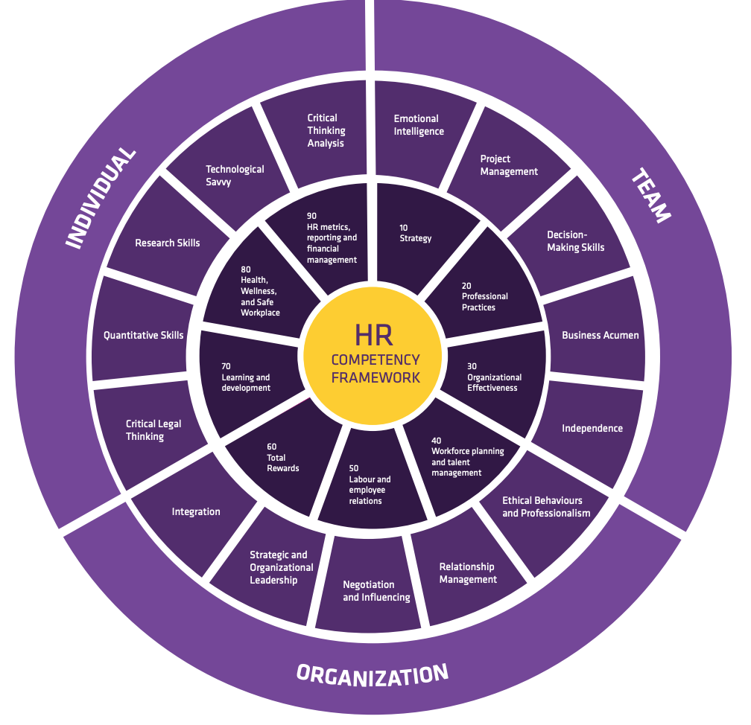
12.2 Competency Framework
Weblink to view image larger
Image © by Human Resources Professionals Association All Rights Reserved.

Slide 6
12.3 How To Earn Certification
HRPA’s 5 Certification Requirements
HRPA Membership in good standing
Successful completion of the Coursework Requirement
Successful completion of the Comprehensive Knowledge Exam 1
Successful completion of the CHRP/CHRL Employment Law Exam 1
Successful completion of the Job Ready Program
HRPA’s Coursework Requirement
The coursework requirement is established to ensure that certified Human Resources Professionals have a solid foundation in the Human Resources discipline.
Notes:
The coursework requirement consists of successful completion of nine courses. Successful completion means obtaining a grade of 70% or better over all nine courses with no single course below 65%.
The nine (9) courses are:
Human Resources Management (HRM)
Organizational Behaviour
Finance and Accounting
Human Resources Planning
Occupational Health and Safety
Training and Development
Labour Relations
Recruitment and Selection
Compensation

Slide 7
12.3 Human Resources Jobs
Recruiter
Compensation
Human Resources Assistant
Employee Relations
Benefits manager
Work-life Coordinator
Training and Development
Health and Safety
Vice President HR/People and Culture
HR Jobs:

Slide 8
Summary
Explain the professional and personal skills needed to be successful in HRM.
Explain the role of the Ontario HR professional – HRPA.
Describe how to earn HRPA Certification.
Apply the cluster of competencies to conduct oneself in a professional manner
Apply a high level of professionalism in all situation

Slide 9
End Chapter Review
Discuss why you believe the statement related to HRPA competencies is important: “standards need to be consistent”. Why do they need to be consistent? Or, maybe flexibility is more relevant? Share answers in a small group.
Review the costs for HRPA membership on the HRPA website. Do you believe it is important to be a member of HRPA? Why? Why not? Is it worth the cost? Share in a small group.
Review the Competency Framework in your text. Name one skill in individual, team and organization that you believe you have strengths? Name one skill you need to improve? How can you go about improving this skill? Write a one-minute paper. Share with a partner.

Slide 10
End Chapter Review
Review Functional Competencies in your text. (Teacher will divide the class into 9 groups, and assign a competency to each group.) Discuss what the competency means in your own words. Decide on your own definition. How would you apply this functional competency into your work as an HR Specialist? Discuss in small group.
Enabling Competencies are important to HR Specialists. Choose one of the enabling competencies and discuss its importance to you as an individual? To an organization that you may work for in the future? Share with a partner.
Research the HRPA course requirements. If you are choosing to earn your Certification, make a plan with action steps on how you will go about earning this Certification. Share with a partner. If you are not choosing to earn the Certification, share why you would not choose this option. Share with your partner.

