Slide 1
Human Resources Management 3rd Edition
Chapter 9: Health and Safety
Unless otherwise noted, this work is licensed under a Creative Commons Attribution-NonCommercial-ShareAlike 4.0 International (CC BY-NC-SA 4.0) license. Feel free to use, modify, reuse or redistribute any portion of this presentation.

Slide 2
Learning Outcomes
Describe employer and employee obligations in regards to Occupational Health and Safety.
Explain the impact of non compliance.
Explain health concerns that can affect employees at work.
List the three rights of workers.
Explain the elements that make up WHMIS 2015.
Identify the pictograms associated with product labels.
Explain how to identify a hazard at work.
Explain the steps and reporting requirements in an incident investigation.

Slide 3
9.1 Introduction To Occupational Health And Safety Legislation
Each jurisdiction has its own amalgam of acts, regulations, policies, and guidelines.
An act is a federal, provincial, or territorial law that sets out the broad legal framework around occupational health and safety in each jurisdiction.
A regulation typically sets out how the general principles of the Act will be applied in specific circumstances and is enforceable.
Notes:
Guidelines and policies are more specific rules about occupational health and safety. Other supporting guidance can be found in standards and codes. These documents provide employers with direction on health and safety implementation in the workplace.

Slide 4
9.2 The Internal Responsibility System (IRS)
Canadian Occupational Health & Safety (OHS) is based upon the internal responsibility system (IRS).
The IRS assumes that workers and employers have a shared responsibility for workplace health and safety.
Employers are obligated to take steps to ensure that workplaces are as safe as reasonably practicable.
Employers are also required to advise workers of hazards and to require workers to use mandated safety equipment.
Notes:
Occupational health and safety legislation consists of rights and responsibilities
The decision by governments to give employers the power to determine how to address workplace hazards bolsters employers’ broader management rights to control and direct work.
It can be difficult for employers to know when they have met their duty to make work as safe as reasonably practicable. Meeting the reasonably practicable standard means taking precautions “that are not only possible but that are also suitable or rational, given the particular situation.”^{[2]} The generally accepted test is that of due diligence.

Slide 5
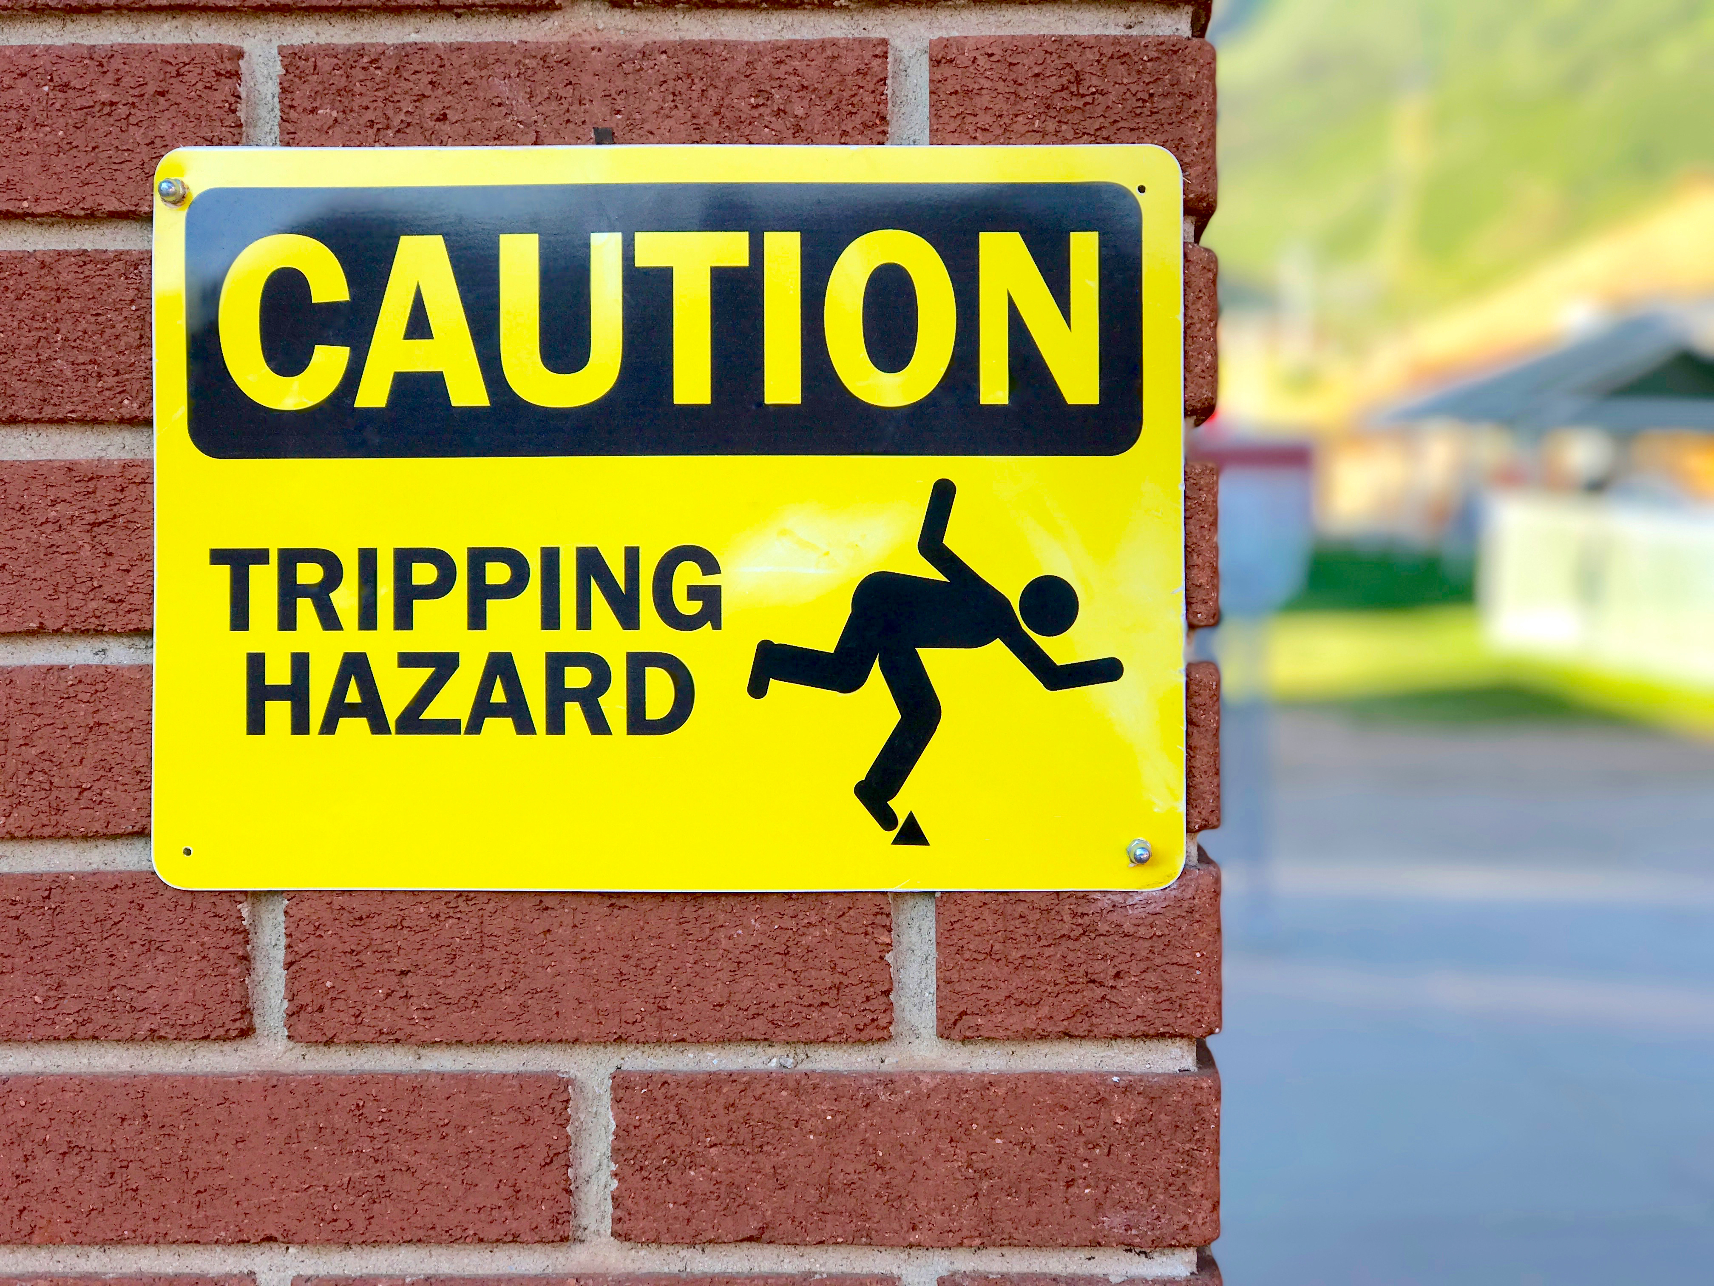
9.2 Due Diligence
Due diligence is taking reasonable precautions and steps to prevent injury, given the circumstances. It is assessed using a three-part test:
Foreseeability
Preventability
Control
This Photo by Lynn Friedman is licensed under CC BY-NC-ND
Notes:
Due diligence is taking reasonable precautions and steps to prevent injury, given the circumstances. It is assessed using a three-part test:
Foreseeability: Reasonable employers are expected to know about the hazards of their business. Injuries that arise from events that other operators in the industry expect might occur are foreseeable events.
Preventability: Reasonable employers are expected to take steps to prevent injury. The normal steps include identifying hazards, preparing and enforcing safe working procedures, training and monitoring worker safety, and ensuring compliance with safety procedures. Injuries that arise because an employer did not take these steps are preventable injuries.
Control: Reasonable employers are expected to take action on hazards that they can control. Injuries that arise from such hazards suggest the employer failed to control these hazards (LeBlanc, n.d.).

Slide 6
9.2 Rights of the Worker
To offset the power of employers under the IRS, governments have granted workers three safety rights:
Right to know: Workers have a right to know about the hazards they face in their workplace.
Right to participate: Workers have the right to participate in workplace health and safety activities.
Right to refuse: Workers have the right to refuse unsafe work. The right to refuse represents one of the few instances where workers can disobey their employer.
Notes:
1. While many hazards are readily apparent, chemical and biological hazards may not be. The right to know has given rise to systems such as the Workplace Hazardous Materials Information System discussed below, which provides workers with information about hazards materials and their safe handling.
2. Participation most often occurs through joint health and safety committees (JHSCs) but can be through other means.
3. A refusal requires employers to investigate and remedy unsafe work. Although the right to refuse sounds like a powerful right, it is one workers rarely use.

Slide 7
9.2 Employer Responsibilities
Employers have specific responsibilities when it comes to health and safety legislation. In Ontario, for example, some of the employer responsibilities include:
Establish and maintain a health and safety committee , or cause workers to select at least one health and safety representative.
Take every reasonable precaution to ensure the workplace is safe.
Train employees about any potential hazards and in how to safely use, handle, store and dispose of hazardous substances and how to handle emergencies.
Notes:
Make sure workers know how to use and handle the equipment safely and properly.
Make sure workers use any necessary personal protective equipment.
Immediately report all critical injuries to the government department responsible for OH&S.
Appoint a competent supervisor who sets the standards for performance, and who ensures safe working conditions are always observed.

Slide 8
9.2 Employee Responsibilities
Common misperception that only the employer has responsibilities for OHS. However, employees have responsibilities too under the Occupational Health and Safety Act, which include:
Work in compliance with OH&S acts and regulations.
Use personal protective equipment and clothing as directed by the employer.
Report workplace hazards and dangers to the supervisor or employer.
Photo by Ben_Kerckx / Pixabay License
Notes:
Work in a safe manner as required by the employer and use the prescribed safety equipment.
Tell the supervisor or employer about any missing or defective equipment or protective device that may be dangerous.

Slide 9
9.2 Manager Responsibilities
Individuals with titles such as supervisor or manager have specific responsibilities, such as:
Make sure workers work in compliance with OH&S acts and regulations.
Make sure that workers use prescribed protective equipment and/or devices.
Advise workers of potential and actual hazards.
Photo by voltamax Pixabay License
Notes:
Provide workers with written instructions as to the measures and procedures to be taken for protection of the worker.
Take every reasonable precaution in the circumstances for the protection of workers.

Slide 10
9.3 Recording Keeping
Record-keeping normally refers to the keeping of incidence rates, or the number of illnesses or injuries per one hundred full-time employees per year, as calculated by the following formula:
incidence rate = number of injuries and illness × 200,000 / total hours worked by all employees in the period
Notes:
The purpose of record keeping does not imply that the employee or the company is at fault for an illness or injury.
Record keeping does not always mean an employee will be eligible for worker’s compensation.

Slide 11
9.3 Worker’s Compensation
If an employee cannot return to their job due to permanent injuries, there are four options available:
Cash payouts (for permanent disability)
Wage loss payments (if worker can no longer earn as much)
Medical aid
Vocational rehabilitation
Notes:
It is important to note that the main intent of the worker’s compensation is to ensure that the employee return to his/her original job.

Slide 12
9.4 Joint Health and Safety Committee
Joint health and safety committees allow workers to exercise their right to participate in occupational health and safety matters.
Comprised of employer and worker representatives who regularly meet to discuss health and safety issues.
The legislative requirements for JHSCs vary by jurisdiction and organization size. Unions may also negotiate mandatory JHSCs into their collective agreements.
Notes:
. The “logic” of these committees is that they marry the job-specific knowledge of workers with the broader perspective of managers to identify and resolve OHS issues.

Slide 13
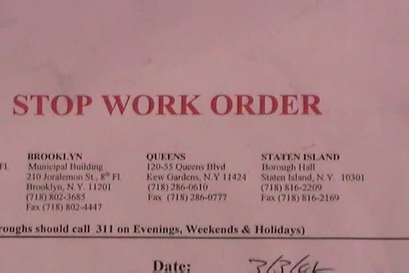
9.5 Powers, Authority And Legal Implications
Governments also employ OHS officers who perform worksite inspections in order to identify health and safety violations and ensure their remediation.
A solution to a violation is the most common response of OHS inspectors.
Sometimes they will issue a stop-work order, which halts operations at the worksite until an unsafe situation is resolved.
This Photo by Unknown Author is licensed under CC BY
Notes:
Inspections may be random or targeted (e.g., focusing on high-injury industries, such as residential construction). Inspections may also be triggered by worker complaints.
Inspectors will also investigate serious workplace injuries and fatalities. Where inspectors find violations of OHS rules, they may order employers to remedy the situation.

Slide 14
9.6 Related Legislation
Occupational health and safety laws are part of a broader web of rules that regulate employment. Other laws passed by legislatures that impact OHS include:
Hazardous products
fire and building codes
occupational-specific regulations
laws regulating hazardous materials
employment (or labour) standards
human rights
workers’ compensation schemes.

Slide 15
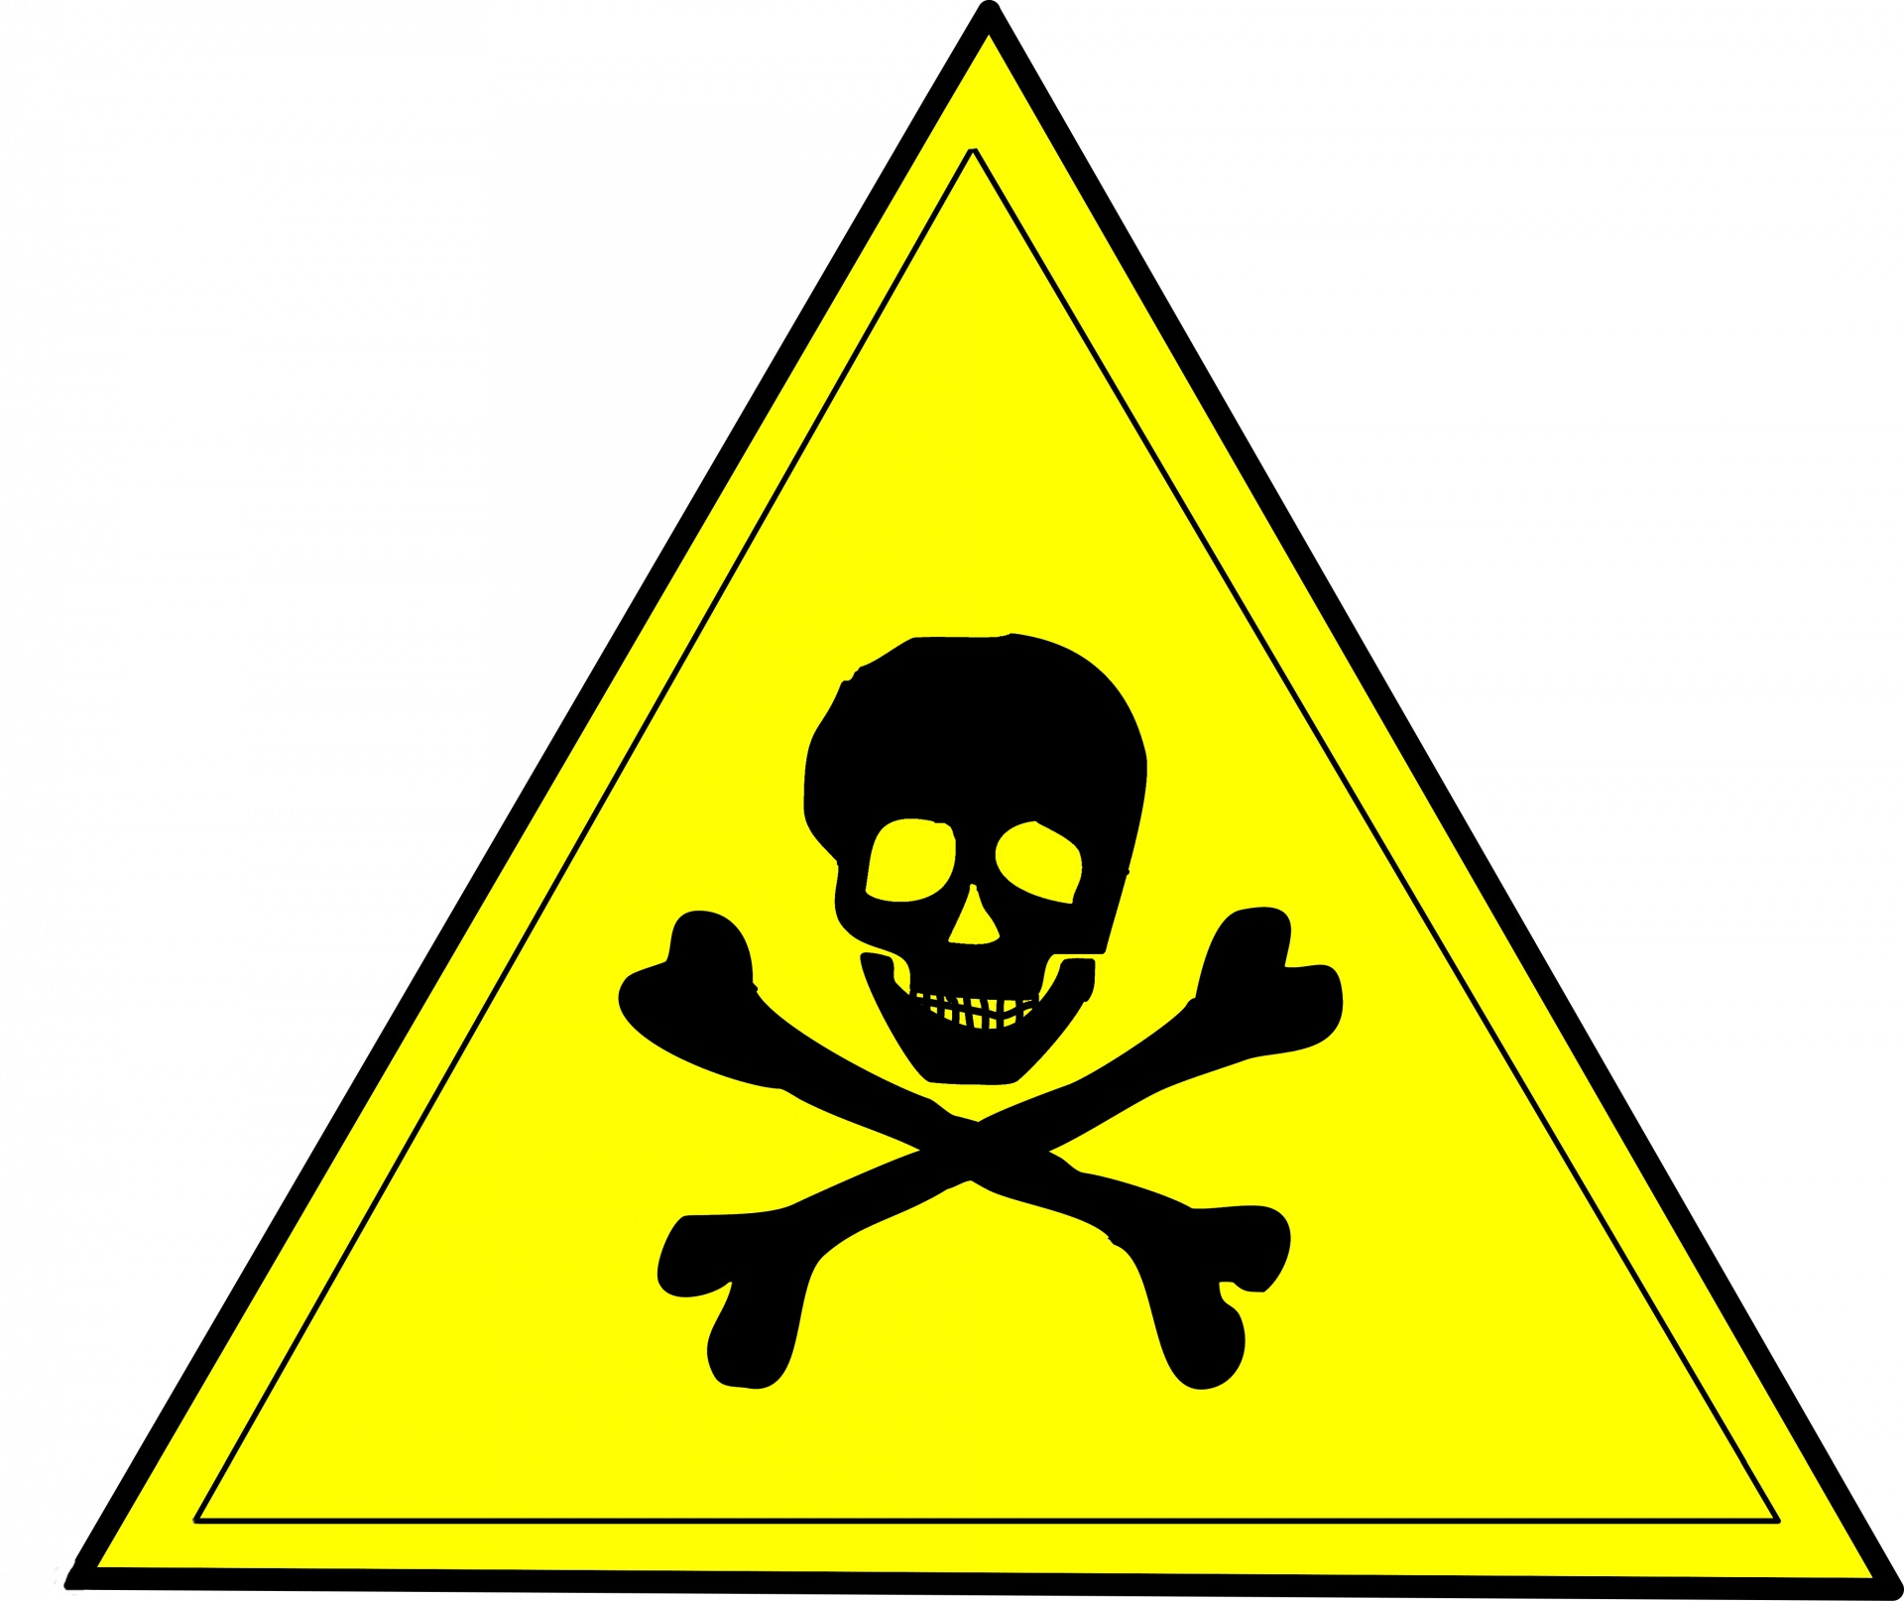
9.6 Hazardous Products
The federal Hazardous Products Act established the Workplace Hazardous Materials Information System (WHMIS). WHMIS protects workers by requiring employers to label hazardous materials and provide safety data sheets (SDS) which outline the hazards of the substance.
Hazard sign by Piotr CCO
Notes:
This information assists workers in exercising their right to know about workplace hazards. Each of Canada’s 14 jurisdictions have included aspects of WHMIS in their own OHS systems.^{[1]}
Governments also regulate aspects of certain occupations. For example, workers whose job requires them to handle or use explosives may be required to undertake specific training and hold a permit. Governments have also enacted environmental laws that regulate air, water, and soil pollution, waste management, and climate change. While environmental regulations are not normally considered a part of occupational health and safety, there is no clear boundary between environmental hazards and workplace hazards.

Slide 16
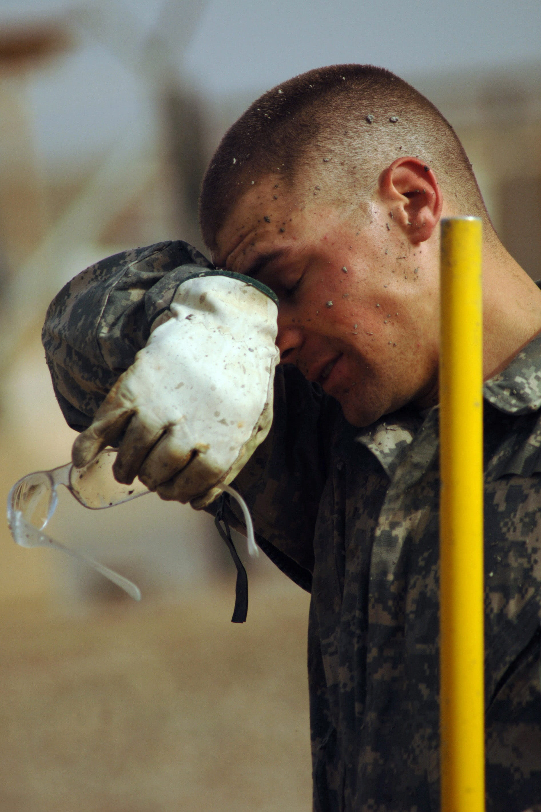
9.6 Employment Standards
All Canadian jurisdictions have enacted laws setting out the minimum terms and conditions of work. These employment standards (or labour standards) acts often outline maximum hours of work and required rest breaks. These requirements prevent workers from becoming overly tired, which increases the risk of injury.
Photo by unknown author pxfuel license
Notes:
Employment standards legislation also usually contains limits on the employment of minors, reflecting their greater vulnerability to occupational injury due to their physical and intellectual immaturity. Such laws preclude employers from recovering the cost of customer theft from workers’ wages. As the vignette at the beginning of this chapter suggests, though, employment standards laws are unevenly enforced, thereby reducing their contribution to injury prevention.

Slide 17
9.6 Human Rights
It is important to consider the impact of human rights legislation on OHS. Human rights acts preclude discrimination on various grounds, such as gender, family status, age, sexual orientation, and disability.
Photo by Markus Spiske Unsplash License
Notes:
The duty to accommodate injured workers that flows from human rights legislation. In short, employers are expected to modify work and workplaces, up to the point of undue hardship for the employer, so as not to discriminate against workers with temporary or permanent disabilities.

Slide 18
9.8 Health Hazards
The main different types of health incidents that can occur are:
Occupational injury: Cut, fracture, sprain, or amputation resulting from a workplace accident or from an exposure involving an accident in the work environment
Occupational illness: Abnormal condition or disorder caused by exposure to environmental factors associated with employment
Industrial disease: Disease resulting from exposure relating to a particular process, trade, or occupation in industry

Slide 19
9.8 Health Hazard Examples
Stress management, office-related injuries such as carpal tunnel syndrome, and no-fragrance areas are all contemporary issues surrounding employee health and safety.
Cumulative trauma disorders (CTDs) are injuries to the fingers, hands, arms, or shoulders that result from repetitive motions such as typing.
Multiple chemical sensitivity (MCS) or environmental illness (EI). MCS or EI is the inability to tolerate an environmental chemical or class of foreign chemicals.
The Workplace Hazardous Materials Information System (WHMIS) gives directives on how to properly label, use, manage, store and dispose of chemical substances.

Slide 20
9.9 Stress
Stress is the reaction we have to a stressor.
A stressor is some activity, event, or other stimulus that causes either a positive or negative reaction in the body.
Despite what people may think, some stress is actually good.

Slide 21
9.10 Incident Investigation
Employers are responsible for investigating workplace incidents. Before the formal incident investigation begins, the employer needs to take the necessary steps to meet both internal and external reporting requirements.
Pre-investigation
Worker’s Compensation and compliance
Incident Investigations
Notes:
Incident investigations are intended to uncover all of the key facts about how and why an incident occurred so that action can be taken to prevent it happening again.

Slide 22
9.11 Hazard Recognition, Assessment and Control
The key to preventing workplace injuries and fatalities is to identify hazards and control them, otherwise known as Hazard Recognition, Assessment and Control (HRAC). This process follows these steps:
Hazard recognition- is the systematic task of identifying all hazards present, or potentially present.
Hazard assessment - workers and employers determine which of the hazards needs to be addressed most urgently.
Hazard control process sees preventive and corrective measures implemented to eliminate or mitigate the effect of the hazard(s).

Slide 23
9.12 Investigation Steps
Scene security
Identify and interview witnesses
Complete the investigation
Root cause analysis
Reporting and recommendations
Follow-up
Photo by Jake Hills Unsplash License
Notes:
Step 1. Scene Security - Securing the scene entails two actions. First, any uncontrolled hazard (e.g., leaking gas) needs to be eliminated to ensure the safety of the investigators and others. Second, the scene needs to be protected so that no evidence can be destroyed or altered (intentionally or unintentionally) until the completion of the investigation. Protection normally includes restricting access to the scene. In some circumstances, it may also require protecting the scene from inclement weather.
Step 2. Identify and Interview Witnesses - Investigators normally prioritize interviewing witnesses, including the injured worker(s). Witnesses should be interviewed as soon as possible after the incident while their memories are fresh and uncontaminated by discussing the event with others.
Step 3. Complete the Investigation - The next step in an investigation is to gather evidence. There are a number of techniques for collecting the relevant information. They will be used in various combinations depending on the nature of the incident and the workplace
Step 4. Root Cause Analysis - Once all the information has been gathered, the next step is to analyze the data to determine the causes. This is a crucial step, and is often where investigations go wrong. The immediate reasons for the incident will be the first to appear. These causes will usually be worker error or some factor that may appear to be uncontrollable
Step 5. Reporting and Recommendations - The next step in the investigation process is to write a formal report outlining the findings and making recommendations. In some respects this can be considered the most crucial phase, as a careful investigation is without value if the recommendations fail to improve the situation. The incident report will be the permanent record of the incident and its causes and thus should clearly outline what happened and why it happened.
Step 6. Follow up - The final step in the incident investigation process is follow up. During the reporting stage, specific recommendations were put forward which most often include corrective and preventative measures. The goal is to eliminate or minimize the risk of a similar incident happening in the future.

Slide 24
9.13 Culture of Health and Safety
Possible techniques you can implement to have a safe and healthy work environment include the following:
Know safety laws.
Provide training to employees on safety laws.
Have a written policy for how violations will be handled.
Commit the resources (time and money) necessary to ensure a healthy work environment.
Involve employees in safety and health discussions, as they may have good ideas as to how the organization can improve.
Make safety part of an employee’s job description; in other words, hold employees accountable for always practising safety at work.
Understand how the health (or lack of health) of your employees contributes to or takes away from the bottom line and implement policies and programs to assist in this effort.
Notes:
Another option to ensure health and safety is to implement an employee assistance program (EAP). This benefit is intended to help employees with personal problems that could affect their performance at work. The EAP usually includes covered counselling and referral services. This type of program can assist employees with drug or alcohol addictions, emotional issues such as depression, stress management, or other personal issues. Sometimes these programs are outsourced to organizations that can provide in-house training and referral services to employees.

Slide 25
Key Takeaways
This chapter outlined the legal framework the state has enacted to prevent and compensate work-related injuries.
To fully appreciate how injury prevention and compensation laws operate we have to be prepared to understand both the technical requirements of the laws and the political economy of their enforcement.
Canadian governments have made employers and workers jointly responsible for OHS via the IRS.
In addition to OHS laws, governments have passed other legislation that makes workplaces safer, including fire and building codes and hazardous materials and environment protection regulations.
It is essential that every employer understand the occupational health and safety legislation that applies to their workplace(s) and implements the essential components of a safety program including training, hazard identification, incident investigation and controls.

Slide 26
Summary
Describe employer and employee obligations in regards to Occupational Health and Safety.
Explain the impact of non compliance.
Explain health concerns that can affect employees at work.
List the three rights of workers.
Explain the elements that make up WHMIS 2015.
Identify the pictograms associated with product labels.
Explain how to identify a hazard at work.
Explain the steps and reporting requirements in an incident investigation.

Slide 27
End Chapter Review
Explain the role due diligence plays in designing a health and safety plan for your company, as the HR Manager.
What is a joint health and safety committee and what is its purpose?
Discuss the rights of the worker and the manager’s responsibilities.
Describe employer and employee obligations in regards to Occupational Health and Safety.
What significance has the Westray Law or former Bill C-45 played in today’s companies?
How does stress impact employees and why is this concerning for HR professionals?
What steps do you take for inspections?

