Slide 1

Principles of Macroeconomics
CHAPTER 10: MONEY AND BANKING
Unless otherwise noted, this work is licensed under a Creative Commons Attribution-NonCommercial-ShareAlike 4.0 International (CC BY-NC-SA 4.0) license. Feel free to use, modify, reuse or redistribute any portion of this presentation.

Slide 2
Learning Outcomes
At the end of this chapter, you will be able to:
Explain what money is and why we need it.
Describe how money is measured in Canada today.
Outline how banks create money.
Identify the roles of the Bank of Canada and its open market operations.
Explain the Equation of Exchange.

Slide 3
10.1 Functions of Money
Economies without money use the barter system
  The barter system is inefficient because it requires a double coincidence of wants and does not easily allow for future contracts
Money solves the double coincidence of wants as:
  It is accepted as a means of payment
  It stores value
  It serves as a unit of account
Notes:
a double coincidence of wants, which means that what one person wants to buy is exactly what the other person wants to sell. This is harder than it sounds. Suppose an accountant wants a new pair of shoes. The accountant doesn’t just need to find someone who has a pair of shoes in the correct size to sell, but they have to find a person who will also be willing to exchange the shoes for what the accountant has to offer, namely accounting services.
Another problem with the barter system is that it does not allow us to easily enter into future contracts for the purchase of many goods and services. For example, if the goods are perishable it may be difficult to exchange them today for other goods in the future. Imagine a farmer wanting to buy a tractor in six months using a fresh crop of strawberries harvested today. Because the strawberries won’t last, such a transaction is unlikely to occur.
means of payment (or medium of exchange), the accountant can pay for new shoes with money, which the shoe seller is willing to accept since he or she can use the money to purchase something they do need.
A store of value is anything that holds value. Money doesn’t have to be a perfect store of value to be acceptable. In an economy with inflation, money loses some buying power each year, but it remains money.
money serves as a unit of account, which means that it is the ruler by which other economic values are measured. If there were no unit of account, the price of every good or service would have to be expressed in terms of the price of every other good and services

Slide 4
10.2 Commodity vs Fiat Money
Commodity money means there is a value from use as something other than money
Commodity-backed currencies are dollar bills or other currencies with values backed up by gold or another commodity held at a bank.
Fiat money has no intrinsic value but is declared by a government to be the legal tender of a country.

Slide 5
10.3 Measuring Money
The total quantity of money in the economy at any one time is called the money supply.
Economists use broad definitions of money based on the concept of Liquidity.
  Liquidity is how quickly an asset can be used to buy a good or service.
  Liquidity is relative
Credit cards are not money.
  It identifies you as a person who has a special arrangement with the card issuer in which the issuer will lend you money and transfer the proceeds to another party. You then repay the loan later.

Slide 6
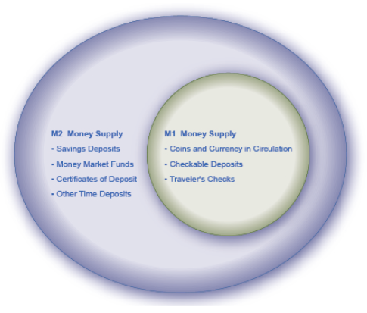
10.3 M1 and M2 I
There are 2 definitions of the supply of money
  M1: Assets that are the most liquid such as cash
  M2: M1 as well as some less liquid assets such as savings, time deposits, certificates of deposit, and money market funds.

Slide 7
10.3 M1 and M2 II
In the table to the right are statistics for the banking sector in Canada (all numbers in billions of domestic currency).
Using the data:
M1 = 1400 + 4 + 1200 = $2,604 billion
M2 = $2,604 + 8000 + 400 + 500 = $11,504 billion
Coins and Currency | 1400
Chequable Deposits | 4
Traveller’s Cheques | 1200
Savings Accounts | 8000
Money Market Mutual Funds | 400
Term Deposits | 500

Slide 8
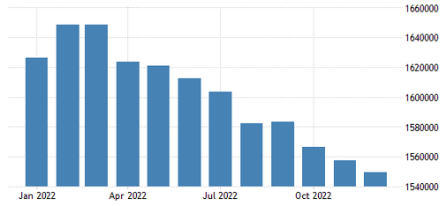
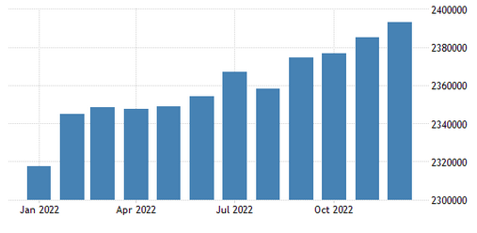
10.3 M1 and M2 III
Money Supply M1 in Canada decreased to 1,557,237 CAD in November 2022 from 1,566,375 CAD in October of 2022
Money Supply M2 in Canada increased to 2,384,951 CAD in November 2022 from 2,376,916 CAD in October of 2022.

Slide 9
10.4 Banks and Financial Intermediaries
An institution that amasses funds from one group and makes them available to another is called a financial intermediary.
  Examples include pension funds and insurance companies.
Banks have a particularly important role as financial intermediaries.
  Depositors’ money is accepted and lent to borrowers
  Interest earns on loans allows banks to pay interest to depositors, cover operating costs, and earn a profit.
  Customers can open chequing accounts creating chequable deposits.

Slide 10

10.4 How Banks Create Money: 100% Reserve System
100% reserve banking system: simply storing money for depositors, not using deposits to make loans means that depositors cannot be paid interest.

Slide 11
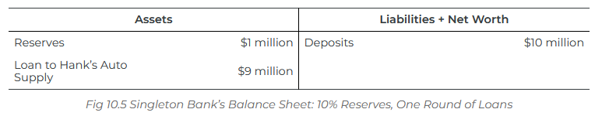
10.4 How Banks Create Money: Fractional Reserve System I
Refer to Fig 10.5, Singleton Bank keeps 10% of its total deposits with Bank of Canada, or $1 million, on reserve. This is called the reserve ratio. It will loan out the remaining $9 million. Loan is an asset because the bank earns interest from the loan. By loaning out the $9 million and charging interest, it will be able to make interest payments to depositors and earn interest income for Singleton.
Money supply is $10 million in this example (remember deposits are counted as Money Supply).

Slide 12
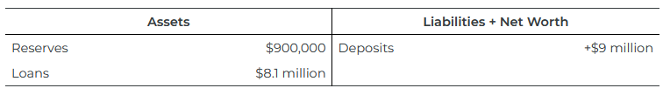
10.4 How Banks Create Money: Fractional Reserve System II
Singleton Bank lends $9 million to Hank’s Auto Supply. Hank’s Auto Supply obtains this loan and make purchases of auto parts from Ben’s Company. Ben’s Company has an account with First National Bank. When Hank pays the $9 million he lent from Singleton Bank to Ben’s company, Ben deposits this money to the First National Bank. Every loan creates a deposit.
Therefore, now money supply is $10million + $9million = $19 million.

Slide 13
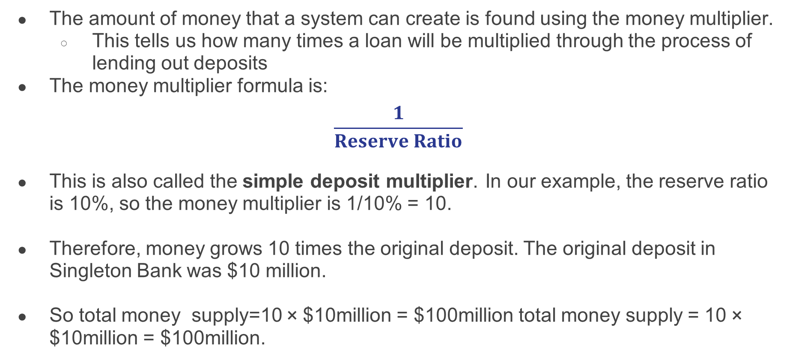
10.4 The Money Multiplier
The amount of money that a system can create is found using the money multiplier.
  This tells us how many times a loan will be multiplied through the process of lending out deposits
The money multiplier formula is:
$$\frac{1}{Reserve Ratio}$$
This is also called the simple deposit multiplier. In our example, the reserve ratio is 10%, so the money multiplier is 1/10% = 10.
Therefore, money grows 10 times the original deposit. The original deposit in Singleton Bank was $10 million.
So total money supply=10 × $10million = $100million total money supply = 10 × $10million = $100million.

Slide 14
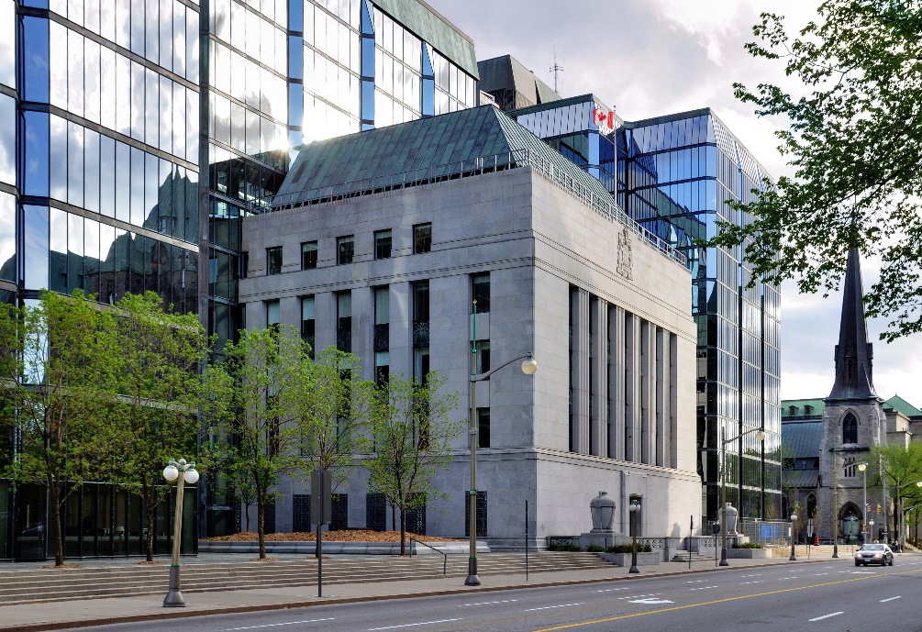
10.5 Bank of Canada
The Bank of Canada is led by the Governing Council.
Its primary functions are:
  Act as a Banker to the Federal Government
  Act as a Banker to the private banks
  Issue bank notes and coins
  Act as a Lender of Last Resort
  Conduct Monetary Policy
“Ottawa: Bank of Canada” by Taxiarchos228, CC BY-SA 3.0

Slide 15
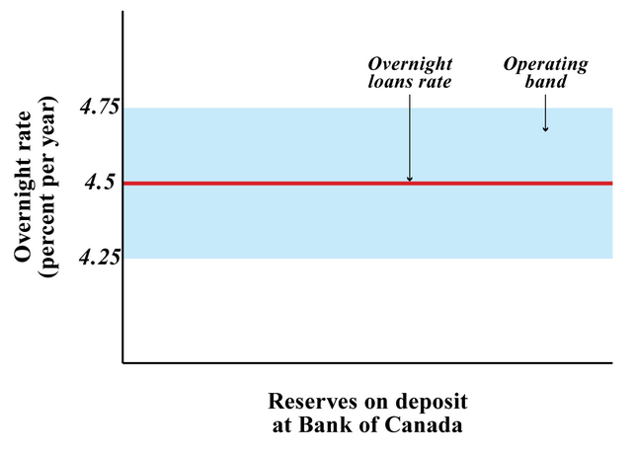
10.5 Overnight Interest Rate I
The overnight interest rate setting is the Bank of Canada’s key policy instrument in keeping the Canadian inflation rate within the target range of
1 - 3%.
The Bank sets a target for the overnight rate at the midpoint of an operating band that is plus or minus one-quarter of one percentage point.

Slide 16
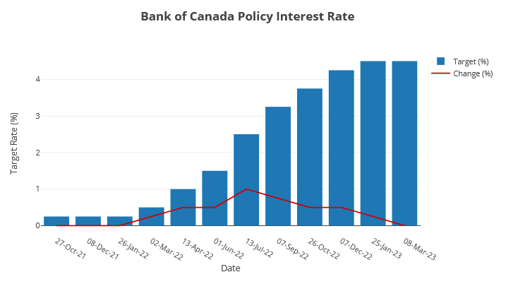
10.5 Overnight Interest Rate II

Slide 17
10.5 Open Market Operations I
Central banks use open market operations, the purchases or sales of government securities in the open market, to manage the size of the money supply.
There are two tools the Bank of Canada uses to maintain the overnight interest rate.
1) Special purchase and resale agreement (SPRA)
  The Bank offers to buy Government of Canada securities from financial institutions with an agreement to sell them back the next business day.
  The injection of cash increases money supply and puts a downward pressure on the overnight interest rate.
  Lowering the policy rate lower the prime lending rate and most interest rates prevailing in the markets fall.

Slide 18
10.5 Open Market Operations II
2) Sale and repurchase agreement (SRA)
  This is a sale of securities to financial institutions for one day combined with a repurchase the following day.
  There is a one-day reduction in money supply that puts upward pressure on the overnight rate raising the operating band.
  Raising the policy rate target raises the prime lending rate and most interest rates prevailing the markets rise.

Slide 19
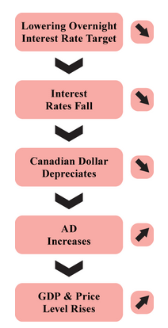
10.6 Overnight Rate and its Implications on the Economy I
If the Bank of Canada expects the economy is slowing down, they would lower the overnight interest rate target and conduct an open market operation of SPRA.
The prevailing market interest rates are lowered, and the money supply is increased.
The value of CAD decreases and consumption and investment increase as the borrowing cost lowers.
The components of the aggregate demand function increase, the aggregate demands increases, and the price level is raised.

Slide 20
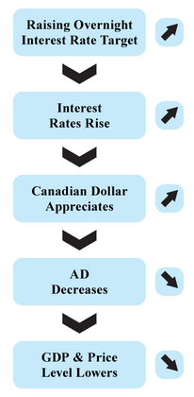
10.6 Overnight Rate and its Implications on the Economy II
If the Bank of Canada expects the economy is experiencing rising prices or inflation, they would raise the overnight interest rate target and conduct an open market operation of SRA.
The prevailing market interest rates are raised, and the money supply is decreased.
The value of CAD appreciates and consumption and investment decrease as the borrowing cost rise.
The components of the aggregate demand function decrease, the aggregate demands decreases, and the price level is lowered.

Slide 21
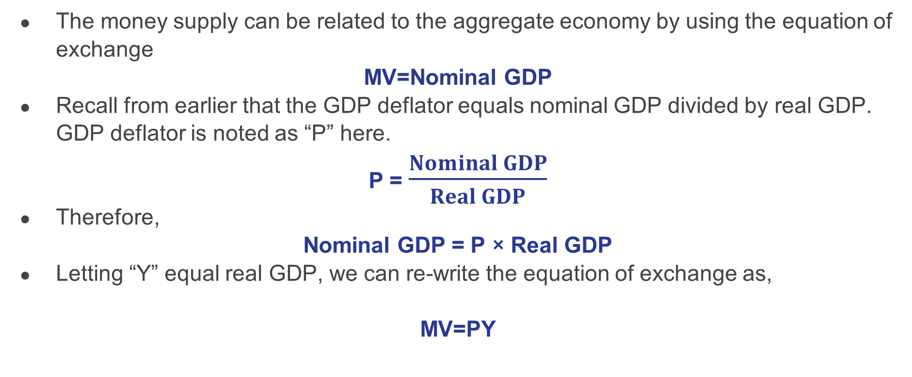
10.7 The Equation of Exchange I
The money supply can be related to the aggregate economy by using the equation of exchange
MV=Nominal GDP
Recall from earlier that the GDP deflator equals nominal GDP divided by real GDP. GDP deflator is noted as “P” here.
P = $\frac{Nominal GDP}{Real GDP}$
Therefore,
Nominal GDP = P × Real GDP
Letting “Y” equal real GDP, we can re-write the equation of exchange as,
MV=PY
Notes:
The equation of exchange shows that the money supply M times its velocity V equals nominal GDP. Velocity is the number of times the money supply is spent to obtain the goods and services that make up GDP during a particular time period.

Slide 22
10.7 The Equation of Exchange - Example
A hypothetical economy that consists of 50 people, each who has a car and $10 in cash with no other money. The money supply of this economy is $500.
First Month | M = $500 and V = 1 Real GDP is measured as # of car washes Y = 50 car washes and P = $10 | $500 × 1 = $10 × 50
Second Month | Money supply has been spent twice V = 2 Total output is $1,000 – 100 car washes have been produced | $500 × 2 = $10 × 100
Third Month | Money supply has been spent three times V = 3 | $500 × 3 = $10 × 150
The equation of exchange always holds.

Slide 23
10.7 Money, Nominal GDP, and Price-Level Changes I
The equation of exchange can be rewritten in terms of percentage rates of change
%ΔM + % ΔV ≈ % ΔP + % ΔY
Assume that velocity is constant, then the above equation becomes,
%ΔM ≈ % ΔP + % ΔY_{P}
Rewriting this as,
%ΔP ≈ % ΔM - % ΔY_{P}
That is,
The rate of inflation = the growth in money supply – growth rate of real GDP

Slide 24
10.7 Money, Nominal GDP, and Price-Level Changes II
The equation helps to make the following predictions:
  If money supply changes faster than the growth rate of GDP, the economy experiences inflation
  If the growth rate of GDP changes faster than money supply, the economy experiences deflation
  3. When both money supply and GDP change in the same proportion, inflation remains unchanged.
The quantity theory of money holds that in the long run the price level moves in proportion with changes in the money supply, at least for high-inflation countries.
Notes:
Several recent studies that looked at all the countries on which they could get data on inflation and money growth over long periods found a very high correlation between growth rates of the money supply and of the price level for countries with high inflation rates, but the relationship was much weaker for countries with inflation rates of less than 10%.

Slide 25
10.8 Key Terms
Asset
Balance sheet
Barter
Certificates of deposit
Commodity-backed currencies
Commodity money
Double coincidence of wants
Fiat money
Financial intermediary
Liability
Liquidity
M1
M2
Money market funds
Money multiplier
Money supply
Overnight interest rate
Prime rate
Quantity theory of money
Savings deposits
Unit of account

