Slide 1

Principles of Macroeconomics
CHAPTER 11: MONETARY POLICY
Unless otherwise noted, this work is licensed under a Creative Commons Attribution-NonCommercial-ShareAlike 4.0 International (CC BY-NC-SA 4.0) license. Feel free to use, modify, reuse or redistribute any portion of this presentation.

Slide 2
Learning Outcomes
At the end of this chapter, you will be able to:
Answer the question, “What is Monetary Policy?”
Explain the Money Market and the Bank of Canada’s Choice of Monetary Policy Targets
Discuss Monetary Policy tools and Economic Activity
Analyze Monetary Policy in the Aggregate Demand and Aggregate Supply Model

Slide 3
11.1 Goals of the Monetary Policy
The Bank of Canada has the following objectives:
  Price Stability: Keeping annual inflation rate within 1-3% range
  Low Unemployment: Keeping the official unemployment rate less than 7%
  Economic Growth: Keeping the long term economic growth rate around 2%
The most important objective is to preserve the value of money by keeping inflation low, stable, and predictable
Notes:
This allows Canadians to make spending and investment decisions with more confidence, encourages longer-term investment in Canada’s economy, and contributes to sustained job creation and greater productivity. This in turn leads to improvements in our standard of living.

Slide 4
11.1 The Inflation Control Target
The inflation-control target is 2%
Jointly set by the Bank of Canada and federal government, it is reviewed every 5 years
The inflation-control target guides the Bank’s decisions on the setting for the policy interest rate to maintain a stable price environment over the medium term
Policy rate settings are announced on fixed announcement dates eight times a year

Slide 5
11.2 Monetary Policy Target
One of the most important functions of the Bank of Canada is to conduct monetary policy.
The main operating tool is open market operations
  Special purchase and resale agreement (SPRA)
  Sale and repurchase agreement (SRA)
These tools allow the Bank of Canada to directly influence the overnight interest rate and money supply

Slide 6
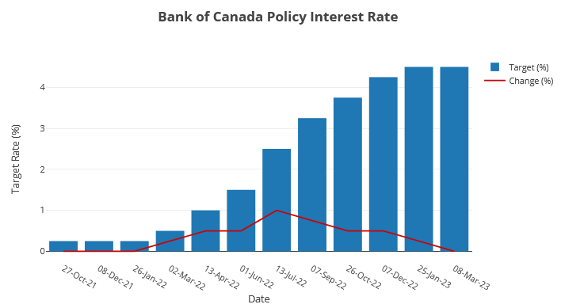
11.2 Overnight Interest Rate Target
The target for the overnight rate or key policy interest rate is the rate the Bank expects to be used in financial markets for one-day loans between institutions.
It serves as a benchmark that banks and financial institutions use to set interest rates for consumer loans, mortgages, and other forms of lending.

Slide 7
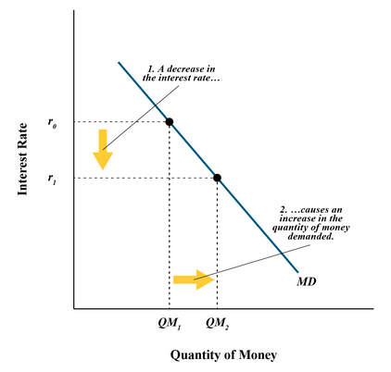
11.3 Demand for Money
As the interest rate falls from r₀ to r₁, the quantity of money demand increases from QM₁ to QM₂, everything else held constant.
As the interest rate falls, the opportunity cost of holding money decreases, so people want to hold money.
  Yields from other financial instruments go down and the quantity of money demand increases by households and businesses.
The reverse is true when interest rates rise

Slide 8
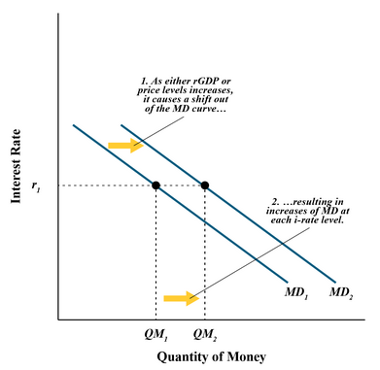
11.3 Changes in Money Demand
All else constant, two main factors that cause shifts in the money demand curve are changes in economic growth and inflation.
An increase in GDP increases transactions and the demand for money increases and the MD curve shifts outwards.
When price levels rise, households and business need more money to pay for goods and services and the demand for money increases and the MD curve shifts outward.

Slide 9
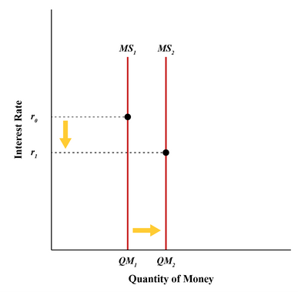
11.4 Supply of Money I
The supply of money is regulated by the Bank of Canada.
  It is shown by a vertical line as the interest rate has no effect on the quantity of money supplied.
When the Bank of Canada wants to increase supply of money the MS curves shifts rightward.
  The Bank conducts an open market operation of purchasing securities to increase money supply.

Slide 10
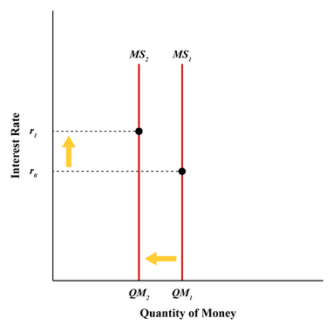
11.4 Supply of Money II
When the Bank of Canada wants to decrease supply of money the MS curves shifts leftward.
  The Bank conducts an open market operation of selling securities to decrease money supply.

Slide 11
11.5 Tale of two interest rates
In conducting monetary policy, it is the short-term nominal rates that are most relevant because the interest rate is most affected by increases or decreases in the money supply.
Often, but not always, are the short-term and long-term interest rates connected. Generally, as short-term rates increase/decrease, so too do long-term rates – but it’s always about the supply and demand for a particular investment time frame.
The market for loanable funds is concerned with long-term real i-rates (recall from Ch 7)…
  Long term rates are for long term decisions (holding investments for future use, or financing a building)

Slide 12
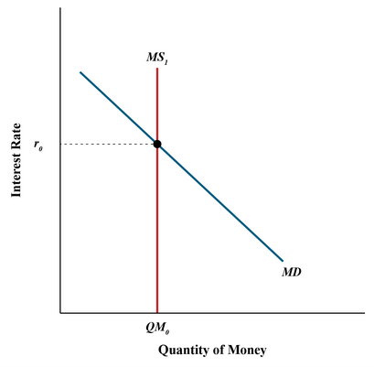
11.6 Money Market and Equilibrium
The money market consists of money demand and money supply functions.
The equilibrium is where money demand intersects with money supply.
The equilibrium interest rate determined in the money market is the short-term interest rate.

Slide 13
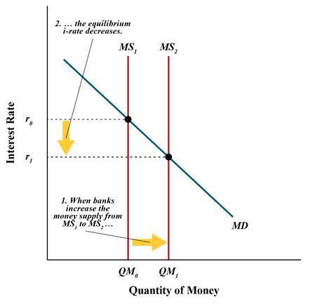
11.7 Expansionary Monetary Policy I
When the Bank of Canada wants to lower the overnight interest rate target, they conduct an open market operation of purchasing securities.
The Bank injects money into the economy through banks and other financial institutions. Retail banks’ reserves increase.
This increases money supply and drives down the interest rate in the short term and keeps the rate close to the overnight target.

Slide 14
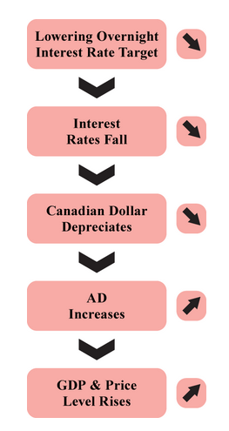
11.7 Expansionary Monetary Policy II
The monetary policy tool of lowering the overnight interest rate target and increasing money supply through an open market operation of purchasing securities will be conducted when the Bank finds the economy is growing slowly.
This policy is adopted to boost economic growth and is called Expansionary Monetary Policy.
The Bank of Canada cannot eliminate a recession but can keep periods of recessions smaller and milder.

Slide 15
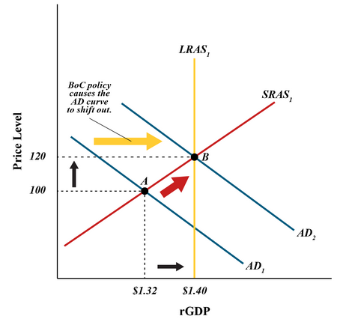
11.7 Expansionary Monetary Policy III
Retail banks obtain money from the Bank of Canada to lend to households and businesses with open market operation of purchasing securities.
Increasing supply of loanable funds (SLF) helps to bring down the long-term interest rates.
As interest rates lower, consumption, investment, and net exports increase.
Dollar depreciates as demand for Canadian dollar decreases with lower interest rates, so exports increase relative to imports.
AD and GDP expands. Price level also rises.

Slide 16

11.7 AD and Investment
Interest rates also affect stock prices – as i-rates decline, the attractiveness of purchasing shares relative to bonds increases, thereby increasing stock prices. Firms will issue more shares at higher prices as it produces more capital for them, which in turn increasing AD through investment.
This Photo by Sounds and Colours is licensed under CC BY-SA-NC

Slide 17
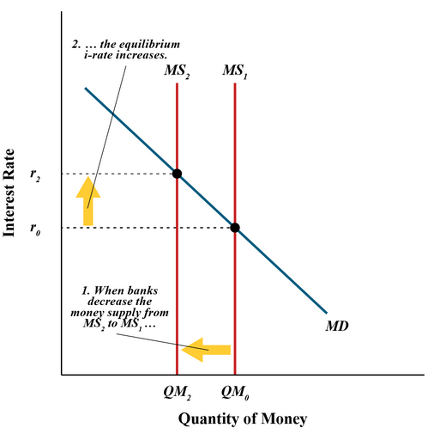
11.8 Contractionary Monetary Policy I
When the Bank of Canada wants to raise the overnight interest rate target, they conduct an open market operation of selling securities.
The Bank gets money from banks and other financial institutions. So banks are left with less reserves.
This decreases money supply in the economy and drives up the interest rate in the short term and keeps the rate close to the overnight target.

Slide 18
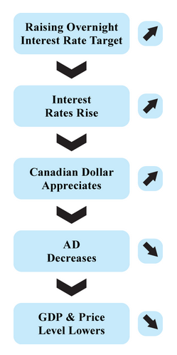
11.8 Contractionary Monetary Policy II
This monetary policy tool of raising the overnight interest rate target and decreasing money supply through an open market operation of selling securities will be conducted when the Bank finds the economy is experiencing inflation.
They adopt this policy to lower the price level, which at the same time result in contracting economic growth.
Therefore, we call this Contractionary Monetary Policy.

Slide 19
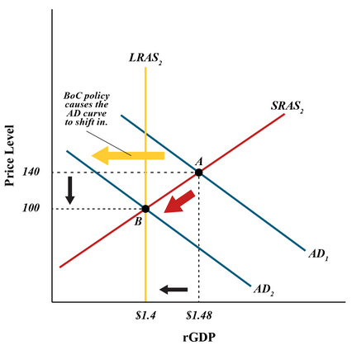
11.8 Contractionary Monetary Policy III
Retail banks are left with less reserves as they give money to the Bank of Canada through open market operations of selling securities. They have less funds to lend out to households and businesses.
Decreasing supply of loanable funds (SLF) raises the long-term interest rates.
As interest rates rise, consumption, investment, and net exports decrease.
Dollar appreciates as demand for Canadian dollar increases with higher interest rates, so exports decrease relative to imports.
AD and GDP contracts. Price level also falls.

Slide 20
11.9 Inflation in Canada in 2022 and Bank of Canada’s Monetary Policy
Canada’s annual inflation rate reached 8.1% in June 2022.
This significant rise in the price level following the Covid outbreak in 2020-2021 was much beyond the Bank’s annual inflation target of 2%.
The Bank consistently kept raising the overnight interest rate throughout 2022.
  In March 2022, the Bank’s overnight rate target was 0.5% which rose to 4.5% in January 2023. (highest overnight interest rate target since Nov 2007)
  The rise in interest rates also helped in cooling down the overheated Canadian housing market.
Following this regular rise in the overnight interest rate targets during 2022, we find the CPI inflation rate started going down slowly, from 8.1% in June to 6.8% in October 2022 and to 5.9% in January 2023.

Slide 21
11.10 Key Terms
Contractionary monetary policy
Expansionary monetary policy
Monetary policy
Money market
Inflation control target
Key policy interest rate
Policy interest rate
Selling securities

