Slide 1
Principles of Macroeconomics
CHAPTER 5: FISCAL POLICY
Unless otherwise noted, this work is licensed under a Creative Commons Attribution-NonCommercial-ShareAlike 4.0 International (CC BY-NC-SA 4.0) license. Feel free to use, modify, reuse or redistribute any portion of this presentation.

Slide 2
Learning Outcomes
At the end of this chapter, you will be able to:
Define the term “Fiscal Policy”
Discuss Federal Government budgets and debts
Analyze the Effects of Fiscal Policy on Real GDP in the AD-AS model
Explain Government Purchase and Tax Multipliers
Discuss Fiscal Policy during Covid 19

Slide 3
12.1 Government of Canada and its Budget I
The Budget is a blueprint for how the Government wants to set the annual economic agenda for Canada.
A basic government budget has two components:
Government expenditures on good and services, G, and transfer payments (G+TR)
Taxes, T is set to generate revenue to finance expenditure
The budget is estimated as the difference between (G+TR) and T

Slide 4
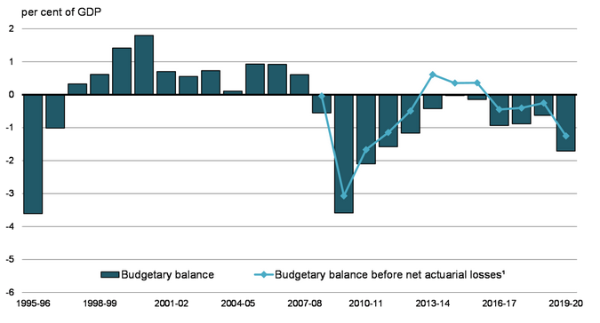
12.1 Government of Canada and its Budget II
The Canadian government faces three budget situations:
Budget deficit: total expenses exceed total revenues (G+TR>T)
Budget surplus: total revenues exceed total expenditures (G+TR<T)
Budget balance: when total expenditure and revenues match (G+TR=T)

Slide 5
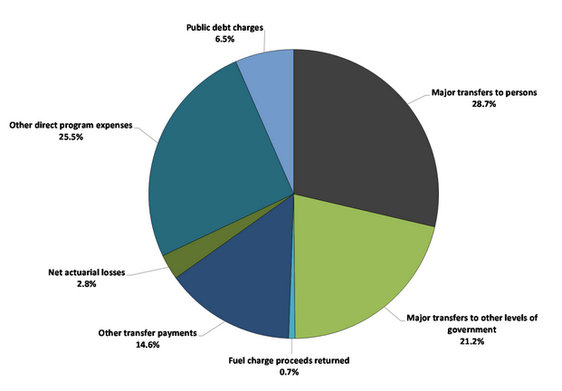
12.1 Government of Canada and its Budget III
Federal expenses can be broken down into four main categories:
transfer payments,
net actuarial losses,
other direct program expenses,
public debt charges.
The main category of transfer payments is major transfers to persons.
This category consists of elderly, EI and children’s benefits, and Canada Emergency Response Benefit given out during Covid 19.

Slide 6
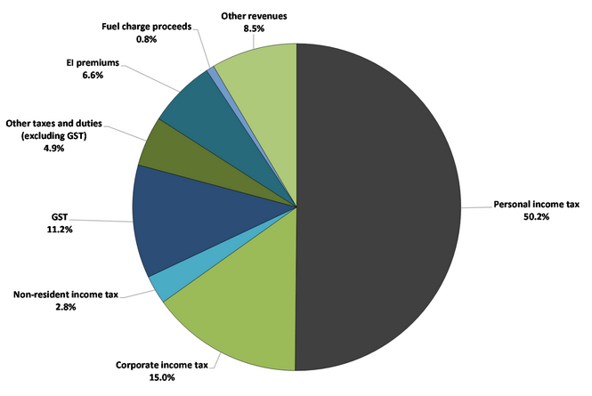
12.1 Government of Canada and its Budget IV
Federal revenues can be broken down into five main categories:
income tax revenues,
other taxes and duties,
Employment Insurance (EI) premium revenues,
fuel charge proceeds,
other revenues.
Within the income tax category, personal income tax revenues are the largest source of federal revenues.

Slide 7
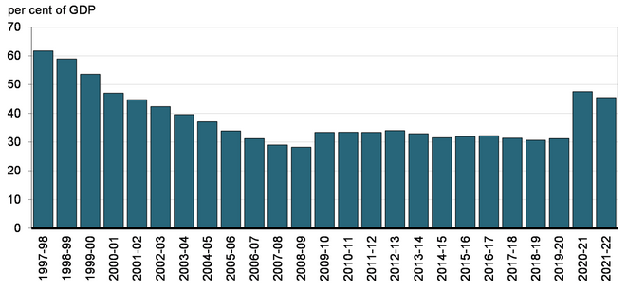
12.1 Government of Canada and its Budget V
As its key fiscal anchor, the government is committed to reducing the accumulated deficit-to-GDP ratio over the medium term.

Slide 8
12.2 Fiscal Policy Tools
The main objective of the Federal Government’s fiscal policy tools is to stimulate the economy out of a recession by increasing GDP or control a rising inflation.
The government controls GDP and/or price levels through:
Government purchases, G
Taxes, T
Transfer payments, TR
Federal, provincial, and local governments could spend tax dollars to stimulate the economy at their own discretion.

Slide 9
12.2 Automatic vs Discretionary Policies
Some types of government expenses and taxes change with respect to the business cycle. During an expansionary phase, unemployment falls, and government’s revenue generation would likely increase while EI claims and transfer payments decrease so government expenses reduce.
During a recession, unemployment increases, and government tax collection (revenues) tend to decrease while claims for unemployment benefits increase as do government expenditures.
These are known as automatic stabilisers.
When the government decides to change taxes or spending to address public policy goals, the policies are discretionary policies.

Slide 10
12.2 Discretionary Policies: Expansionary Fiscal Policy I
If the economy is experiencing recession and the government wants to stimulate the economy by increasing Aggregate demand (AD) and real GDP it would,
Increase G
Decrease T
Increase TR
When the government increases G, it would increase AD and real GDP.
If the government decides to lower tax rates, disposable income increases which increases consumption spending by households. Increase in C increases AD and real GDP.
Lowering corporate tax rates boost firms’ net profitability which could stimulate investment spending by the private sector. AD and real GDP could increase.
Increases in welfare payments, supplements household income. AD and real GDP also increase.

Slide 11
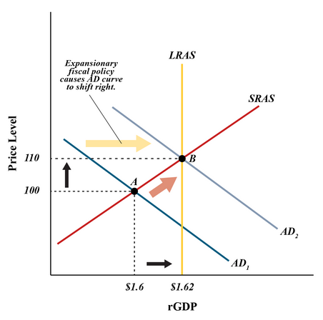
12.2 Expansionary Fiscal Policy II
Aggregate demand and GDP expand, and therefore these policy measures are called Expansionary Fiscal Policy tools as they help in increasing economic growth.
The price level rises due to an increase in AD, as
At point A, the economy faces a recessionary gap.
An increase in AD eliminates the gap takes the economy to full employment at point B.
Expansionary policies help in eliminating recessionary gaps but might result in inflation.
An increase in government expenditure could widen a budget deficit or reduce a budget surplus.

Slide 12
12.2 Discretionary Policies: Contractionary Fiscal Policy I
If the economy is experiencing inflation and the government wants to bring down prices, it would,
Decrease G
Increase T
Decrease TR
When the government decreases G, it would decrease AD and real GDP
If the government increases tax rates disposable income decreases which decreases consumption spending by households. Decrease in C decreases AD and real GDP.
Raising corporate tax rates lowers firms’ net profitability which could negatively affect investment spending by the private sector. AD and real GDP could decrease.
A cut in welfare payments reduces household income. Decrease in AD helps to lower the price level.

Slide 13
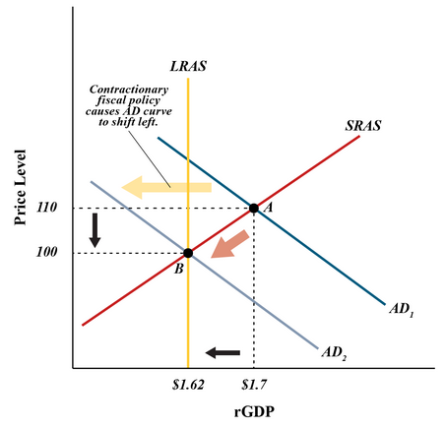
12.2 Contractionary Fiscal Policy II
Decrease in AD helps to lower the price level.
At point A, the economy faces an inflationary gap. A decrease in AD eliminates the gap and brings the economy back to full employment at point B.
Aggregate demand and real GDP contract, and these policy measures are called Contractionary Fiscal Policy tools as they tend to decrease economic growth to lower inflation.
A decrease in government expenditure could also help reduce a budget deficit.

Slide 14
12.3 Government Purchases (Spending) Multiplier I
Government spending on goods and services, G, is a autonomous spending (recall from Ch 8).
This is directly added to the Aggregate demand (AD) equation and increases real GDP.
Increases in autonomous spending bring increases in induced expenditure, because government investment spending are spent and re-spent.
Spending in successive rounds will result in further increases in real GDP through additional induced expenditure, and the overall effect on GDP will likely be much greater than the initial Government spending. This is the multiplier effect.

Slide 15
12.3 Government Purchases (Spending) Multiplier II
The increase in real GDP over successive rounds is determined using the following multiplier formula:
$$Multiplier=\frac{1}{(1−MPC)}$$
Suppose the MPC=75%, therefore, the multiplier is:
$$\frac{1}{(1−0.75)}=\frac{1}{0.25}=4$$
This implies a dollar increase in G increases GDP by $4.
The multiplier can also be calculated as:
$$\frac{Change in real GDP}{Change in G}$$
Change in real GDPChange inG
Suppose a government increase in G by $100billion (expansionary fiscal policy) increases real GDP by $400billion, the multiplier is:
$400billion$100billion=4
which implies a dollar increase in G increases real GDP by $4.

Slide 16
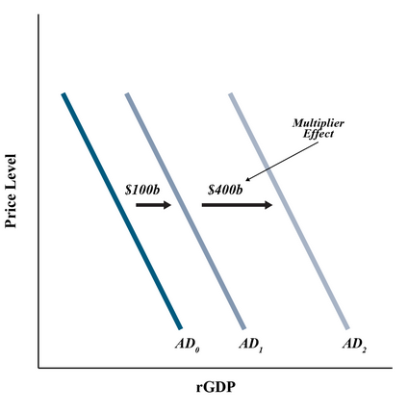
12.3 Government Purchases (Spending) Multiplier III
Example
Suppose a government increase in G by $100billion (expansionary fiscal policy) increases real GDP by $400billion, the multiplier is:
$$\frac{\$400 billion}{\$100 billion}=4$$
which implies a dollar increase in G increases real GDP by $4.

Slide 17
12.4 Tax-Cut Multiplier I
The government can induce spending in the economy through tax cuts.
people will have more disposable income to spend which could increase consumption spending.
The initial benefits could generate more spending for the overall economy.
Tax-cuts also generate a multiplier effect calculated using the formula:
$$\frac{Change in real GDP}{Change in Taxes}$$
A $15 billion tax cut results in increase in real GDP by $20 billion therefore:
$$Tax Multiplier=\frac{\$20 billion}{\$−15 billion}=−1.3$$
So, a dollar cut in taxes will increase real GDP by $1.3
Note the tax multiplier is negative because an increase in GDP is caused by a cut in taxes.

Slide 18
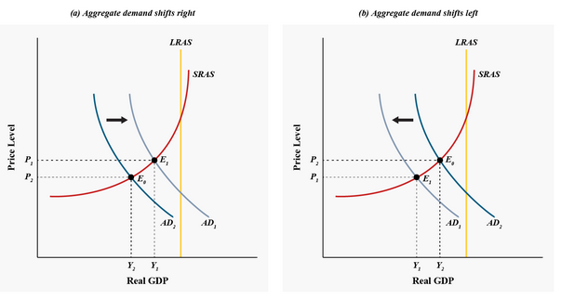
12.4 Fiscal Policies
The two graphs below show the effect of an expansionary policy in lowering the recessionary gap (a) and the effect of a contractionary policy in widening the recessionary gap (b).
At E₀, in both graphs, the economy is facing a recession as the LRAS curve lies to the right of the equilibrium point E₀. In (a), the gap lessens as the AD shifts to the right; in (b) the gap widens as AD shifts to the left.

Slide 19
12.4 Government Expense Multiplier vs Tax-Cut Multiplier
The government expense multiplier is more effective in generating economic growth than the tax cut multiplier because any increase in public investment spending is expected to generate more induced consumption spending through job creation.
The tax cut multiplier does help in generating economic growth but tax cuts may not directly help in adding jobs to the economy.
From a policy perspective, an expansionary fiscal policy using G is more effective for the economy in the long run than lowering taxes.

Slide 20
12.4 Multipliers work both ways
Note: The multiplier applies when G decreases or taxes increase as well as when G increases or taxes decrease.
When G decreases or people face rising taxes, consumer confidence goes down which will reduce aggregate expenditure and will have a larger effect on real GDP than the initial changes.

Slide 21
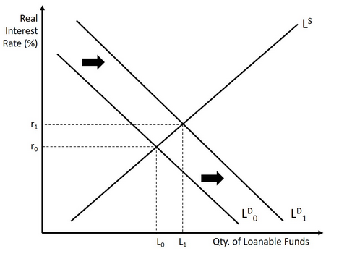
12.5 Possible Obstacles to Fiscal Policy Measures I
In case of expansionary fiscal policy measures, the government increases G and/or transfer payments to lower the effects of a recession.
If the government faces a budget deficit, they have to borrow money to finance expenditure.
As seen earlier, the gap between G+T and TR increases with deficit. Therefore, public dissavings increases.
In this case, the demand for loanable funds increases as the government increases its borrowings.
With this the real interest rate and quantity of loanable funds increase from r₀ to r₁ and L₀ to L₁.

Slide 22
12.5 Possible Obstacles to Fiscal Policy Measures II
Rising interest rates tends to lower investments by the private sector as loans get more costly.
This reduction in investment due to higher interest rate is known as the crowding out effect.
Scaling back on investments, might lower the outcome of the multiplier effect.
An increase in G by $100billion (expansionary fiscal policy) increases real GDP by $400billion, the multiplier is 4. However, due to the presence of crowding out effect, we might see, an increase in G by $100billion increases real GDP by $50billion, so the multiplier is:
$$\frac{\$50 billion}{\$100 billion}=\frac{1}{2}$$
This implies a dollar increase in G increases real GDP by $0.50. Crowding out partially offsets the impact of the multiplier effect.
The Bank of Canada could increase money supply to offset the rise in the interest rates, when fighting to lower the effects of a recession.

Slide 23
12.5 Possible Obstacles to Fiscal Policy Measures III
Another obstacle to the fiscal policy measures are the three lags in conducting fiscal policy tools which are:
Recognition lag: Identifying the correct economic circumstance to identify the appropriate policy tool to be used, through data collection which might take anywhere between three to six months
Implementation lag: Results from the approval of the tool through discussions and arguments by Members of the Parliament to decide on the appropriate course of action. This process takes a great deal of time as there are political consequences of certain policy changes.
Impact lag. The time to assess the impact it is having on our economy, after the plan of action has been implemented. It could take several months or years for fiscal policy to have the desired effect on the economy.

Slide 24
12.6 Supply-Side Effects of Fiscal Policy I
The fiscal policy on the supply-side of the economy has important effects as on the demand side.
a. Lower corporate tax rates increase firms’ net profitability and provides incentive for capital formation which increasing productivity.
This increases short term aggregate supply (SRAS) and long run aggregate supply (LRAS) GDP [effects of expansionary fiscal policies]
b. Higher income tax rates reduces people’s incentive to work affecting labour productivity that negatively affects businesses’ incentives to future investments and production.
c. A rise in capital gains tax reduces people’s incentive to save and invest and decrease capital formation.
Both (b) and (c) decrease short term aggregate supply (SRAS) and long run aggregate supply (LRAS) or potential GDP [effects of contractionary fiscal policies]

Slide 25
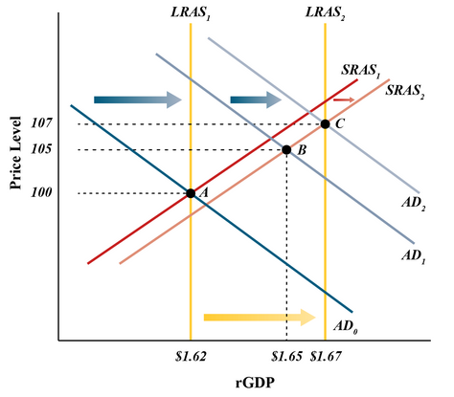
12.6 Supply-Side Effects of Fiscal Policy II
If the government lowers corporate taxes, AD increases through larger investment expenditure as firms’ net earnings increase, and at the same time both short and long run AS also increase through greater productivity from capital creation (Both SRAS and LRAS curves shift rightward).
The economy moves from full employment point A to a full employment level of output at C, where real GDP increases, and the price level also rises.

Slide 26
12.7 Covid 19 and Fiscal Policy
In response to the Covid 19 outbreak the Ministry of Finance announced the COVID-19 Economic Response Plan to help stabilize the economy. This was part of their Expansionary Fiscal Policy.
Legislation was enacted to provide the government additional borrowing authority to fund their response.
Between April 1 and July 2020, the government increased its debt by $323 billion
The reported budgetary deficit was $327.7 billion for the fiscal year ended March 2021.
Federal revenues decreased in 2021 due to the economic impacts on employment levels and business activity.
For the financial year ending March 2022 the government posted a budgetary deficit of $90.2 billion primarily due to an increase in tax revenues as the economy reopened and markets started functioning normally.

Slide 27
12.8 Key Terms
Automatic stabilizers
Balanced budget
Budget deficit
Budget surpluses
Contractionary fiscal policy
Crowding out effect
Discretionary policies
Expansionary fiscal policy
Impact lag
Implementation lag
Multiplier effect
Recognition lag
Tax-cut multiplier

