Slide 1

Principles of Macroeconomics
CHAPTER 1: INTRODUCTION
Unless otherwise noted, this work is licensed under a Creative Commons Attribution-NonCommercial-ShareAlike 4.0 International (CC BY-NC-SA 4.0) license. Feel free to use, modify, reuse or redistribute any portion of this presentation.

Slide 2
Learning Outcomes
At the end of this chapter, you will be able to:
Define Economics
Distinguish between Micro and Macro Economics
Recognize Key Economic terms

Slide 3
1.1 Economics
Economics is a social science that examines how people choose among the alternatives available to them. It is social because it involves people and their behavior. It is a science because it uses, as much as possible, a scientific approach in its investigation of choices.
Notes:
Economics is concerned with the well-being of all people, including those with jobs and those without jobs, as well as those with high incomes and those with low incomes. Economics acknowledges that the production of useful goods and services can create problems of environmental pollution. It explores the question of how investing in education helps to develop workers’ skills. It probes questions like how to tell when big businesses or big labor unions are operating in a way that benefits society as a whole and when they are operating in a way that benefits their owners or members at the expense of others. It looks at how government spending, taxes, and regulations affect decisions about production and consumption.
It should be clear by now that economics covers considerable ground. We can divide that ground into two parts: microeconomics and macroeconomics.

Slide 4

1.1 Scarcity and Choices
Scarcity means that human wants for goods, services and resources exceed what is available. Because of scarcity, we need to make choices.
Choices mean that one alternative is selected over another. Selecting among alternatives involves three ideas central to economics: scarcity, choice, and opportunity cost.
Photo by PxHere, CC0 1.0
Notes:
If you look around carefully, you will see that scarcity is a fact of life. Our resources are limited. At any one time, we have only so much land, so many factories, so much oil, so many people. But our wants, our desires for the things that we can produce with those resources, are unlimited. We would always like more and better housing, more and better education—more and better of practically everything.
If our resources were also unlimited, we could say yes to each of our wants—and there would be no economics. Because our resources are limited, we cannot say yes to everything. To say yes to one thing requires that we say no to another. Whether we like it or not, we must make choices.

Slide 5

1.2 Microeconomics and Macroeconomics
Microeconomics focuses on the actions of individual agents within the economy, like households, workers, and businesses.
Macroeconomics looks at the economy as a whole.
Photo by Mathieu Stern, licensed under the Unsplit License
Notes:
Microeconomics focuses on the actions of individual agents within the economy, like households, workers, and businesses. Some examples of microeconomics include: What determines the products, and how many of each, a firm will produce and sell? What determines the prices a firm will charge? What determines how a firm will produce its products? What determines how many workers it will hire? How will a firm finance it’s business? When will a firm decide to expand, downsize, or even close?
Macroeconomics looks at the economy as a whole. Microeconomics and macroeconomics are not separate subjects, but rather complementary perspectives on the overall subject of the economy. What determines the level of economic activity in a society? In other words, what determines how many goods and services a nation actually produces? What determines how many jobs are available in an economy? What determines a nation’s standard of living?We can determine an economy’s macroeconomic health by examining a number of goals: growth in the standard of living, low unemployment, and low inflation, to name the most important.

Slide 6
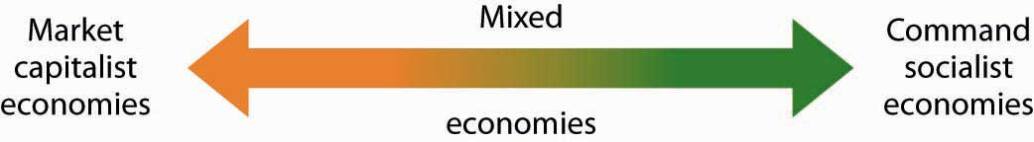
1.2 Organizing Economies
“Economic Systems” by University of Minnesota Libraries, CC-BY-NC-SA (click to enlarge)

Slide 7
1.2 Command Economy
The government decides what goods and services will be produced and what prices it will charge for them.
The government decides what methods of production to use and sets wages for workers.
The government provides many necessities like healthcare and education for free.
Currently, Cuba and North Korea have command economies.

Slide 8
1.2 Market Economy
A market is an institution that brings together buyers and sellers of goods or services, who may be either individuals or businesses.
The New York Stock Exchange is a prime example of a market that brings buyers and sellers together.
In a market economy, decision-making is decentralized.
Market economies are based on the private enterprise: the private individuals or groups of private individuals own and operate the means of production (resources and businesses). (In a command economy, by contrast, the government owns resources and businesses).

Slide 9
1.2 Mixed Economy
Most economies in the real world are mixed.
They combine elements of command and market systems.
The Canadian economy is positioned toward the market-oriented end of the spectrum. Some countries in Europe (Belarus) and Latin America (Venezuela), while primarily market-oriented, have a greater degree of government involvement in economic decisions than the Canadian economy.

Slide 10

1.3 Scarcity and the Fundamental Economic Questions
The choices we confront in the society as a result of scarcity raise three sets of issues. Every economy must answer the following BIG questions:
What should be produced?
How should goods and services be produced?
For whom should goods and services be produced?
Photo by Jezael Melgoza, licensed under the Unsplit License
Notes:
The choices we confront in the society as a result of scarcity raise three sets of issues. Every economy must answer the following BIG questions:

Slide 11
1.3 What Should Be Produced?
The economy’s scarce resources to produce one thing requires giving up another.
Producing better education, for example, may require cutting back on other services, such as health care.
A decision to preserve a wilderness area requires giving up other uses of the land. Every society must decide what it will produce with its scarce resources.

Slide 12
1.3 How Should Goods and Services Be Produced?
There are all sorts of choices to be made in determining how goods and services should be produced.
Should a firm employ a few skilled or a lot of unskilled workers?
Should it produce in its own country, or should it use foreign plants?
Should manufacturing firms use new or recycled raw materials to make their products?
Goods and services are produced by factors of production.

Slide 13
1.3 For Whom Should Goods And Services Be Produced?
If a good or service is produced, a decision must be made about who will get it.
Who gets the good or service depend on the income that people earn.

Slide 14
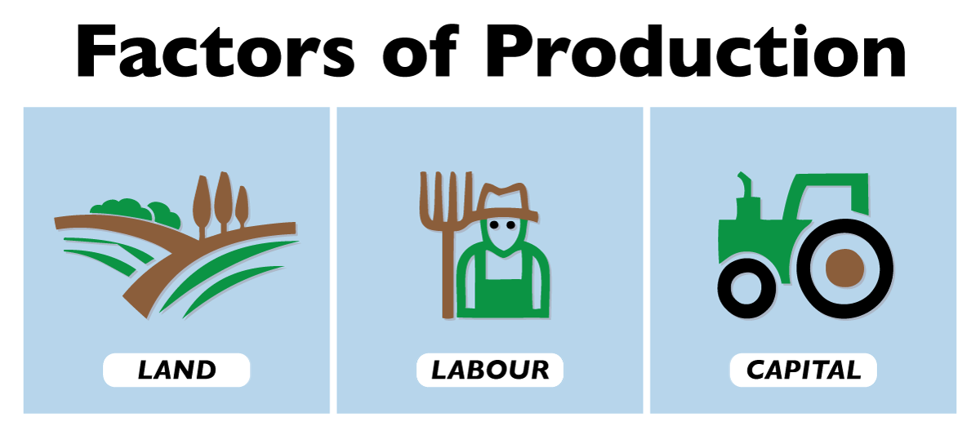
1.3 Factors of Production
The factors of production in an economy are its labour, capital, natural resources, and technology.

Slide 15
1.3 Labour
Is the human effort that can be applied to production.
People who work to repair tires, pilot airplanes, teach children, or enforce laws are all part of the economy’s labors.
People who would like to work but have not found employment—who are unemployed—are also considered part of the labors available to the economy.

Slide 16
1.3 Capital
Tools such as hammers, screwdrivers, and wrenches are also capital.
Transportation equipment, such as cars and trucks, is capital. Facilities such as roads, bridges, ports, and airports are capital. Buildings, too, are capital; they help us to produce goods and services.
Capital does not consist solely of physical objects.
Computer software used by business firms or government agencies to produce goods and services is capital.
Capital may thus include physical goods and intellectual discoveries.

Slide 17
1.3 Natural Resources
There are two essential characteristics of natural resources:
The first is that they are found in nature—that no human effort has been used to make or alter them.
The second is that they can be used to produce goods and services. That requires knowledge; we must know how to use the things we find in nature before they become resources.

Slide 18
1.3 Technology and Entrepreneurship
Goods and services are produced using the factors of production available to the economy. Two things play a crucial role in putting these factors of production to work:
The first is technology, the knowledge that can be applied to the production of goods and services.
The second is an individual who plays a key role in a market economy: the entrepreneur. An entrepreneur is a person who, operating within the context of a market economy, seeks to earn profits by finding new ways to organize factors of production.

Slide 19

1.4 Choices
Choices made in Pursuing Self-Interest
Choices, Opportunity Cost, and Trade–Off
Choices and Marginal thinking
Photo by Letizia Bordoni, Unsplit License

Slide 20
1.4 Choices Made in Pursuing Self-Interest
Perhaps more than anything else, it is the economist’s answer to this question that distinguishes economics from other fields.
Economists assume that individuals make choices that they expect will create the maximum value of some objective, given the constraints they face. Economists assume that people’s objectives will be those that serve their own self-interest. Economists assume, for example, that the owners of businesses seek to maximize profit.
Given the assumed goal of profit maximization, economists can predict how firms in an industry will respond to changes in the markets in which they operate.
Notes:
Due to relatively higher labor costs in the West, for example, economists are not surprised to see firms moving some of their manufacturing operations overseas. Similarly, in studying consumers, economists assume that individual consumers make choices aimed at maximizing their level of satisfaction.

Slide 21
1.4 Choices, Opportunity Cost, and Trade–Off
It is within the context of scarcity that economists define, perhaps the most important concept in all of economics, the concept of opportunity cost.
Opportunity cost: is the value of the best alternative forgone in making any choice. The opportunity cost is the value of the best other use to which you could have put your time. A good is scarce if the choice of one alternative requires that another be given up. The existence of alternative uses forces us to make choices.
The opportunity cost of any choice is the value of the best alternative forgone in making it. This is the trade-off that individuals face in making choices. As decision-makers, we have to make trade-offs on what we do with finite resources.
Notes:
If you choose to spend $20 on a potted plant, you have simultaneously chosen to give up the benefits of spending the $20 on pizzas or a paperback book or a night at the movies. If the book is the most valuable of those alternatives, then the opportunity cost of the plant is the value of the enjoyment you otherwise expected to receive from the book. The concepts of scarcity, choice, and opportunity cost are at the heart of economics.

Slide 22
1.4 Choices and Marginal Thinking
Economists argue that most choices are made “at the margin.” The margin is the current level of activity. Think of it as the edge from which a choice is to be made. A choice at the margin is a decision to do a little more or a little less of something. Assessing choices at the margin can lead to extremely useful insights.

Slide 23

1.4 Marginal Benefit and Marginal Cost
Marginal Analysis is the process of breaking down a decision into a series of ‘yes or no’ decisions. More formally, it is an examination of the additional benefits of an activity compared to the additional costs incurred by that same activity. If benefits > costs, this is the right choice for a rational thinker.
Photo by Florian Schmetz, licensed under the Unsplit License
Notes:
Most decisions involve doing a little more or a little less of something. Such as: should you watch an extra hour of TV, or study instead? Marginal cost and benefit (MC and MB): the additional cost or benefit associated with a small addition to some action. Comparing MC and MB is known as Marginal Analysis.

Slide 24
1.5 Economics – Social Science & Policy Tool
Economists distinguish between two types of statements: Positive and Normative. Two kinds of assertions in economics can be subjected to testing.
A statement of fact or a hypothesis is a positive statement.
A normative statement is one that makes a value judgment.
Notes:
Economists distinguish between two types of statements: Positive and Normative. Two kinds of assertions in economics can be subjected to testing.
A statement of fact or a hypothesis is a positive statement. Although people often disagree about positive statements, such disagreements can ultimately be resolved through investigation such as “the unemployment rate in Canada is 6 percent,” or “It is raining outside” or “Microsoft is the largest producer of operating systems for personal computers in the world.”
There is another category of assertions, however, for which investigation can never resolve differences. A normative statement is one that makes a value judgment. Such a judgment is the opinion of the speaker; no one can “prove” that the statement is or is not correct. Here are some examples of normative statements in economics: “We ought to do more to help the poor.” “People in Canada should save more.” “The government should raise minimum wages.” The statements are based on the values of the person who makes them. They cannot be proven false.

Slide 25

1.6 Economic Model
A theory is a simplified representation of how two or more variables interact with each other.
A hypothesis is an assertion of a relationship between two or more variables that could be proven to be false.
Photo by Kier In Sight, licensed under the Unsplit License
Notes:
The purpose of a theory is to take a complex, real-world issue and simplify it down to its essentials. If done well, this enables the analyst to understand the issue and any problems around it. A good theory is simple enough to understand, while complex enough to capture the key features of the object or situation you are studying. Sometimes economists use the term model instead of theory. Strictly speaking, a theory is a more abstract representation, while a model is a more applied or empirical representation Models in economics also help us to generate hypotheses about the real world.
The statement “Increased solar radiation increases the rate of plant growth” is a hypothesis; experiments could be done to show the relationship between solar radiation and plant growth. If solar radiation were shown to be unrelated to plant growth or to retard plant growth, then the hypothesis would be demonstrated to be false. If a test reveals that a particular hypothesis is false, then the hypothesis is rejected or modified. In the case of the hypothesis about solar radiation and plant growth, we would probably find that more sunlight increases plant growth over some range but that too much can actually retard plant growth. Such results would lead us to modify our hypothesis about the relationship between solar radiation and plant growth. Economists often use statistical methods to test a hypothesis.
If the tests of a hypothesis yield result consistent with it, then further tests are conducted. A hypothesis that has not been rejected after widespread testing and that wins general acceptance is commonly called a theory. A theory that has been subjected to even more testing and that has won virtually universal acceptance becomes a law.

Slide 26
1.7 Key Terms
Capital
Choices
Command Economy
Economics
Hypothesis
Labour
Macroeconomics
Marginal Analysis
Market Economy
Microeconomics
Mixed Economy
Normative Statement
Positive Statement
Scarcity
Technology and Entrepreneurship Theory

