Slide 1
Principles of Macroeconomics
CHAPTER 2: SCARCITY AND CHOICES
Unless otherwise noted, this work is licensed under a Creative Commons Attribution-NonCommercial-ShareAlike 4.0 International (CC BY-NC-SA 4.0) license. Feel free to use, modify, reuse or redistribute any portion of this presentation.

Slide 2
Learning Outcomes
At the end of this chapter, you will be able to:
Describe how market systems work
Analyze Production Possibilities Frontier (PPF) and opportunity cost
Explain Comparative Advantage and Trade

Slide 3
2.1 The Time at Our Disposal is Limited
There are only twenty-four hours in the day. We must choose between the different uses to which they may be put. Everywhere we turn, if we choose one thing, we must relinquish others which, in different circumstances, we will wish not to have relinquished. Scarcity of means to satisfy given ends is an almost ubiquitous condition of human nature.
Photo by Akram Hyseyn Unsplash License

Slide 4
2.1 Economic Model
An Economic Model is a simplified framework that is designed to illustrate complex processes.
The Two Basic Economic Models
Circular Flow Model
Production Possibility Model
Notes:
An economic model is a simplified framework that is designed to illustrate complex processes. Oftentimes in introductory Microeconomics, these models seem oversimplified because they hold certain variables constant. While one should remain aware of this, these models are still useful. Holding some information constant can help us understand a concept without being overwhelmed by a vast number of influencing factors. Economic models are the building blocks of most modern economic
theories. By understanding these models, we can develop a mindset to understand the economic world.
The two basic Economic Models we shall consider here are:
Circular Flow Model
Production Possibility Model

Slide 5
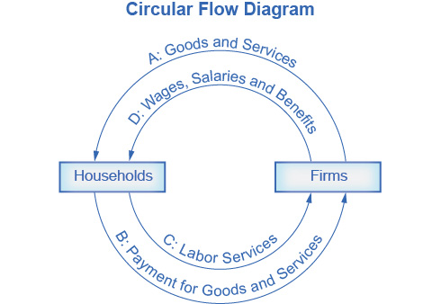
2.2 Circular Flow Model
The Circular Flow Diagram pictures the economy as consisting of two groups—households and firms—that interact in two markets: the goods and services market in which firms sell and households buy and the labor market in which households sell labor to business, firms or other employees.
Notes:
Fig 2.1 Circular Flow Diagram The Circular Flow Diagram The circular flow diagram shows how households and firms interact in the goods and services market, and in the labor market. The direction of the arrows shows that in the goods and services market, households receive goods and services and pay firms for them. In the labor market, households provide labor and receive payment from firms through wages, salaries, and benefits.
Firms produce and sell goods and services to households in the market for goods and services (or product market). Arrow “A” indicates this. Households pay for goods and services, which becomes the revenues to firms. Arrow “B” indicates this. Arrows A and B represent the two sides of the product market. Where do households obtain the income to buy goods and services? They provide the labor and other resources (e.g. land, capital, raw materials) firms need to produce goods and services in the market for inputs (or factors of production). Arrow “C” indicates this. In return, firms pay for the inputs (or resources) they use in the form of wages and other factor payments. Arrow “D” indicates this. Arrows “C” and “D” represent the two sides of the factor market.

Slide 6
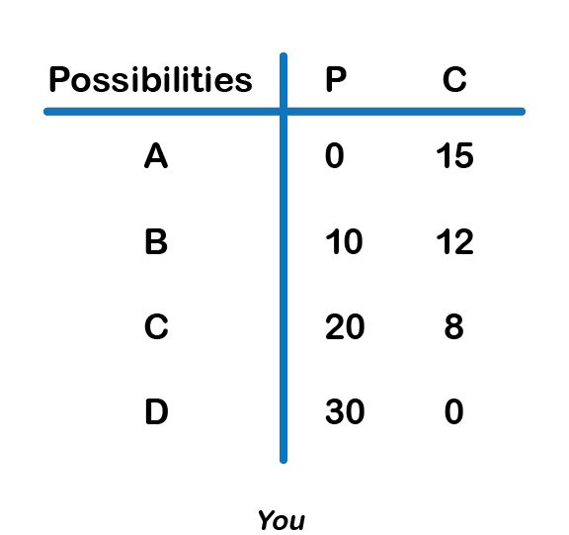
2.3 Production Possibility Model
EXAMPLE
You are stranded on a tropical island alone. On this island, there are only two foods: pineapples and crabs. In other words, you face a trade-off: any time you spend harvesting pineapples is time that cannot be spent looking for crabs. You are forced to make a decision on how to allocate the scarce resource of time.
This scarcity limits the amount of total production.

Slide 7
2.3 Production Possibility Model
Marginal (Opportunity) Cost of an action. In this case, since you have to give up three crabs to produce 10 pineapples, the marginal cost for one pineapple is 3/10 of a crab.
A Production Possibility Frontier (PPF) is the graphical representation of Figure 2.2. It represents the maximum combination of goods that can be produced given available resources and technology. Each point represents one of the combinations from Figure 2.2.
Notes:
Figure 2.2 displays a table showing several different combinations of goods that can be harvested in a given week. The table is very logical – if you spend all your time catching crabs, you will have no pineapples. Notice that you can produce either all crabs, all pineapples, or a mix of the two.
Assume you choose to only catch crabs. How many would have to be given up in order to obtain ten pineapples? In this example, three. This is an important concept; even though our scarce resource is time, we can measure the cost of a good, in this case, pineapples, in terms of the foregone good, in this cases crabs.
Notice how the marginal cost changes as you harvest more pineapples. To produce the next ten pineapples, it costs four crabs, and the next ten costs eight. Now there are no more crabs to give up. While marginal opportunity cost is not always increasing, it is intuitive to think that the more pineapples you pick, the harder they will be to find, and therefore the more time you will have to give up to harvest 10 more.

Slide 8
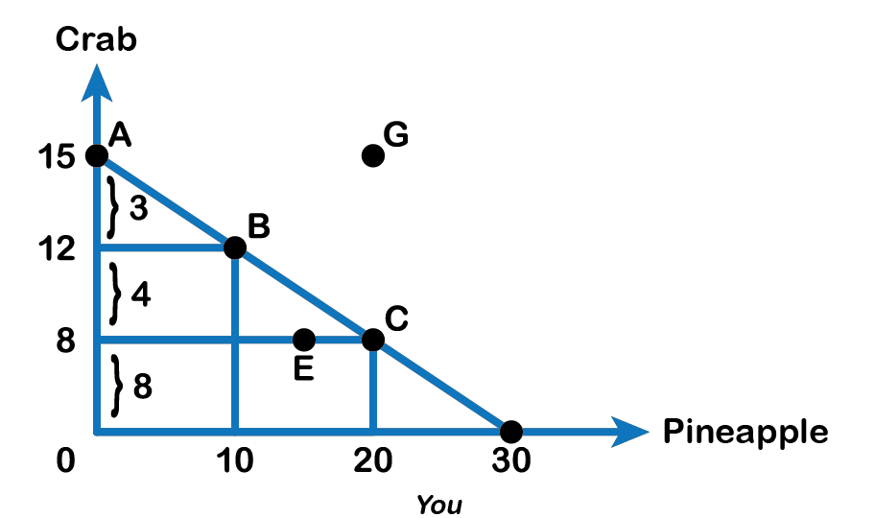
2.3 Production Possibility Model Continued
In our example, while we would love to produce 30 pineapples and 30 crabs, this is out of our realm of possible production. In other words, it is not a point on our PPF.
Any point on the PPF is efficient.
A point outside (G) is unattainable while a point inside (E) is inefficient
Fig 2.3
Notes:
Using our terminology from before, each point along our PPF (i.e. Point A) is efficient (in a one-person world) since there is no way to get more pineapples without giving up some crabs and vice-versa. If we are inside the PPF (i.e. Point B), we are not fully using our resources. In this case, we can produce more pineapples without having to give up any more crabs. This point is inefficient. Points outside the PPF (i.e. Point C), while preferable, are unattainable given constraints in resources and time.

Slide 9
2.3 PPF and Increasing Opportunity Cost
The law of increasing opportunity cost : which holds that as the production of a good or service increases, the marginal opportunity cost of producing it increases as well.
Photo by micheile || visual stories Unsplit License
Notes:
Using our analysis of Marginal Cost (MC) from before, we see that the Slope (absolute value) of the PPF is the amount of the good on the vertical axis given up to obtain additional units of the good on the horizontal axis. Recall that slope is calculated using rise overrun. From Fig 2.2, we see that to gain 10 additional pineapples (from 10 to 20 units), we give up 4 crabs (12 to 8 units). To obtain another 10 units of pineapples (from 20 to 30 units), we give up 8 crabs (8 to 0 units). As we move down the PPF, the slope and MC increase. This pattern is common enough that economists have given it a name: the law of increasing opportunity cost.
This happens because some resources are better suited for producing certain goods and services instead of others. When the producer wants to obtain more pineapples and devotes more resources (time and effort) to it, there will be fewer resources available for obtaining the other goods, crab. Therefore, more pineapples result in the greater sacrifice of crabs.

Slide 10
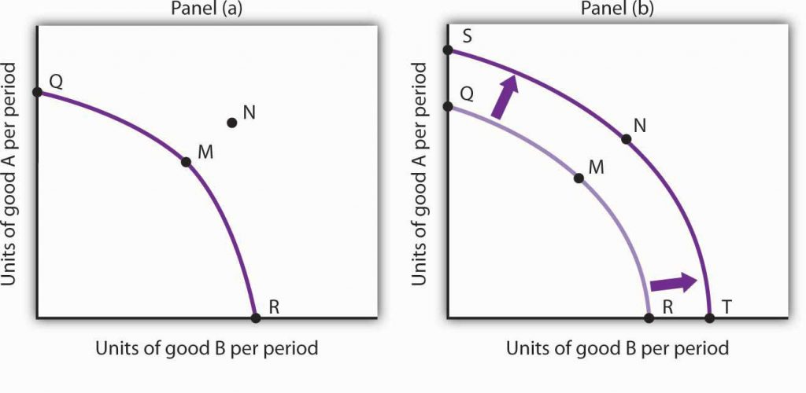
2.4 Economic Growth
Economic Growth: allows countries, individuals, or firms to reach points outside their PPF. Factors that allow shifts in countries’ PPF, resulting in a change in attainable output include:
A Shift in Technology:.
More Physical capital,
Education or Training
Fig 2.4 Economic Growth and the Production Possibilities Curve
Notes:
Economic Growth: allows countries, individuals, or firms to reach points outside their PPF. Factors that allow shifts in countries’ PPF, resulting in a change in attainable output include:
A Shift in Technology: If you were to invent a computer system that showed the location of crabs and pineapples on the island, you would be able to produce more of both goods, shifting the PPF outward.
More Physical capital, Education or Training: If you were to become more skilled at harvesting pineapples or crabs and obtain more equipment, your attainable output would increase, shifting the PPF outward.
An increase in the physical quantity or in the quality of factors of production available to an economy or a technological gain will allow the economy to produce more goods and services; it will shift the economy’s production possibilities curve outward. The process through which an economy achieves an outward shift in its production possibilities curve is called economic growth. An outward shift in a production possibilities curve is illustrated in Fig 2.4. In Panel (a), a point such as N is not attainable; it lies outside the production possibilities curve. Growth shifts the curve outward, as in Panel (b), making previously unattainable levels of production possible.

Slide 11
2.5 Trade and Economic Growth
One of the most important implications of the concepts of the production possibilities curve relates to International Trade. The evidence that international trade confers overall benefits on economies is very strong.
Trade generates economic growth by bringing in technology and/or capital, thus increasing individual's and society's wealth.
To understand the benefits of trade, or why we trade in the first place, we need to understand the concepts of comparative and absolute advantage.
Notes:
Trade has accompanied economic growth in Canada and around the world. Many economies that have shown the most rapid growth in the last few decades—for example, Japan, South Korea, China, and India—have done so by dramatically orienting their economies toward international trade. To understand the benefits of trade, or why we trade in the first place, we need to understand the concepts of comparative and absolute advantage.

Slide 12
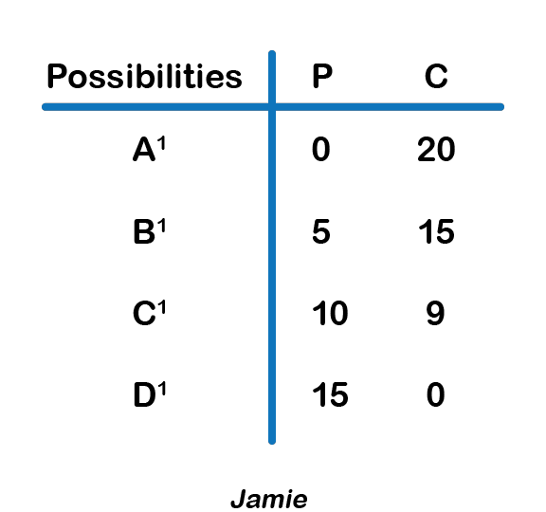
2.5 PPF and International Trade
Jamie has an absolute advantage in crabs as he can produce a maximum of 20 while you can produce a maximum of 15 crabs.
You have an absolute advantage in pineapples as you can grow a maximum of 30 while Jamie can produce a maximum of 15.
The graph below (Fig 2.6) shows Jamie’s production possibilities.
Fig 2.5
Notes:
Continuing the pineapple and crab example from Fig 2.2, suppose another person, Jamie, becomes stranded on the island with you. You could choose to avoid him and live your own separate lives, or you could work together to improve each other’s well-being. It turns out Jamie has different skills than you – he is better at producing crabs and you are better at growing pineapples. Jamie’s production possibilities are shown in the table below (Fig 2.5).
In this case, where one person or group is better at producing a good, we say they have an Absolute Advantage in the production of the good. In this example, from Fig 2.2 and 2.5, Jamie has an absolute advantage in the production of crab as he can produce a maximum of 20 crabs while you can produce a maximum of 15 crabs, and you have an absolute advantage in producing pineapples as you can grow a maximum of 30 pineapples while Jamie can produce a maximum of 15 only.

Slide 13
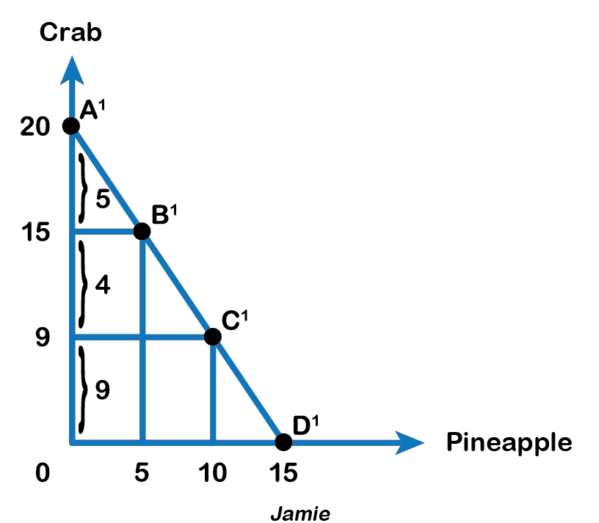
2.5 Comparative Advantage
Comparative Advantage. When one can produce a good at a lower opportunity cost than another, the person is said to be efficient or have a comparative advantage in producing that good.
Fig 2.6
Notes:
Finding out Comparative Advantage
Refer to Fig 2.3. When you produce 15 crabs, you give up 30 pineapples. So your opportunity cost of producing 1 crab is 2 pineapples. Referring to Fig 2.6, when Jamie produces 20 crabs, he gives up 15 pineapples. So Jamie’s opportunity cost of producing 1 crab is 0.75 pineapples. Because Jamie has a lower opportunity cost in producing crabs, he has a comparative advantage in crabs. Similarly, we can find your opportunity cost in producing 1 pineapple is 0.5 crabs and Jamie’s opportunity cost is 1.33 crabs. Therefore, we can infer you have a lower opportunity cost or comparative advantage in producing pineapples.

Slide 14
2.5 Comparative Advantage and Specialization
When one has a comparative advantage in producing a good, that person should specialize in producing that good. This specialization in production results in gains from trade, as each person or country, can focus on what it can produce at the lowest cost and trade it with its partner.
Notes:
Note that even though Jamie had the absolute advantage in both goods, his opportunity cost of producing crabs was still higher, since opportunity or marginal cost is based on a trade-off between the two goods. We can liken this example to trade between Canada and a developing country. Canada may be better at producing both computers and textiles (the absolute advantage) but the advantages we have in producing computers are far greater. Any hour we have to give up to produce textiles comes at a much higher cost to us than it would to a developing country, giving us the comparative advantage at producing computers, and the developing country the advantage at producing textiles.
The island example is no different. Even though Jamie is better at producing pineapples, what Jamie is really an expert at is producing crabs, so having to give up time spent catching crabs comes at a high cost. Therefore, you should specialize in producing pineapples and export them to Jamie while Jamie should specialize in producing crabs and export them to you.

Slide 15
2.6 Gains from Trade
Before Trade Production Possibilities:
You have a comparative advantage in pineapples, you should specialize in
pineapples (max 30 pineapples).
Jamie specializes in crabs and produces a maximum of 20 crabs.
In this situation, both players are producing only the goods they have the comparative advantage in.
 | Pineapple | Crab
You | 20 | 8
Jamie | 10 | 9
Notes:
Suppose, before trade you choose to produce 20 pineapples and 8 crabs and Jamie chooses to produce 10 pineapples and 9 crabs.

Slide 16
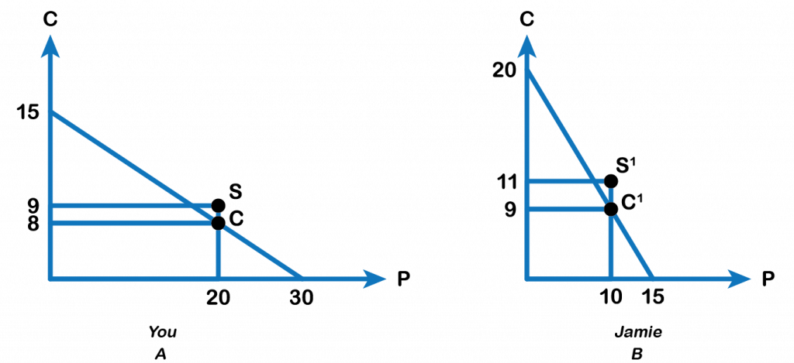
2.6 Exchange
Exchange: If you and Jamie choose to trade 10 pineapples for 9 crabs, then after trade you are left with 20 pineapples and 9 crabs (point S in Fig 2.8 Panel [A]) while Jamie is left with 10 pineapples and 11 crabs (Point S’ in Fig 2.8 Panel [B])
Fig 2.8
Notes:
Therefore, after the trade, You gain +1 crab, and Jamie gains +2 crabs. Both trading partners move to a point outside their current PPF, resulting in economic growth. Figure 2.8 (Panels (A) and (B)) and Fig 2.9 below show Yours’s and Jamie’s production possibilities both before and after the trade.

Slide 17
2.6 Implications
 | You |  | Jamie
 | Pineapples | Crabs | Pineapples | Crabs
Before trade production | 20 | 8 | 10 | 9
Specialization | 30 | 0 | 0 | 20
After trade production and consumption | 20 | 9 | 10 | 11
Gains from trade | - | +1 | - | +2
The implications of our model for trade are that,
trade is mutually beneficial;
certainly, redistributes resources among the two trading partners;
leads to specialization and greater skills.

Slide 18
2.7 Key Terms
Absolute Advantage
Circular Flow Diagram (Fig 2.1)
Comparative Advantage
Economic Growth
Economic Model
Production Possibility Frontier (PPF)
Specialization
The law of increasing opportunity cost

