Slide 1

Principles of Macroeconomics
CHAPTER 4: GDP and Measurements of Production
Unless otherwise noted, this work is licensed under a Creative Commons Attribution-NonCommercial-ShareAlike 4.0 International (CC BY-NC-SA 4.0) license. Feel free to use, modify, reuse or redistribute any portion of this presentation.

Slide 2
Learning Outcomes
At the end of this chapter, you will be able to:
Define gross domestic product and its four major spending components and illustrate the various flows using the circular flow model.
Distinguish between measuring GDP as the sum of the values of final goods and services and as the sum of values added at each stage of production.
Distinguish between Real and Nominal gross domestic products
Distinguish between GDP and GNP

Slide 3
4.1 Definition of Gross Domestic Product
GDP is defined as the market value of all final goods and services produced within an economy in a given time period.
Market Value is calculated as price multiplied by the quantity produced of a good.
Intermediate Goods are used in the production of final goods. Their value is not counted towards GDP, since their value is included in the value of the final goods they are used to produce.
Final Goods are finished products whose value is counted towards the GDP.
“Within” an economy refers to goods produced within the geographical boundaries of a country.

Slide 4
4.1 GDP Measured by Components of Demand I
GDP=consumption (C) + private investment (I) + government purchases( G) + net exports (X)
Or
GDP=C + I + G + NX, where NX = Exports (X) – Imports (M)
Notes:
Who buys all of this production? We can divide this demand into four main parts: consumer spending (consumption), business spending (private investment), government spending on goods and services (government), and spending on net exports (net exports).

Slide 5
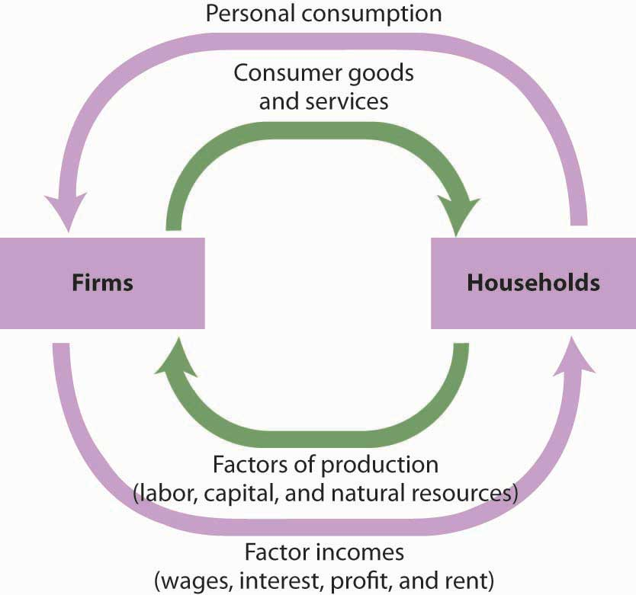
4.1 GDP Measured by Components of Demand II
Personal Consumption is a flow variable that measures the value of goods and services purchased by households during a time period. Purchases by households of groceries, health-care services, clothing, and automobiles—all are counted as consumption.
Notes:
The production of consumer goods and services accounts for about 70% of total output. Because consumption is such a large part of GDP, economists seeking to understand the determinants of GDP must pay special attention to the determinants of consumption.
The figure above presents a circular flow model for an economy that produces only personal consumption goods and services.

Slide 6
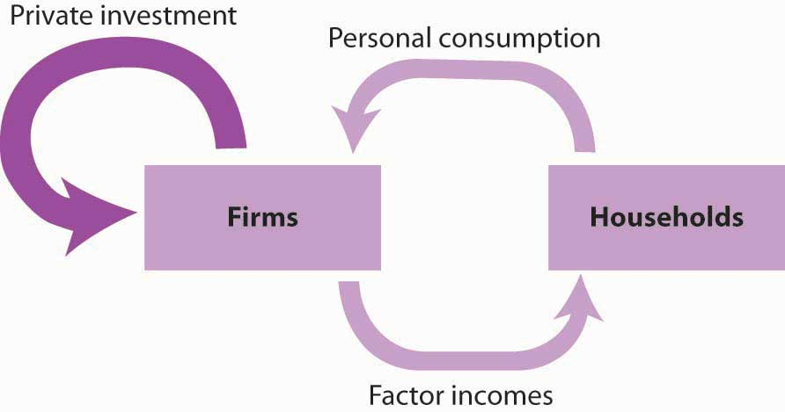
4.1 GDP Measured by Components of Demand III
Private Investment
Gross private domestic investment is the value of all goods produced during a period for use in the production of other goods and services. Like personal consumption, gross private domestic investment is a flow variable. It is often simply referred to as “private investment.”
Notes:
A hammer produced for a carpenter is private investment.
A printing press produced for a magazine publisher is private investment, as is a conveyor-belt system produced for a manufacturing firm.
Capital includes all the goods that have been produced for use in producing other goods; it is a stock variable. Private investment is a flow variable that adds to the stock of capital during a period.
Gross private domestic investment includes three flows that add to or maintain the nation’s capital stock: expenditures by business firms on new buildings, plants, tools, equipment, and software that will be used in the production of goods and services; expenditures on new residential housing; and changes in business inventories. If a clothing store stocks 1,000 pairs of jeans, the jeans represent an addition to inventory and are part of gross private domestic investment.

Slide 7
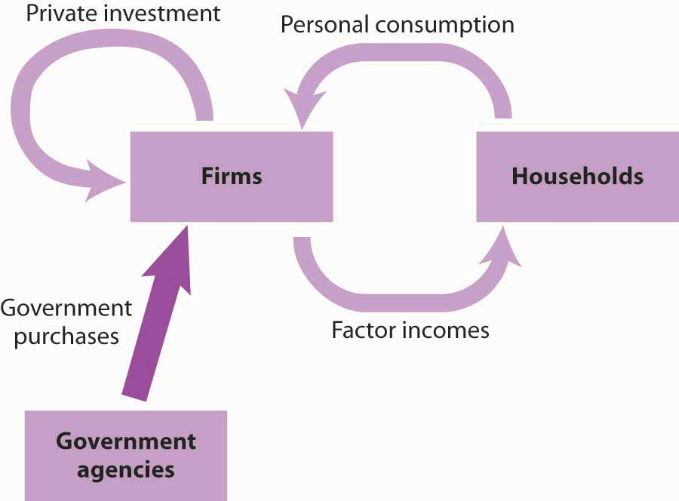
4.1 GDP Measured by Components of Demand IV
Government Purchases
Government purchases are the sum of purchases of goods and services from firms by government agencies plus the total value of output produced by government agencies themselves during a time period.
Notes:
Government agencies at all levels purchase goods and services from firms. They purchase office equipment, vehicles, buildings, janitorial services, and so on. Many government agencies also produce goods and services. Police departments produce police protection. Public schools produce education. The Banks produce financial services.

Slide 8
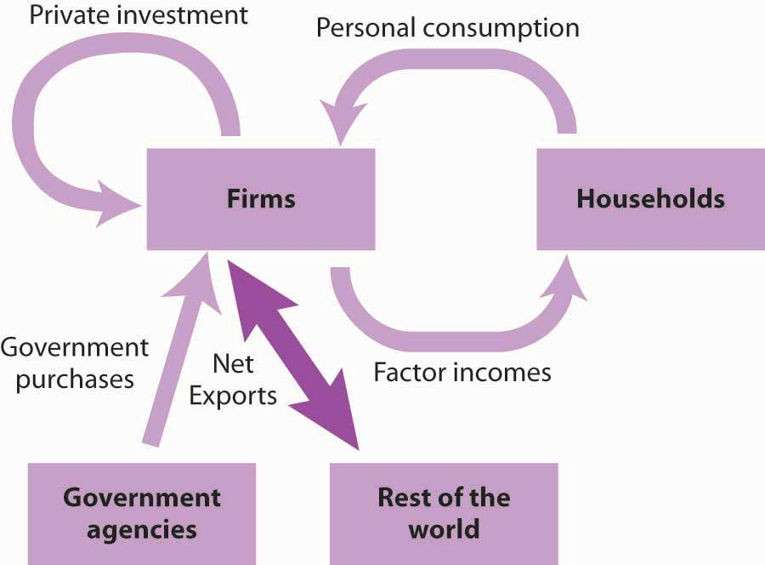
4.1 GDP Measured by Components of Demand V
Net Exports
Net exports can be negative if imports exceed exports. Negative net exports constitute a trade deficit. The amount of the deficit is the amount by which imports exceed exports. When exports exceed imports there is a trade surplus.
Notes:
Sales of a country’s goods and services to buyers in the rest of the world during a particular time period represent its exports. A purchase by a buyer of a Ford Taurus produced in the Canada by someone in Japan is Canada’s export. Exports also include such transactions as the purchase of accounting services from a Toronto accounting firm by a shipping line based in Hong Kong. Imports are purchases of foreign-produced goods and services by a country’s residents during a period.

Slide 9
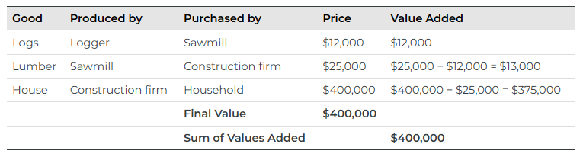
4.2 Value Added Approach
Another approach to estimating the value of final production is to estimate for each stage of production the value added, the amount by which the value of a firm’s output exceeds the value of the goods and services the firm purchases from other firms.
Notes:
If we sum the value added at each stage of the production of a good or service, we get the final value of the item. The example shown here involves the construction of a house, which is produced from lumber that is, in turn, produced from logs.

Slide 10
4.3 Goods not in GDP
The sales of used goods are not included because they were produced in a previous year and are part of that year’s GDP. The entire underground economy of services paid “under the table” and illegal sales should be counted, but is not, because it is impossible to track these sales.
Notes:
Statistics Canada estimates underground economic activity for 2013 totaled $45.6 billion in Canada, or about 2.4% of gross domestic product.
Also, production of some goods — such as home production as when you make your breakfast—is not counted because these goods are not sold in the marketplace. Therefore, the estimated value of GDP is an underrepresentation of the actual production taking place in an economy in a given time period.

Slide 11
4.4 Income Approach to measuring GDP
Gross domestic income (GDI) equals the total income generated in an economy by the production of final goods and services during a particular period. It is a flow variable. Because an economy’s total output equals the total income generated in producing that output, GDP = GDI. We can estimate GDP either by measuring total output or by measuring total income.

Slide 12
4.5 Nominal and Real GDP I
Calculating Nominal GDP
As mentioned, nominal GDP is the value of the goods and services produced in the stated year.
Nominal GDP = Price × Quantity
Therefore, the nominal GDP is simply the sum of all of the individual contributions.
Notes:
The distinction is between nominal and real measurements, which refer to whether or not inflation has distorted a given statistic. Looking at economic statistics without considering inflation is like looking through a pair of binoculars and trying to guess how close something is: unless you know how strong the lenses are, you cannot guess the distance very accurately.

Slide 13
4.5 Nominal and Real GDP II
Calculating Real GDP
The real GDP calculation requires a base year.
Prices are kept constant at base year levels, to allow us to focus only on changes in production rather than also allowing changes in price level.
Since the price for each good remains constant, any increase in the real GDP must be caused by an increase in production.

Slide 14
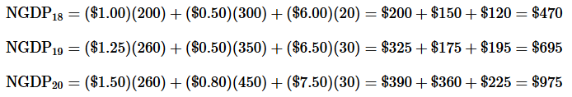
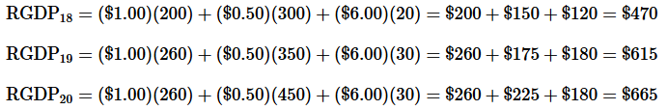
4.5 Nominal and Real GDP III
Calculating Nominal GDP
Take the price of each good and multiply by the corresponding quantity, then add the individual contributions.
Calculating Real GDP
Start with the base year, prices will remain constant with the base year. Multiply by the corresponding quantity, then add the individual contributions.
In the following example, the base year is 2018.

Slide 15
4.6 GDP Deflator I
Price changes can be tracked using GDP and this measure is called GDP Deflator.
GDP Deflator is calculated as:
GDP Deflator = 100 (Nominal GDP ÷ Real GDP)
We multiply by 100 to make it an index. An index is just an easy-to-use value which can we can use to easy compare different years. The goal of the deflator is to keep track of price levels from one year to the next.
The GDP Deflector will always be 100 in the base year as the nominal GDP and real GDP are equal in the base year.

Slide 16
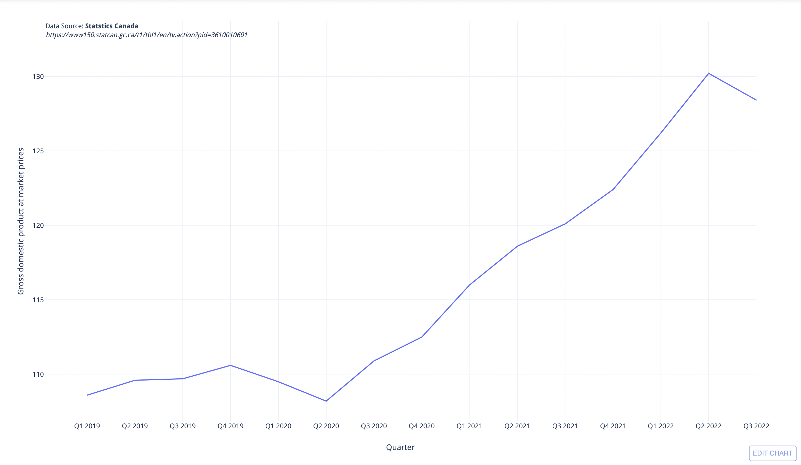
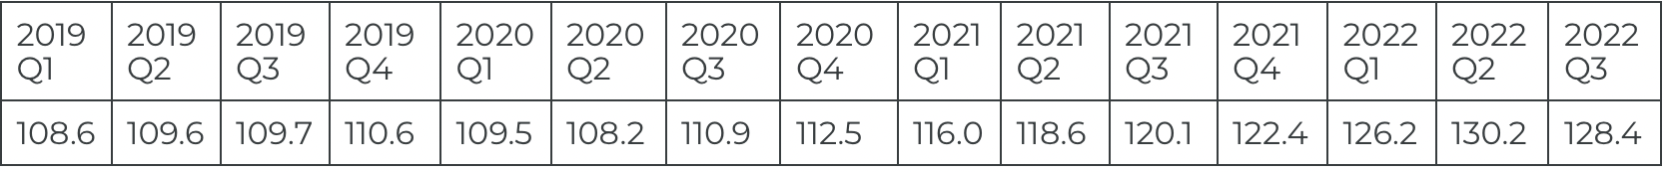
4.6 GDP Deflator II
The GDP deflator is calculated as
GDP Deflator = 100× (Nominal
GDP/Real GDP)
Notes:
The graph and table above show GDP Deflator in Canada decreased to 128.40 points in the third quarter of 2022 from 130.20 points in the second quarter of 2022.

Slide 17
4.7 GNP – An Alternative Measure of Output
While GDP represents the most commonly used measure of an economy’s output, economists sometimes use an alternative measure. Gross national product (GNP) is the total value of final goods and services produced during a particular period with factors of production owned by the residents of a particular country.
Notes:
The difference between GDP and GNP is a subtle one. The GDP of a country equals the value of final output produced within the borders of that country; the GNP of a country equals the value of final output produced using factors owned by residents of the country

Slide 18
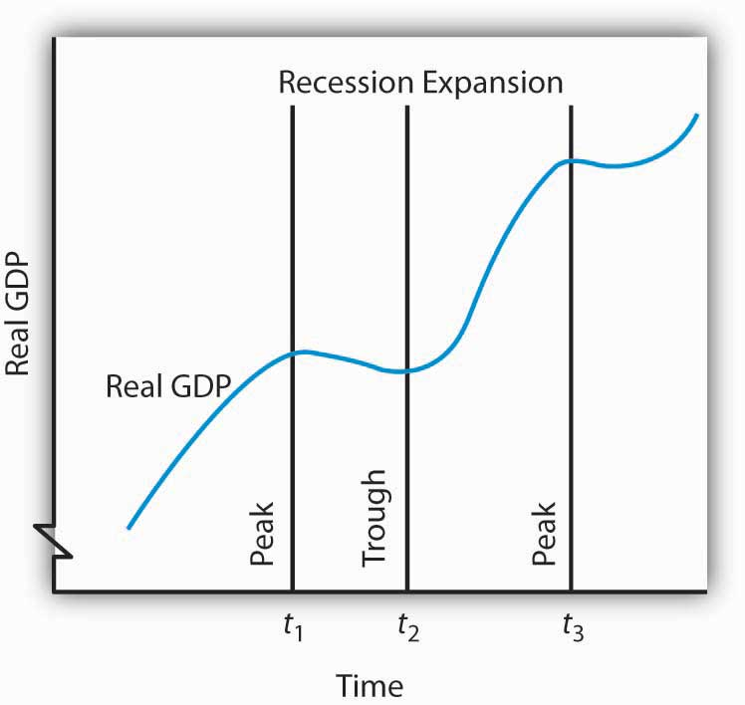
4.8 Business Cycles
The business cycle is a series of expansions and contractions in real GDP. The cycle begins at a peak and continues through a recession, a trough, and an expansion. A new cycle begins at the next peak.
Notes:
Fig 11- Here, the first peak occurs at time t1, the trough at time t2, and the next peak at time t3. Notice that there is a tendency for real GDP to rise over time.

Slide 19
4.9 GDP and Human Happiness
More GDP cannot necessarily be equated with more human happiness. But more GDP does mean more of the goods and services we measure. It means more jobs. It means more income. And most people seem to place a high value on these things.
Notes:
But as we mentioned before, GDP has its own faults because it includes only goods and services that can be bought or sold in the market place. GDP does measure the production of most goods and services. And goods and services get produced, for the most part, because we want them.

Slide 20
4.10 Key Terms
Base Year
Flow Variable
Stock Variable
Intermediate Goods
Final Goods
Gross Domestic Product (GDP)
Value Added
Gross National Product (GNP)
GDP Deflator
Nominal GDP
Real GDP
Business Cycle

