Slide 1

Principles of Macroeconomics
CHAPTER 5: UNEMPLOYMENT AND INFLATION
Unless otherwise noted, this work is licensed under a Creative Commons Attribution-NonCommercial-ShareAlike 4.0 International (CC BY-NC-SA 4.0) license. Feel free to use, modify, reuse or redistribute any portion of this presentation.

Slide 2
Learning Outcomes
At the end of this chapter, you will be able to:
Measure different labour market indicators
Identify different types of unemployment
Explain the shortcomings of unemployment measures
Calculate the Consumer Price Index
Measure the inflation rate
Discuss the difference between Real and Nominal Interest Rates

Slide 3

5.1 The Labour Force I
We do not just divide the adult population into employed and unemployed. The adult population is called the working age population. Anyone aged 15 and over is included in the Working Age Population, as defined by Statistics Canada (2022).
Notes:
Apart from the people employed or unemployed within the working age group, a third group exists: people who do not have a job, and for some reason—retirement, looking after children, taking a voluntary break before a new job—are not interested in having a job, either
Should we count everyone without a job as unemployed? Of course not. For example, we should not count children as unemployed. Surely, we should not count the retired as unemployed. Many full-time college students have only a part-time job, or no job at all, but it seems inappropriate to count them as suffering the pains of unemployment. Some people are not working because they are rearing children, ill, on vacation, or on parental leave.

Slide 4
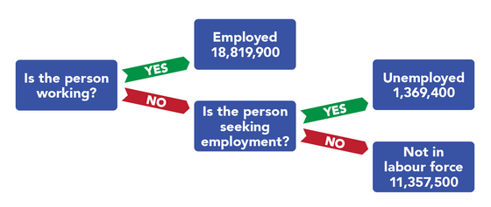
5.1 The Labour Force II
Notes:
Fig 5.1 above shows how the unemployment rate is computed. A monthly survey of households divides the civilian adult population into three groups. Those who have jobs are counted as employed; those who do not have jobs but are looking for them and are available for work are counted as unemployed; and those who are not working and are not looking for work are not counted as members of the labour force. The unemployment rate equals the number of people looking for work divided by the sum of the number of people looking for work and the number of people employed. Values are for February 2012 and all numbers are in thousands:

Slide 5
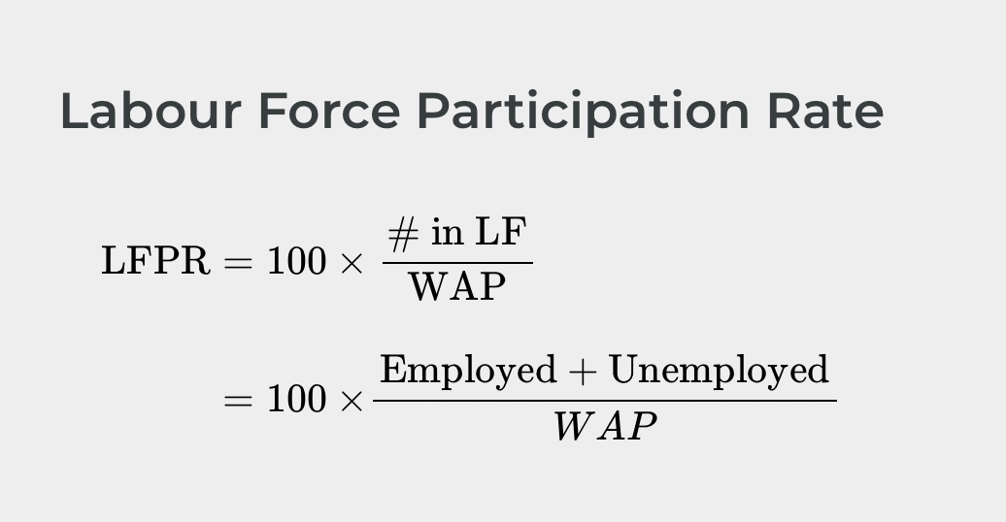
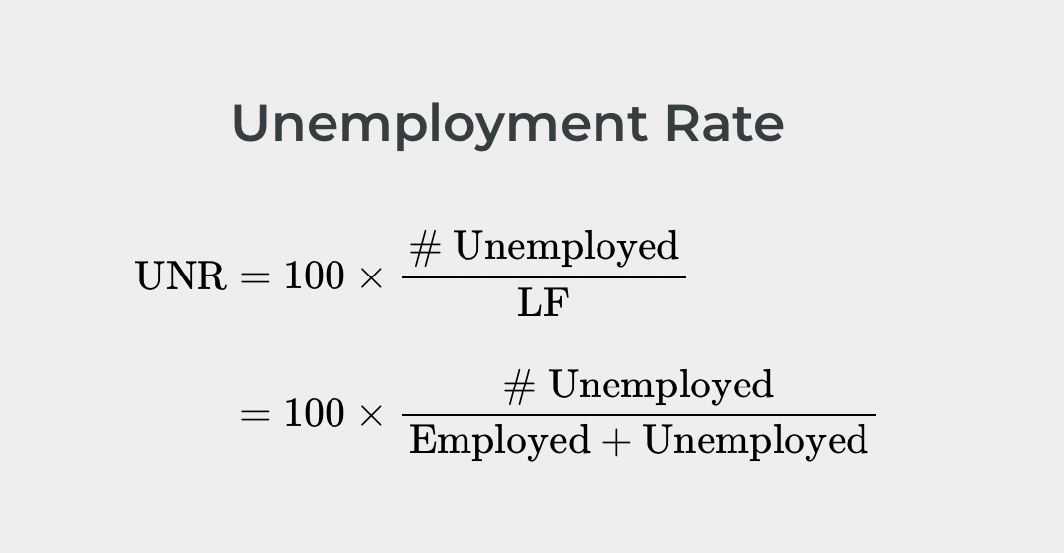
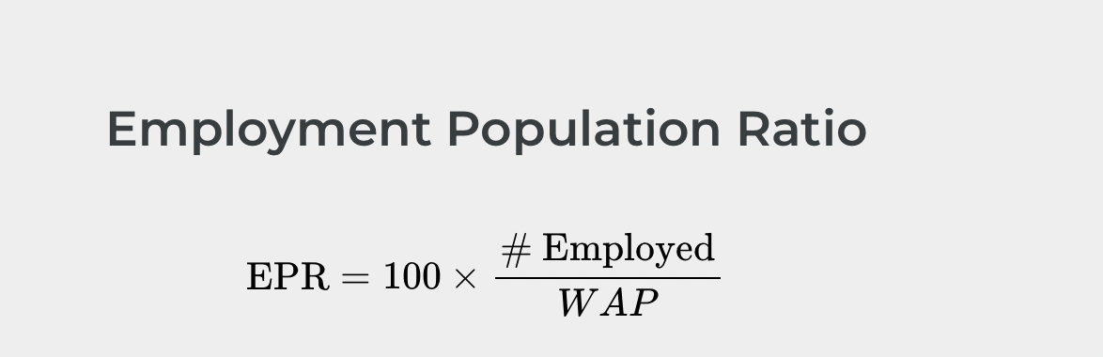
5.2 Labour Force Indicators I
Notes:
The labour force (LF) is the total number of people working or unemployed.
The unemployment rate (UNR) is the percentage of the labour force that is unemployed.
The labour force participation rate (LFPR) is the percentage of the working age population that is in the labour force.
The employment population ratio (EPR) is percentage of the working age population (WAP) that is employed or has some form of paid work.

Slide 6
5.2 Labour Force Indicators II
As of January 2022, if the working age population in Canada was 31.11 M, and labor force was 20 M, therefore,
Labour force participation rate = (20M / 31.11M)*100 = 64.2 percent.
Remember,

Slide 7
5.2 Labour Force Indicators III
In January 2022, if the number of unemployed people Canada was 1.4 M, and labour force was 20 M, therefore,
Unemployment Rate = (1.4M / 20M)*100 = 7 percent.
Apply the formula,

Slide 8
5.2 Labour Force Indicators IV
If the number of people employed in Canada in January 2022 is 18 M and the working age population was 31.11 M, then,
Employment Population Ratio = (18M / 31.11M)*100 = 57.8 percent
Remember,

Slide 9
5.3 Other Classifications of Employment and Shortcomings of the Unemployment Measure
Even with the “out of the labour force” category, there are still some people who are mislabelled in the categorization of employed, unemployed, or out of the labour force.
There are some people who have only part time or temporary jobs, and they are looking for full time employment that are counted as employed, although they are not employed in the way they would like or need to be. They are “Underemployed.”
Discouraged workers are also excluded from the UN measure. This is the category of people who are not “actively” job searching.
Notes:
Additionally, there are individuals who are underemployed. This includes those who are trained or skilled for one type or level of work but are working in a lower paying job or one that does not utilize their skills. For example, we would consider an individual with a college degree in finance who is working as a sales clerk underemployed. They are, however, also counted in the employed group. All of these individuals fall under the umbrella of the term “hidden unemployment.”
Discouraged workers, those who have stopped looking for employment and, hence, are no longer counted in the unemployed also fall into this group. As we will see in the following example, when a large number of people become discouraged, all else equal, the unemployment rate can actually fall!

Slide 10
5.4 Types of Unemployment I
Frictional Unemployment
There’s always a situation where some workers are looking for jobs, and some employers are looking for workers. During the time it takes to match them up, the workers are unemployed. Unemployment that occurs because it takes time for employers and workers to find each other is called frictional unemployment.
Notes:
The case of college graduates engaged in job searches is a good example of frictional unemployment. Those who did not land a job while still in school will seek work. Most of them will find jobs, but it will take time. During that time, these new graduates will be unemployed. If information about the labour market were costless, firms and potential workers would instantly know everything they needed to know about each other and there would be no need for searches on the part of workers and firms.

Slide 11
5.4 Types of Unemployment II
Structural Unemployment
The structurally unemployed are individuals who have no jobs because they lack skills valued by the labour market, either because demand has shifted away from the skills they do have, or because they never learned any skills.
Notes:
An example of the former would be the unemployment among aerospace engineers after the U.S. space program downsized in the 1970s. An example of the latter would be high school dropouts.
Some people worry that technology causes structural unemployment. In the past, new technologies have put lower skilled employees out of work, but at the same time they create demand for higher skilled workers to use the new technologies. Education seems to be the key in minimizing the amount of structural unemployment. Individuals who have degrees can be retrained if they become structurally unemployed. For people with no skills and little education, that option is more limited

Slide 12
5.4 Types of Unemployment III
Cyclical Unemployment
Unemployment changes with changes in GDP. People are likely going to be laid off from jobs when the economy faces a recession. This arises cyclical unemployment. So cyclical unemployment is a type of unemployment that changes with the business cycle. During recession, cyclical unemployment increases and during expansionary or recovery phase of the economy, cyclical unemployment decreases.
Notes:
You may recall from Chapter 4, the increase in GDP is called economic expansion and the decrease in GDP is called economic recession.
The economy faces boom and bust and that is what we call the business cycle. In certain periods, real GDP increases and in other periods real GDP decreases

Slide 13
5.4 Types of Unemployment IV
Seasonal Unemployment
Seasonal unemployment may be seen as a kind of structural unemployment, since it is a type of unemployment that is linked to certain kinds of jobs (construction work, migratory farm work, and fishing). The official unemployment measures erase this kind of unemployment from the statistics using “seasonal adjustment” techniques.

Slide 14
5.4 Types of Unemployment IV
Natural Unemployment
Natural UN is the type of unemployment that arises from frictional and structural unemployment only. There is NO Cyclical Unemployment.
Economy faces Natural UN when real GDP = Potential GDP and the economy operates at Full Employment.

Slide 15
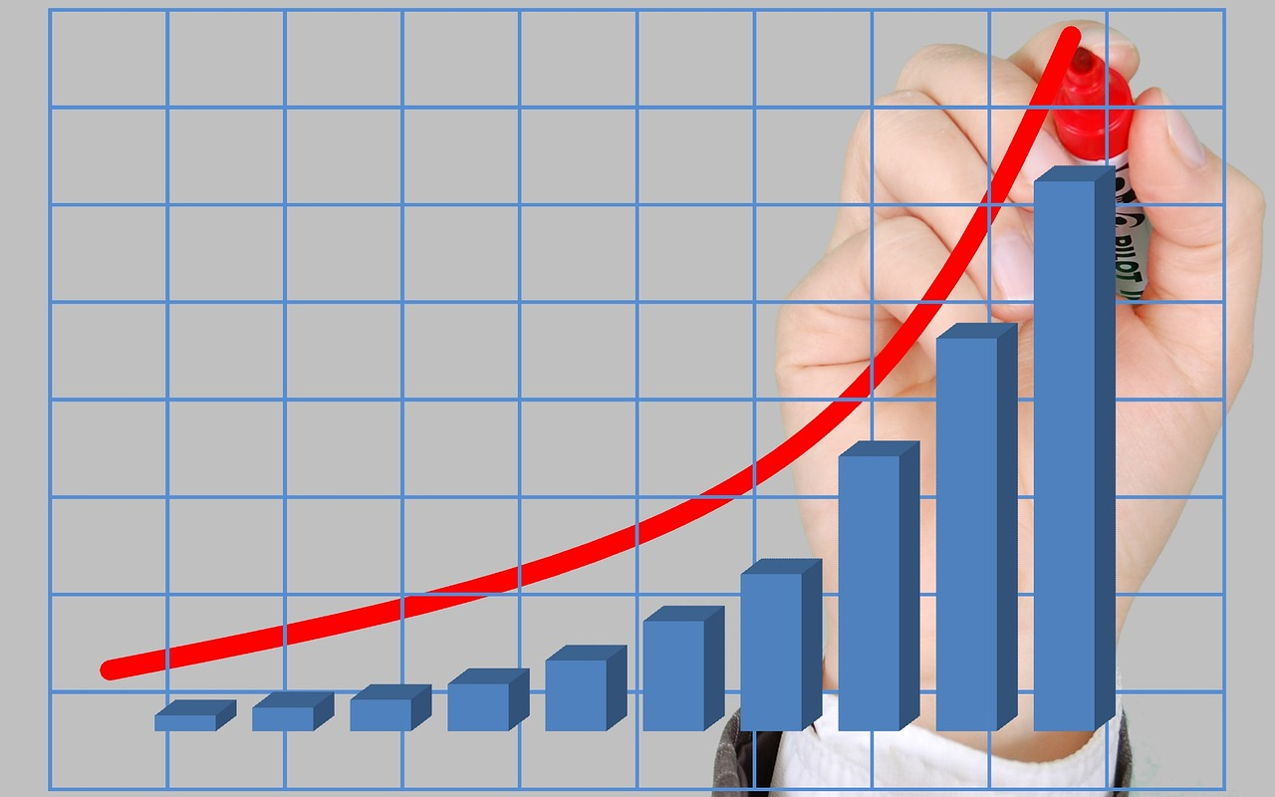
5.5 Inflation
Inflation is a general and ongoing rise in the level of prices in an entire economy. Inflation does not refer to a change in relative prices. Inflation means that there is pressure for prices to rise in most markets in the economy.
In addition, price increases in the
supply-and-demand model were
one-time events, representing a shift from a previous equilibrium to a new one.
Photo Source: Pixabay
Notes:
Inflation implies an ongoing rise in prices. If inflation happened for one year and then stopped, then it would not be inflation any more. Similarly, a consistent fall in average price level is referred to as deflation.
Concern about changes in the price level has dominated economic discussion since 2022. With inflation in Canada generally averaging only between 2% and 3% each year since 1990, it is not surprising how much attention inflation has caught in the past several months when the average inflation in Canada rose to 8.1% in June 2022.

Slide 16
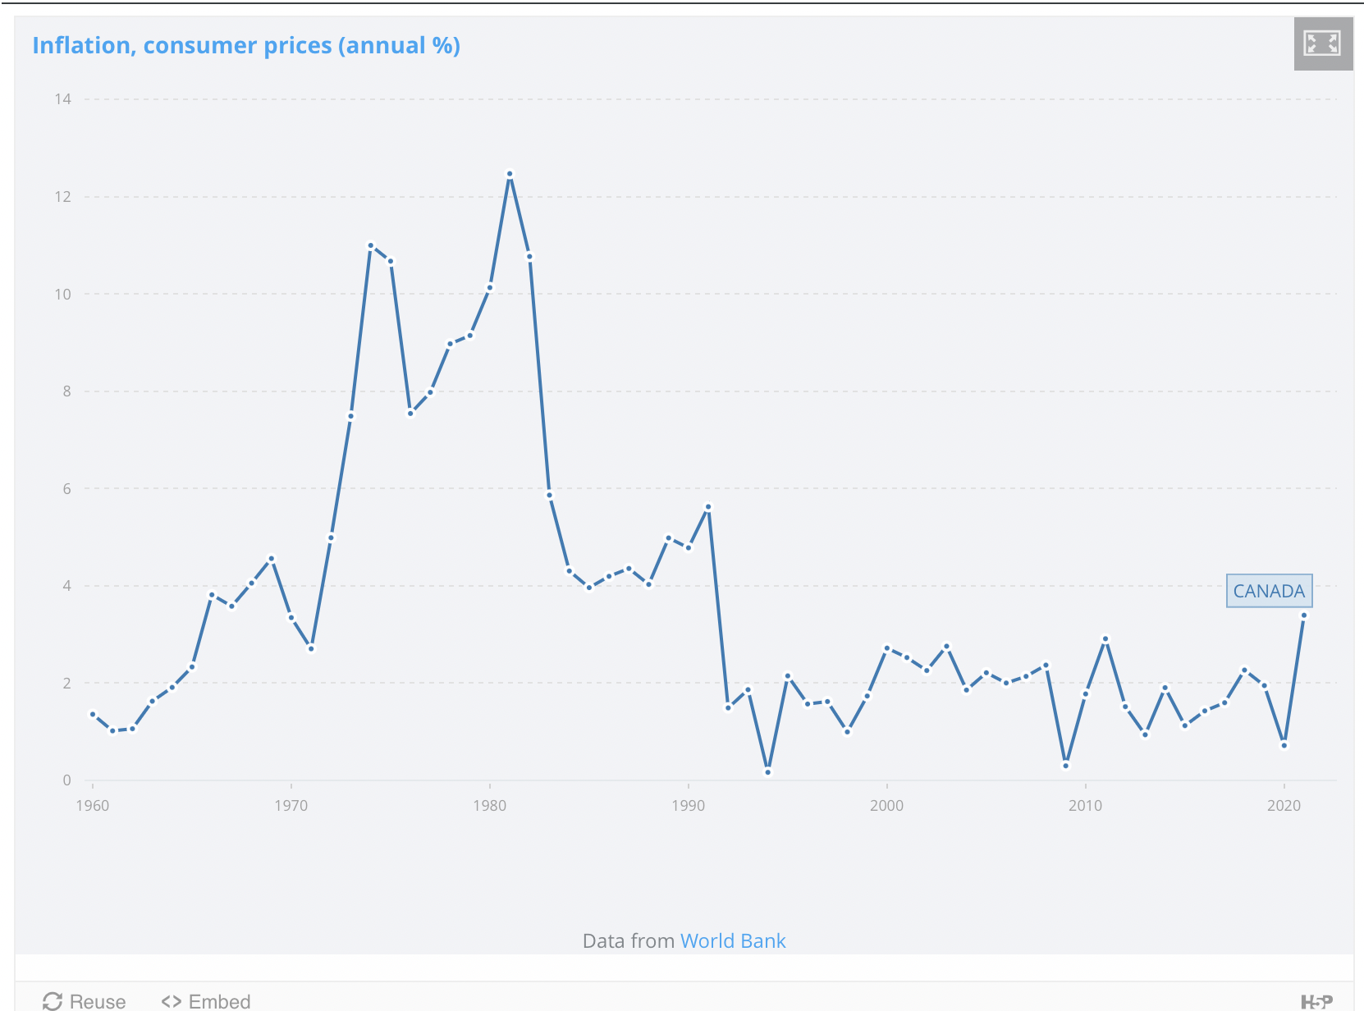
5.6 Why Do We Care About Inflation?
Notes:
Whether one regards inflation as a “good” thing or a “bad” thing depends very much on one’s economic situation.
If you are a borrower, unexpected inflation is a good thing—it reduces the value of money that you must repay.
If you are a lender, it is a bad thing because it reduces the value of future payments you will receive.
Whatever any particular person’s situation may be, inflation always produces the following effects on the economy: it reduces the value of money and it reduces the value of future monetary obligations. It can also create uncertainty about the future.

Slide 17
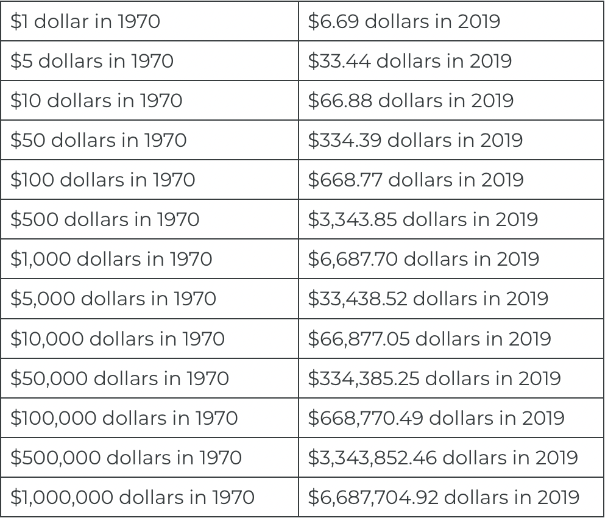
5.7 Understanding How Inflation Changes the Value of the Dollar
Notes:
The figure above shows conversion of 1970 dollars (amounts) in 2019. $40,000 in 1970 is equivalent in purchasing power to about $267,508.20 in 2019, an increase of $227,508.20 over 49 years. The Canadian dollar had an average inflation rate of 3.95% per year between 1970 and 2019, producing a cumulative price increase of 568.77%.
This means that prices in 2019 are 6.69 times as high as average prices since 1970, according to Statistics Canada consumer price index, that we will discuss in the next section. (Webster, 2023)

Slide 18
5.8 Price Indexes: Consumer Price Index and Inflation Rate I
Economists measure the price level with a price index. A price index is a number whose movement reflects movement in the average level of prices. If a price index rises 10%, it means the average level of prices has risen 10%.
There are four steps one must take in computing a price index:
Select the kinds and quantities of goods and services to be included in the index.
Determine what it would cost to buy the goods and services in the market basket in some period that is the base period for the index.
Compute the cost of the market basket in the current period.
Compute the price index. It equals the current cost divided by the base-period cost of the market basket.
Notes:
1. A list of these goods and services, and the quantities of each, is the “market basket” for the index.
2…..A base period is a time period against which costs of the market basket in other periods will be compared in computing a price index. Most often, the base period for an index is a single year. If, for example, a price index had a base period of 1990, costs of the basket in other periods would be compared to the cost of the basket in 1990. We will encounter one index, however, whose base period stretches over three years.

Slide 19
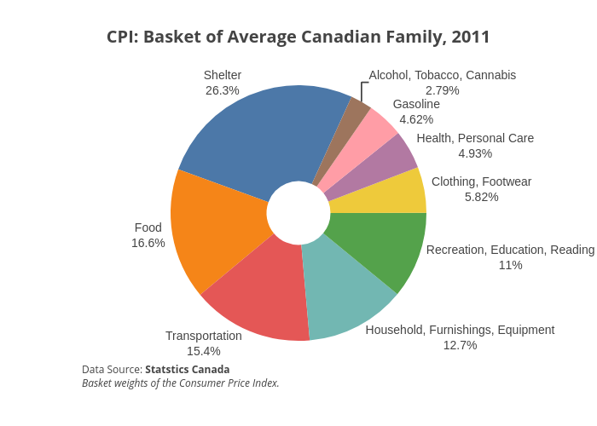
5.8 Price Indexes: Consumer Price Index and Inflation Rate II
Consumer Price Index
Notes:
To simplify the task of interpreting the price levels for more realistic and complex baskets of goods, economists typically report the price level in each period as an index number, rather than as the dollar amount for buying the basket of goods. Economists create price indices to calculate an overall average change in relative prices over time. We refer to this as the consumer price index (CPI).
The figure above shows the CPI basket of an average Canadian family in 2011.

Slide 20
5.8 A Basket of Goods
 | Hamburgers | Aspirin | Movies
Quantity | 20 | 1 | 5
2017 | $3.10 | $10.00 | $6.00
2018 | $3.20 | $10.00 | $6.50
2019 | $3.10 | $10.00 | $7.00
2020 | $3.50 | $10.00 | $7.50
Notes:
Prices of some goods in the basket may rise while others fall. In this example, the price of aspirin does not change over the four years, while movies increase in price and hamburgers bounce up and down. The table shows the cost of buying the given basket of goods at the prices prevailing at that time.
We can calculate the price of this basket of goods for each year.

Slide 21
5.9 CPI and Inflation Rate III
We can calculate the price of this basket of goods for each year. We will refer to the basket price as BP.
BP17 = ($3.10)(20)+($10.00)(1)+($6.00)(5)=$62.00+$10.00+$30.00=$102.00
BP18 = ($3.20)(20)+($10.00)(1)+($6.50)(5)=$64.00+$10.00+$32.50=$106.50
BP19 = ($3.10)(20)+($10.00)(1)+($7.00)(5)=$62.00+$10.00+$35.00=$107.00
BP20 = ($3.50)(20)+($10.00)(1)+($7.50)(5)=$70.00+$10.00+$37.50=$117.50

Slide 22
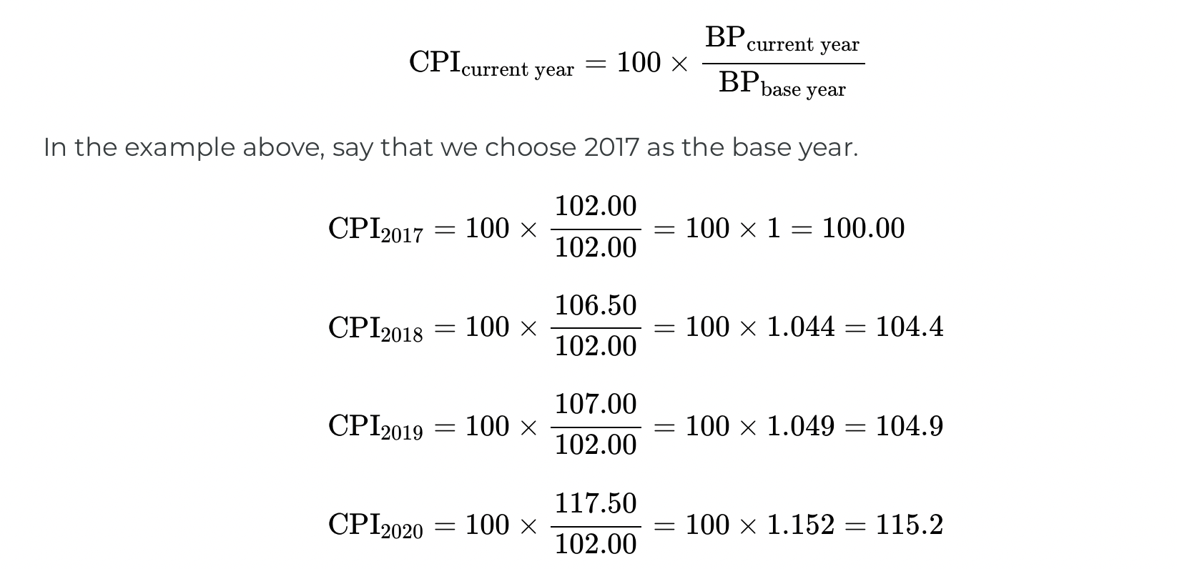
5.10 Price Indexes: Consumer Price Index and Inflation Rate IV
Notes:
To convert the money spent on the basket to an index number, economists arbitrarily choose one year to be the base year, or starting point from which we measure changes in prices. The base year, by definition, has an index number equal to 100.
This sounds complicated, but it is really a simple math trick. We calculate the CPI using the above equation.
CPI in 2020 turns out to be 115, thus implying the price of a basket of goods is about 15% higher in 2020 than the same basket measured in 2017, that is, at the base year prices. Similarly, the price of the basket is about 5% higher in 2019 compared to price of the same basket measured in 2017.

Slide 23
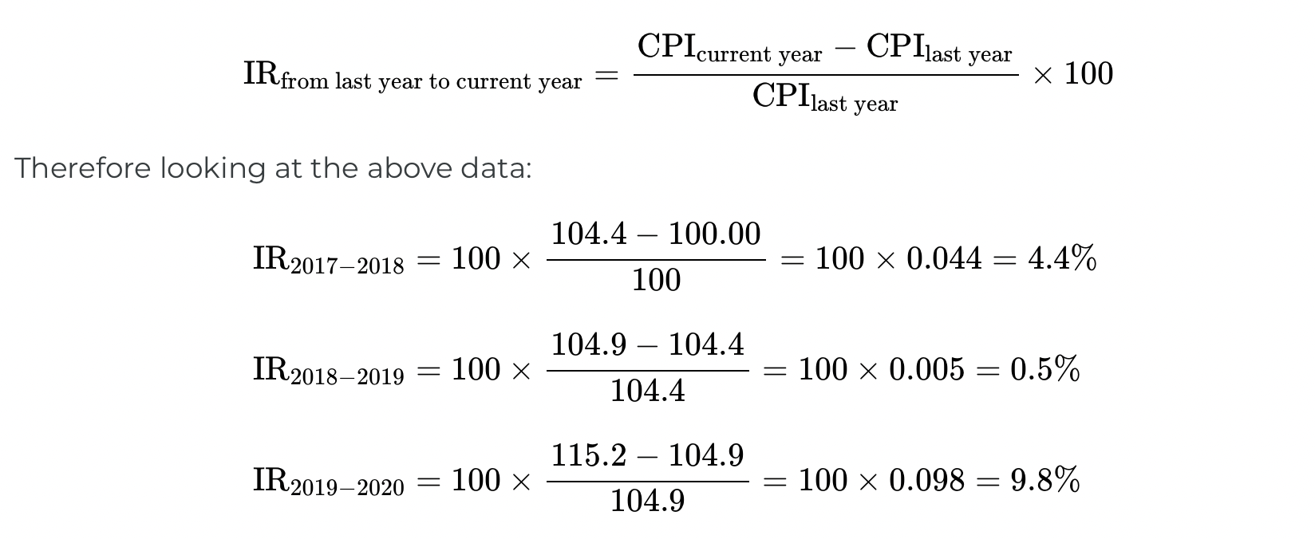
5.10 Price Indexes: Consumer Price Index and Inflation Rate V
Notes:
We can also calculate the inflation rates using the CPI values. IR is just a percentage change in the CPIs.
The advantage is that indexing allows easier eyeballing of the inflation numbers. If you glance at two index numbers like 107 and 110, you know automatically that the rate of inflation between the two years is about, but not quite exactly equal to, 3%. By contrast, imagine that we express the price levels in absolute dollars of a large basket of goods, so that when you looked at the data, the numbers were $19,493.62 and $20,040.17.
Most people find it difficult to eyeball those kinds of numbers and say that it is a change of about 3%. However, the two numbers expressed in absolute dollars are exactly in the same proportion of 107 to 110 as the previous example.

Slide 24
5.11 The Flaws in the Consumer Price Index
Consumer Price indexes that employ fixed market baskets are likely to overstate inflation (and understate deflation) for four reasons:
Because the components of the market basket are fixed, the index does not incorporate consumer responses to changing relative prices.
A fixed basket excludes new goods and services.
Quality changes may not be completely accounted for in computing price-level changes.
The type of store in which consumers choose to shop can affect the prices they pay, and the price indexes do not reflect changes consumers have made in where they shop.
BoC estimated the total annual bias in the CPI is 0.5 per cent.
Notes:
To see how these factors can lead to inaccurate measures of price-level changes, suppose the price of chicken rises and the price of beef falls. The law of demand tells us that people will respond by consuming less chicken and more beef.
But if we use a fixed market basket of goods and services in computing a price index, we will not be able to make these adjustments. The market basket holds constant the quantities of chicken and beef consumed.
The importance in consumer budgets of the higher chicken price is thus overstated, while the importance of the lower beef price is understated. More generally, a fixed market basket will overstate the importance of items that rise in price and understate the importance of items that fall in price. This source of bias is referred to as the substitution bias.

Slide 25
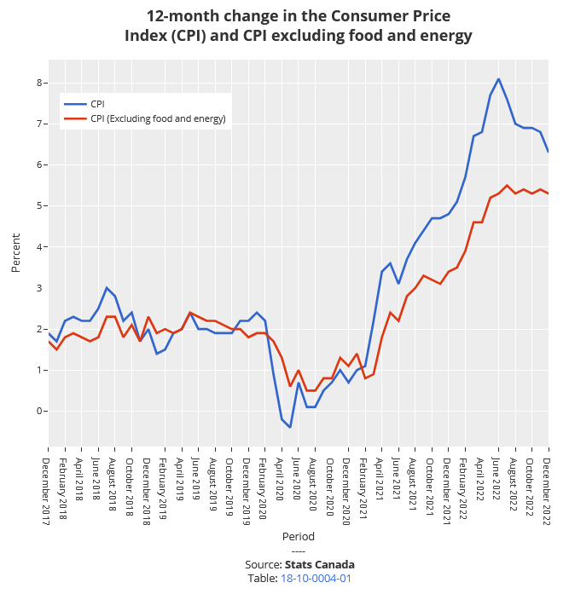
5.12 CPI and Core Inflation
CPI measures prices as they affect everyday household spending. Economists typically calculate a core inflation index by taking the CPI and excluding volatile economic variables. In this way, economists have a better sense of the underlying trends in prices that affect the cost of living.
Notes:
Imagine if you were driving a company truck across the country- you probably would care about things like the prices of available roadside food and motel rooms as well as the truck’s operating condition. However, the manager of the firm might have different priorities. He would care mostly about the truck’s on-time performance and much less so about the food you were eating and the places you were staying. In other words, the company manager would be paying attention to the firm’s production, while ignoring transitory elements that impacted you, but did not affect the company’s bottom line.

Slide 26
5.13 Other Price Indexes I
The basket of goods behind the Consumer Price Index represents an average hypothetical Canadian household’s consumption, which is to say that it does not exactly capture anyone’s personal experience. When the task is to calculate an average level of inflation, this approach works fine.
Notes:
What if, however, you are concerned about inflation experienced by a certain group, like the elderly, or the poor, or single-parent families with children? In specific situations, a price index based on the buying power of the average consumer may not feel quite right.
This problem has a straightforward solution. If the Consumer Price Index does not serve the desired purpose, then invent another index, based on a basket of goods appropriate for the group of interest. Stats Canada publishes a number of experimental price indices: some for particular groups like the elderly or the poor, some for different geographic areas, and some for certain broad categories of goods like food or housing

Slide 27
5.14 Other Price Indexes II
What’s the best measure of inflation?
If one is concerned with the most accurate measure of inflation, one should use the GDP deflator as it picks up the prices of goods and services produced. However, it is not a good measure of the cost of living as it includes prices of many products not purchased by households (for example, aircraft, fire engines, factory buildings, office complexes, and bulldozers)
Notes:
If one wants the most accurate measure of inflation as it impacts households, one should use the CPI, as it only picks up prices of products purchased by households. That is why economists sometimes refer to the CPI as the cost-of-living index.

Slide 28
5.15 Real vs Nominal Interest rates
Inflation influences the interest rates we pay for our car loans or personal lines of credit.
For instance, imagine that you borrowed $100 from your bank one year ago at 8% interest on your loan. When you repay the loan, you must repay the $100 you borrowed plus $8 in interest—a total of $108.This 8% interest rate is the stated interest rate on the loan that you must pay back which is called the nominal interest rate.
Notes:
But the nominal interest rate doesn’t take inflation into account. In other words, it is unadjusted for inflation.
To continue our scenario, suppose on your way to the bank a newspaper headline caught your eye stating: “Inflation at 5% This Year!” Inflation is a rise in the general price level, as you know. A 5% inflation rate means that an average basket of goods you purchased this year is 5% more expensive when compared to last year.
This leads to the concept of the real, or inflation-adjusted, interest rate. The real interest rate measures the percentage increase in purchasing power the lender receives when the borrower repays the loan with interest. In our earlier example, the lender earned 8% or $8 on the $100 loan. However, because inflation was 5% over the same time period, the lender actually earned only 3% in real purchasing power or $3 on the $100 loan.

Slide 29
5.16 Real vs Nominal Interest rates contd..
If the inflation rate is 5%, the real interest rate = 8% – 5% = 3%
Real interest rate is the real cost of the loan to the borrower and the real yield to the lender. Higher inflation makes the lender worse off and the borrower better off.

Slide 30
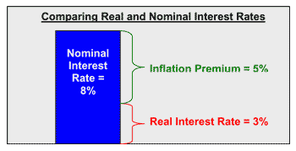
5.17 Real vs Nominal Interest rates II
Notes:
The diagram above illustrates the relationship between nominal interest rates, real interest rates, and the inflation rate. As shown, the nominal interest rate is equal to the real interest rate plus the rate of inflation.

Slide 31
5.18 Key Terms
Cyclical Unemployment
Employment population ratio (EPR)
Frictional Unemployment
Full Employment
Inflation Rate
Labour force (LF)
Labour force participation rate (LFPR)
Natural Rate Unemployment
Price Index (CPI)
Seasonal Unemployment
Structural Unemployment
Unemployment rate (UNR)

