Slide 1

Principles of Macroeconomics
CHAPTER 6: ECONOMIC GROWTH AND FINANCIAL
SYSTEMS
Unless otherwise noted, this work is licensed under a Creative Commons Attribution-NonCommercial-ShareAlike 4.0 International (CC BY-NC-SA 4.0) license. Feel free to use, modify, reuse or redistribute any portion of this presentation.

Slide 2
Learning Outcomes
At the end of this chapter, you will be able to:
Measure Economic Growth
Explain Long Run Economic Growth & Growth Policies
Analyze The Business Cycle

Slide 3
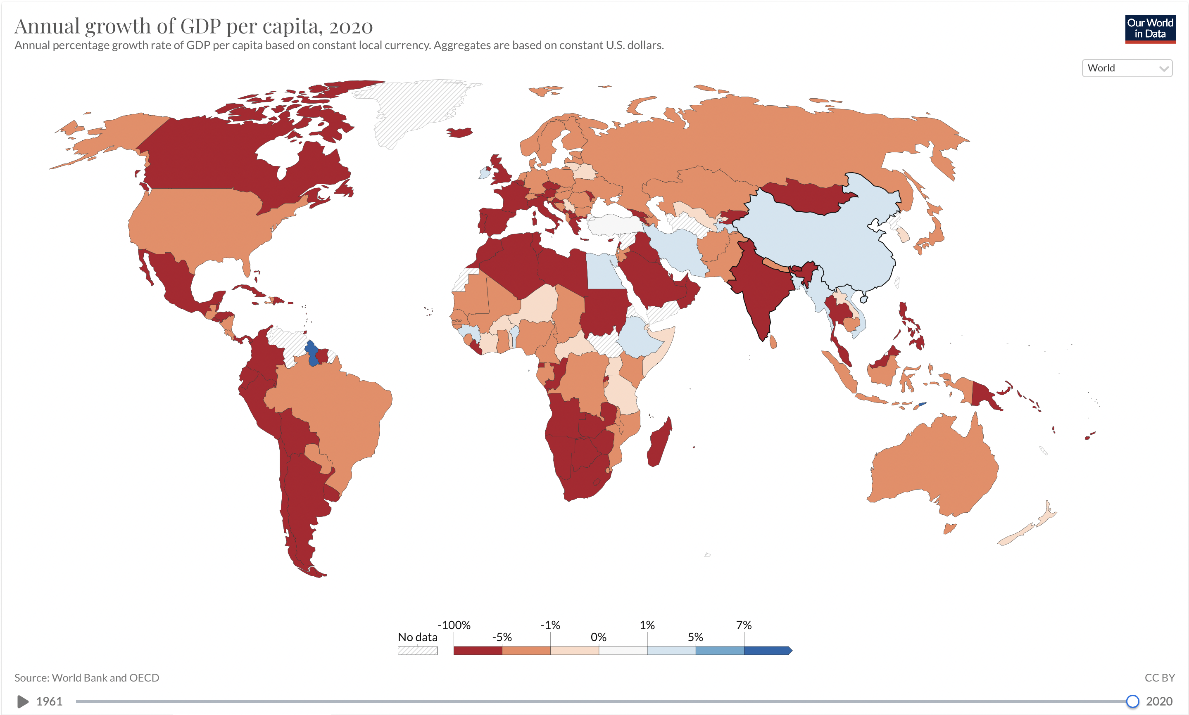
6.1 Global Economic Growth
Notes:
Every country worries about economic growth. In Canada and other high-income countries, the question is whether economic growth continues to provide the same remarkable gains in our standard of living as it did during the twentieth century.
Meanwhile, can middle-income countries like India, Brazil, Egypt, or Poland catch up to the higher-income countries? Or must they remain in the second tier of per capita income? Of the world’s population of roughly 6.7 billion people, about 2.6 billion are scraping by on incomes that average less than $2 per day, not that different from the standard of living 2,000 years ago.

Slide 4
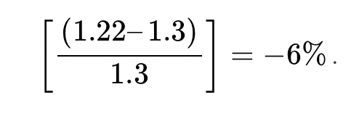
6.2 Measuring Economic Growth
Economic Growth is measured as a percentage change in real GDP between different time periods. If Canada’s real GDP for 2019 is $1.3 trillion and in 2020, real GDP changed to $1.22 trillion, then economic growth rate between this one-year period would be:
The example shows negative growth rate or a decline in economic growth.
Notes:
In our example, we find the annual economic growth rate declining between this time period. Suppose, real GDP in 2021 is $1.28 trillion and that of in 2022 is $1.31 trillion. Then how do we measure the average annual growth rate over this time period between 2019 and 2022? We would need to find the annual growth rate between 2019 and 2020 (i.e. −6%), between 2020 and 2021 (i.e. +4.9%), and finally that of between 2021 and 2022 (i.e. +2.3%)

Slide 5
6.3 The Significance of Economic Growth
There are three key points about economic growth to keep in mind:
Growth is a process. It is not a single event; rather, it is an unfolding series of events.
We define growth in terms of the economy’s ability to produce goods and services, as indicated by its level of potential output.
Growth suggests that the economy’s ability to produce goods and services is rising. A discussion of economic growth is thus a discussion of the series of events that increase the economy’s ability to produce goods and services.
Notes:
To demonstrate the impact of economic growth on living standards of a nation, we must start with a clear definition of economic growth and then study its impact over time. We will also see how population growth affects the relationship between economic growth and the standard of living an economy is able to achieve.
Economic growth is a long-run process that occurs as an economy’s potential output increases. Earlier we defined economic growth as the process through which an economy achieves an outward shift in its production possibilities curve. How does a shift in the production possibilities curve relate to a change in potential output? To produce its potential level of output, an economy must operate on its production possibilities curve. An increase in potential output thus implies an outward shift in the production possibilities curve.

Slide 6
6.4 Growth in Output or real GDP per Capita I
An economy’s output per capita equals real GDP per person. Real GDP per capita is an important indicator of economic performance, more than just the real GDP because it measures the average income.
If we denote N as population, then
Real GDP per capita = Real GDP
N
Notes:
Of course, it is not just how fast potential output grows that determines how fast the average person’s material standard of living rises. For that purpose, we examine economic growth on a per capita basis.
In Canada, for example, real GDP in 2008 was $930,720 million (annual rate). The Canadian population was 30.7 million. Real GDP per capita thus equalled $30,316.

Slide 7
6.4 Growth in Output or real GDP per Capita II
We use output per capita as a gauge of an economy’s material standard of living. If the economy’s population is growing, then output must rise as rapidly as the population if real GDP per capita is to remain unchanged.
If, for example, population increases by 2%, then real GDP would have to rise by 2% to maintain the current level of output per capita. If real GDP rises by less than 2%, output per capita will fall. If real GDP rises by more than 2%, output per capita will rise. More generally, we can write,
Notes:
For economic growth to translate into a higher standard of living on average, economic growth must exceed population growth. From 1970 to 2004, for example, Sierra Leone’s population grew at an annual rate of 2.1% per year, while its real GDP grew at an annual rate of 1.4%; its real GDP per capita thus fell at a rate of 0.7% per year.
Over the same period, Singapore’s population grew at an annual rate of 2.1% per year, while its real GDP grew 7.4% per year.
The resultant 5.3% annual growth in output per capita transformed Singapore from a relatively poor country to a country with the one of the highest per capita incomes in the world.

Slide 8
6.5 Rule of 70 and Difference in Growth Rates I
Suppose two economies with equal populations start out at the same level of real GDP but grow at different rates. Economy A grows at a rate of 3.5%, and Economy B grows at a rate of 2.4%.
In how many years will each of the two economies double in size? That is, if the GDP of economy A is $1.3 trillion in 2019, in how many years will the real GDP grow to $2.6, at its current growth rate of 3.5%? Similarly, if the GDP of economy B is $1.3 trillion in 2019, in how many years will the real GDP grow to $2.6, at its current growth rate of 2.4%?
Notes:
The doubling time is given by the Rule of 70, which states that a variable’s approximate doubling time equals 70 divided by the growth rate, stated as a whole number. If the level of income were increasing at a 9% rate, for example, its doubling time would be roughly 70÷9, or 7.7 years.
So, given the Rule of 70, economy A would double in size in 70/3.5=20 years, and economy B would double in 70/2.4=29 years.
The rule of 70 gives an approximation, not an exact measure, of the impact of exponential growth.

Slide 9
6.5 Rule of 70 and Difference in Growth Rates I I
Rule of 70 provides answers to the above two questions:
If the GDP of economy A is $1.3 trillion in 2019, in how many years will the real GDP grow to $2.6, at its current growth rate of 3.5%?
70/3.5 = 20 years approximately
If the GDP of economy B is $1.3 trillion in 2019, in how many years will the real GDP grow to $2.6, at its current growth rate of 2.4%?
70/2.4 = 29 years approximately

Slide 10
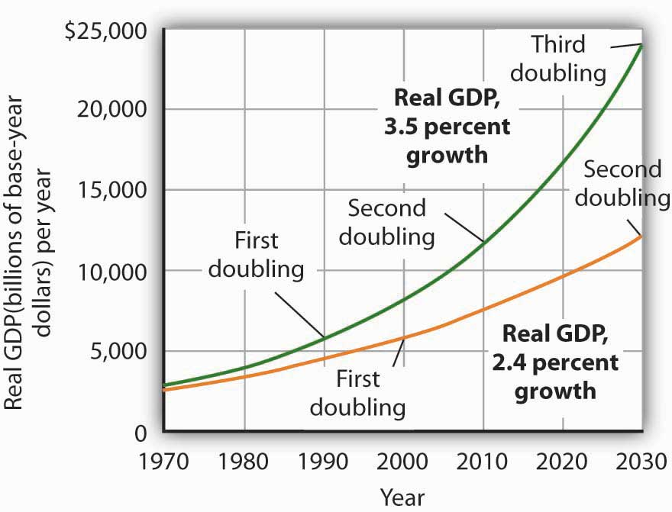
6.5 Rule of 70 and Difference in Growth Rates II
Notes:
Fig 6.3--- Differences in Growth Rates. We begin in 1970, when real GDP equalled $2,873.9 billion. If real GDP grew at an annual rate of 3.5% from that year, it would double roughly every 20 years: in 1990, 2010, and 2030. Growth at a 2.4% rate, however, implies doubling every 30 years: in 2000 and 2030. By 2030, the 3.5% growth rate leaves real GDP at twice the level that would be achieved by 2.4% growth.

Slide 11
6.6 Determinants of Economic Growth in the Long Run I
Labour Productivity
Sustained long-term economic growth comes from increases in worker productivity, which essentially means how well we do things. In other words, how efficient is your nation with its time and workers? Labor productivity is the value that each employed person creates per unit of his or her input.
Notes:
The easiest way to comprehend labor productivity is to imagine a Canadian worker who can make 10 loaves of bread in an hour versus a U.S. worker who in the same hour can make only two loaves of bread. In this fictional example, the Canadians are more productive. More productivity essentially means you can do more in the same amount of time. This in turn frees up resources for workers to use elsewhere.
What determines how productive workers are? The answer is pretty intuitive. ----The first determinant of labor productivity is human capital
The second factor that determines labor productivity is technological change. Technological change is a combination of invention—advances in knowledge—and innovation, which is putting that advance to use in a new product or service
The third factor that determines labor productivity is economies of scale. Recall that economies of scale are the cost advantages that industries obtain due to size.

Slide 12

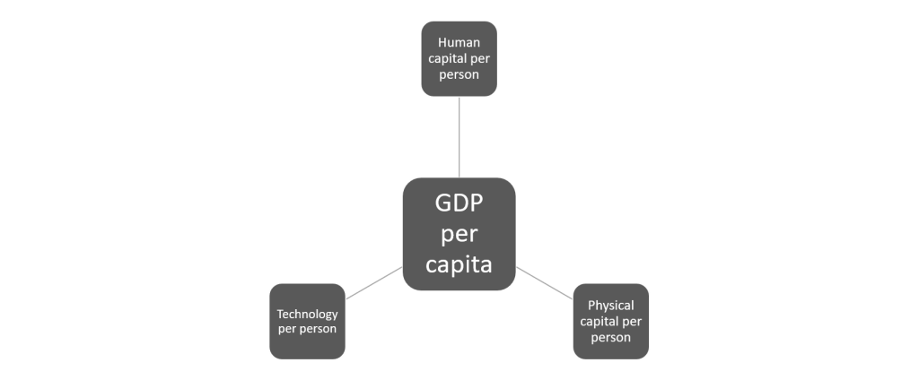
6.6 Determinants of Economic Growth in the Long Run II
Notes:
Figure 6.4 presents two examples of aggregate production functions.
In the first production function, shown in Figure 6.4 (a), the output is GDP and in Fig 6.4 (b), the output is GDP per capita.
NB---Recall that one way to measure human capital is to look at the average levels of education in an economy

Slide 13
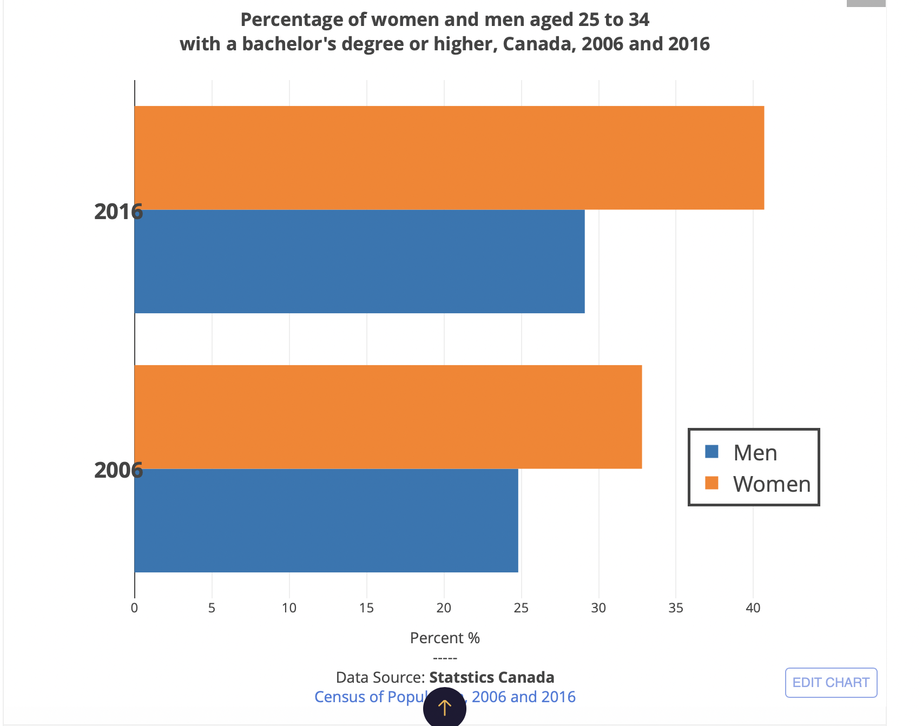
6.6 Determinants of Economic Growth in the Long Run III
Notes:
Figure 6.5 illustrates the human capital deepening for Canadian workers by showing that the proportion of Canada’s population aged 25 to 34 years with a high college degree or diploma has risen between 2006 and 2016, as shown in the graph below. Not only does the current Canadian economy have better-educated workers with more and improved physical capital than it did several decades ago, but these workers have access to more advanced technologies.

Slide 14
6.7 Measuring Productivity I
An economy’s rate of productivity growth is closely linked to the growth rate of its GDP per capita, although the two are not identical.
For example, if the percentage of the population who holds jobs in an economy increases, GDP per capita will increase but the productivity of individual workers may not be affected. Over the long term, the only way that GDP per capita can grow continually is if the productivity of the average worker rises or if there are complementary increases in capital per worker.
Notes:
A common measure of Canadian productivity per worker is dollar value per hour the worker contributes to the employer’s output.

Slide 15
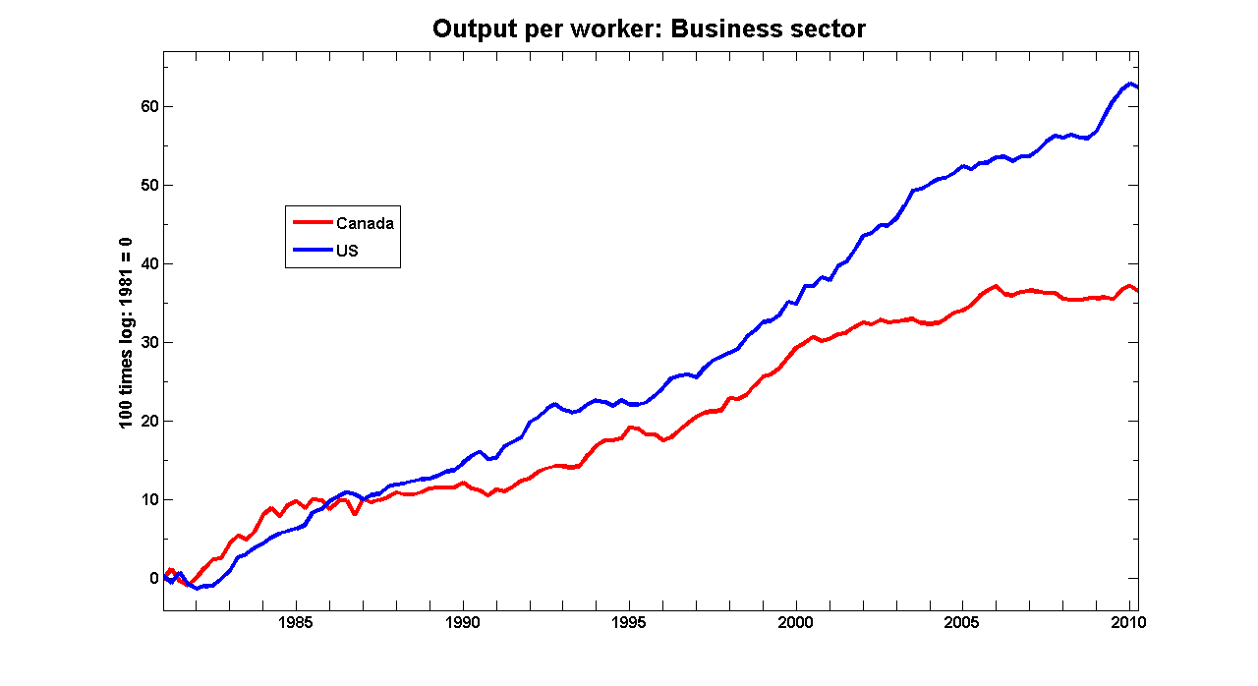
6.7 Measuring Productivity II
Notes:
“Before the 2008 recession hit, the overriding concern for the Canadian macroeconomy was our poor record of productivity growth . . . When we talk about the importance of productivity, the point is invariably made that increasing output per worker is the only sustainable way of generating long-run gains in real purchasing power.”(Gordon, 2010) Meanwhile, output per worker in the US has been growing almost twice as fast.

Slide 16
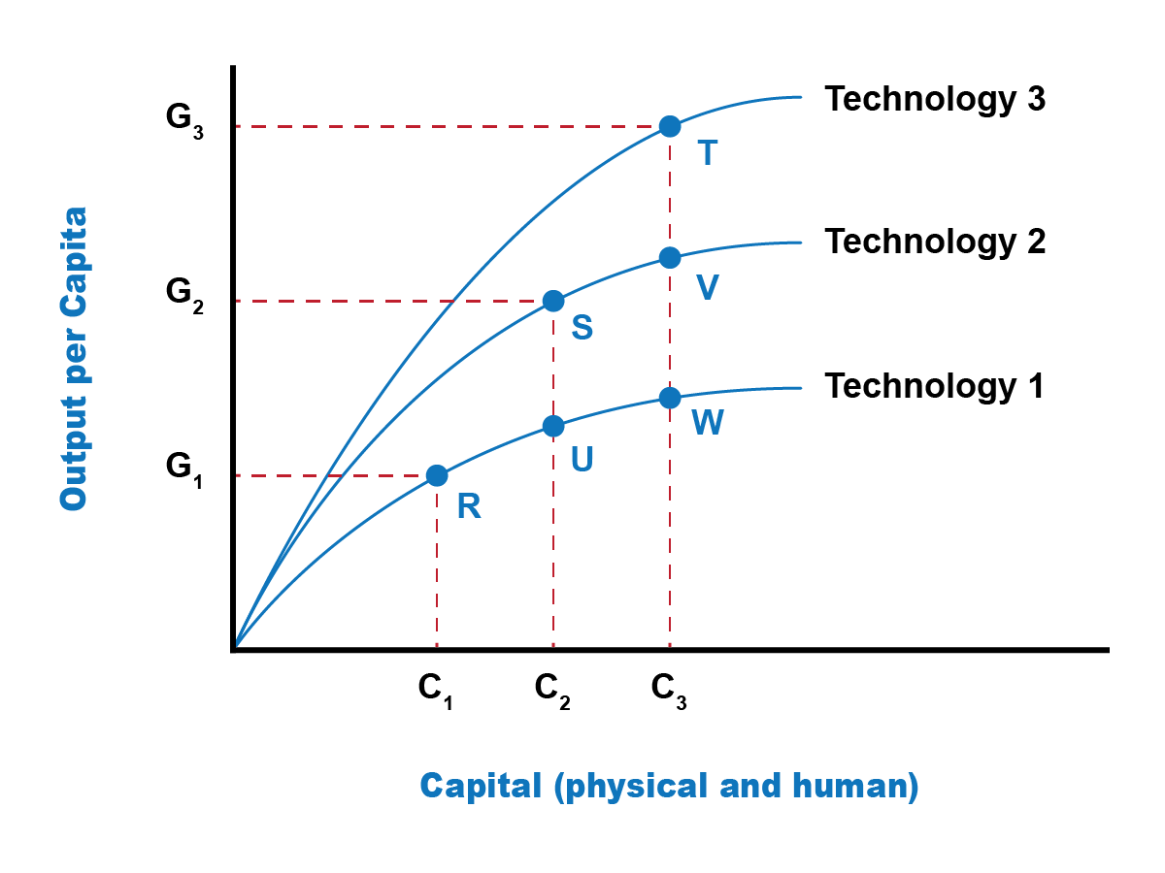
6.7 Measuring Productivity III
Technology and Productivity
If the economy’s growth depended only on the deepening of human capital and physical capital, then we would expect that economy’s growth rate to slow down over the long run because of diminishing marginal returns. However, there is another crucial factor in the aggregate production function: Technology.
Notes:
Developing new technology can provide a way for an economy to sidestep the diminishing marginal returns of capital deepening. Fig 6.6 demonstrates that.
The horizontal axis measures deepening of both physical and human capital. The amount of human and physical capital per worker increases as one moves from left to right, from C1 to C2 to C3. The vertical axis measures per capita output.
We consider the lowest aggregate production function in this diagram, labeled Technology 1. Along this aggregate production function, the level of technology is held constant, so the line shows only the relationship between capital deepening and output.
As capital deepens from C1 to C2 to C3 and the economy moves from R to U to W, per capita output does increase—but the way in which the line starts out steeper on the left but then flattens as it moves to the right shows the diminishing marginal returns, as additional marginal amounts of capital deepening increase output by ever-smaller amounts.
The shape of the aggregate production line (Technology 1) shows that the ability of capital deepening to generate sustained economic growth is limited, since diminishing returns will eventually set in

Slide 17
6.7 Measuring Productivity IV
As capital deepens from C1 to C2 to C3 with no change in technology, the economy moves from R to U to W, per capita output does increase.
Both human and physical capital deepening and increasing technology at the same time result in the economy moving from point R on the Technology 1 aggregate production line to a point like S on Technology 2 and a point like T on the still higher aggregate production line (Technology 3).

Slide 18
6.8 Economic Convergence and Catch up I
This recipe for economic growth—investing in labour productivity, with investments in human capital and technology, as well as increasing physical capital—also applies to other economies.
Therefore, some low-income and middle-income economies around the world have shown a pattern of convergence, in which their economies grow faster than those of high-income countries. GDP increased by an average rate of 2.7% per year in the 1990s and 2.3% per year from 2000 to 2008 in the high-income countries of the world, which include the United States, Canada, the European Union countries, Japan, Australia, and New Zealand.
Notes:
This recipe for economic growth—investing in labor productivity, with investments in human capital and technology, as well as increasing physical capital—also applies to other economies.

Slide 19
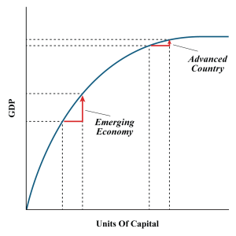
6.8 Economic Convergence and Catch up II
Catch-up implies circumstances under which relatively low-income countries grow at a faster rate than high income or advanced economies.
Due to this faster growth rate eventually, the low-income countries can “catch up” to the high-income countries in terms of their per capita GDP.

Slide 20
6.9 Key Terms
Aggregate production function
Human capital
Labour Productivity
Long run economic growth
Output per capita
Rule of 70
Technological change

