Slide 1

Principles of Macroeconomics
CHAPTER 9: AGGREGATE DEMAND-AGGREGATE SUPPLY
Unless otherwise noted, this work is licensed under a Creative Commons Attribution-NonCommercial-ShareAlike 4.0 International (CC BY-NC-SA 4.0) license. Feel free to use, modify, reuse or redistribute any portion of this presentation.

Slide 2
Learning Outcomes
At the end of this chapter, you will be able to:
Explain the determinants of Aggregate Demand
Explain the determinants of Aggregate Supply
Define Macroeconomic Equilibrium in the Long Run and the Short Run
Identify Output Gaps

Slide 3
9.1 Aggregate Supply I
The Aggregate Demand-Aggregate Supply model answers questions about what determines the level of economic activity and what causes economic activity to speed up or slow down.
Decisions are made about the quantity of output based on profits expected, which are determined by the sell price of the outputs and the inputs needed.
The aggregate supply (AS) curve shows total quantity of output firms will produce and sell at each aggregate price level, holding the price of inputs fixed.

Slide 4
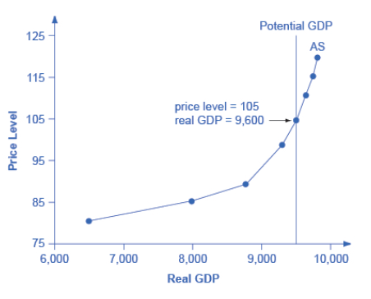
9.1 Aggregate Supply II
The short run aggregate supply curve slopes up to show that as the price level for outputs rises and the price of inputs remains fixed there is an incentive to produce more. (movement along the AS curve).
In the long run, real GDP is independent of price level so the long run aggregate supply curve is a vertical line at potential GDP.

Slide 5
9.1 Aggregate Supply III
When real GDP (shown by the AS curve) is equal to potential GDP, the economy faces full employment, unemployment (UN) is at its natural rate.
To the left of the potential GDP line, real GDP is less than Potential GDP, and the economy faces recession, UN is greater than its natural rate.
To the right of the potential GDP line, real GDP is greater than Potential GDP, and the economy faces inflation, UN is less than its natural rate.

Slide 6
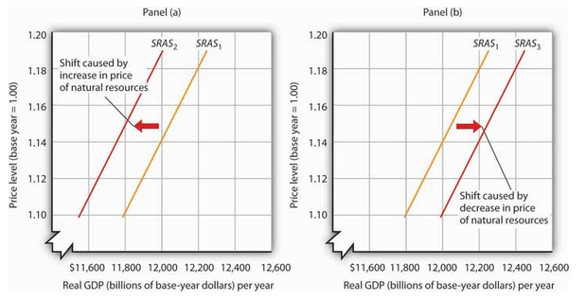
9.1 Changes or Shifts in the Short Run Aggregate Supply Curve
Notes:
Changes in the factors held constant in drawing the short-run aggregate supply curve will shift the curve. An increase in capital stock or an increase in natural resources, or technological advancement, or a fall in the prices of factors of production will shift the Aggregate Supply curve rightward.
In Panel (a), SRAS1 shifts leftward to SRAS2 that is caused by an increase in the price of natural resource. A decrease in the price of a natural resource would lower the cost of production and, other things unchanged, would allow greater production from the economy’s stock of resources and would shift the short-run aggregate supply curve to the right; such a shift is shown in Panel (b) by a shift from SRAS1 to SRAS3.

Slide 7
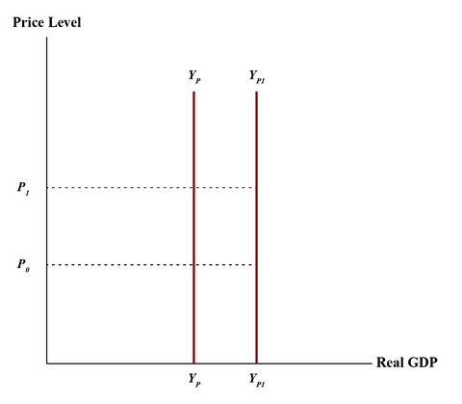
9.1 Changes or Shifts in the Long Run Aggregate Supply Curve
Growth in Labour productivity as a result of advances in technology and knowledge increases potential GDP (PGDP). The PGDP line shifts rightward.
Notes:
Growth in the labour force and improvements in labour productivity increase the economy’s potential GDP or potential output over time. Labour productivity grows as a result of advances in technology and knowledge coming from investments in capital equipment, education and training

Slide 8
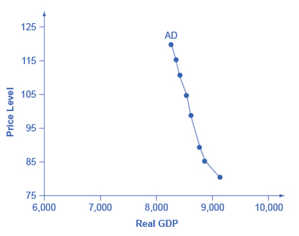
9.2 Aggregate Demand I
The aggregate demand equation consists of the following components:
AD = C + I + G + X - M
The aggregate demand curve shows the total spending on domestic goods and services at each price level.
The downward slope shows that a decrease in aggregate price level leads to an increase in the quantity of aggregate spending (movement along the AD curve).

Slide 9
9.2 Aggregate Demand II
There are 3 reasons why AD curves have downward slope
  Wealth Effect: as prices increase the buying power of savings diminish.
  Interest Rate Effect: as prices for outputs rise, the same purchases will take more money or credit to accomplish.
  Foreign Price Effect: if Canadian prices rise, exports will be relatively more expensive and the export quantity will fall while imported goods will be relatively cheaper and the quantity of imports will rise.

Slide 10
9.2 Changes or Shifts in the Aggregate Demand Curve I
Changes in consumption is affected by:
  Consumer confidence
  Tax policy
  Transfer payments
Changes in investment
  Choices are made on future expectations.
  Changes in interest rate affect the cost of borrowing.
Changes in Net Exports
  An increase in foreign GDP increases Canada’s net exports while slumps in foreign countries reduce Canadian exports.
  Canadian Exchange rate increases raise the price of Canadian goods to foreigners and reduce exports while increasing imports.

Slide 11
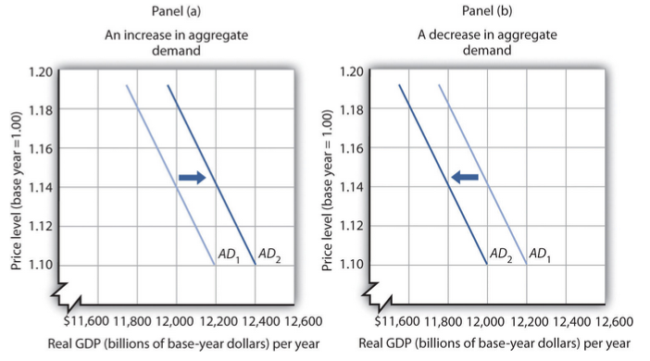
9.2 Changes or Shifts in the Aggregate Demand Curve II
Notes:
A change in the aggregate quantity of goods and services demanded at every price level is a change in aggregate demand, which shifts the aggregate demand curve. Increases and decreases in aggregate demand are shown in Fig 9.6 below. Changes occur when the price level is constant.

Slide 12
9.2 Changes or Shifts in the Aggregate Demand Curve III
Panel A shows an increase in consumer confidence or a fall in income taxes, could increase AD.
Panel B shows a rise in the interest rate or an appreciation of the CAD, could decrease AD.

Slide 13
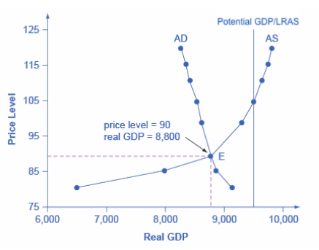
9.3 Equilibrium in the AD-AS Model
The intersection of the aggregate supply (AS) and aggregate demand (AD) curves shows:
  The equilibrium level of real GDP
  The equilibrium price level in the economy
The is the short run macro equilibrium

Slide 14
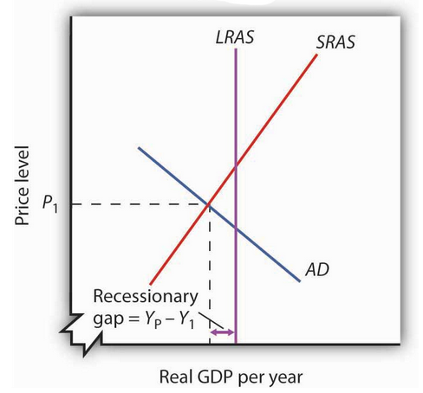
9.3 Recessionary and Inflationary Gaps I
Real GDP and price level are determined by the intersection of the aggregate demand and short-run aggregate supply curves.
When employment below natural level, real GDP will be below potential and the intersection will be to the left of the long-run aggregate supply curve. This gap between real and potential GDP (LRAS) is called the recessionary gap.

Slide 15
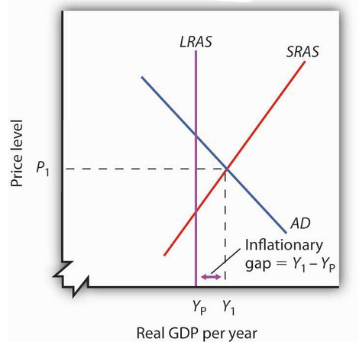
9.3 Recessionary and Inflationary Gaps II
When employment is above natural level, real GDP will be greater than potential and the intersection will be to the right of the long-run aggregate supply curve. This gap between real and potential GDP is called the inflationary gap.

Slide 16
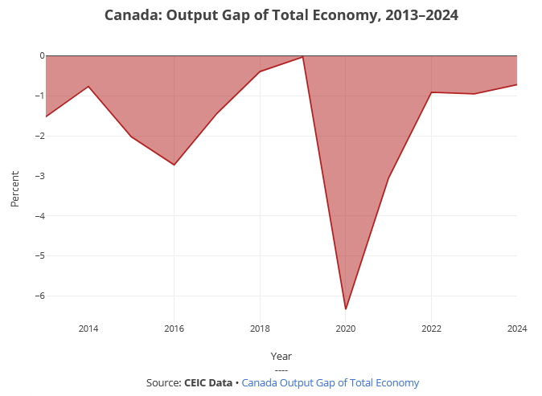
9.3 Recessionary and Inflationary Gaps III
The Bank of Canada’s estimates of differences between actual and potential GDP for Canada from 1992_{Q1} to 2019_{Q1}

Slide 17
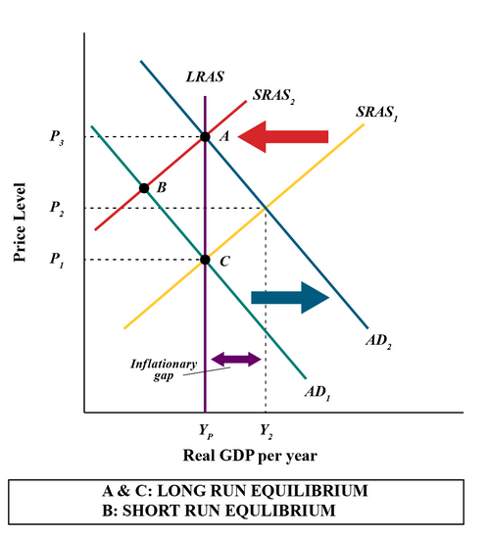
9.4 Shifts in Aggregate Demand I
If aggregate demand increases, the curve shifts from AD₁ to AD₂
Real GDP will increase to Y₂ and force prices levels to P₂
The new production level, Y₂, exceeds potential output (inflationary gap)
Nominal wages will rise and the short-run aggregate supply curve will shift left.
When it reaches SRAS2 the economy will have returned to its potential output
The inflationary gap will be closed and at price level P₃, the economy will reach the new Long run equilibrium at point A.

Slide 18
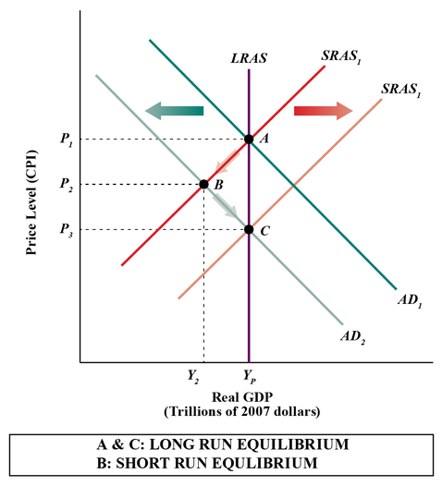
9.4 Shifts in Aggregate Demand II
If aggregate demand decreases, the curve shifts from AD₁ to AD₂
Real GDP will decrease to Y₂ and force the price level to fall to P₂
The new production level Y₂ is less than potential output and employment is less than its natural level (recessionary gap)
As nominal wage falls the short-run aggregate supply curve will shift to the right
When it reaches SRAS₂ the economy will have returned to its potential output, employment will have returned to its natural level, and at price level P₃ the economy reaches the new Long run equilibrium at point C

Slide 19
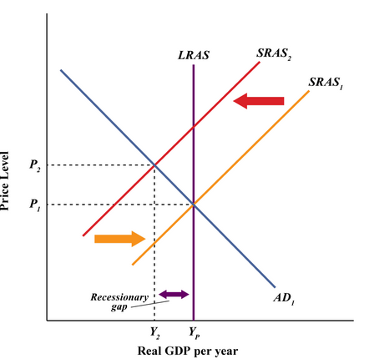
9.4 Shift in Aggregate Supply
If the short-run aggregate supply curve shifts due to an increase in the cost of production there will be a reduction from SRAS₁ to SRAS₂
Price level rises to P₂ and real GDP falls to Y₂
There is a recessionary gap between Y_{P} and Y₂ called stagflation

Slide 20
9.5 Gaps and Public Policy
Economic gaps have 2 alternatives
  Non-intervention policy
    Allow the economy to adjust on its own back to potential output
  Stabilization policy
    Work on policies that shift the aggregate demand or short-run aggregate supply curves

Slide 21
9.5 Key Terms
Aggregate demand (AD)
Aggregate demand curve
Aggregate supply (AS)
Aggregate supply curve
Exchange rate
Foreign price effect
Full-employment GDP
Inflationary gap
Interest rate effect
Long run aggregate supply (LRAS) curve
Long run macro equilibrium
Recessionary gap
Short run aggregate supply (SRAS) curve
Short run macro equilibrium
Stagflation
Wealth effect

