Slide 1
Introduction to Marketing
Module 3: Segmentation and Targeting
Notes:
All text in these slides is taken from https://courses.lumenlearning.com/wmopen-principlesofmarketing/, where it is published under one or more open licenses.
All images in these slides are attributed in the notes of the slide on which they appear and licensed as indicated.
Cover Image: "Shopping freak." Provided by: freestocks.org. Located at: https://unsplash.com/photos/_3Q3tsJ01nc. Content Type: CC Licensed Content, Shared Previously. License: CC0: No Rights Reserved.

Slide 2

Segmentation and Targeting
Segmentation is the process of dividing a broader market into smaller groups of customers who share similar characteristics, needs, or behaviours.
Targeting involves evaluating those segments and selecting the most appropriate ones to pursue with customized marketing strategies
Professional tennis players are a specific segment of the market.
Notes:
2014 US Open (Tennis) - Tournament - Dustin Brown. Authored by: Steven Pisano. Located at: https://www.flickr.com/photos/stevenpisano/15140591721/. License: CC BY: Attribution

Slide 3
Five Criteria for a Market
There must be a true need and/or want for the product, service, or idea; this need may be recognized, unrecognized, or latent
The person/organization must have the ability to pay for the product via means acceptable to the marketer
The person/organization must be willing to buy the product
The person/organization must have the authority to buy the product
The total number of people/organizations meeting the previous criteria must be large enough to be profitable for the marketer

Slide 4
Objectives of Segmentation
To improve an organization’s understanding of who their prospective customers are and how to serve them
To reduce risk in deciding where, when, how, and to whom a product, service, or brand will be marketed
To increase marketing efficiency by directing effort toward designated segment(s) in ways that are consistent with that segment’s characteristics

Slide 5
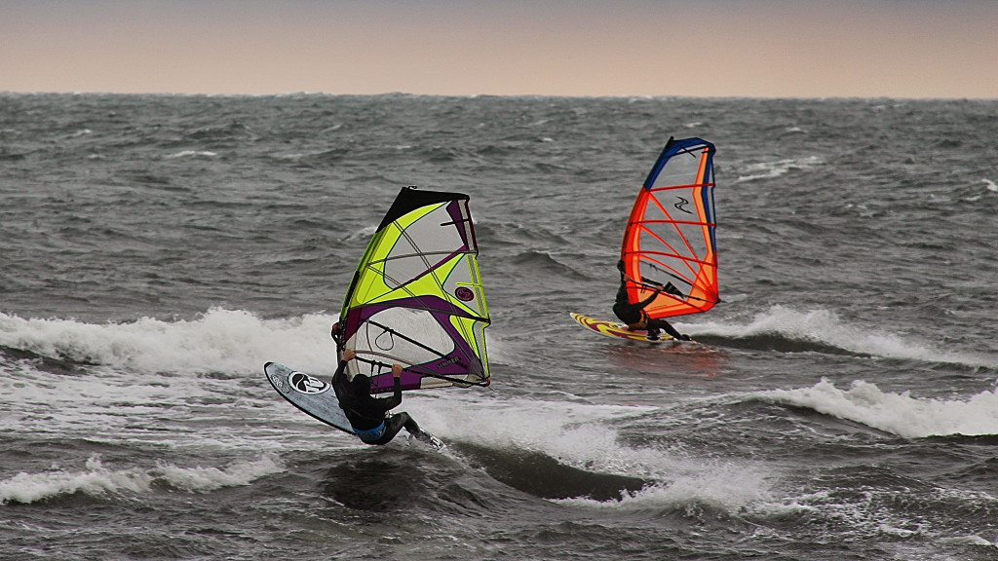
Choosing a Target Market
The target market should include only those segments of a market that are both:
Profitable to serve
Likely to be receptive to the products a company provides
Notes:
Windsurfing at Gislu00f6vshammar. Authored by: Matthias Weinberger. Located at: https://www.flickr.com/photos/infomastern/10271441954/. License: CC BY-SA: Attribution-ShareAlike

Slide 6
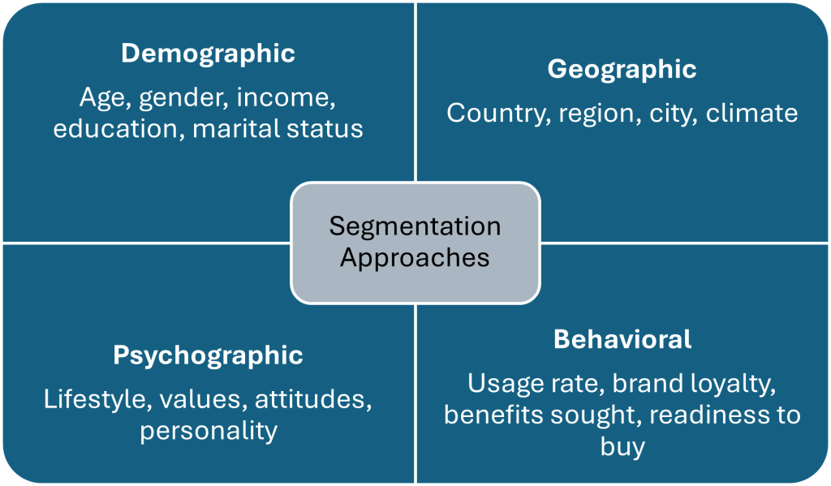
Common Market Segmentation Approaches
Notes:
The following is a list of common market segmentation approaches:
Geographic criteria—countries, provinces, regions, cities, neighbourhoods–define geographic market segments.
Demographic segmentation consists of dividing the market into groups based on demographic variables such as age, gender, family size, income, occupation, education, religion, political opinions, ethnicity, and nationality.
In psychographic segmentation, consumers are divided according to common characteristics in their lifestyle, personality, attitudes, and social class.
Behavioral Segmentation: behaviours link to their knowledge of, attitude toward, use of, or response to a product.
User status: Looking beyond “heavy users,” it can also be helpful to identify segments based on a broader set of use patterns, such as non-users versus ex-users, or one-time users versus regular users. Smartphone and Android service providers examine usage patterns to create optimal plans and targeting based on specific sets of user needs: family plans, individual plans, no-contract plans, unlimited talk and data plans, and so forth. New car producers have become very sensitive to the need to provide new car buyers with a great deal of supportive information after the sale in order to minimize unhappiness after the purchase.
Purchase occasion: This approach tries to determine the reason or occasion for purchasing a product and how it will be used. For example, airlines typically segment customers based on the reason for a passenger’s trip: business versus personal travel. Someone traveling for business generally has different needs and wants from someone traveling for pleasure. A business traveler tends to be less sensitive about price and more focused on timing, location, and convenience.
Loyalty: This approach places consumers in loyalty categories based on their purchase patterns of particular brands. A key category is the brand-loyal consumer. Companies have assumed that if they can identify individuals who are brand loyal to their brand, and then delineate other characteristics these people have in common, they will locate the ideal target market. There is still a great deal of uncertainty about the most reliable way of measuring brand loyalty.
Readiness: Readiness segmentation proposes that potential customers can be segmented according to how ready they are to purchase a product: unaware, aware, informed, interested, desirous, and intend to buy. Using this approach, a marketing manager can design the appropriate market strategy to move them through the various stages of readiness. These stages of readiness are rather vague and difficult to measure accurately, but readiness may be a useful lens for understanding the customer’s mindset and how to nudge them toward buying, particularly when an education process is required prior to purchase.
Decision-maker: This segmentation approach groups people according to who makes the purchasing decision in an organization or household. Typically there is a “primary buyer”: the individual who makes the final decision about what to buy and allocates the budget for the purchase. Many purchasing decisions also involve “influencers.” These are people who do not make the final purchasing decision, but they can influence the final choice about what to buy.

Slide 7
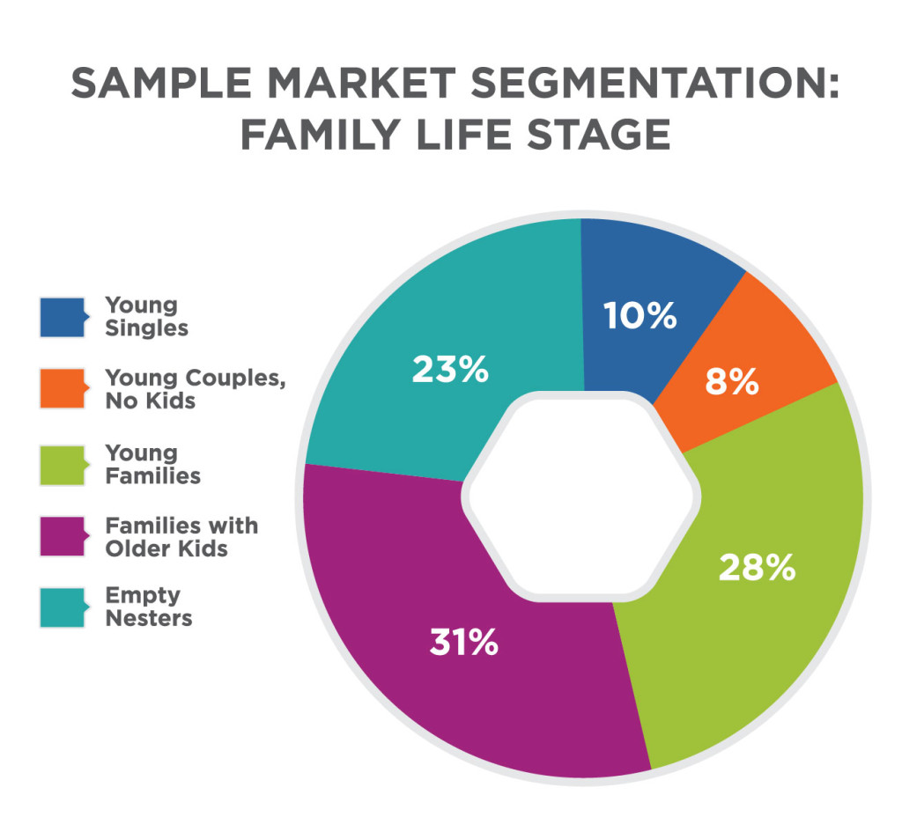
Practice Question
What products or companies would find this market segmentation by family life stage useful?
Notes:
Answers may vary. McDonald’s is an example in the module. Companies that sell foods, clothes, toys, etc. Hot restaurants might want to capture the young couples and empty nesters.
Sample Market Segmentation (Chart). Authored by: Lumen Learning. License: CC BY: Attribution

Slide 8

Combining Bases for Segmentation
Geo-cluster approach demographic + geographic data
Geographic + behavioral data
  Can point companies toward locations where customers are clustered
Demographic + lifestyle or behavioral segments
Notes:
Marketers may find it most useful to combine different bases for segmentation in order to create a richer picture of their target market.
A “geo-cluster” approach combines demographic data with geographic data to create a more accurate profile of a specific consumer.
Geographic data combined with behavioural data can point companies toward locations where customers are clustered who demonstrate behaviours that make them a good target for a company’s product.
Overlaying demographic data onto lifestyle or behavioural segments helps marketers understand more about their target customers and how to reach them effectively with the marketing mix.
Sophie shopping. Authored by: David Veksler. Located at: https://www.flickr.com/photos/heroiclife/15316262230/. License: CC BY-SA: Attribution-ShareAlike

Slide 9
Common Business Segmentation Approaches
Organization size: by revenue, number of employees, geographic reach, etc.
Geography
Industry
User status: usage frequency, volume used, loyalty, longevity, products already in use, readiness to buy, etc.
Benefits sought
End use
Purchasing approaches
Notes:
Organization size: segmentation according to large, medium, and small customers by revenue, by number of employees, by geographic reach, etc.
Geography: organizing segments based on geographic location
Industry: segmenting by the industrial sector an organization operates within—for example manufacturing, retail, hospitality, education, technology, health care, government, professional services, and so forth
User status: usage frequency, volume used, loyalty, longevity, products already in use, readiness to buy, etc. For example, longtime loyal customers with “strategic” relationships are often handled differently and receive preferable terms compared to newer customers.
Benefits sought: grouping customers by common elements they look for in a product or purchasing experience
End use: identifying segments based on how they plan to use the product and where it fits into their operations and supply chain. For example, an electric motor manufacturer learned that customers operated motors at different speeds. After making field visits and confirming these uses, he thought to divide the market into slow-speed and high speed segments. In the slow-speed segment, the manufacturer emphasized a competitively priced product with a maintenance advantage, while in the high-speed market product, superiority was stressed.
Purchasing approaches: organizing the market according to the way in which organizations prefer to make purchases; those preferences, in turn, determine how the seller builds the relationship with the customer and works the deal.

Slide 10
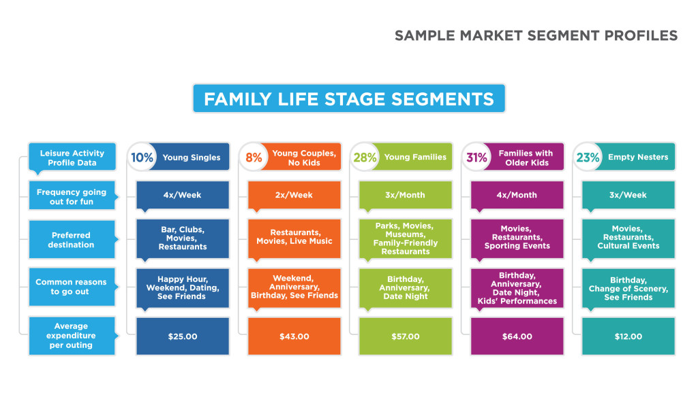
Some Market Segment Profiles

Slide 11
Ideal Market Segment
It’s measurable
It’s profitable
It’s stable
It’s reachable
It’s internally homogeneous
It’s externally heterogeneous
It’s responsive
It’s cost-effective
It helps determine the marketing mix
Notes:
If your segmentation approach fails to meet any of these conditions, you should go back to the drawing board to refine it. If any one of these factors is not in place, your market segmentation may actually undermine the effectiveness of your marketing and business. But with all these factors in place, market segmentation will point you toward the most promising customer groups in your target market.
It’s possible to measure. If you can’t measure it, you can’t collect data to know who the segment is or how to reach them.
It’s profitable. Segments must have the resources to purchase the product and be large enough to earn a profit for the company; otherwise they aren’t worth pursuing.
It’s stable. Segments need to stick around long enough for you to execute your marketing plan.
It’s reachable. It must be possible for marketers to reach potential customers via the organization’s promotion and distribution channel(s).
It’s internally homogeneous. Potential customers in the same segment must prefer the same product qualities and exhibit similar characteristics that are pertinent to the segmentation approach.
It’s externally heterogeneous. Potential customers from different segments have different product quality preferences and characteristics that affect their purchasing decisions.
It’s responsive. Segments should respond consistently to a given market stimulus or marketing mix. If they do not, then marketing efforts directed at them will not be well spent.
It’s cost-effective. Worthwhile market segments can be reached by marketing activities in a cost-effective manner. If too expensive to reach, then serving this segment will negatively impact profits.
It helps determine the marketing mix. Ideally, when you have identified a market segment, you’ll have insight into ways of shaping the combination of product, promotion, price, and place to fit that segment’s needs.

Slide 12
Questions to Consider in Selecting a Target Segment
Whose needs can you best satisfy?
Who will be the most profitable customers?
Can you reach and serve each target segment effectively?
Are the segments large and profitable enough to support your business?
Do you have the resources available to effectively reach and serve each target segment?

Slide 13
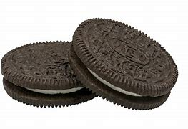
Class Activity
Some products are marketed differently depending on the country or region. This is called a differentiated marketing strategy. A good example is the Oreo cookie, which has many unique variations around the world.
Do you eat Oreo’s?
Activity Steps
Explore Oreo Variations
  In groups, research Oreo flavors and packaging from different countries.
  Collect images of these products and record:
  a) The country/region
  b) The image of the Oreo variation
Share with the Class
  Present your group’s findings.
  Highlight the differences you noticed in flavors, packaging, or marketing approaches between regions.
Think Beyond Oreos
  After exploring Oreo, brainstorm other products that use a differentiated marketing strategy based on geographic segmentation.
  Be prepared to share at least one example with the class.
Notes:
Image Copyright info: Vanamo Media Public Domain http://commons.wikimedia.org/
Looking to turn this into a worksheet activity for Brightspace?
Worksheet: Differentiated Marketing Strategy
Name: ___________________________
Group Members: ___________________________
Date: ___________________________
Part 1: Explore Oreo Variations
Research Oreo products in different countries. Collect images and record your findings in the table below.
Country/RegionImage of Oreo ProductNotes on Flavor/Packaging/Marketing
(Add more rows as needed.)
Part 2: Share with the Class
Be ready to present your findings to the class.
Highlight how Oreo changes its product, packaging, or marketing across regions.
Part 3: Beyond Oreo
List two other products you can think of that use a differentiated marketing strategy based on geographic segmentation:
Product 1: ___________________________
Product 2: ___________________________
Explain briefly how each product changes across regions (flavors, design, price, ads, etc.):
Reflection Question:
Why do you think companies adapt their products and marketing strategies for different geographic regions?
______________________________________________________________________________________________________________________________________________________________________________________________________________________________________________________

Slide 14
Targeting Strategy
Concentration
Multi-segment
Only one marketing mix is developed
Advantage: focus
Disadvantage if demand in segment declines, company will suffer
Marketing mix for each segment
Advantage: may reach more customers
Disadvantage: Costs of multiple campaigns and distribution channels
Notes:
In the concentration strategy, a company chooses to focus its marketing efforts on only one market segment.
Only one marketing mix is developed: the combination of product offerings, promotional communications, distribution, and pricing targeted to that single market segment. The primary advantage of this strategy is that it enables the organization to analyze the needs and wants of only one segment and then focus all its efforts on that segment. The primary disadvantage of concentration is that if demand in the segment declines, the organization’s sales and financial position will also decline.
In the multisegment strategy, a company focuses its marketing efforts on two or more distinct market segments.
The organization develops a distinct marketing mix for each segment. Then they develop marketing programs tailored to each of these segments. This strategy is advantageous because it may increase total sales with more marketing programs targeting more customers. The disadvantage is the higher costs, which stem from the need for multiple marketing programs that may include segment-specific product differentiation, promotions and communication, distribution/delivery channels, and pricing.

Slide 15
Targeting Strategies
Strategy | Target Market | Example
Mass marketing | Everybody everywhere | Superstore, Tim Hortons
Differentiated marketing | Large groups within the total market | Costco, Sam’s Club
Niche marketing | High penetration within smaller, specialized segments | Jollytails, Cows Ice Cream
Micromarketing | Individual customers or localized microsegments | Local Farmer’s markets
Notes:
Mass marketing, also called undifferentiated marketing, involves marketing to the entire market the same way. Mass marketing effectively ignores segmentation and instead generates a single offer and marketing mix for everyone. The market is treated as a homogeneous aggregate. Mass marketing aims to reach the largest audience possible, and exposure to the product is maximized.
A differentiated marketing strategy is one in which the company decides to provide separate offerings to each different market segment that it targets. It is also called multisegmented marketing. Each segment is targeted in a particular way, as the company provides unique benefits to different segments. The goal is to help the company increase sales and market share across each segment it targets. Proctor and Gamble, for example, segments some of its markets by gender, and it has separate product offerings and marketing plans for each: Secret-brand deodorant for women, and Rogaine (a treatment for hair loss) for men
Niche marketing (also called concentrated marketing) is a strategy that targets only one or a few very defined and specific segments of the consumer population. The goal is to achieve high penetration among the narrowly defined target segments. For example, the manufacturer of Rolex watches has chosen to concentrate on only the luxury segment of the watch market.
Micromarketing is a targeting strategy that focuses even more narrowly than niche marketing. It caters to the needs of individuals (“individual marketing”) or very small segments in a targeted geography (“local marketing”). Micromarketing can be very powerful by giving consumers exactly what they want, when they want it. However, to achieve large-scale success with this approach, companies must figure out how to meet highly individualized needs efficiently and profitably.
Individual marketing is sometimes referred to as “mass customization” or “one-to-one marketing.” With this approach, companies offer consumers a product created to their individual specifications.
Local marketing is a targeting strategy focused expressly on a small, clearly defined neighborhood or geographic area. Organizations using this technique strive to generate a strong local presence, and targets may include any person or organization within that small area.

Slide 16
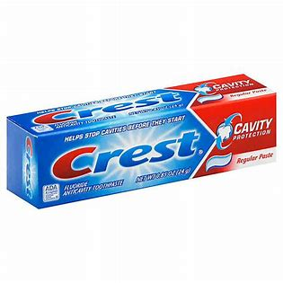

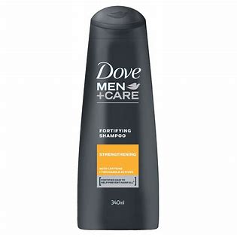
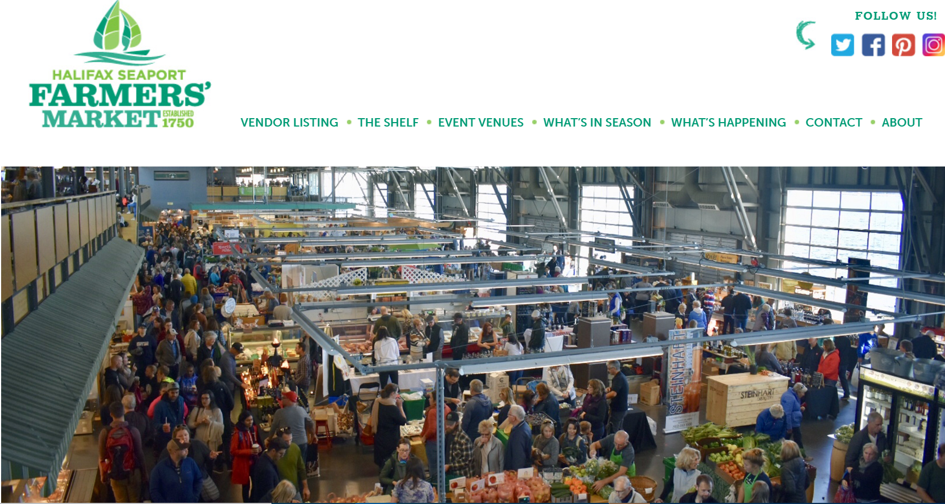
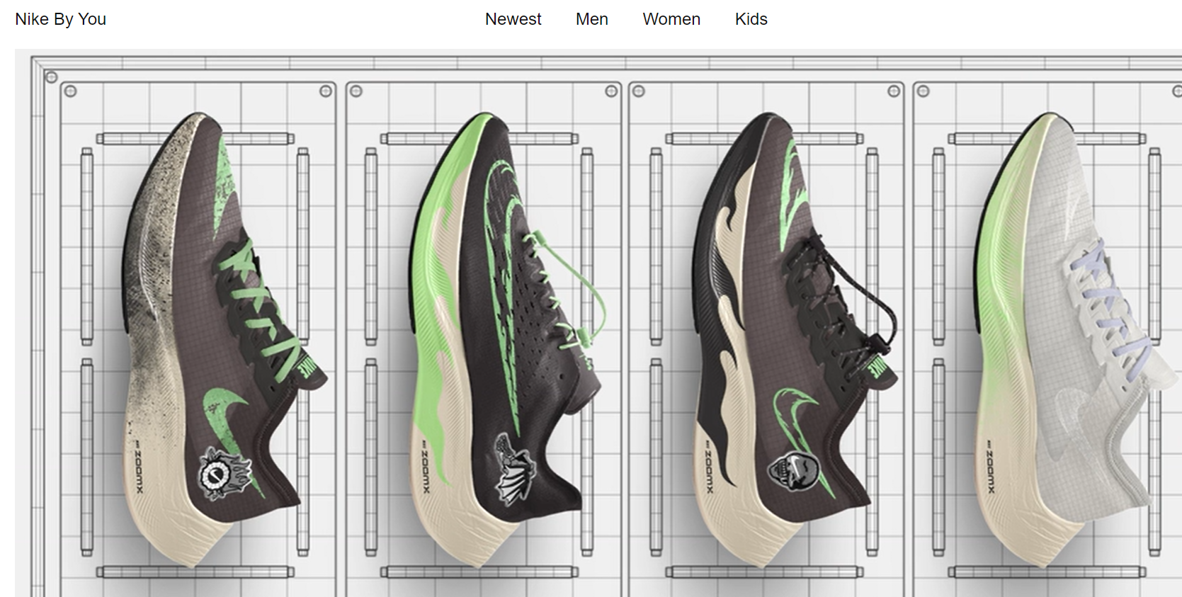
Match the product to the target strategy.
Strategy | Target Market
Mass marketing | Everybody everywhere
Differentiated marketing | Large groups within the total market
Niche marketing | High penetration within smaller, specialized segments
Micromarketing | Individual customers or localized microsegments
Notes:
Mass marketing, also called undifferentiated marketing, involves marketing to the entire market the same way. Mass marketing effectively ignores segmentation and instead generates a single offer and marketing mix for everyone. The market is treated as a homogeneous aggregate. Mass marketing aims to reach the largest audience possible, and exposure to the product is maximized.
A differentiated marketing strategy is one in which the company decides to provide separate offerings to each different market segment that it targets. It is also called multisegment marketing. Each segment is targeted in a particular way, as the company provides unique benefits to different segments. The goal is to help the company increase sales and market share across each segment it targets. Proctor and Gamble, for example, segments some of its markets by gender, and it has separate product offerings and marketing plans for each: Secret-brand deodorant for women, and Rogaine (a treatment for hair loss) for men
Niche marketing (also called concentrated marketing) is a strategy that targets only one or a few very defined and specific segments of the consumer population. The goal is to achieve high penetration among the narrowly defined target segments. For example, the manufacturer of Rolex watches has chosen to concentrate on only the luxury segment of the watch market.
Micromarketing is a targeting strategy that focuses even more narrowly than niche marketing. It caters to the needs of individuals (“individual marketing”) or very small segments in a targeted geography (“local marketing”). Micromarketing can be very powerful by giving consumers exactly what they want, when they want it. However, to achieve large-scale success with this approach, companies must figure out how to meet highly individualized needs efficiently and profitably.
Individual marketing is sometimes referred to as “mass customization” or “one-to-one marketing.” With this approach, companies offer consumers a product created to their individual specifications.
Local marketing is a targeting strategy focused expressly on a small, clearly defined neighborhood or geographic area. Organizations using this technique strive to generate a strong local presence, and targets may include any person or organization within that small area.

Slide 17
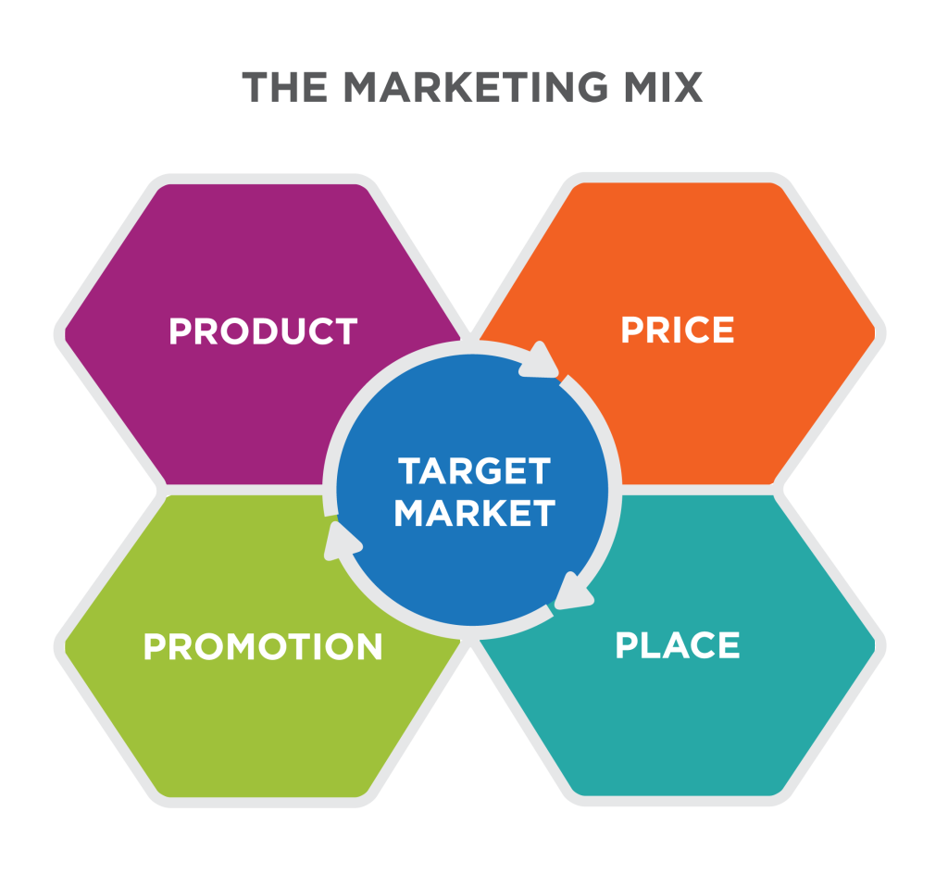
The Marketing Mix
Notes:
Defining the Marketing Mix. Provided by: Lumen Learning. License: CC BY-SA: Attribution-ShareAlike

Slide 18
Shaping Marketing Mix for Target Markets
Marketing Element | Targeting Criteria
Product | What would make the ideal product for your target segment? What special features or capabilities are critical for this segment? What unique problems does your product help them solve?
Promotion | What are the best ways to get your target segment’s attention? What do you want this segment to remember about your product?
Place / Distribution | Where does this segment look or shop for your product? What is the best way to get your product to your target customers?
Price | What price(s) are your target customers willing to pay? How much is too expensive? How much is too cheap?

Slide 19
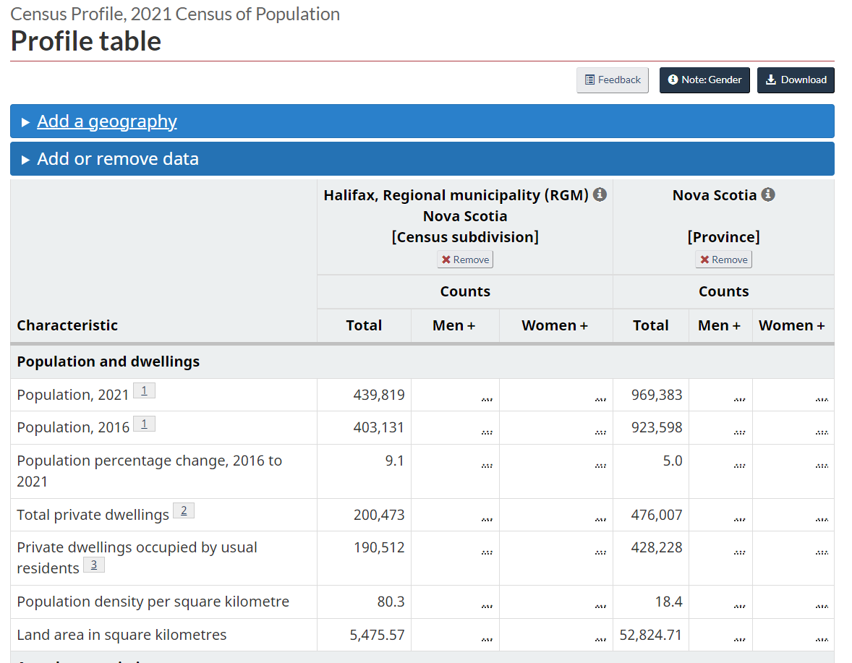
Statistics Canada
1.What was the population of Halifax in 2021?
2.What was the population of Nova Scotia in 2021?
3.What was the population of Halifax in 2016?

Slide 20
Notes:
1.What was the population of Halifax in 2016?
a)Males?
b)Females?
2.What was the population of Nova Scotia in 2016?
3.What was the population of Halifax in 2011?
3.How many more people were there in Halifax in 2016 vs. 2011?
4.How many people aged 20-29? (look carefully as you will need to add groups together)
5.What are the top 3 languages other than English and French? (look under “Mother Tongue languages” in the “non- official languages” ?

Slide 21
Notes:
1.What was the population of Halifax in 2016?
a)Males?
b)Females?
2.What was the population of Nova Scotia in 2016?
3.What was the population of Halifax in 2011?
3.How many more people were there in Halifax in 2016 vs. 2011?
4.How many people aged 20-29? (look carefully as you will need to add groups together)
5.What are the top 3 languages other than English and French? (look under “Mother Tongue languages” in the “non- official languages” ?

Slide 22
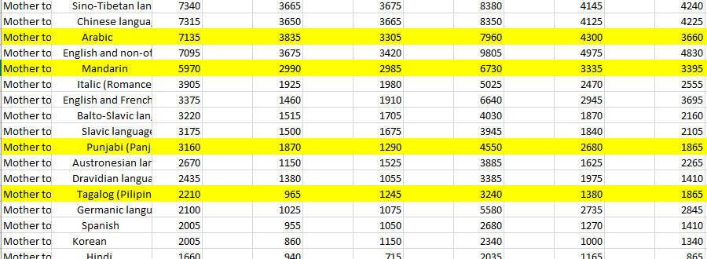
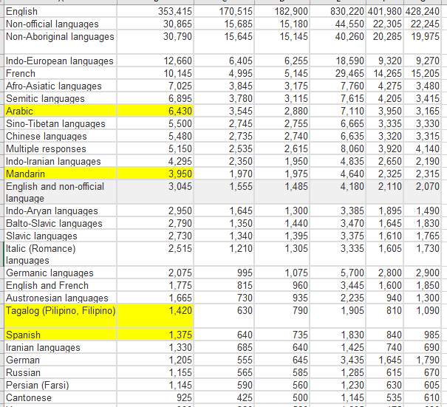
2021 Census
2016 Census

Slide 23
Activity
Target Strategy
Using the information identified in Market Segmentation, your team must now evaluate the various segments and decide how many and which segments you can serve best. Look at three factors to evaluate which segment you should target: segment size and growth, segment structural attractiveness and company objectives and resources. Be sure to include the approximate number of customers you will be targeting, use Statistics Canada to estimate your market size.
Once you’ve chosen the segment(s) you will target you must then determine the strategy you will use. Strategies include, but are not limited to, undifferentiated marketing, differentiated marketing, concentrated (niche) marketing, and micromarketing.

