Slide 1
Introduction to Marketing
Module 1: What is Marketing?
Notes:
All text in these slides is taken from https://courses.lumenlearning.com/wmopen-principlesofmarketing/, where it is published under one or more open licenses.
All images in these slides are attributed in the notes of the slide on which they appear and licensed as indicated.
Cover Image: "Shopping freak." Provided by: freestocks.org. Located at: https://unsplash.com/photos/_3Q3tsJ01nc. Content Type: CC Licensed Content, Shared Previously. License: CC0: No Rights Reserved.

Slide 2

What is Marketing?
Marketing is a set of activities related to creating, communicating, delivering, and exchanging offerings that have value for others.

Slide 3
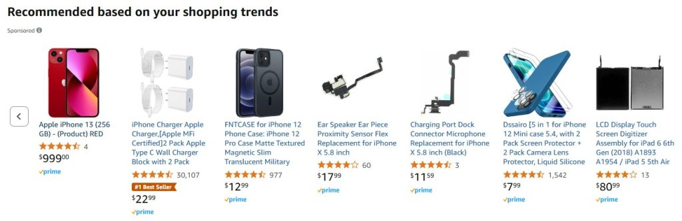
What is the function of marketing?
Marketing brings value to customers, whom the business seeks to identify, satisfy, and retain.
Notes:
Screen shot of Amazon unicorn recommendations. Provided by: Amazon. License: All Rights Reserved. License Terms: Fair Use

Slide 4
Exchange Process
In marketing, the act of obtaining a desired object from someone by offering something of value in return is called the exchange process.
the customer (or buyer): a person or organization with a want or need who is willing to give money or some other personal resource to address this need
the product: a physical good, a service, experience, or idea designed to fill the customer’s want or need
the provider (or seller): the company or organization that is offering a product (a good, service, experience, or idea) to satisfy a need
the transaction: the terms around which both parties agree to trade value-for-value (most often, money for product)

Slide 5
What are needs, wants & demands?
Needs | State of felt deprivation. • Physical, social and individual needs. • E.g. need for food
Wants | The form taken by human needs as they are shaped by culture and individual personality. • E.g. want a Big Mac
Demands | Human wants that are backed by buying power. • Willingness and ability to pay and purchase.

Slide 6
Class Activity
Needs
State of felt deprivation.
Want
The form taken by human needs as they are shaped by culture and individual personality.
Demand
Human wants that are backed by buying power.
Physical, social and individual needs.
E.g. need for food
E.g. want a Big Mac
Willingness and ability to pay and purchase.
Notes:
Class Activity: "From Hunger to a Big Mac"
Objective: To illustrate how basic human needs evolve into wants and then into demands, aligning with the marketing concept.
Step 1: Break into Groups
Divide the students into small groups (3–5 per group). Each group will work with a scenario.
Step 2: Assign a Scenario
Provide each group with a different basic human need. For example:
Hunger (food)
Thirst (drink)
Shelter
Social belonging
Safety/security
Entertainment
Step 3: Define the Need
Ask the group to define the need in the scenario (state of felt deprivation). Example: Hunger → Need for food.
Step 4: Translate to a Want
Ask them to shape the need into a want, showing how culture and personality influence it. Example: Hunger → Want a Big Mac, or sushi, or homemade pasta (depending on culture/personal preference).
Step 5: Move to Demand
Finally, ask them to turn the want into a demand, factoring in the ability and willingness to pay. Example: Hunger → Want a Big Mac → Demand a Big Mac meal from McDonald’s because they have the money and desire to buy it.
Step 6: Present & Compare
Each group presents their scenario, showing:
The need (basic deprivation)
The want (specific cultural/personal expression)
The demand (backed by buying power)

Slide 7
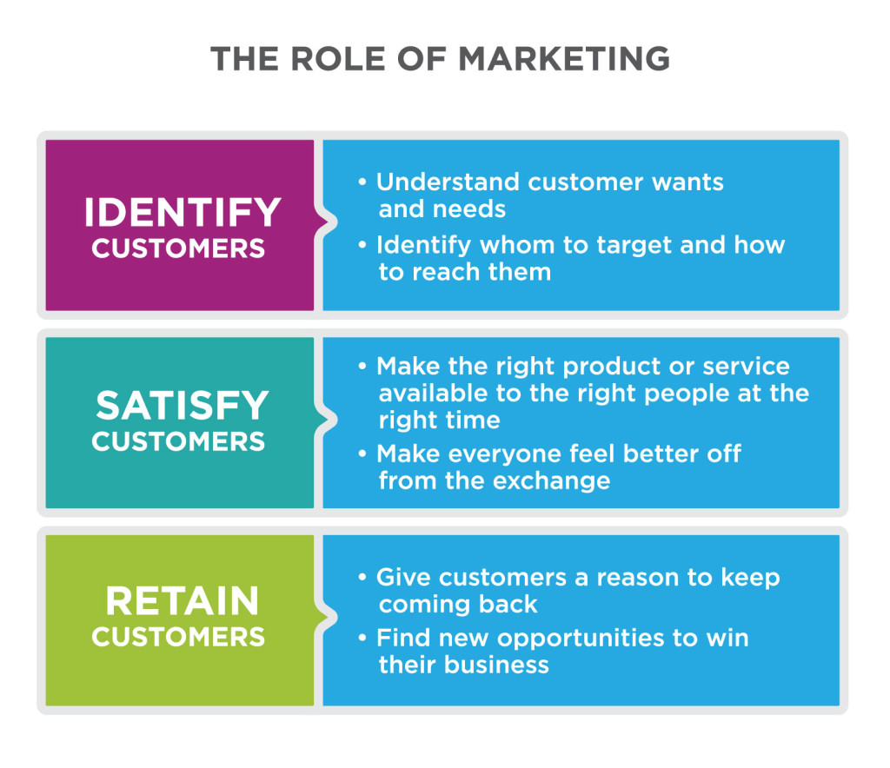
The Role of Marketing
Notes:
What Is Marketing?, Marketing Creates Value for Customers. Authored by: Lumen Learning. License: CC BY: Attribution

Slide 8
Marketing vs. Advertising
Advertising uses paid notices in different forms of media to draw public attention to a company, product, or message, usually for the purpose of selling products or services [1]
While advertising is a common and useful tool for marketing, it’s just one of many tactics marketers may use to achieve their goals.
Notes:
[1] "Advertising." The Free Dictionary. Accessed September 10, 2019. http://www.thefreedictionary.com/advertising

Slide 9
Marketing vs. Branding
Branding is the practice of “creating a name, symbol or design that identifies and differentiates a product from other products.” ^{[1]}
Marketing builds brands, and branding is an important strategic consideration in marketing, but marketing is broader than branding.
Notes:
[1] "Branding." Business Dictionary. Accessed September 10, 2019. http://www.businessdictionary.com/definition/branding.html

Slide 10
Marketing vs. Sales
Sales is the process of actually selling products or services, leading up to the point where the exchange of value takes place.
Effective marketing aligns well with the sales process and leads to increased sales, but there is more to marketing than just supporting sales

Slide 11
Company Orientations
Orientation | Focus Area | Key Assumption | Risk
Marketing Concept | Customer Needs | Understand and deliver better value than competitors | Requires ongoing effort, research, and coordination
Product Concept | Product Innovation | A technically superior product will sell itself | May overlook changing customer preferences
Sales Concept | Sales Process & Promotions | Good salespeople can sell anything | Customer dissatisfaction if product doesn’t meet needs
Production Concept | Efficiency & Low Cost | Customers prefer availability and affordability | May ignore ethics, sustainability, and quality
Notes:
The Marketing Concept
Success depends on doing better than competitors at understanding, creating, delivering, and communicating value to their target customers
The Product Concept
Success depends on creating the best, most innovative product for the lowest price
The Sales Concept
Success depends on a good sales team with the right tools and incentives.
The Production Concept
Success depends on low production costs, highly efficient processes, and mass distribution.

Slide 12

Relationship Stages
Meeting and Getting Acquainted
Providing a Satisfying Experience
Sustaining a Committed Relationship

Slide 13
Assignment #1
Marketing Journal- What is Marketing and How Does it Affect You?
Instructions are in Brightspace
Review assignment
Citation
Notes:
Marketing Journal
Assignment 1 Instructions
Please complete the following assignment by answering all five questions in detail. Use your OER textbook and other resources to support your answers.
Requirements:
Your answers should be written in complete sentences and organized in paragraph form.
Use a citation (APA 7) from the textbook for Question 1 definition.
For Question 2, you must use at least 10 glossary terms from OER Chapters 1–3 in your response. Be sure to highlight these terms.
For each example in Question 2, include a photo or screenshot to illustrate your point.
Length: Each question should be answered in at least one paragraph (4–6 sentences).
Submit your work as a typed document (Word or PDF).
Questions:
1.What is marketing? Provide the definition from the textbook and include a proper citation.
2. Examples of marketing in your life Provide 3 examples of where you encounter evidence of marketing in your daily life.
Use at least 10 glossary terms from the OER glossary (Chapters 1–3) in your explanation.
Include a photo or screenshot for each example (e.g., an ad on social media, product packaging in a store, or a promotion on a website).
3. Influence on choices How does marketing influence the choices you make as a consumer?
4. Attitudes and perceptions What impact does marketing have on your attitudes and perceptions toward products, services, or brands?
5. Effectiveness of marketing Why are various marketing activities effective or ineffective at reaching you as a customer or consumer?

Slide 14
Stage 1: Meeting and Getting Acquainted
Find
Find desirable target customers, including those likely to deliver a high customer lifetime value
Understand
Understand what these customers want
Build
Build awareness and demand for what you offer
Capture
Capture new business

Slide 15
Stage 2: Providing a Satisfying Experience
Measure and improve
Measure and improve customer satisfaction
Track
Track how customers’ needs and wants evolve
Develop
Develop customer confidence, trust, and goodwill
Demonstrate and communicate
Demonstrate and communicate competitive advantage
Monitor and counter
Monitor and counter competitive forces

Slide 16
Stage 3: Sustaining a Committed Relationship
Convert
Convert contacts into loyal repeat customers, rather than one-time customers
Anticipate and respond
Anticipate and respond to evolving needs
Deepen
Deepen relationships, expand reach of and reliance on what you offer

Slide 17

How Do Strong Customer Relationships Help a Business?
Happy customers . . .
Return to buy more goods and services
Help market the business with positive reviews or word of mouth
Engage with the brand

Slide 18
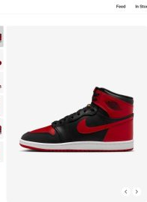
CRM
CRM: Customer Relationship Management
CRM is a business philosophy rooted in the marketing concept, where the entire organization is aligned around understanding and serving customer needs
Notes:
Image:Nike’s AJ1 ‘High ’85’ . Screen capture 2025-06-03 https://www.nike.com/ca/launch/t/air-jordan-1-high-85-emea

Slide 19

What is Customer Lifetime Value?
Customer lifetime value predicts how much profit the company will make from the customer during his or her lifetime relationship with the company ^{[1]}
#GoPro and #GoProAwards
https://youtu.be/0VfW6-1DM8Y
Notes:
Screen capture from Go Pro Awards video https://youtu.be/0VfW6-1DM8Y
[1] "Customer Lifetime Value." Cambridge Dictionary. Accessed September 10, 2019. http://dictionary.cambridge.org/us/dictionary/english/customer-lifetime-value

Slide 20
Goals of Marketing
For profit companies
Not for profit organizations
Increase profits by selling products or services to customers
Promote the mission by attracting donors or participants or by raising awareness of an issue or cause

Slide 21
Difference Between Customers and Consumers
Customers are the individuals who buy the product
Consumers are the individuals who actually use the product
The customer and the consumer are not always the same
Example: A food distributor’s customer is the restaurant, not the diner who is the consumer

Slide 22
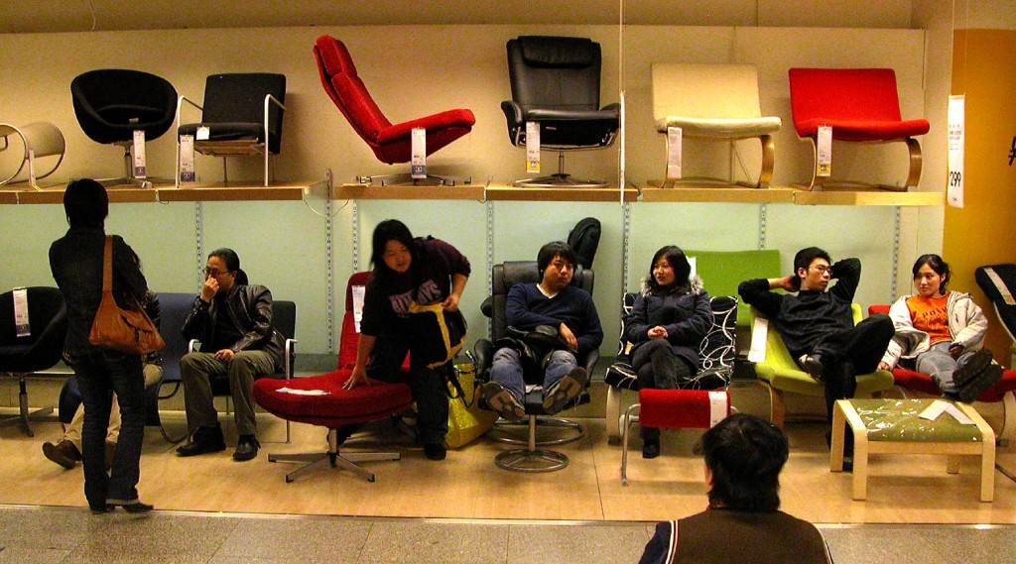
B2B vs. B2C
B2B or Business to Business companies sell products or services to other businesses
B2C or Business to Consumer companies sell directly to consumers
Notes:
IKEA, Bejing. Authored by: Peter Morgan. Located at: https://www.flickr.com/photos/pmorgan/5517848/. License: CC BY-NC-ND: Attribution-NonCommercial-NoDerivatives

Slide 23
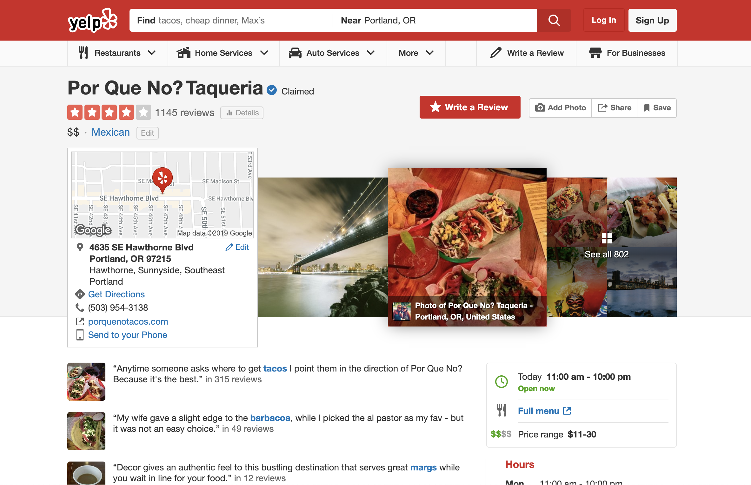
How does Marketing Serve Customers?
Marketing can help customers find goods and services that are valuable to them
Notes:
Screen Shot of Yelp Review. Authored by: Yelp.com. Located at: https://www.yelp.com/biz/por-que-no-taqueria-portland. License: All Rights Reserved. License Terms: Fair Use

Slide 24
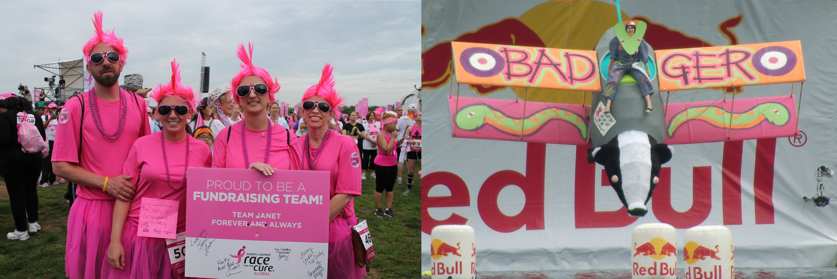
How Does Marketing Serve Society?
Marketing helps customers and businesses find each other to make exchanges that benefit them both
Marketing can spread ideas and innovation
Notes:
Global Race for the Cure. Authored by: Elvert Barnes. Located at: https://www.flickr.com/photos/perspective/13987275038/. License: CC BY-SA: Attribution-ShareAlike
Flugtag (22). Authored by: Helen Crook. Located at: https://www.flickr.com/photos/lalalen/2565923132/. License: CC BY-NC-ND: Attribution-NonCommercial-NoDerivatives

