Slide 1
Introduction to Marketing
Module 2: Marketing Function
Notes:
All text in these slides is taken from https://courses.lumenlearning.com/wmopen-principlesofmarketing/, where it is published under one or more open licenses.
All images in these slides are attributed in the notes of the slide on which they appear and licensed as indicated.
Cover Image: "Shopping freak." Provided by: freestocks.org. Located at: https://unsplash.com/photos/_3Q3tsJ01nc. Content Type: CC Licensed Content, Shared Previously. License: CC0: No Rights Reserved.

Slide 2

Marketing Orientation
Companies with a marketing orientation focus on identifying and understanding the customer’s needs and wants and addressing them more effectively or efficiently than one’s competitors

Slide 3

Why Do Customers Matter in Marketing?
Marketing exists to help organizations understand, reach, and deliver value to their customers
The customer is considered the cornerstone of marketing
Notes:
OOL. Authored by: Christian Rivera. Located at: https://www.flickr.com/photos/sevenfloorsdown/4543508614/. License: CC BY-NC-ND: Attribution-NonCommercial-NoDerivatives

Slide 4

Segmentation and Targeting
Segmentation is the process of dividing a broader market into smaller groups of customers who share similar characteristics, needs, or behaviours.
Targeting involves evaluating those segments and selecting the most appropriate ones to pursue with customized marketing strategies
Identify a target market for automotive detailing products.
Notes:
Step 1: Identify the Business Need You Address
To define your total market, start by stating the needs you will fulfill: Who are your products or services intended for? Who do you want to do business with? What is unique about your product? If you’re selling products used in automotive detailing, your total market consists of vehicle owners—that is, all the people who could potentially buy your product. Your business will help them keep their vehicles clean and shiny.
Step 2: Segment Your Total Market
Next, break down this large market into smaller sections, using a process known as segmentation. You can divide your total market into groups with common wants or needs. In this case, we can segment by vehicle ownership and related behaviour.
Market segment for automotive detailing products: will be automobile owners who have both the time and the interest to do their own detailing work—people who enjoy puttering with their vehicles, who have the time to spend, and who take pride in their vehicle’s appearance.

Slide 5
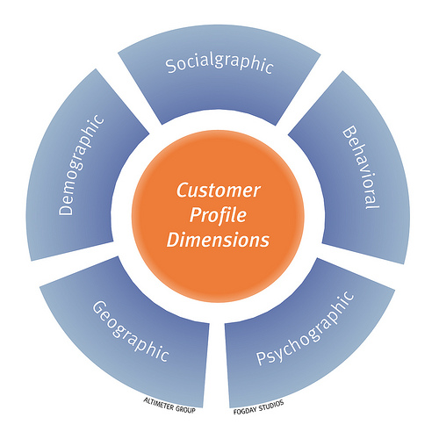
Defining a Target Market
Identify the business need you address
Segment your total market
Profile your target customer segment(s)
Research and validate your market opportunity
Notes:
Customer Profile Dimensions. Authored by: fogfish. Located at: https://www.flickr.com/photos/fogfish/4404316225. License: CC BY-SA: Attribution-ShareAlike
Develop profiles of your target customer(s) to get a true picture of the people you’re trying to serve. Describe these potential customers as fully as you can. Who will actually buy your product? What do you know about them? Where are they situated geographically? How much do they spend on car detailing? What are they likely to spend on your products? Where do they shop? What is their annual income? What languages do they speak? What kinds of automobiles do they drive? If you are selling online, what methods do they prefer for online payment? What type of Web sites do they visit? How do they want their product delivered?

Slide 6
Value for the Customer
Value is the measure of the benefit gained from a product or service relative to the full cost of the item.
Value = benefit – cost
Price is only part of cost
Customers will consider competitors and substitutes
Differentiation is how marketers optimize the elements of a product that provide unique value to customers
When a company can create greater value for customers than its competitors, it has a competitive advantage

Slide 7
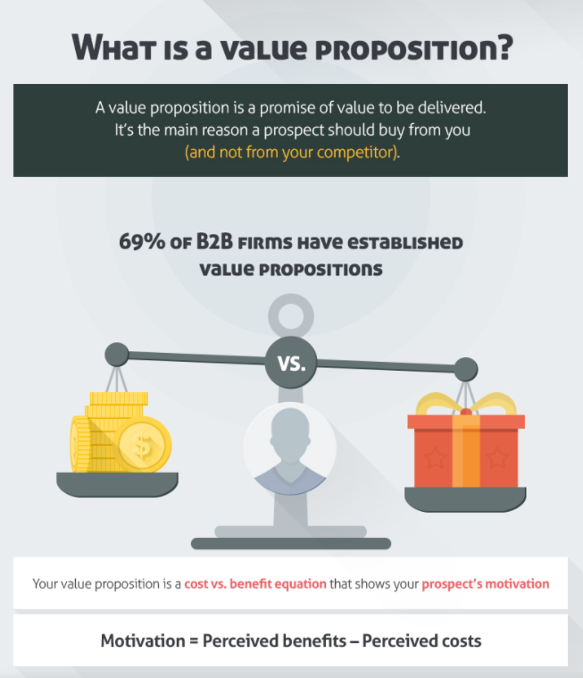
Value Proposition
A value proposition provides a very simple answer to the question: Why should someone buy what you are offering?
The value proposition should be clear, compelling, and differentiating.
Who? The value proposition does not name the target buyer, but it must show clear value to the target buyer.
What? The offering needs to be defined in the context of that buyer.
Why? It must show that the offering is uniquely valuable to the buyer.
More info on Value Proposition: https://www.quicksprout.com/value-proposition/
Notes:
A value proposition needs to very simply answer the question: Why should someone buy what you are offering? If you look closely at this question it contains three components:
Who? The value proposition does not name the target buyer, but it must show clear value to the target buyer.
What? The offering needs to be defined in the context of that buyer.
Why? It must show that the offering is uniquely valuable to the buyer.
A value proposition should be clear, compelling, and differentiating:
Clear: short and direct; immediately identifies both the offering and the value or benefit
Compelling: conveys the benefit in a way that motivates the buyer to act
Differentiating: sets the offering apart or differentiates it from other offerings
Shopify’s value proposition:
Shopify is everything you need to sell everywhere.
Image from https://www.quicksprout.com/value-proposition/ . Link for more info on the Value Proposition
Examples:
7 of the Best Value Proposition Examples We've Ever Seen
Uber – The Smartest Way to Get Around. ...
Apple iPhone – The Experience IS the Product. ...
Unbounce – A/B Testing Without Tech Headaches. ...
Slack – Be More Productive at Work with Less Effort. ...
Digit – Save Money Without Thinking About It. ...
LessAccounting – Bookkeeping, Without the Hassle.

Slide 8
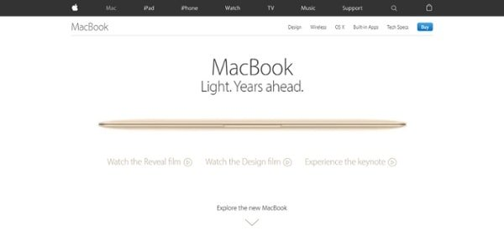
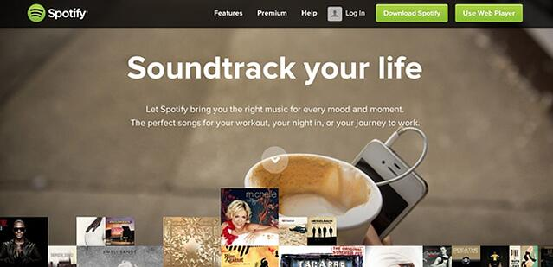
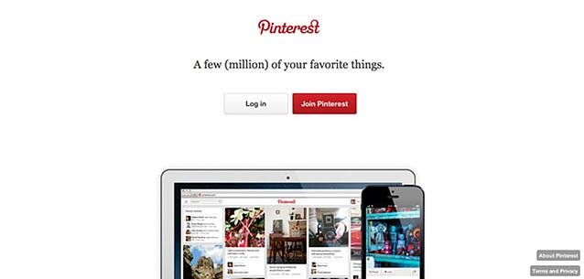
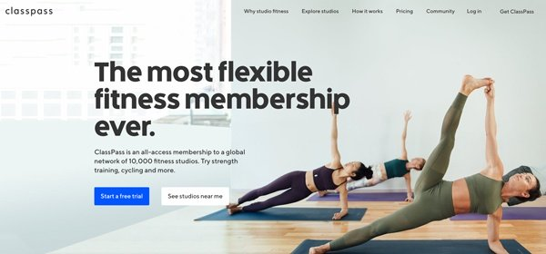
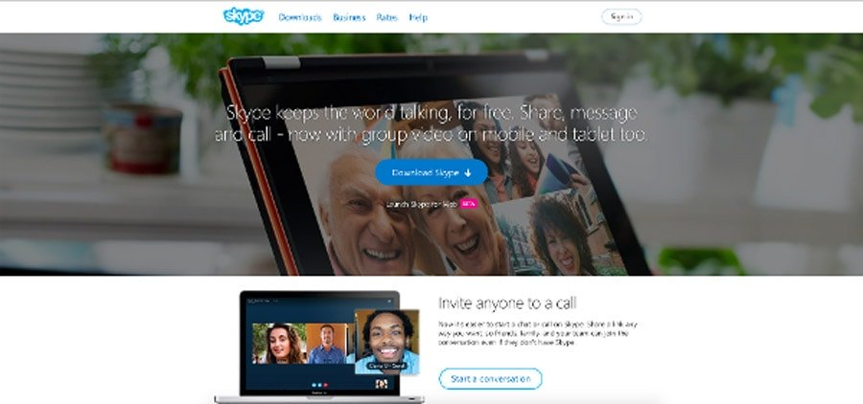
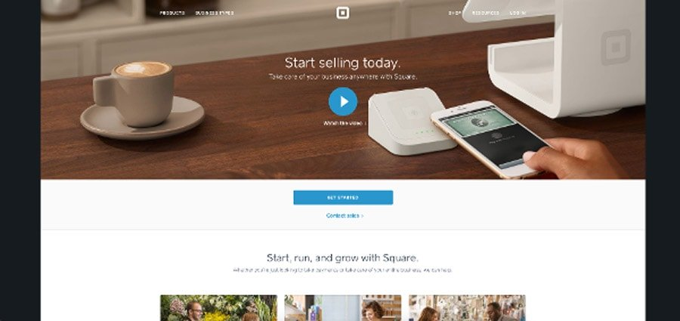
Skype keeps the world talking, for free.

Slide 9
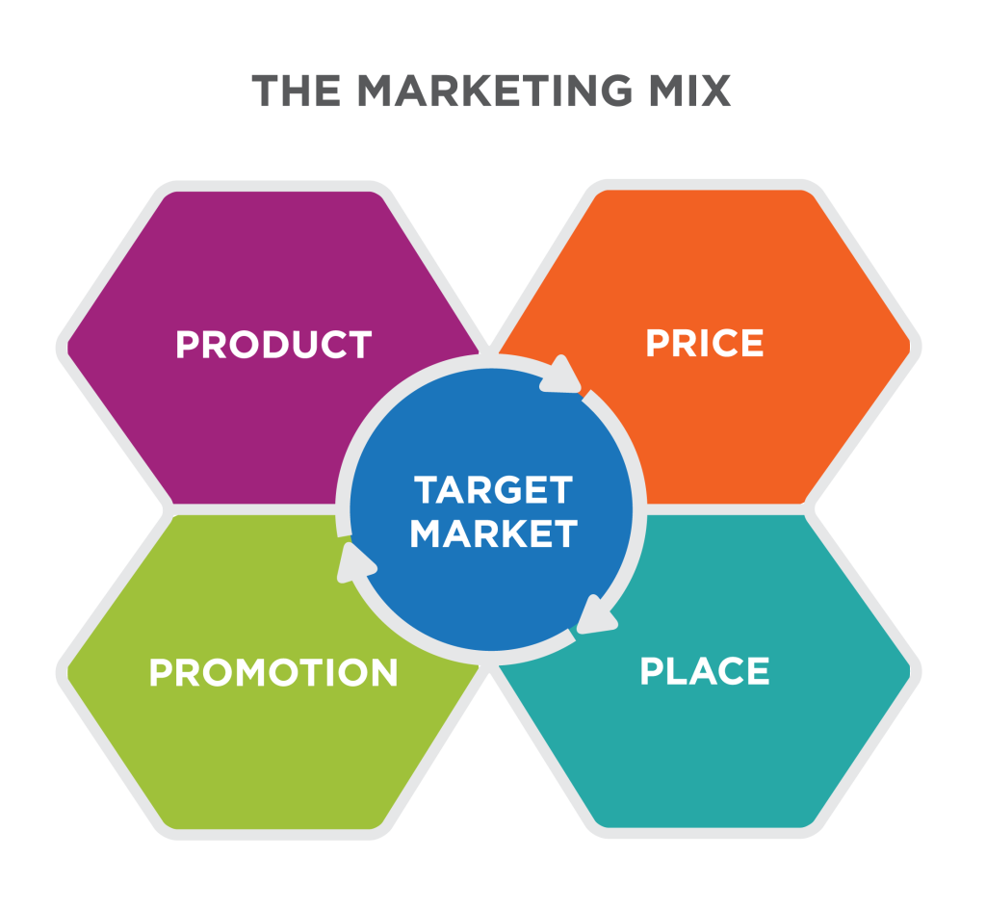
The Marketing Mix
Marketing Mix: represents the way an organization's broad marketing strategies are translated into marketing programs for action.
Notes:
Defining the Marketing Mix. Provided by: Lumen Learning. License: CC BY-SA: Attribution-ShareAlike

Slide 10
Evolving Definitions of the Marketing Mix
The 4 P’s
The 4 C’s
Product
Price
Promotion
Place
Consumer solution
Cost
Communication
Convenience
Notes:
The marketing mix represents the way an organization’s broad marketing strategies are translated into marketing programs for action. This combination—the marketing mix—is the combination of factors that a company controls to provide value to its target customers.
4Ps
Product: the goods and services offered
Promotion: communication and information
Place: distribution or delivery
Price: ensuring fair value in the transaction^{[1]}
The four Cs include a greater focus on the customer but align nicely with the older four Ps.
4Cs
Customer solution: what the customer wants and needs
Communication: a two-way dialogue with the customer
Convenience: an easy process to act or buy
Cost: the customer’s cost to satisfy that want or need^{[2]}
Product Consumer solution
A company will only sell what the consumer specifically wants to buy. So, marketers should study consumer wants and needs in order to attract them one by one with something he/she wants to purchase.
Price Cost
Price is only a part of the total cost to satisfy a want or a need. For example, the total cost might be the cost of time in acquiring a good or a service, along with the cost of conscience in consuming it. It reflects the total cost of ownership. Many factors affect cost, including but not limited to the customer’s cost to change or implement the new product or service and the customer’s cost for not selecting a competitor’s product or service.
Promotion Communication
Communications can include advertising, public relations, personal selling, viral advertising, and any form of communication between the organization and the consumer.
Place Convenience
In the era of Internet, catalogs, credit cards, and smartphones, often people don’t have to go to a particular place to satisfy a want or a need, nor are they limited to a few places to satisfy them. Marketers should know how the target market prefers to buy, how to be there and be ubiquitous, in order to provide convenience of buying. With the rise of Internet and hybrid models of purchasing, “place” is becoming less relevant. Convenience takes into account the ease of buying the product, finding the product, finding information about the product, and several other factors

Slide 11

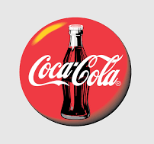
Product vs Customer Solution
A company will only sell what the consumer specifically wants to buy. So, marketers should study consumer wants and needs to attract them.
Notes:
Adapted from 4 Ps and 4 Cs chart. Provided by: Wikipedia. Located at: https://en.m.wikipedia.org/wiki/Marketing_mix#Lauterborn.27s_four_Cs. License: CC BY-SA: Attribution-ShareAlike
Coca Cola located at: https://pixy.org/4166906/ License: Free for commercial use, No attribution required

Slide 12
Price vs Cost
Price is only a part of the total cost to satisfy a want or a need. For example, the total cost might be the cost of time in acquiring a good or a service, along with the cost of conscience in consuming it. It reflects the total cost of ownership. Many factors affect cost, including but not limited to the customer’s cost to change or implement the new product or service and the customer’s cost for not selecting a competitor’s product or service.
Notes:
Adapted from 4 Ps and 4 Cs chart. Provided by: Wikipedia. Located at: https://en.m.wikipedia.org/wiki/Marketing_mix#Lauterborn.27s_four_Cs. License: CC BY-SA: Attribution-ShareAlike

Slide 13
Promotion vs Communication
Communications can include advertising, public relations, personal selling, viral advertising, and any form of communication between the organization and the consumer.
Notes:
Adapted from 4 Ps and 4 Cs chart. Provided by: Wikipedia. Located at: https://en.m.wikipedia.org/wiki/Marketing_mix#Lauterborn.27s_four_Cs. License: CC BY-SA: Attribution-ShareAlike

Slide 14
Place vs Convenience
Marketers should know how the target market prefers to buy, how to be there and be ubiquitous, in order to provide convenience of buying. With the rise of Internet and hybrid models of purchasing, “place” is becoming less relevant. Convenience takes into account the ease of buying the product, finding the product, and finding information about the product.
Notes:
Adapted from 4 Ps and 4 Cs chart. Provided by: Wikipedia. Located at: https://en.m.wikipedia.org/wiki/Marketing_mix#Lauterborn.27s_four_Cs. License: CC BY-SA: Attribution-ShareAlike

Slide 15
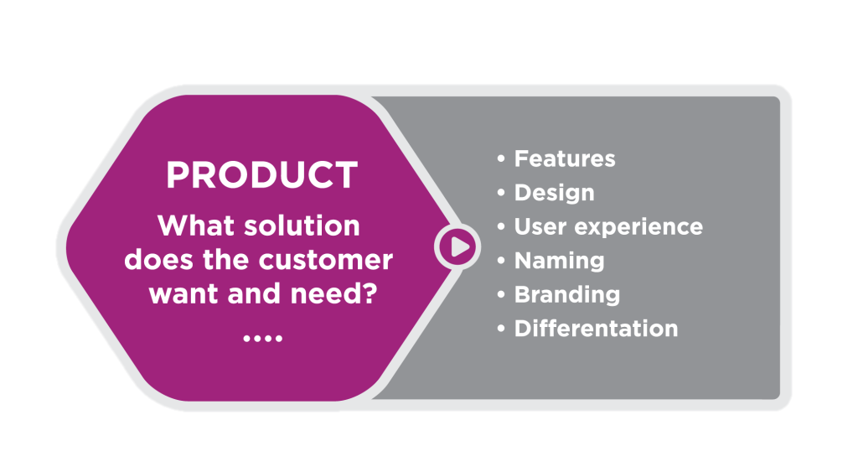
Product
Notes:
Products include either physical things (goods) and/or intangible things (services). Some products include both goods and services. In combination, or individually goods and services are a solution and referred to as the product in the marketing mix. Examples of the product include:
The Tesla Model S, a premium electric car
A Stay at a Holiday Inn Express, a low-price national hotel chain
Doritos Nachos Cheese, a snack food
Simple, an online banking service
Each of these products has a unique set of features, design, name, and brand that are focused on a target customer. The characteristics of the products are different from competitors’ products.

Slide 16
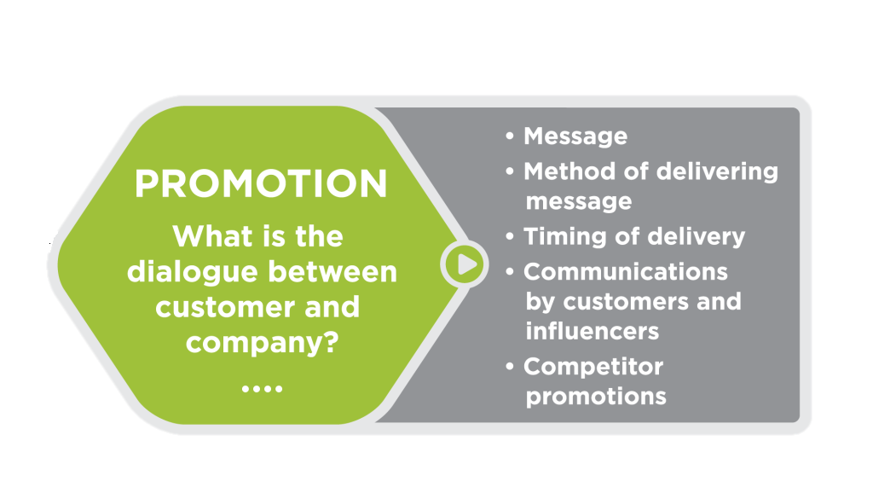
Promotion
Notes:
In the marketing mix, the term “promotion” refers to the communications that occur between the company and the customer. Promotion includes both the messages sent by the company and messages that customers send to the public about their experience. Examples of promotion include:
An advertisement in Cooking Light magazine
A customer’s review of the product on Tumblr
A newspaper article in the local paper quoting a company employee as an expert
A test message sent to a list of customers or prospect

Slide 17
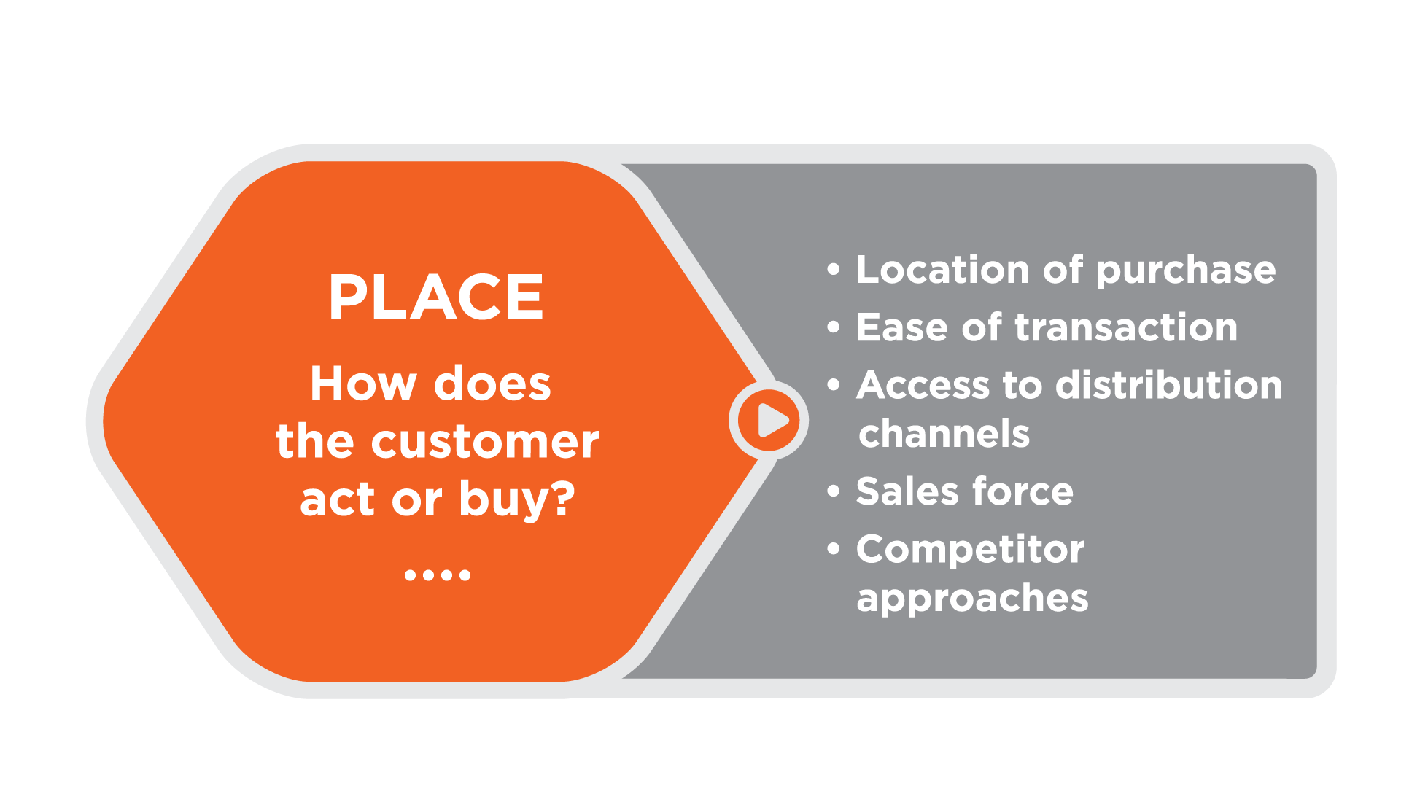
Place
Notes:
In the marketing mix, the term “place” refers to the distribution of the product. Where does the customer buy the product? “Place” might be a traditional brick-and-mortar store, or it could be online. Examples include:
Distribution through an online retailer such as Amazon.com
Use of a direct sales force that sells directly to buyers
Sales through the company’s Web site, such as the shoe purchases at Nike.com
Sales by a distributor or partner, such as the purchase of a Samsung phone from Best Buy or from a Verizon store

Slide 18
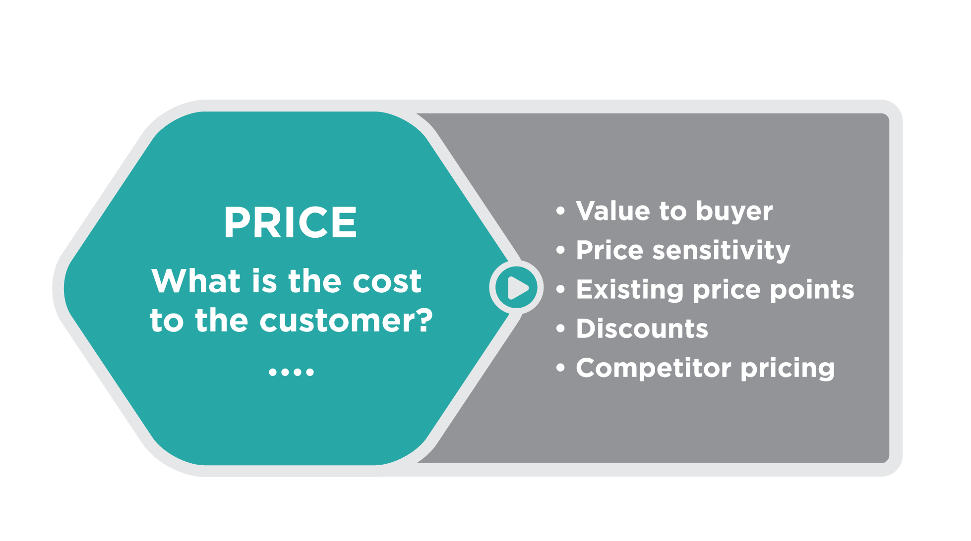
Price
Notes:
In the marketing mix, the term “price” refers to the cost to the customer. This requires the company to analyze the product’s value for the target customer. Examples of price include:
The price of a used college textbook in the campus bookstore
Promotional pricing such as Sonic Drive-In’s half-price cheeseburgers on Tuesdays
Discounts to trade customers, such as furniture discounts for interior designers
Marketing professionals must analyze what buyers are willing to pay, what competitors are charging, and what the price means to the target customer when calculating the product’s value. Determining price is almost always a complicated analysis that brings together many variables.

Slide 19
Marketing Mix: Shampoo
 | Discount | Upscale | Premium
Product | Cleansing product, pleasant smell, low-cost packaging | Cleansing product, pleasant smell, attractive packaging | Cleansing product, pleasant smell created by named ingredients, premium packaging
Promotion | Few, if any, broad communications | National commercials show famous female “customers” with clean, bouncy hair | Differentiating features and ingredients highlighted (e.g., safe for coloured hair), as well as an emphasis on the science behind the formula. Recommended by stylist in the salon.
Place | Distributed in grocery stores and drugstores | Distributed in grocery stores and drugstores | Distributed only in licensed salons
Price | Lowest price on the shelf | Highest price in the grocery store (8 times the prices of discount) | 3 to 5 times the price of Upscale
Discount, Upscale, and Premium Shampoo Brands and the Marketing Mix
Let’s think about three different brands of shampoo and call them Discount, Upscale, and Premium. The table below shows some of the elements of the marketing mix that impact decisions by target customers.
Notes:
Chobani- yogourt example- 4 Ps
Product_ the recipe for Chobani is thicker and creamier than regular yogurt, with twice the protein and none of the preservatives and artificial flavors found in conventional yogurt
Place-mass-distribution channels of grocery store chains.
Promo- SM- Chobani worked to develop a two-way dialogue with happy customers.
We’re on all the major social media platforms. The growth of Chobani really started virally, where one person would try it, tell five friends who each told five friends,
Price its product at roughly $1 per cup. This decision was based on the expectation that the product would be successful. Ulakaya set the price assuming economies of scale—that the company would gain efficiencies as sales increased—instead of trying to recover the early costs. The price factored in the higher cost of premium ingredients, which also supported the product and promotion goals. ^{[4]}
Chobani Ventures- supporting entrepreneurs making delicious, nutritious and natural foods more affordable to people.
When Chobani entered the market, prices for the traditional offerings in the market clustered around 65 cents per cup. Premium Greek yogurt cost $1.34 per cup. ^{[3]}

Slide 20
Activity
In groups discuss the product mix for a brand of bread using the 4 Ps
product
price
place
Promotion
Target market :
Cost sensitive, not health conscious, 20 years old
Parent, 30, healthy eater, cost sensitive
Empty nester, dual income, 45, healthy eater
Gluten intolerant, 35, single, professional.

Slide 21
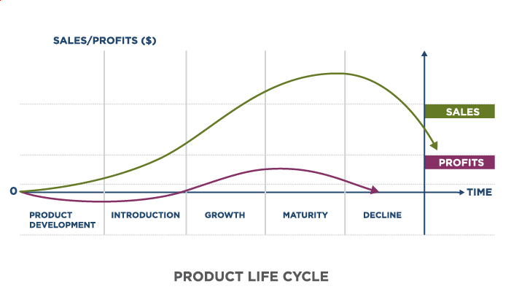
Product Life Cycle
Notes:
Revision and adaptation. Provided by: Lumen Learning. License: CC BY: Attribution
Marketers use the product life cycle to follow this progression and identify strategies to influence it.
The five stages of the PLC are:
Product development
Market introduction
Growth
Maturity
Decline
In this case, the product has four stages:
Introduction – when the product is introduced and struggles to gain brand recognition.
Growth – advertising and word of mouth helps the product to increase sales. As sales growth, more firms are willing to stock the product which helps the product to grow even further.
Maturity – When the product reaches peak market penetration.
Decline – the product gets eclipsed by new products
https://www.economicshelp.org/blog/140934/business/product-life-cycle/

Slide 22
Stages of Product Lifecycle
Stage 1: Product Development | Investment is made Sales have not begun New product ideas are generated, operationalized, and tested
Stage 2: Market Introduction | Costs are very high Slow sales volumes to start Little or no competition Demand has to be created Customers have to be prompted to try the product Makes little money at this stage
Stage 3: Growth | Costs reduced due to economies of scale Sales volume increases significantly Profitability begins to rise Public awareness increases Competition begins to increase with a few new players in establishing market Increased competition leads to price decreases
Stage 4: Maturity | Costs are lowered as a result of increased production volumes and experience curve effects Sales volume peaks and market saturation is reached New competitors enter the market Prices tend to drop due to the proliferation of competing products Brand differentiation and feature diversification is emphasized to maintain or increase market share Profits decline
Stage 5: Decline | Costs increase due to some loss of economies of scale Sales volume declines Prices and profitability diminish Profit becomes more a challenge of production/distribution efficiency than increased sales
Notes:
Product Life-cycle Management (Marketing). Provided by: Wikipedia. Located at: https://en.wikipedia.org/wiki/Product_life-cycle_management_(marketing). License: CC BY-SA: Attribution-ShareAlike
Development- R&d
Introduction – Self-driving cars. Self-driving cars are still at the testing stage, but firms hope to be able to sell to early adopters relatively soon.
Growth – Electric cars. For example, the Tesla Model S is in its growth phase. Electric cars still need to convince people that it will work and be practical. As there are more electric charging points and more people adopt, it becomes easier to sell to those who are more sceptical of new technology like electric cars.
Maturity – Ford Focus. The Ford Focus is a well-established car. It has a good brand reputation and has reached its peak level of market penetration. It would be difficult to gain a significantly greater market share. The product life cycle of the Ford Focus has been extended by constant upgrades and redesigns to keep the car on top of the market.
Decline – Diesel cars. Since governments have expressed concern at the level of pollution from diesel cars. Some cities have threatened to ban diesel cars within a few years. Sales have fallen considerably and the market for diesel cars may be in terminal decline.
https://www.economicshelp.org/blog/140934/business/product-life-cycle/

Slide 23

Marketing Plan
The marketing plan describes how the company will use the marketing mix—product, promotion, place, and price—to achieve its marketing objectives effectively within the competitive market environment

Slide 24
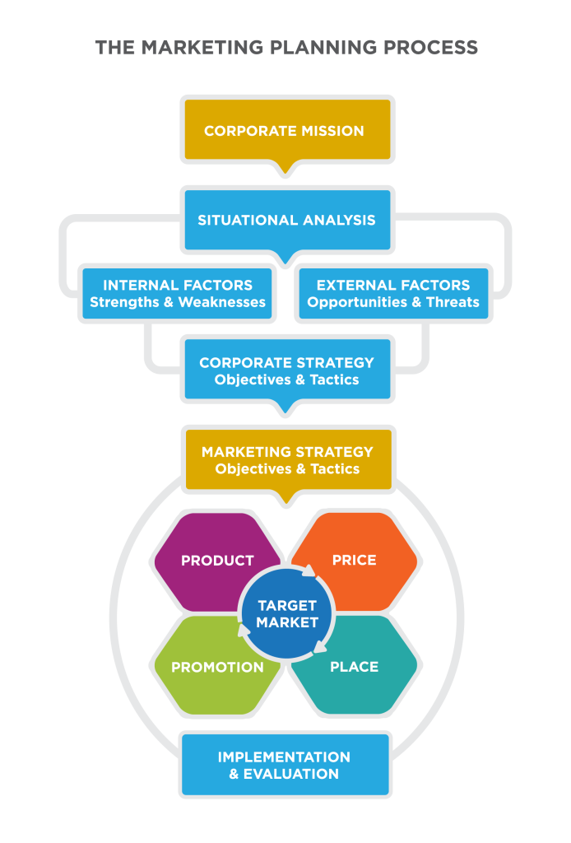
The Marketing Planning Process
Notes:
The company’s mission describes its purpose and explains why it exists. The executive leadership defines corporate goals and the high-level strategies that marketing activities should support.
A situation analysis examines both the internal and external factors that might impact the marketing plan.
The situation analysis helps refine corporate goals and produce a relevant set of marketing objectives
Once the organization has conducted a situation analysis and identified its marketing objectives, the next step is to figure out what strategies will be most effective and the tactics that will be used to carry them out
Implementation and evaluation- How will you know if it has been executed well? Marketing organizations need to identify what constitutes a successful marketing campaign and then measure the results to determine whether it had the desired impact.
think of the strategy as the “big idea,” or approach, and tactics as “the details”—the specific actions that will be taken to make the big idea a reality and help the organization reach its goals.

Slide 25
Activity: Match the Marketing Mix to a Market Segment
Marketing Mix
A. Trendy graphic hoodies at $39.99.
Sold in mall stores and online.
Promoted through TikTok influencers, sports YouTube channels, and gaming sponsorships.
Frequent buy-one-get-one-half-off promotions.
B. Organic, hypoallergenic baby lotion at $12.99 per bottle.
Distributed in grocery stores, baby specialty shops, and online marketplaces.
Marketed through pediatrician recommendations, parenting blogs, and ads on parenting podcasts.
Includes loyalty programs for repeat buyers.
C. Exceptionally soft cashmere blankets priced at $89.99.
Available in-store or with two-day free delivery when ordered online.
Free returns and excellent customer service.
Samples sent to lifestyle bloggers and ads in home décor magazines.
Market Segment
1.Parents of newborns
2. Women aged 40-55
3. Boys 14-17

