Slide 1
Introduction to Marketing
Module 4: Marketing Strategy
Notes:
All text in these slides is taken from https://courses.lumenlearning.com/wmopen-principlesofmarketing/, where it is published under one or more open licenses.
All images in these slides are attributed in the notes of the slide on which they appear and licensed as indicated.
Cover Image: "Shopping freak." Provided by: freestocks.org. Located at: https://unsplash.com/photos/_3Q3tsJ01nc. Content Type: CC Licensed Content, Shared Previously. License: CC0: No Rights Reserved.

Slide 2
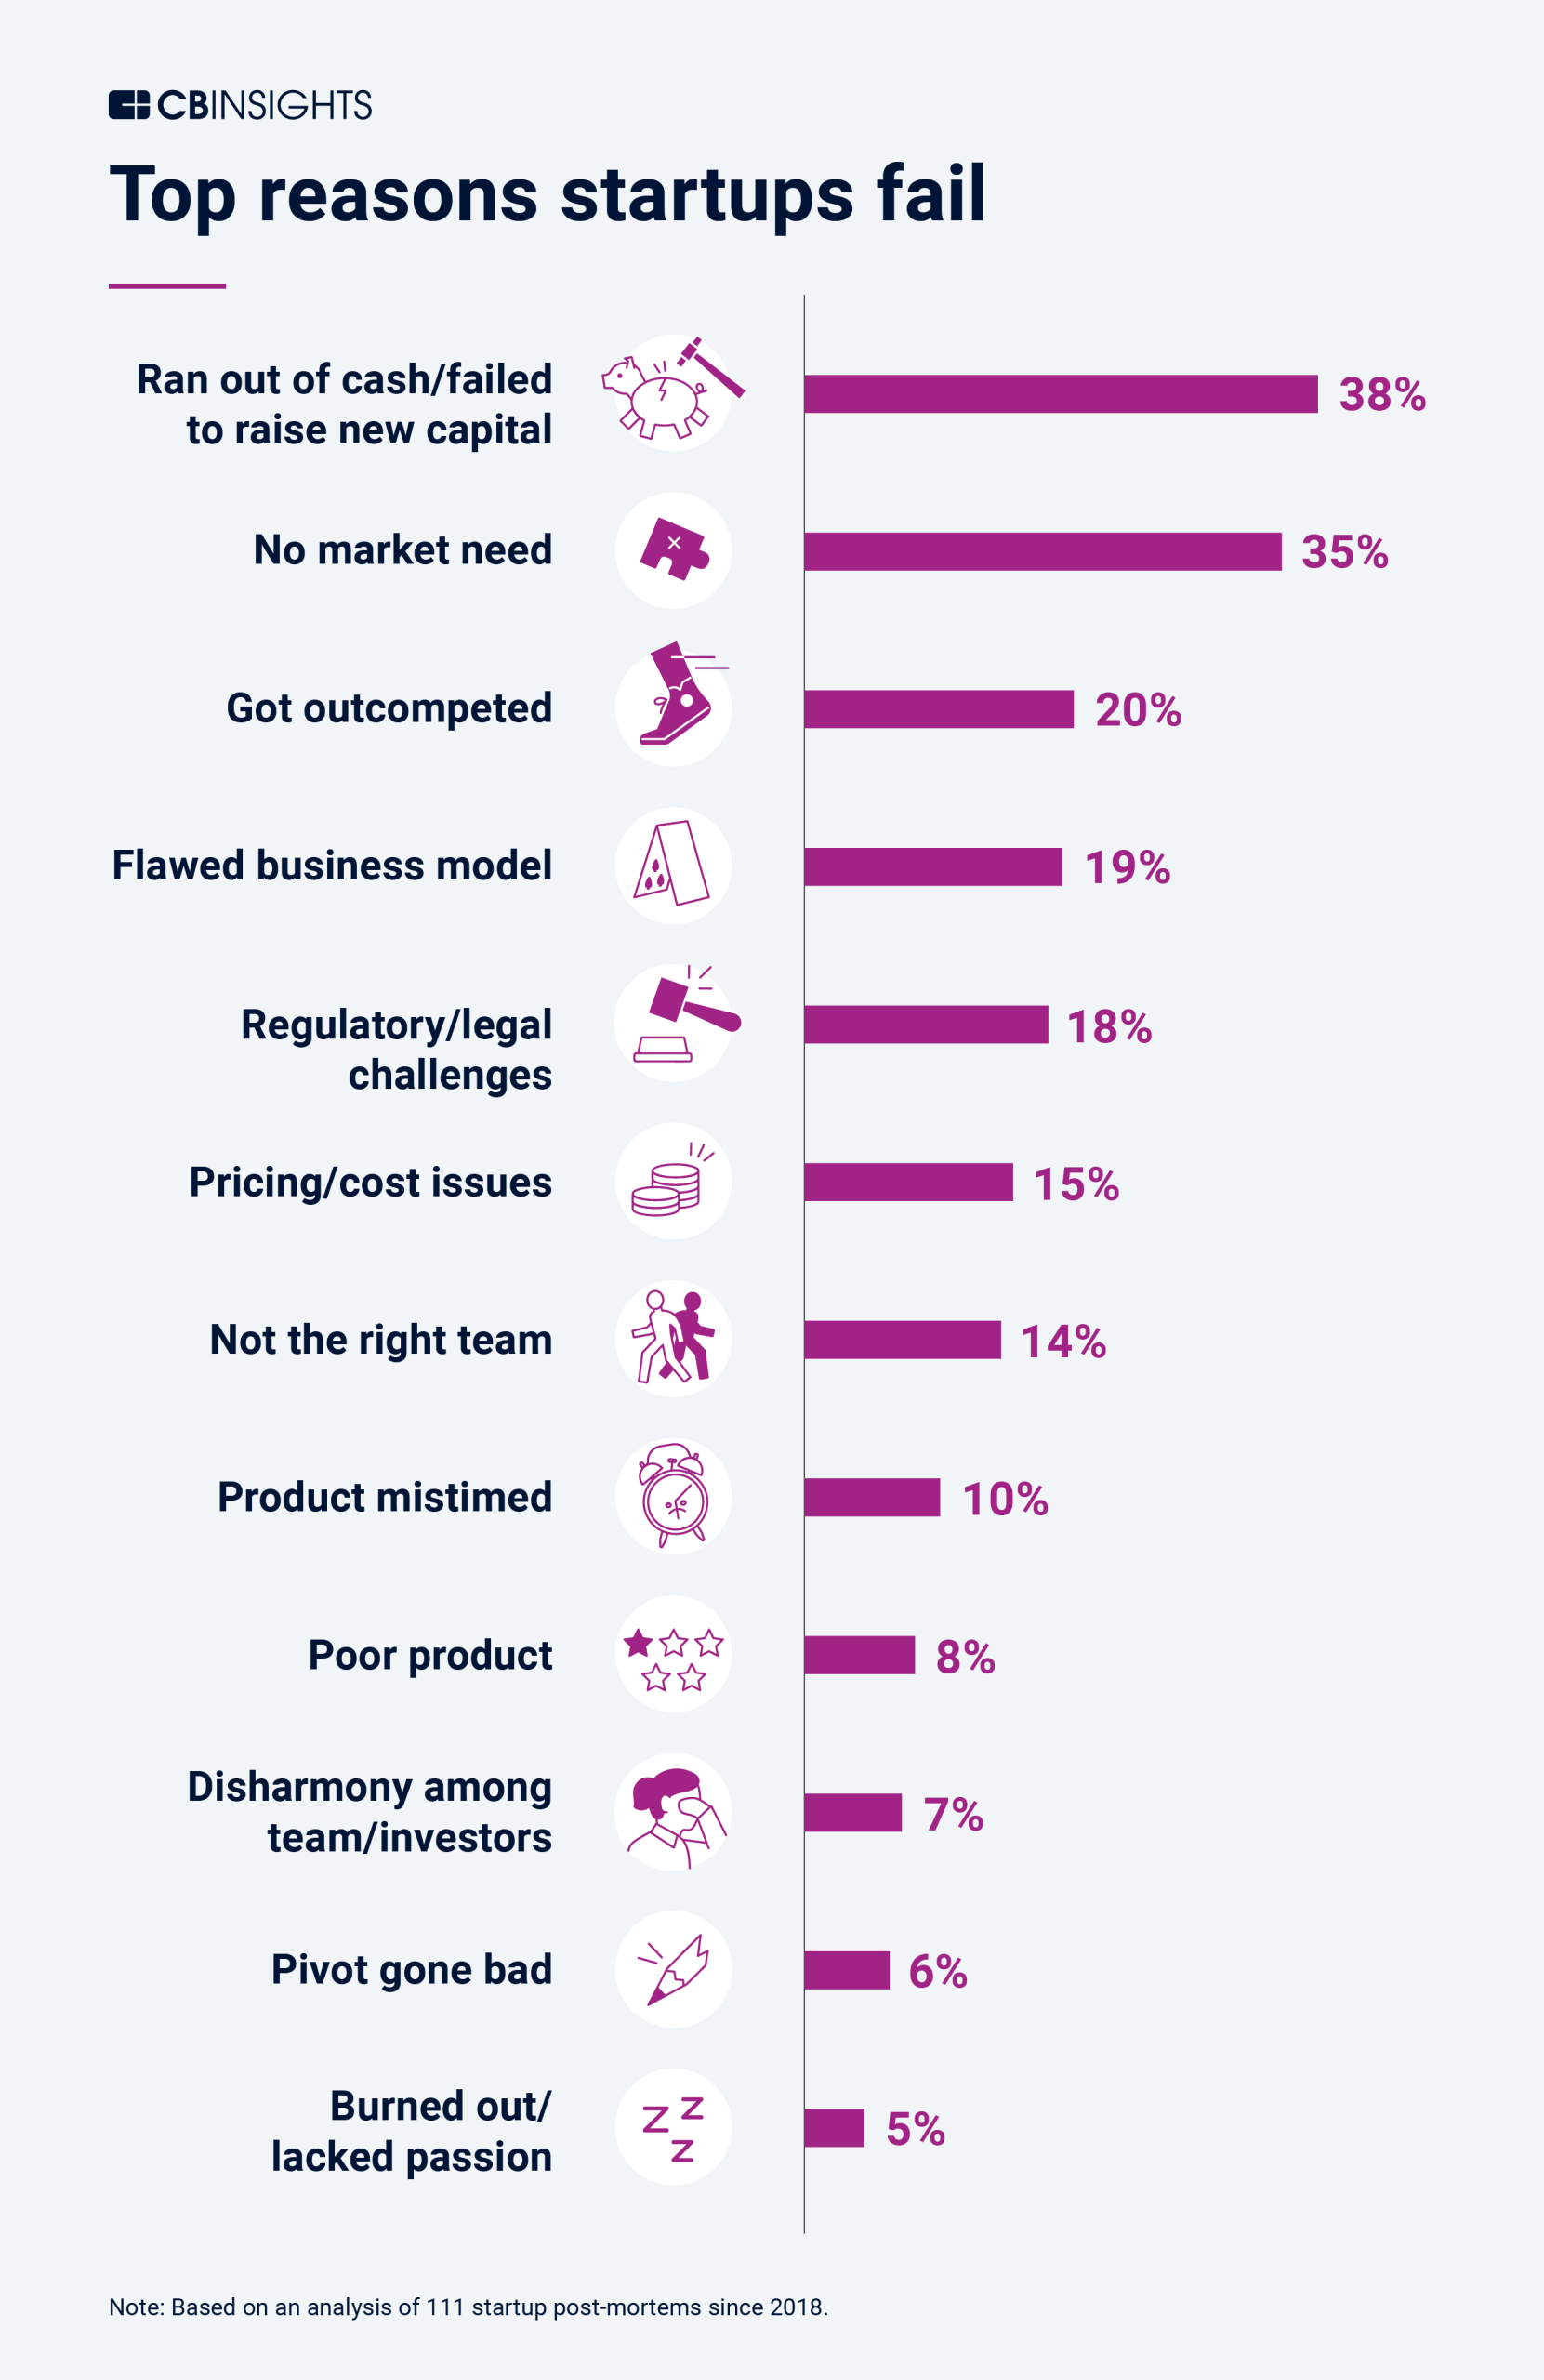
Why is a Market Strategy Important?
Source: CBInsights https://www.cbinsights.com/research/report/startup-failure-reasons-top/#:~:text=the%20CB%20Insights%20data%20treatment
Notes:
Source: CBInsights https://www.cbinsights.com/research/report/startup-failure-reasons-top/#:~:text=the%20CB%20Insights%20data%20treatment

Slide 3

What is Strategy?
Notes:
A strategy is a directed course of action to achieve an intended set of goals.^{[1]}
A tactic is the means by which a strategy is carried out. ^{[2]}
Strategy answers the following four questions:
Where do we compete?
What unique value do we bring to customers?
How will we use our capabilities to provide unique value?
How will we sustain our unique value and position?
This Is Some Rescue. Authored by: Camille Rose. Located at: https://www.flickr.com/photos/pinkpurse/5291302347/. License: CC BY-NC-ND: Attribution-NonCommercial-NoDerivatives

Slide 4

Strategy Identifies Where We Will Compete
The strategy determines which markets we will pursue, where we will sell our goods and services
Focuses efforts on a specific target market
Tactics indicate specific actions that we will take in those markets.
Notes:
Battle of Chantilly. Provided by: Wikimedia. Located at: https://commons.wikimedia.org/wiki/File:BattleOfChantillyMap.jpg. License: Public Domain: No Known Copyright

Slide 5

Strategy Describes Unique
Value for Customers
When developing a strategy, the aim is to identify unique benefits in the products or services that customers value and that differ from what competitors offer
A strategy should define and clarify the unique value.
Tactics include the tasks of creating, delivering, and expanding the value
Notes:
Southwest Airlines Boeing 737. Authored by: Dylan Ashe. Located at: https://commons.wikimedia.org/wiki/File:Southwest_Airlines_Boeing_737-700_N231WN.jpg. License: CC BY-SA: Attribution-ShareAlike

Slide 6
Strategy Explains How the Co’s Assets Will Create Unique Value
How do the company’s activities interact and reinforce one another?
For an organization to define a strategy that creates a unique and valuable position, it must bring together and align the various capabilities and resources of the business
Tactics are planned to reinforce this unique value
Effective tactics, or specific actions, must support the strategy in order for the customer to have a consistent experience with the product or service that aligns with the unique value that the company is seeking to deliver

Slide 7
Strategy Determines How the Co. Will Sustain Unique Value
Over time, competitors will try to eliminate the company’s advantage or copy the areas where it is successful
How will the company continue to provide unique value and protect or expand the areas in which it has an advantage?
As the company refines its strategy retain or expand its advantage, the tactics must also be adjusted to execute the strategy effectively

Slide 8
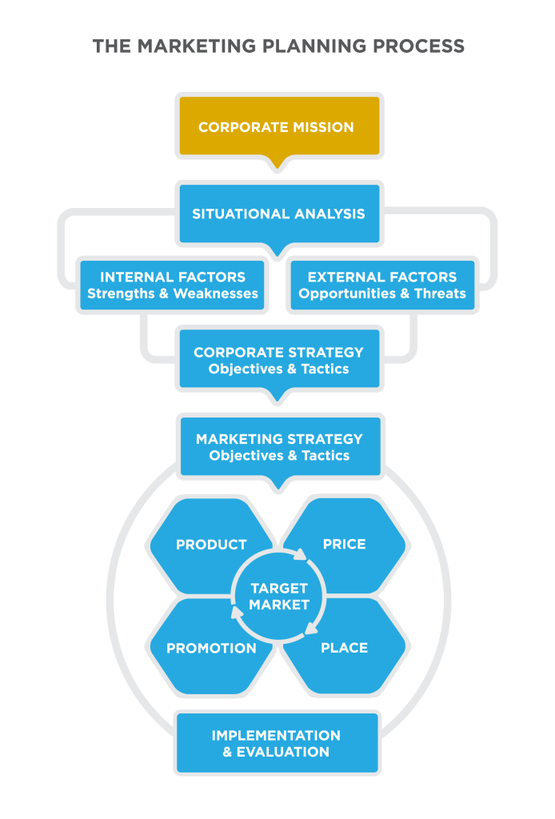
Mission Statement
The mission statement explains why an organization exists
Notes:
The Mission Statement. Provided by: Lumen Learning. License: CC BY: Attribution
Google’s mission is to organize the world’s information and make it universally accessible and useful.^{[1]}
The mission statement is clear and direct, and it gives the company enormous opportunity to make an impact.
How does Google’s mission statement drive the company’s strategies? Let’s look at it from several different angles.
The mission statement functions as an important guide for all aspects of company strategy.
When the strategy and tactics support the mission statement, they are more effective because they reinforce one another.

Slide 9
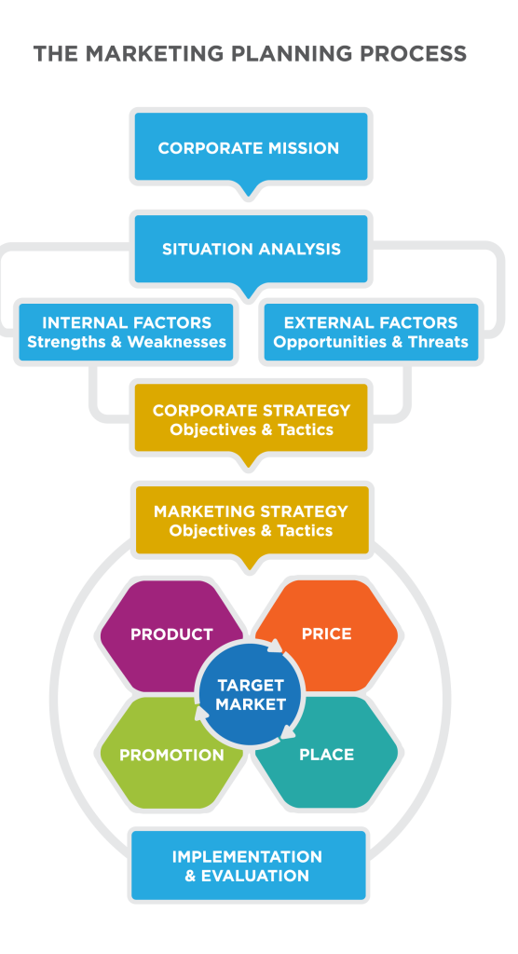
Marketing Planning Process
Notes:
Recall the following steps of determining who your target customer is:
Identify the business need you will address, which will be driven by the corporate strategies and objectives;
Segment your total market, breaking down the market and identifying the subgroup you will target;
Profile your target customer, so that you understand how to provide unique value;
Research and validate your market opportunity.

Slide 10
Situation Analysis: SWOT
Notes:
Internal Factors
Strengths and weaknesses include the resources and capabilities within the organization now. Since the company has the most control over internal factors, it can craft strategies and objectives to exploit strengths and address weaknesses. Examples of internal factors include the following:
Financial resources
Technical resources and capabilities
Competitive position
Human resources
Product lines
All of these are controlled by the organization. Competitive positioning can also be a strength or a weakness. While competitors’ strategies and tactics are external to the company, the company’s position relative to the competitors is something that it can control.
External Factors
External factors include opportunities and threats that are outside of the organization. These are factors that the company may be able influence—or at least anticipate—but not fully control. Examples of external factors include the following:
Technology innovations and changes
Competition
Economic trends
Government policies and legislation
Legal judgments
Social trends
While a company can control how it positions itself relative to the competition, it can’t control competitors’ actions or strategies.
SWOT Analysis. Provided by: Lumen Learning. License: CC BY: Attribution

Slide 11
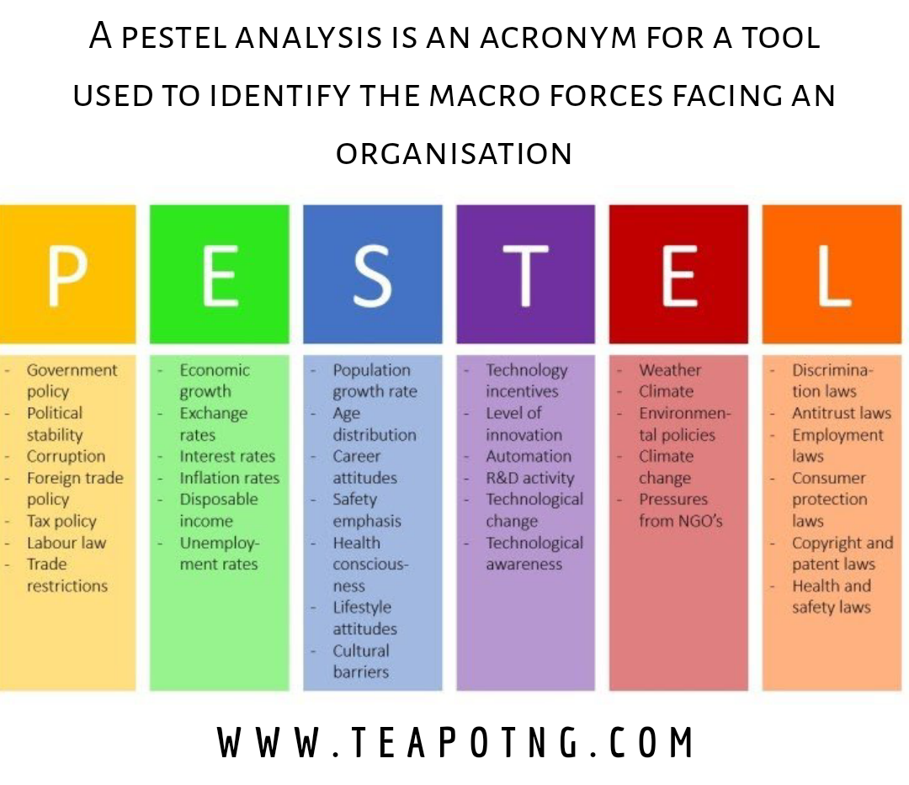
External Factors:
Notes:
Image source: teapotng.com
PESTLE is a mnemonic which in its expanded form denotes P for Political, E for Economic, S for Social, T for Technological, L for Legal, and E for Environmental ...

Slide 12
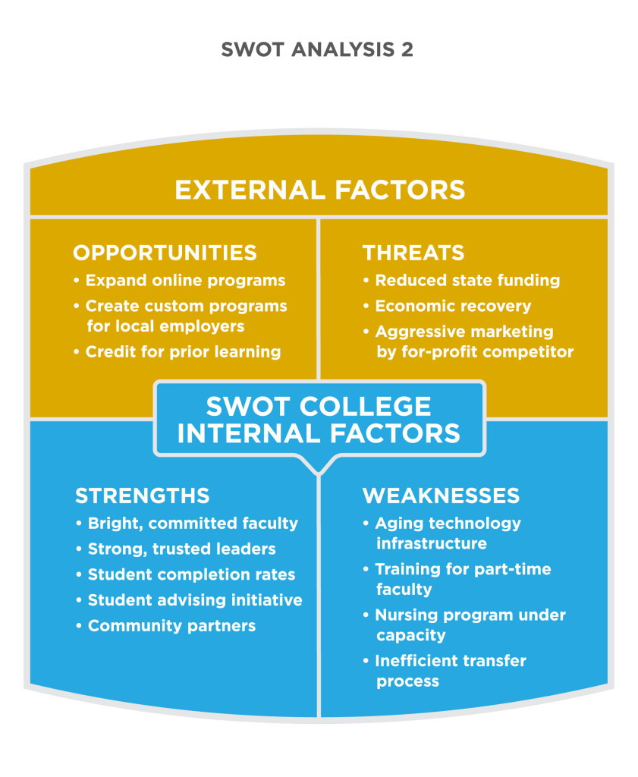
SWOT Example For a College
Notes:
SWOT Analysis. Provided by: Lumen Learning. License: CC BY: Attribution

Slide 13
Situation Analysis: BCG Growth-Share Matrix
Notes:
The BCG matrix (sometimes called the Growth-Share matrix) was created in 1970 by Bruce Henderson and the Boston Consulting Group to help companies with many businesses or products determine their investment priorities.
The BCG matrix considers two different aspects of a business unit or product:
What is the current market share?
What is the market’s growth potential?
Dog
A product or business with low market share in a mature industry is a dog. There is no room for growth, which suggests that no new funds should be invested in it.
Cash Cow
A cash cow is a product or business that has high market share and is in a slow-growing industry. It’s bringing in more money than is being invested in it, but it doesn’t have much growth potential. The profits from a cash cow can be used to fund high-growth investments, but the cash cow itself warrants low investment.
Question Mark
A question mark is a product or business that has low market share currently, but in a growing industry. This case is trickier: the product/business is consuming financing and creating a low rate of return for now, but its direction isn’t clear. A question mark has the potential to become either a star or a dog, so close monitoring is needed to determine its growth potential.
Star
A star has high market share in a fast-growing industry. This kind of product or business is poised to bring strong return on the funds invested. It also has the potential to become a cash cow at the end of the product life cycle, which can fund future investments.
According to the logic of the BCG matrix, as an industry grows, all investments become cows or dogs. The intent of the matrix is to help companies make good portfolio-management decisions, focusing investment in the areas that are likely to provide returns and fund future growth.
Market Share and Market Growth Potential. Provided by: Lumen Learning. License: CC BY: Attribution

Slide 14
Situation Analysis: Strategic Opportunity Matrix
Notes:
The last strategic framework that we will consider is the strategic opportunity matrix (sometimes called the Ansoff matrix, named after its creator, Igor Ansoff). Whereas the SWOT analysis can help organizations identify new market and new product opportunities (it’s the “O” in SWOT), the strategic opportunity matrix focuses on different growth strategies for markets and products. The matrix examines the following:
New vs. existing markets
New vs. existing products
As the diagram shows, each quadrant represents a different growth strategy:
Market penetration: focus on current products and current markets with the goal of increasing market share
Market development: use existing products to capture new markets
Product development: create new products that can be sold in existing markets
Diversification: create completely new opportunities by developing new products that will be introduced in new markets
Each strategy entails a different level of risk. Market penetration has the lowest risk since it emphasizes known markets and existing products. Diversification has the highest risk because it involves the development of new products and taking them to new markets. The company must consider whether it can achieve the desired returns without risking a move into new markets or introducing new products. Often, though, higher risk leads to a higher return.
Strategies and Risks. Authored by: Lumen Learning. License: CC BY: Attribution

Slide 15
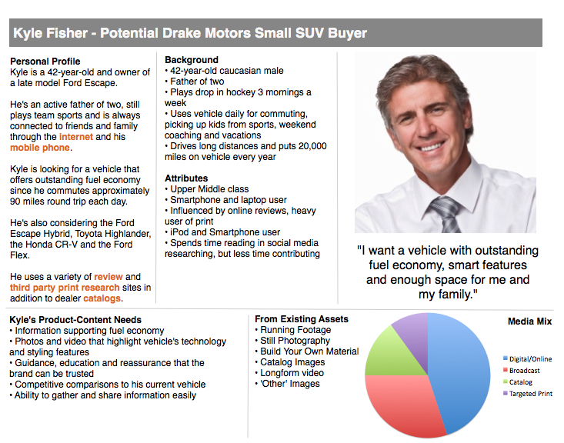
Situation Analysis: Customer Personas
Fictional, generalized representations of an ideal customer that help a marketer understand current and potential customers better
Notes:
Marketers use something called “buyer personas” to get a more accurate picture of the customers they’re trying to connect with and also to help them think of customers as real people. Buyer personas are fictional, generalized representations of a company’s ideal, or typical, customer. They help the marketer understand current and potential customers better. As a marketer, knowing whom you’re trying to reach and attract makes it easier to tailor your content, messages, product development, and services to the specific needs, behaviours, and concerns of different groups.
Typically, a buyer persona will have a name and a story, as in Figure 1, above. The story will include information about how the persona spends her time and details about her interests, her concerns or fears, and her goals. Often, the write-up will explain what the persona wants from the company and its products to help marketers to use the information consistently. Each of these details helps the marketer focus on developing relationships with real people, and that results in a more personalized marketing plan.^{[1]}
Strategies and Risks. Authored by: Lumen Learning. License: CC BY: Attribution

Slide 16
Customer Relationships Management
Customer relationships management. Customer relationship management seeks to create more meaningful one-on-one communications with the customer by applying customer data (demographic, industry, buying history, etc.) to every communications vehicle.
Notes:
The American Marketing Association defines customer relationship management in the following way:
A discipline in marketing combining database and computer technology with customer service and marketing communications. Customer relationship management seeks to create more meaningful one-on-one communications with the customer by applying customer data (demographic, industry, buying history, etc.) to every communications vehicle. At the simplest level, this would include personalizing e-mail or other communications with customer names. At a more complex level, customer relationship management enables a company to produce a consistent, personalized marketing communication whether the customer sees an ad, visits a Web site, or calls customer service.^{[1]}
Buyer persona. Fictional, generalized representations of an ideal customer that help a marketer understand current and potential customers better.
Customer relationships management. A discipline in marketing combining database and computer technology with customer service and marketing communications. Customer relationship management seeks to create more meaningful one-on-one communications with the customer by applying customer data (demographic, industry, buying history, etc.) to every communications vehicle.

Slide 17

Growth Strategies
Each strategy entails a different level of risk
Market penetration
Market development
Product development
Diversification

Slide 18

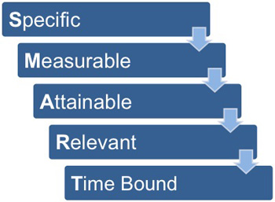
Effective Objectives are:
Notes:
Climbing. Authored by: Marcus Hansson. Located at: https://www.flickr.com/photos/marcus_hansson/14659581920/. License: CC BY: Attribution

Slide 19
Aligning Annual Company and Marketing Objectives: Ex # 1
Company Objective: Increase profitability by 6% over prior year
Marketing Objective: Increase the average selling price of the product from $186 to $198
Marketing Objective: Complete end-of-life process for three products with profit margins below 3%
Marketing Objective: Increase sales of star product 30% over prior year

Slide 20
Aligning Annual Company and Marketing Objectives: Ex #2
Company Objective: Increase market share in one key market by 4%
Marketing Objective: Implement a competitive-positioning campaign relative to a key competitor
Marketing Objective: Introduce two new products to market
Marketing Objective: Introduce major enhancements in two product lines
Marketing Objective: Bring two new distribution partners on board to expand coverage to new major markets

Slide 21

Implementation and Budget
Implementation involves the tactics used to execute the strategy
The implementation process emphasizes the timely completion of tasks
The marketing budget represents a plan to allocate expenditures to each of the components of the marketing mix
Notes:
Airport Traveler. Authored by: Nick Harris. Located at: https://www.flickr.com/photos/nickharris1/7004114708/. License: CC BY-ND: Attribution-NoDerivatives

Slide 22

Return on Marketing Investment
What were the goals of the campaign?
How did the target customer influence the campaign and the goals?
Was it successful?
What metrics were used to determine the success of the campaign?
Notes:
Increasingly, the single most important evaluation measure is the return on the marketing investment (or marketing ROI). Earlier in this module we learned that strategies define how an organization can best use its resources to achieve the mission. Measuring return on the marketing investment helps marketers understand whether their use of resources is yielding the most effective results.
Graveyard Lemonade Stand. Authored by: Nina Frazier. Located at: https://www.flickr.com/photos/ninajeaninephotography/2802597662/. License: CC BY-SA: Attribution-ShareAlike

