Slide 1
Introduction to Marketing
Module 5: Ethics and Corporate Social Responsibility
Notes:
All text in these slides is taken from https://courses.lumenlearning.com/wmopen-principlesofmarketing/, where it is published under one or more open licenses.
All images in these slides are attributed in the notes of the slide on which they appear and licensed as indicated.
Cover Image: "Shopping freak." Provided by: freestocks.org. Located at: https://unsplash.com/photos/_3Q3tsJ01nc. Content Type: CC Licensed Content, Shared Previously. License: CC0: No Rights Reserved.

Slide 2
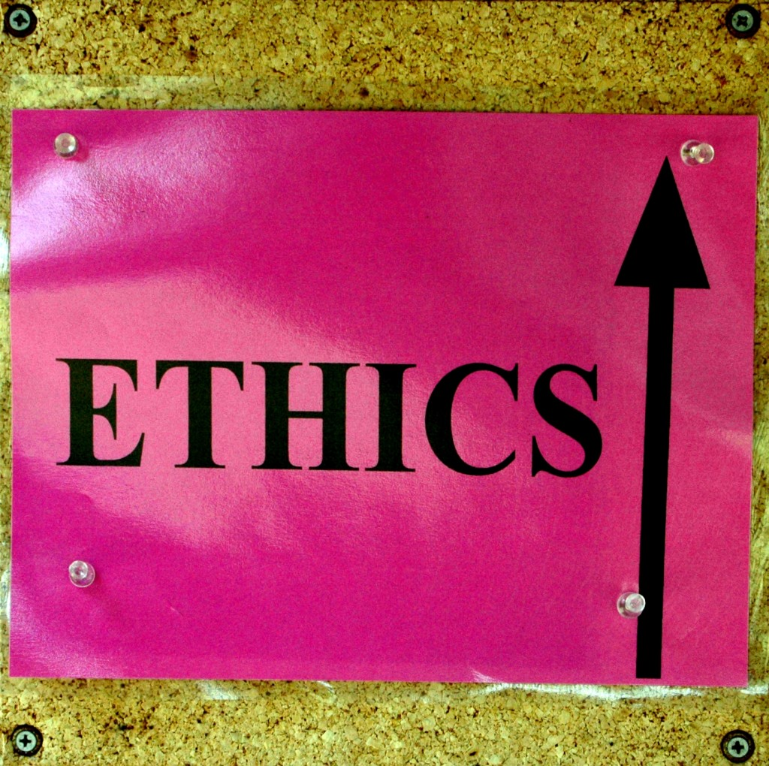
Ethics
Ethics is the set of moral principles or values that guides behavior
If a company acts unethically, it risks damaging its reputation and its customers’ trust—worse, it can face lawsuits and criminal prosecution
Notes:
Under the umbrella of business ethics, Corporate Social Responsibility (CSR) with a focus on what a company’s social obligations are but it was difficult to determine if a company followed through as CSR is self-regulated.
These days, CSR has evolved to Environmental Social Governance (ESG) which holds companies to account for not just their intentions but also measures their impact.
To create greater clarity for marketing professionals, the Canadian Marketing Association (CMA) has created the: CMA Code of Ethics and Standards. There are 18 components that address the most common ethical issues.

Slide 3
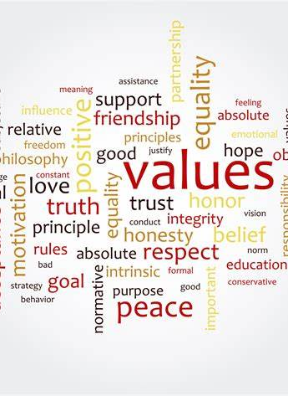
Norms and Values
Norms are widely accepted standards of conduct that are shaped by society and professional bodies.
Norms may evolve over time, while values tend to be more stable.
Values represent what communities consider desirable, important, and morally appropriate. They guide how we evaluate our own actions and those of others, and they are often expressed as beliefs.²³

Slide 4
Common Ethical Issues in Marketing
Challenge | Key Focus | Best Practice / Ethical Approach
1. AI and Automation | Risks of bias, misinformation, and loss of oversight. | Ensure transparency, human oversight, fairness, accountability, and protect consumer privacy.
2. Cultural Sensitivity | Avoiding offensive or stereotypical messages. | Respect cultural values, avoid appropriation, tailor campaigns to diverse audiences.
3. Data Ethics | Collection and use of consumer data. | Obtain informed consent, provide opt-outs, secure data, avoid discriminatory targeting.
4. Environmental Sustainability | Impact of marketing practices on the planet. | Reduce emissions, use sustainable materials, promote eco-friendly products, advocate responsible consumption.
5. Fair Pricing | Risk of discriminatory or exploitative pricing. | Set reasonable, justifiable prices; avoid targeting vulnerable groups; be transparent on pricing.
6. Influencer Marketing | Lack of disclosure and misalignment with brand values. | Ensure transparency in sponsorships, select ethical influencers, promote responsible messaging.
7. Misleading Advertising | False or exaggerated claims that mislead consumers. | Use accurate, evidence-based claims; fact-check; provide clear disclaimers; update content regularly.
8. Privacy Concerns | Misuse or mishandling of personal data. | Collect only with consent, secure data, provide opt-outs, avoid third-party selling without consent.
9. Social Responsibility | Growing demand for brands to align with social/environmental values. | Engage in cause marketing, support inclusion, fair treatment of stakeholders, reduce marketing footprint.
10. Targeting Vulnerable Populations | Harmful or exploitative targeting of children, elderly, or disadvantaged groups. | Respect boundaries, avoid harmful products, prioritize consumer well-being and accurate information.
The following is a summary of the top 10 ethical issues in marketing in 2025.
Notes:
Taylor, J. (2025, August 15). Top 10 ethical issues in marketing for 2025. TrinityP3. Retrieved [Date you accessed it], from https://www.trinityp3.com/ethics-in-marketing/top-ethical-issues-for-marketers/

Slide 5

Brand Management
Societal expectations are changing at a faster rate due to technology. In 2018, Pepsi’s advertisement featuring Kendall Jenner quickly went viral, and impacted the brand Pepsi
Screenshot from controversial Pepsi ad where Kendall Jenner hands a police officer a can of Pepsi after joining a protest. https://www.youtube.com/watch?v=fjAvpjzHLzY
Notes:
Three Steps to Improve Ethics in Social Media Marketing. Authored by: Augie Ray. Provided by: Experience: The Blog. Located at: http://www.experiencetheblog.com/2013/04/three-steps-to-improve-ethics-in-social.html. License: CC BY: Attribution

Slide 6

Corporate Social Responsibility
Corporate social responsibility is the ethical behavior of a company toward society
It means acting responsibly toward the stakeholders—not just the shareholders—who have a legitimate interest in the business
Notes:
Honey Bee (Apis mellifera Linnaeus). Authored by: Jim, the Photographer. Located at: https://www.flickr.com/photos/jcapaldi/6162898675/. License: CC BY: Attribution

Slide 7
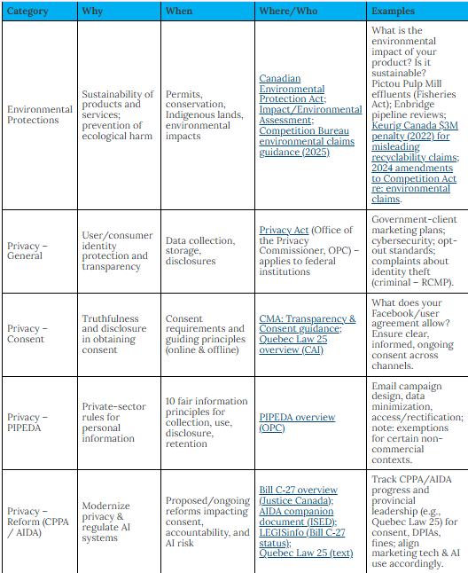
Canadian Society Protection Laws and Standards
Notes:
Marketing professionals in Canada need to continually review these laws and standards as they assess the external environment for their marketing strategies.
BUSINESSES need protection from other businesses. Competition protection laws address fairness and pricing.
CONSUMER need protection from businesses. Consumer protection laws are created to ensure the rights of consumers and to create a fair marketplace for consumers.
SOCIETY needs protection from businesses. Social costs businesses create, must be regulated.
nCommercial-NoDerivatives

Slide 8
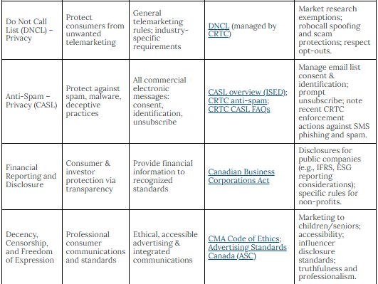
Canadian Society Protection Laws and Standards
Notes:
The Competition Bureau is an independent law enforcement agency that advocates for and protects Canadian consumers and works to foster a competitive and innovative marketplace in which Canadian businesses can prosper.
We are the “watchdog” of competition. We enforce the Competition Act, Consumer Packaging and Labelling Act, Textile Labelling Act and Precious Metals Marking Act, and will not hesitate to take action when business is not carried out in ways that are truthful, fair and legal.
We work to protect and promote competition by:
ensuring truth in advertising
investigating illegal agreements that hinder competition
preventing abuse of market power
reviewing mergers
advocating for competitive and fair marketplaces
working with a variety of Canadian and international organizations.

Slide 9
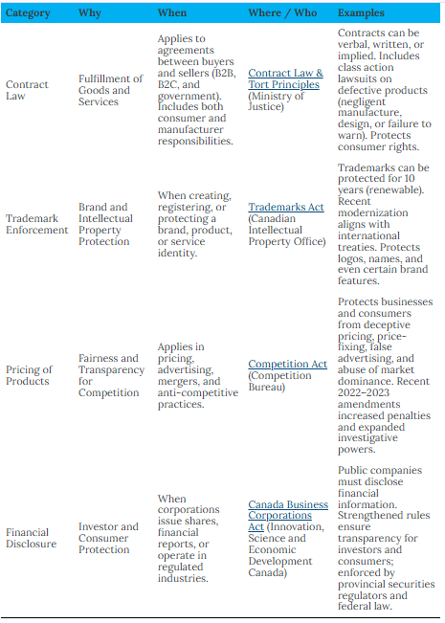
Business Protections Laws and Standards
Notes:
The Competition Bureau is an independent law enforcement agency that advocates for and protects Canadian consumers and works to foster a competitive and innovative marketplace in which Canadian businesses can prosper.
We are the “watchdog” of competition. We enforce the Competition Act, Consumer Packaging and Labelling Act, Textile Labelling Act and Precious Metals Marking Act, and will not hesitate to take action when business is not carried out in ways that are truthful, fair and legal.
We work to protect and promote competition by:
ensuring truth in advertising
investigating illegal agreements that hinder competition
preventing abuse of market power
reviewing mergers
advocating for competitive and fair marketplaces
working with a variety of Canadian and international organizations.

Slide 10
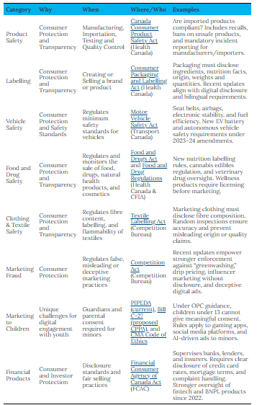
Consumer Protection Laws and Standards
Notes:
The Competition Bureau is an independent law enforcement agency that advocates for and protects Canadian consumers and works to foster a competitive and innovative marketplace in which Canadian businesses can prosper.
We are the “watchdog” of competition. We enforce the Competition Act, Consumer Packaging and Labelling Act, Textile Labelling Act and Precious Metals Marking Act, and will not hesitate to take action when business is not carried out in ways that are truthful, fair and legal.
We work to protect and promote competition by:
ensuring truth in advertising
investigating illegal agreements that hinder competition
preventing abuse of market power
reviewing mergers
advocating for competitive and fair marketplaces
working with a variety of Canadian and international organizations.

Slide 11

Product Liability:
Product liability Product liability is the legal liability a manufacturer or importer/exporter incurs for producing or selling a faulty product.
There are three types of product defects that incur product liability:
Negligent manufacture (how they made it)
Negligent design (how they designed it)
Negligent failure to warn (how they marketed it)
Notes:
Lawsuits Welcome. Authored by: Chris Tengi. Located at: https://www.flickr.com/photos/cjtengi/2022308688/. License: CC BY-NC-ND: Attribution-No
In Canada, there is not a single federal law or code that covers all product liability. In general, product liability laws typically come about as a result of civil court cases being prosecuted through class action law suits.
A manufacturer or supplier of a defective product may be liable to a consumer or other party injured by the product on the basis of either contract or tort law principles. Where a contractual relationship exists between the manufacturer and the customer, liability will normally be founded on contract law principles. There is NO strict liability for manufacturers in Canada.^{[1]}
Tort liability for damages or injuries caused by a defective or dangerous product is based on the claim of negligence.
In Canada, there are three main types of negligence establishing tort liability for damages or injuries caused by defective products:
negligent manufacture (how they made it)
negligent design (how they designed it)
negligent failure to warn (how they marketed it)

Slide 12
Privacy
PIPEDA
Accountability
Identifying Purposes
Consent
Limiting Collection
Limiting Use, Disclosure, and Retention
Accuracy
Safeguards
Openness
Individual Access
Challenging Compliance
Privacy is the ability of an individual or group to seclude themselves, or information about themselves, and thereby express themselves selectively
Telemarketing- Do Not Call List (DNCL)
Email Spam- Canada's Anti Spam Legislation (CASL)
Privacy- The Personal Information Protection and Electronics Document Act (PIPEDA)

Slide 13
Keep Customer Information Secure
Start with security: only collect customer data when necessary; be transparent; and treat the data with extreme care
Control and restrict access to sensitive data
Make sure your service providers implement reasonable security measures: write security into contracts and verify compliance
Establish procedures to keep your security current and address vulnerabilities that may arise; heed credible security warnings
Secure paper, physical media, and devices—not all data are stored digitally
World’s Biggest Data Breaches & Hacks — Information is Beautiful

Slide 14
Key Takeaways For Good Corporate Cyber-Hygiene
Start
Start with security: only collect customer data when necessary; be transparent; and treat the data with extreme care.
Control
Control and restrict access to sensitive data.
Require
Require strong, secure passwords and authentication; protect access to sensitive data
Store
Store sensitive personal information securely and protect it during transmission: use best-in-class security technology.
Segment
Segment your network and monitor who’s trying to get in and out.
Secure
Secure remote access to your network: put sensible access limits in place.
Apply
Apply sound security practices when developing new products; train engineers in security and test for common vulnerabilities.
Make
Make sure your service providers implement reasonable security measures: write security into contracts and verify compliance.
Establish
Establish procedures to keep your security current and address vulnerabilities that may arise; heed credible security warnings.
Secure
Secure paper, physical media, and devices—not all data are stored digitally.
Notes:
Group C- ended on Oct 10 (started SWOT for Discussion 4).
Group A Ended – Oct 6

Slide 15

Fraud
Fraud is the deliberate deception of someone else with the intent of causing damage.
A representation, omission, or practice is deceptive if it is likely to:
mislead consumers and
affect consumers' behaviour or decisions about the product or service.
Notes:
Integrity. Authored by: atalou. Located at: https://www.flickr.com/photos/natalieguinsler/5565750498/. License: CC BY-NC-ND: Attribution-NonCommercial-NoDerivatives

Slide 16
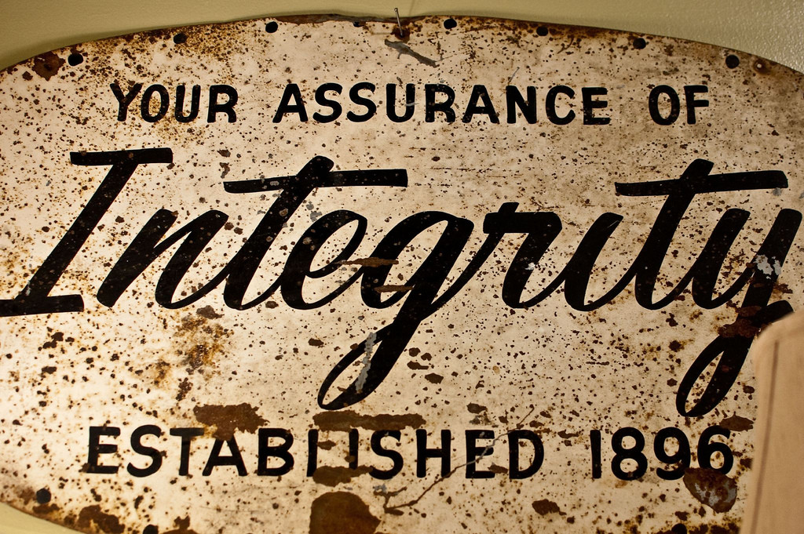
Trust
The goal of marketing is not to deceive the customer; it is, in fact, to build trust
Notes:
Integrity. Authored by: atalou. Located at: https://www.flickr.com/photos/natalieguinsler/5565750498/. License: CC BY-NC-ND: Attribution-NonCommercial-NoDerivatives

Slide 17
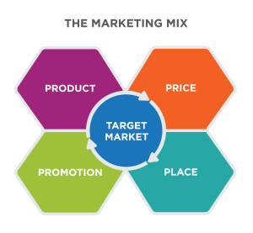
Deception in Product
Is the product designed and manufactured as the customer would expect, given the other elements of the marketing mix?
Is the customer warned about the product’s limitations or uses that are not recommended?
Notes:
Fraud in Marketing. Provided by: Lumen Learning. License: CC BY: Attribution

Slide 18
Deception in Price
Is the total price of the product fairly presented to the customer?
Is the price charged for the product the same as the price posted or advertised?
Has something been marketed as “free” and, if so, does it meet FTC guidelines for the definition of free?
Does the company disclose information about finance charges?
Notes:
Fraud in Marketing. Provided by: Lumen Learning. License: CC BY: Attribution

Slide 19
Deception in Promotion
Can claims made to consumers be substantiated?
Are disclaimers clear and conspicuous?
For products marketed to children, is extra care taken to accurately represent the product?
Notes:
Fraud in Marketing. Provided by: Lumen Learning. License: CC BY: Attribution

Slide 20
Deception in Place
Does the distribution channel deliver the product at the price and quality promised?
Do other companies in the distribution channel (wholesalers, retailers) perform as promised and deliver on expectations set for product, price, and promotions?
Notes:
Fraud in Marketing. Provided by: Lumen Learning. License: CC BY: Attribution
Stop at week 6 class 1.

Slide 21
Challenges of B2B Ethics
Personal sales are relationship based, requiring the seller to tailor the process according to the buyer’s personality and approach
B2B sales are often large and complex
Pricing is negotiated between the buyer and seller, rather than being set and uniform across all customers
Communication about the product and pricing takes place mainly through informal or formal verbal presentations and discussions

Slide 22
Company Policies
Company policies generally define:
The total purchase authority of a single individual or department
The threshold at which a purchase decision must go out for competitive bid
The circumstances under which the company’s status as a customer can be disclosed
A dollar threshold for gifts from vendors
It is wise for B2B Marketers to understand these rules to avoid putting people in awkward positions.

Slide 23
Business Gifts
Business gifts are usually seen as an advertising, sales-promotion, and marketing-communication medium. Such gifting is usually practiced for the following reasons:
In appreciation for past client relationships, placing a new order, referrals to other clients, etc
In the hopes of creating a positive first impression that might help to establish an initial business relationship
As a quid pro quo—returning a favor or expecting a favor in return for something

Slide 24
Standards for Business Conduct
Define the threshold for behavior: Companies require their employees to follow the law
Create expectations for behavior: The policies identify common issues that employees may encounter—such as accepting gifts from suppliers—and explain how they should be handled
Set policy: establish company protocols for handling confidential information, including customer data, etc.
Give guidance on making judgment calls
Describe reporting and enforcement procedures

Slide 25

Judgement Calls
Is it legal? If it’s not legal, don’t do it.
Is it ethical? If it feels wrong, it probably is wrong.
How would it look in the newspaper? If you wouldn’t feel comfortable if your friends and family knew about your actions, you probably shouldn’t do it.
Notes:
Acer Ferrari One. Authored by: Masaru Kamikura. Located at: https://www.flickr.com/photos/kamikura/3976320866/. License: CC BY: Attribution

Slide 26
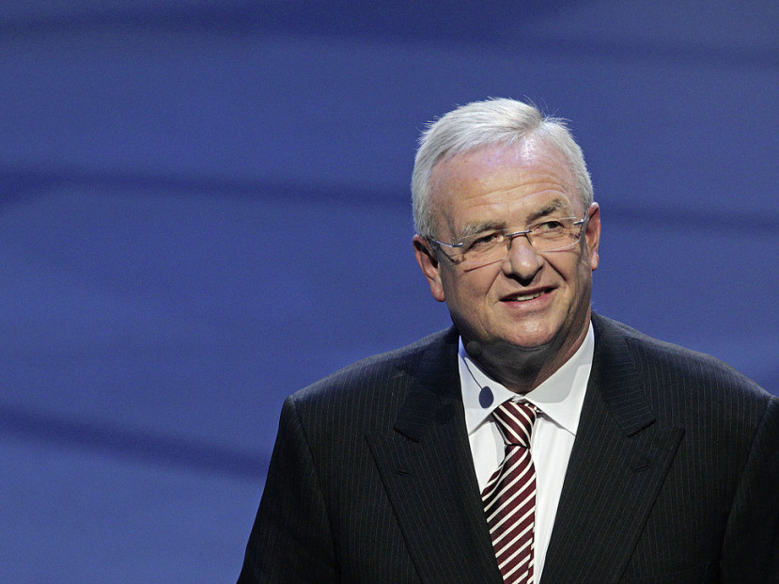
Executives Shape Company Culture and Policy
They set objectives, policies, and make personnel decisions.
Former Volkswagon CEO, Martin Winterkorn
Notes:
Martin Winterkorn. Former Volkswagon CEO, Martin Winterkorn
In the Volkswagen case, internal investigations have questioned how both the company culture and the behaviour of former CEO Martin Winterkorn contributed to a systemic ethical breach. Like many chief executives, Martin Winterkorn was a demanding boss who didn’t like failure, but critics say the pressure on managers at Volkswagen was unusual, which may go some way toward explaining the carmaker’s crisis
Authored by: Volkswagon AG. Provided by: Wikimedia. Located at: https://commons.wikimedia.org/wiki/File:Martin_Winterkorn_2013-09-09_001.jpg. License: CC BY: Attribution

Slide 27
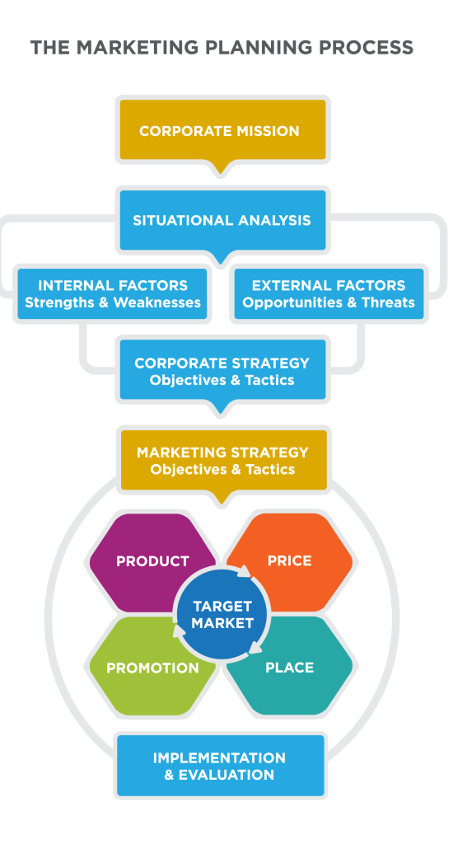
Social Responsibility in Marketing Strategy
Social responsibility may be a corporate-level strategy with specific objectives.
Social responsibility may be part of the marketing mix based on the situation analysis

Slide 28
Sustainable Products
A sustainable product is constantly environmental-friendly during its entire life
From the moment the raw materials are extracted to the moment the final product is disposed of, there must be no permanent damage to the environment

Slide 29
Ethics for Marketing Employees
Demonstrate
Demonstrate respect for your target customer
Prepare
Prepare the sales team to sell effectively and ethically
Demonstrate
Demonstrate high personal standards in business relationships
Provide
Provide fair value to the target customer
Play
Play nicely in the competitive environment
Be
Be truthful
Notes:
Many companies have a specific policy that defines appropriate behaviour. The policy is often called the Standards for Business Conduct. As the name suggests, the policy is intended to set the standards for acceptable behaviour; it’s not meant to be an exhaustive list of every type of ethical behaviour.
Many of these policies do the following:
Define the threshold for behaviour: While it should go without saying that employees are expected to be law abiding, companies choose to be quite explicit about stating that they require their employees to follow the law.
Create expectations for behaviour: The policies identify common issues that employees may encounter—such as accepting gifts from suppliers—and explain how they should be handled.
Set policy: establish company protocols for handling confidential information, including customer data, etc.
Give guidance on making judgment calls: Companies often define how they would like employees to make decisions when guidelines do not adequately cover them.
Describe reporting and enforcement procedures: There is generally a process for reporting and addressing issues, as well as information about how the company will protect those reporting concerns.

Slide 30

Ethics Makes (Dollars and) Cents
The world’s most ethical companies out perform their peers in the stock market.

