Slide 1
Introduction to Marketing
Module 6: Marketing Information and research
Notes:
All text in these slides is taken from https://courses.lumenlearning.com/wmopen-principlesofmarketing/, where it is published under one or more open licenses.
All images in these slides are attributed in the notes of the slide on which they appear and licensed as indicated.
Cover Image: "Shopping freak." Provided by: freestocks.org. Located at: https://unsplash.com/photos/_3Q3tsJ01nc. Content Type: CC Licensed Content, Shared Previously. License: CC0: No Rights Reserved.

Slide 2
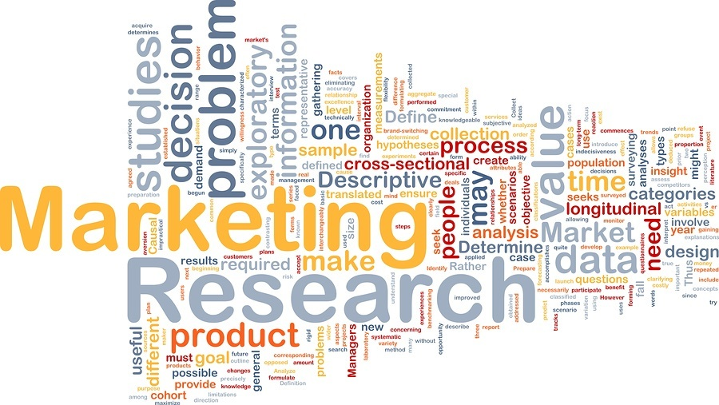
Marketing Research
Marketing research is a systematic process for identifying marketing opportunities and solving marketing problems
Uses customer insights that come out of collecting and analyzing marketing information

Slide 3

Environmental Factors
Market research examines environmental factors and how they affect consumer behavior:
Health of the economy
Legal environment
Market trends
Technology and its influence
Cultural factors

Slide 4

Competitive Intelligence
Competitive intelligence is marketing information that helps marketers and other members of an organization better understand their competitors and competitive market dynamics, such as:
Product information
Market share and penetration
Pricing strategy
Competitive positioning and messaging
Win/loss analysis

Slide 5

Customer Attitudes, Behaviors, and Perceptions
Marketing research can be essential in understanding customer needs
How their needs are or aren’t being met by the market
Views about various products and companies
Satisfaction levels, preferences for product features and pricing
Consumer decision-making process, and factors that influence it.
Notes:
Urban life (Version 2.0). Authored by: Ian D. Keating. Located at: https://www.flickr.com/photos/ian-arlett/19313315520/. License: CC BY: Attribution

Slide 6
Product Research Explores…
Opportunities and gaps for improving existing products or introducing new ones
Concept testing
Sizing the market
Market penetration
Prioritizing product features and preferences
Product effectiveness
Customer receptivity
User testing
Pricing strategies,
Product naming and branding
How to position a product relative to competitors

Slide 7

Marketing, Advertising, and Promotion Research
This area of research seeks to improve the effectiveness and reach of marketing activities such as market segmentation, messaging and communications, advertising and media testing, events and sponsorships, packaging and display testing
Notes:
Chapter 3: Marketing Research: An Aid to Decision Making, from Introducing Marketing. Authored by: John Burnett. Provided by: Global Text. Located at: http://solr.bccampus.ca:8001/bcc/file/ddbe3343-9796-4801-a0cb-7af7b02e3191/1/Core%20Concepts%20of%20Marketing.pdf. License: CC BY: Attribution

Slide 8

Corporate Research
Corporate research investigates corporate reputation and opportunities for strengthening an organization’s position in the market through brand building, research and development, mergers and acquisitions, strategic partnerships, corporate planning and profitability
Notes:
Target Shopper. Authored by: Wm. Mag.. Located at: https://www.flickr.com/photos/jojomelons/2041121410/. License: CC BY-NC-ND: Attribution-NonCommercial-NoDerivatives

Slide 9
Questions to Ask in Market Research
Who is the customer?
What problems is the customer trying to solve with a given purchase?
What does the customer desire in the way of satisfaction?
How does the customer get information about available choices?
Where does the customer choose to purchase?
Why does the customer buy, or not buy?
When does the customer purchase?
How does the customer go about seeking satisfaction in the market?

Slide 10
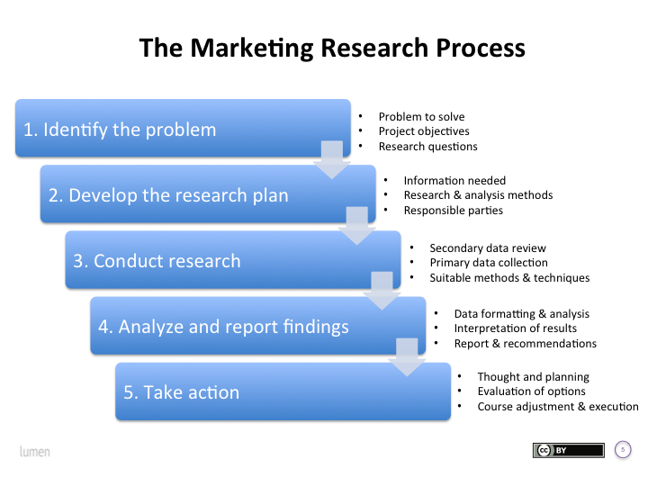
Marketing Research Process
The Marketing Research Process
Notes:
Revision and Adaptation. Authored by: Lumen Learning. License: CC BY: Attribution

Slide 11
Types of Marketing Information: Internal Data
Large databases collect massive amounts of data from a variety of sources: customer demographic and profile data linked to in-store and online purchasing history, Web site search terms, page views, social media posts, and other data
In a process called data mining, computer algorithms search for patterns in the data and generate recommendations and insights about how to increase sales
Notes:
Book has a video from software provider salesforcs. CRM in 2nd year.

Slide 12
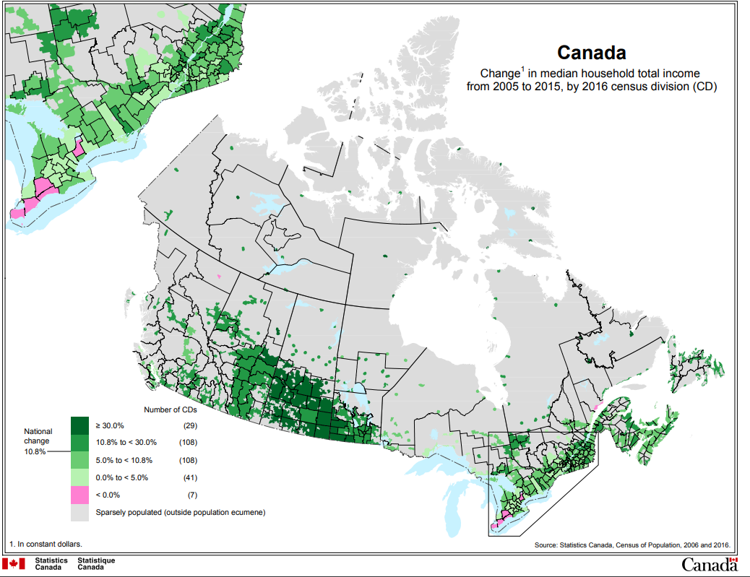
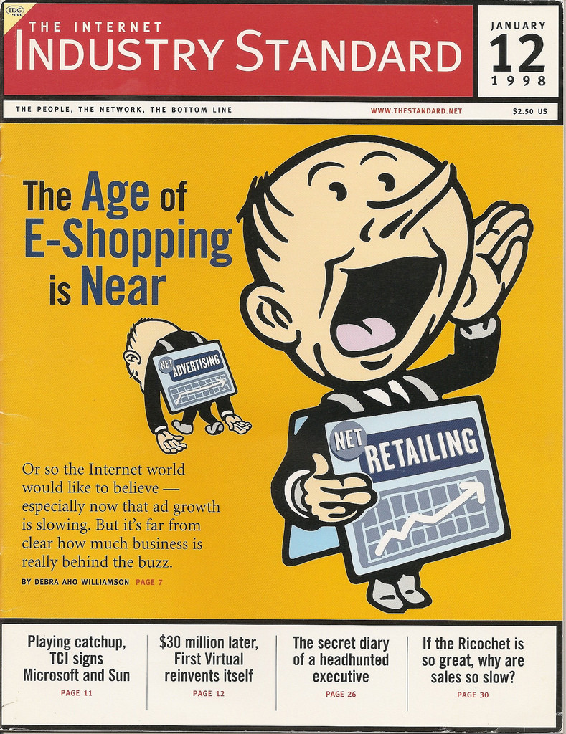
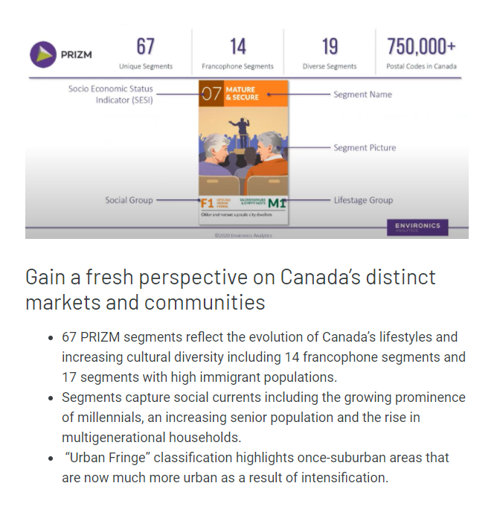
Secondary Research
Secondary research uses information that has previously been collected either inside or outside the organization such as:
Internal data
Government and non-governmental organization
Industry associations, journals, and media
Commercial market research data
Search engine results
Notes:
The Industry Standard Cover. Authored by: Matt McAlister. Located at: https://www.flickr.com/photos/mattmcalister/3600857428/. License: CC BY-NC: Attribution-NonCommercial

Slide 13

Advantages and Disadvantages Secondary Research
Advantages
Disadvantages
Less expensive
Less time intensive
Information may be somewhat dated
Probably does not address your exact problem with your exact market and competitive dynamics

Slide 14
Quantitative vs. Qualitative Research
Qualitative research explores ideas, perceptions, and behaviors in depth with a relatively small number of research participants. It aims to answer questions with more complex, open-ended responses.
Quantitative research collects information that can easily be counted, tabulated, and statistically analyzed.

Slide 15
Discussion #6
Segmentation
Target Strategy
Customer Profile
Revisit Segmentation and Target Strategy and add to Customer Profile

Slide 16

Qualitative Research Methods
behavioral observation
in-depth interviews
focus groups
social listening
Notes:
Interview. Authored by: Amy Hirschi. Provided by: Unsplash. Located at: https://unsplash.com/photos/JaoVGh5aJ3E. License: CC0: No Rights Reserved. License Terms: Unsplash License

Slide 17
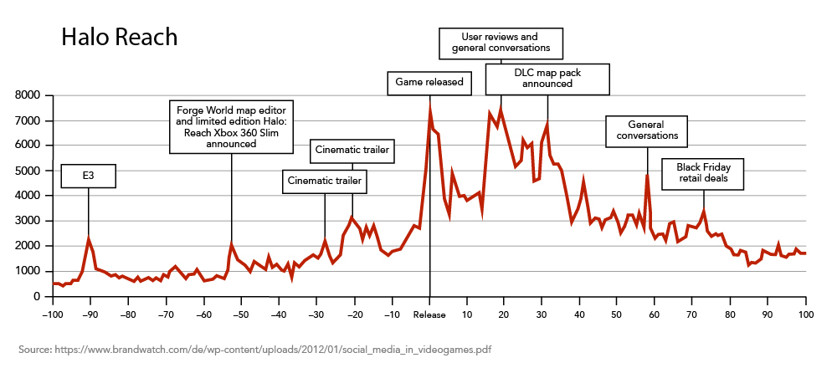
Social Listening
Social listening is a systematic process for tracking what is being said about a given topic in forums such as Facebook, Twitter, LinkedIn, blogs, and even mainstream media.

Slide 18
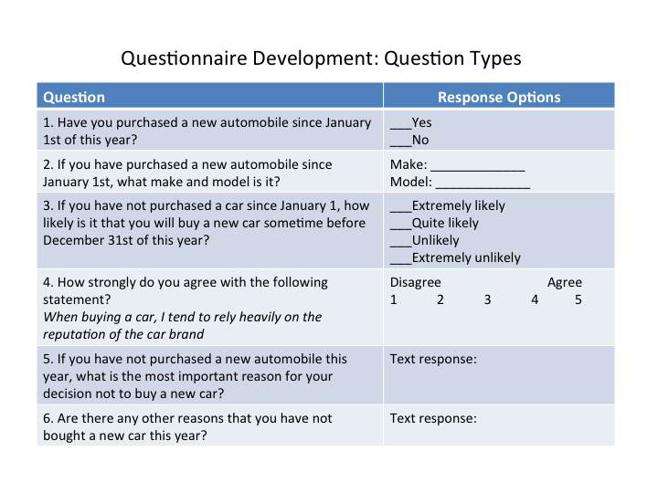
Quantitative: Surveys
Surveys ask individual consumers to give responses to a questionnaire.
Notes:
Revision and Adaptation. Authored by: Lumen Learning. License: CC BY: Attribution

Slide 19
Marketing Research Contact Methods: Pros and Cons
Contact Method | Advantages | Disadvantages
Telephone | Good control over screening; quick turnaround | Rising costs; declining response rates; caller ID screening
Mail | Inexpensive; reaches offline populations | Slow; low response rates; little control over participants
In-person | High engagement; good for in-depth data | Expensive; geographic limitations
Online | Fast; inexpensive; scalable; flexible design | Self-selection bias; excludes offline populations
Notes:
Revision and Adaptation. Authored by: Lumen Learning. License: CC BY: Attribution

Slide 20
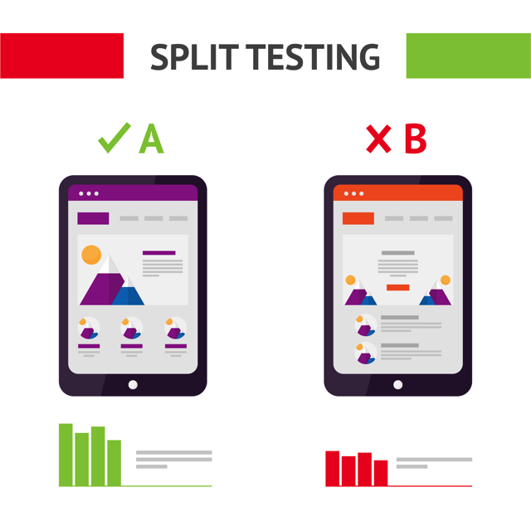
Quantitative: Experiments
A typical example is A/B testing in marketing campaigns. In an A/B test, the marketers use two different versions of promotional materials with two samples of target customers and then track the results to see which version is most effective.

Slide 21

Sampling
A sample is a smaller group selected to represent the larger audience.
A sample is a group of elements (persons, stores, financial reports) chosen for research purposes from among a “total population” or “universe” of all possible participants who fit the target criteria for research subjects.
Notes:
USAG-Humphreys teens participate in a focus group. Provided by: USAG-Humphreys. Located at: https://www.flickr.com/photos/usaghumphreys/3568673346/. License: CC BY: Attribution

Slide 22
Analyzing Primary Data
Analyzing data is the process of interpreting what it means, generating recommendations, and reporting results to the appropriate stakeholders within an organization.
Qualitative: Summarizing key themes and takeaways as well as including verbatim comments from research participants that express important points.
Quantitative: Researchers apply a variety of statistical tabulations and tests to determine what the data are saying, which findings are truly significant, and what meaningful correlations or relationships exist to offer new insights about the target segment.

Slide 23
Publicly Available Data Sources
Source | Description
Statistics Canada | Canada’s central statistical agency providing national data on demographics, economic activity, labour markets, income, consumer expenditures, and more.
Government of Canada Open Data Portal | Centralized federal portal offering datasets across industries, transportation, health, environment, and business.
Provincial & Municipal Open Data Portals | Each province and many cities (e.g., Ontario Data Catalogue, City of Toronto Open Data) provide regional data on demographics, health, housing, and local economic activity.
CMHC (Canada Mortgage and Housing Corporation) | Housing market, rental, and affordability data critical for marketers in housing-related industries.
Google Trends | Global tool for tracking search term volumes, useful for identifying consumer interest trends in Canada and internationally.
Pew Research Center | U.S.-based but globally relevant public opinion data on social issues and consumer attitudes.
UNdata (United Nations) | Centralized access to a wide variety of U.N.-maintained datasets such as demographics, socioeconomic status, and development indicators.
World Bank Data | Economic data and development indicators for 100+ countries worldwide.
World Trade Organization (WTO) Data | Information about international trade, tariffs, and the regulatory environment for WTO member countries.
Notes:
Marketing Information: Where the Data Are. Authored by: Lumen Learning. License: CC BY: Attribution

Slide 24
Syndicated Marketing Research Data
Source | Description
NielsenIQ (Canada) | POS and household purchasing data with detailed insights into sales, pricing, promotion, and consumer behaviour.
Ipsos Canada | Syndicated surveys on Canadian consumers, public opinion, media, and social trends.
Environics Analytics (Canada) | Known for PRIZM segmentation, offering lifestyle, demographic, and behavioural data tailored to Canadian markets.
Numeris | Official source for Canadian media ratings and audience measurement (TV, radio).
Vividata | Provides syndicated research on Canadian consumers’ media habits, demographics, and product usage.
IRI Worldwide | POS and household panel data, with strong insights in grocery and retail.
Leger | Leading Canadian market research and polling company with syndicated reports across industries.
Acxiom | Extensive consumer datasets companies can map to their own customer and prospect data for analytics and campaigns.
Experian | Consumer datasets with demographic, purchasing, and credit information for marketing analytics.
Media Audit | U.S.-focused audience demographics and media consumption profiles for 100+ media markets.
MRI Simmons | Multimedia audience research and measurement datasets.
Roper Center for Public Opinion Research | Database of public opinion and polling questions, including historical archives.
Yankelovich MONITOR | Long-running syndicated research about consumer values, attitudes, and trends..
Notes:
Marketing Information: Where the Data Are. Authored by: Lumen Learning. License: CC BY: Attribution

Slide 25
Other Sources of Marketing Data
Source | Description
Google Analytics (GA4) | Website analytics tool providing insights into traffic, user behaviour, and conversion.
Social Media Analytics (Meta, TikTok, LinkedIn, YouTube, X) | Native platform dashboards providing real-time audience and engagement data.
Statista | Subscription-based portal with searchable access to market, industry, and business data.
LexisNexis | Aggregated full-text news, legal, and business publications searchable by topic.
Factiva | Business information and news database with global coverage.
Comscore | Digital audience measurement, including Canadian online and cross-platform media consumption.
Notes:
Marketing Information: Where the Data Are. Authored by: Lumen Learning. License: CC BY: Attribution

Slide 26

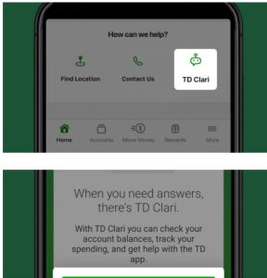
Customer Relationship Management (CRM)
CRM systems are powerful platforms that serve several critical functions for marketing, sales, and customer experience. Organizations use them to:
Capture and centralize internal data about customers and interactions across channels.
Provide employees with access to customer data to inform a wide variety of touchpoints, from sales calls to customer support.
Conduct data analysis and generate insights about how to better meet the needs of target segments and individual customers.
Deliver a marketing mix tailored to the needs and interests of these target segments and customers in real time.
Leading providers of CRM systems today include Salesforce, Microsoft Dynamics 365, Oracle, and HubSpot, among others. These platforms combine multiple components:
Databases and Data Warehouses: Provide the infrastructure for storing and retrieving customer data at scale.
Contact and Interaction Management: Track and integrate customer communications across email, phone, social media, and web.
Analytics and AI: Use predictive modeling and machine learning to identify customer patterns, anticipate needs, and personalize offers.^{[2]}
CRM Software from Salesforce.com - Customer Relationship Management - Salesforce.com
Notes:
Screencapture of TD Clari from https://www.td.com/ca/en/personal-banking/how-to/td-app/clari 19/08/2025.

Slide 27

Using Marketing Information to Shape Marketing Strategy
Different elements require different types of questions:
Target Segment(s)
Product
Promotion
Price
Place

Slide 28
Types of Questions…
What new insights do we have about our target segment(s)?
Are we targeting the right segments?
What attracts customers to our products?
What improvements would make them even more attractive to our target segments?
What types of promotional campaigns will work best for each target segment?
Who do out target segments listen to, and what are they saying about us?
How does out pricing affect customers' willingness to buy?
How would changes to pricing affect sales?
Are we offering our products in the places and times that target segments feel the need for them? If now, how can we improve?
Are there more efficient ways for us to get out products into customers' hands?

Slide 29

Don’t Forget to Measure Impact!
This link between taking action and measuring results is important. It provides a continuing stream of marketing information to help marketers understand if they are on the right path and where to continue to make adjustments.
Notes:
Cake Milkshake Heaven. Authored by: Tina H. Located at: https://www.flickr.com/photos/ohocheese/4963121362/. License: CC BY-NC-ND: Attribution-NonCommercial-NoDerivatives

