Slide 1
Introduction to Marketing
Module 7: Consumer Behaviour
Notes:
All text in these slides is taken from https://courses.lumenlearning.com/wmopen-principlesofmarketing/, where it is published under one or more open licenses.
All images in these slides are attributed in the notes of the slide on which they appear and licensed as indicated.
Cover Image: "Shopping freak." Provided by: freestocks.org. Located at: https://unsplash.com/photos/_3Q3tsJ01nc. Content Type: CC Licensed Content, Shared Previously. License: CC0: No Rights Reserved.

Slide 2
The Exchange Process
Notes:
Revision and Adaptation. Authored by: Lumen Learning. License: CC BY: Attribution

Slide 3
Consumer Behavior Theories:
The Economic Man
According to the “economic man” model, consumers are rational actors who seek to maximize personal benefit, just as sellers aim to maximize profits. Under this model, buyers carefully evaluate all available information before making a choice.
Limitations: People are not always rational or they define value differently than this model would suggest

Slide 4
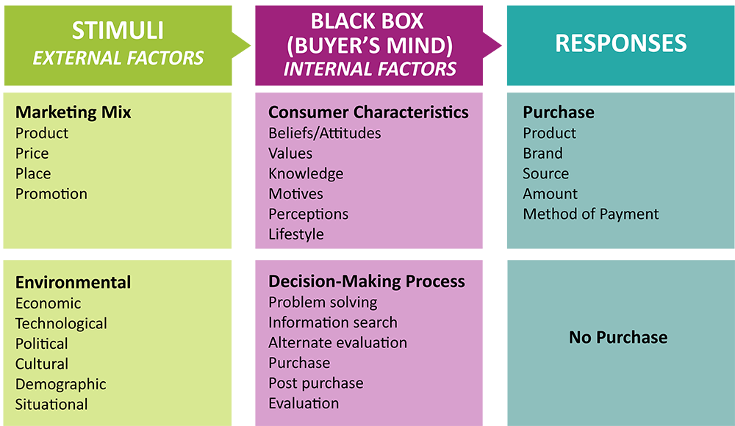
The Stimulus Response Model
Inputs: External stimuli such as the marketing mix (product, price, place, promotion) and environmental forces (economic, political, cultural, and technological).
The Black Box: Internal factors including consumer attitudes, beliefs, values, motivation, and decision-making processes.
Outputs: Observable responses such as purchase or non-purchase.
Notes:
Revision and Adaptation. Authored by: Lumen Learning. License: CC BY: Attribution

Slide 5
Consumer Decision-Making Process
Notes:
Revision and adaptation. Provided by: Lumen Learning. License: CC BY: Attribution

Slide 6
Needs Recognition
Consumer
Marketer
Whether we act to resolve a particular problem depends upon two factors:
  the magnitude of the difference between what we have and what we need, and
  the importance of the problem
Know what problems consumers are facing, so the marketing mix fits
Activate problem recognition to trigger the purchasing process
Shape how consumers define the need or problem
Notes:
The first step of the consumer decision process is recognizing that there is a problem–or unmet need–and that this need warrants some action.
Whether we act to resolve a particular problem depends upon two factors: (1) the magnitude of the difference between what we have and what we need, and (2) the importance of the problem.
Marketers get involved in the need recognition state at three points:
Knowing what problems consumers are facing, so they can develop a marketing mix to address these problems
Activating problem recognition, in order to trigger the start of the purchasing process
Shaping how consumers define the need or problem, in order to influence their wants as they look for a solution

Slide 7
Information Search
Consumer
Marketer
Seeks information
May come from past experience, word of mouth, or research
Promotions should give consumers the info they seek in the places they look for it
Notes:
After recognizing a need, the prospective consumer may seek information to help identify and evaluate alternative products, services, experiences, and outlets that will meet that need. Information may come from any number of sources: family and friends, search engines, Yelp reviews, personal observation, Consumer Reports, salespeople, product samples, and so forth. Which sources are most important depends on the individual and the type of purchase he or she is considering.

Slide 8
Evaluation of Alternatives
Consumer
Marketer
Develop a criteria to make a choice and evaluate options based on that criteria
Understand your target consumer’s evaluation criteria is critical. Your product needs to demonstrate these qualities in order to be short-listed in the selection set
Notes:
Evaluation of Alternatives
As a consumer finds and processes information about the problem she is trying to solve, she identifies the alternative products, services, and outlets that are viable options. The next step is to evaluate these alternatives and make a choice, assuming a choice is possible that meets the consumer’s financial and psychological requirements. Evaluation criteria vary from consumer to consumer and from purchase to purchase, just as the needs and information sources vary. One consumer may consider price most important while another puts more weight on quality or convenience.

Slide 9
Purchase Decision
Consumer
Marketer
Decide and buy
Try to simplify the purchase decision
Be aware of point of sale factors
Notes:
The Purchase Decision
After much searching and evaluating (or perhaps very little), consumers at some point have to decide whether they are going to buy. Anything marketers can do to simplify purchasing will be attractive to buyers. For example, in advertising, marketers might suggest the best size of product for a particular use or the right wine to drink with a particular food. Sometimes several decision situations can be combined and marketed as one package. For example, travel agents often package travel tours, and stores that sell appliances try to sell them with add-on warranties.
To do a better job of marketing at this stage of the buying process, a seller needs to have answers to questions about consumers’ shopping behaviour. Those answers will increase the likelihood of closing the sale and maximizing value at the moment of purchase. Useful questions to ask include the following:
How much effort is the consumer willing to spend in shopping for the product?
What factors influence when the consumer will actually make the purchase?
Are there any conditions that would prohibit or delay the purchase?

Slide 10
Postpurchase Behavior
Consumer
Marketer
May experience postpurchase anxiety due to cognitive dissonance
New-customer communications that confirm the quality and popularity of the product
Providing personal reinforcement has proven effective with big-ticket items such as automobiles and major appliances
Notes:
Postpurchase Behavior
All the behaviour determinants and the steps of the buying process up to this point take place before or during the time a purchase is made. However, a consumer’s feelings and evaluations after the sale are also significant to a marketer, because they can influence repeat sales and what the customer tells others about the product or brand.
Marketing is all about keeping the customer happy at every stage of the decision-making process, including postpurchase. It is normal for consumers to experience some postpurchase anxiety after any significant or nonroutine purchase. This anxiety reflects a phenomenon called cognitive dissonance. According to this theory, people strive for consistency among their cognitions (knowledge, attitudes, beliefs, and values). When there are inconsistencies, dissonance arises, which people try to eliminate.
Marketers may take specific steps to reduce postpurchase dissonance. One obvious way is to help ensure delivery of a quality solution that will satisfy customers. Another step is to develop advertising and new-customer communications that stress the many positive attributes or confirm the popularity of the product.

Slide 11

High-involvement Decisions
High-involvement decisions are important to the buyer
These decisions are closely tied to the consumer’s ego and self-image
They also involve some risk to the consumer, such as:
Financial risk (highly priced items)
Social risk (products that are important to the peer group)
Psychological risk (the wrong decision may cause the consumer some concern and anxiety)
Notes:
High-involvement decisions are those that are important to the buyer. These decisions are closely tied to the consumer’s ego and self-image. They also involve some risk to the consumer. This may include financial risk (highly priced items), social risk (products that are important to the peer group), or psychological risk (the wrong decision may cause the consumer some concern and anxiety). In making these decisions, consumers generally feel it is worth the time and energy needed to do research and consider solution alternatives carefully. The full, six-stage, complex process of consumer decision making is more likely to happen with high-involvement product purchases. In these cases, a buyer gathers extensive information from multiple sources, evaluates many alternatives, and invests substantial effort in making the best decision.

Slide 12
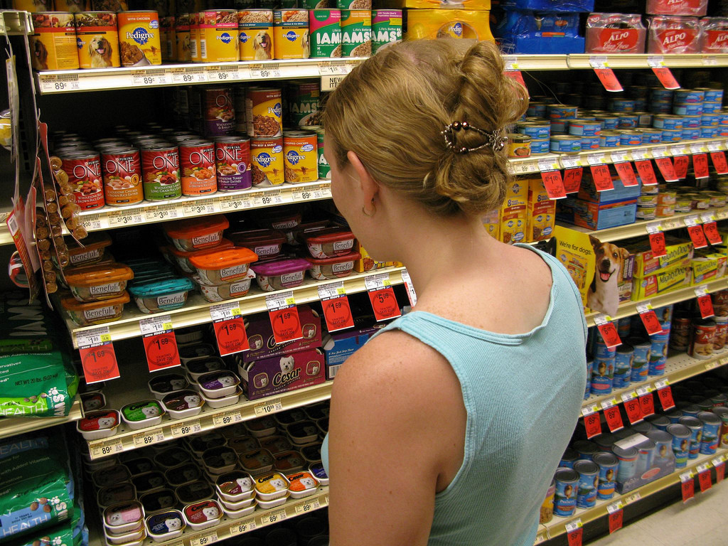
Low-involvement Decisions
Straightforward
Require little risk
Are repetitive and often lead to a habit
Not very important to the consumer
Notes:
Low-involvement decisions are more straightforward, require little risk, are repetitive, and often lead to a habit. In effect, these purchases are not very important to the consumer. Financial, social, and psychological risks are not nearly as great. In these cases, it may not be worth the consumer’s time and effort to search for exhaustive information about different brands or to consider a wide range of alternatives. A low-involvement purchase usually involves an abridged decision-making process. In these situations, the buyer typically does little if any information gathering, and any evaluation of alternatives is relatively simple and straightforward. Consumers are diligent enough to get a product they want, but they generally spend no more time or effort than is needed.
Dog Food Selection. Authored by: Christopher. Located at: https://www.flickr.com/photos/colorblindpicaso/2676714959/. License: CC BY-NC: Attribution-NonCommercial

Slide 13
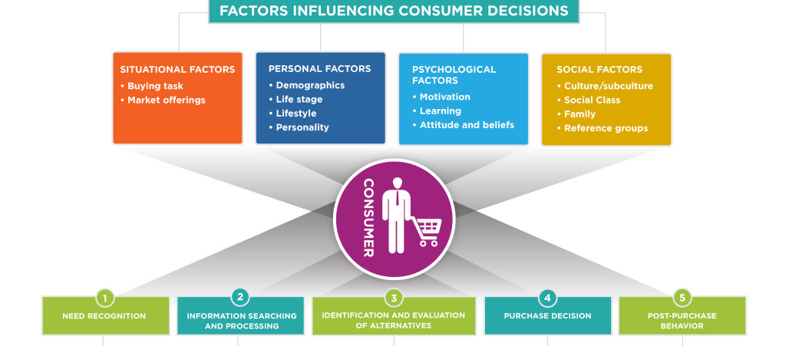
Factors Influencing Consumer Decisions and the Consumer Decision-Making Process
Notes:
The factors that influence the consumer problem-solving process are many and complex. As marketers gain a better understanding of these influencing factors, they can draw more accurate conclusions about consumer behaviour.
We can group these influencing factors into four sets, illustrated in the figure below. Each of these factors will be discussed in greater detail in the next four readings:
Situational Factors – Conditions tied to the specific buying task and marketplace context (e.g., time pressure, physical environment, availability).
Personal Factors – Individual characteristics such as age, life stage, income, lifestyle, and personality.
Psychological Factors – Internal influences including motivation, perception, learning, attitudes, and beliefs.
Social Factors – External influences from culture, subculture, social class, family, and reference groups.
Think about the Heinz beans video in the textbook and how consumers reacted to the taste test in Heinz vs Tesco beans.
Revision and Adaptation. Authored by: Lumen Learning. License: CC BY: Attribution

Slide 14
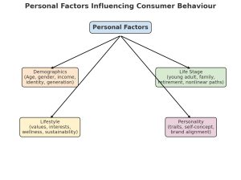
Personal Factors
Personal factors like demographics, life stage, lifestyle, and personality all combine to influence purchasing decisions.
Notes:
Diagram of Personal Factors Influencing Consumer Behaviour. Created using ChatGPT.

Slide 15
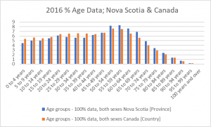
Demographics
Generational Cohorts. Marketers continue to examine consumer behaviour across generations, although the focus has shifted from broad generalizations to more nuanced insights.
Baby Boomers (1946–1964) are entering or already in retirement, increasingly targeted with products and services related to healthcare, financial security, and leisure. Many also embrace digital technologies for convenience, especially e-commerce and telehealth.
Generation X (1965–1980) is known for pragmatism and brand skepticism. They balance careers, aging parents, and teenage/adult children, making them a key market for financial services, travel, and household purchases.
Millennials / Gen Y (1981–1996) are highly digital, value authenticity, and often favour experiences over things. Rising housing costs and student debt shape their financial choices. They care about sustainability and brand purpose, rewarding companies with clear ethical stances.
Gen Z (1997–2012) are true digital natives. They are highly visual consumers (TikTok, YouTube, Instagram) who prefer personalized, fast, and inclusive experiences. They value diversity, climate action, and mental health awareness, and they expect brands to reflect these priorities.
Gen Alpha (2013 onward) are the first generation growing up entirely in a world of tablets, smart speakers, and AI-driven personalization. While still young, they are already influencing household purchases, particularly in entertainment, toys, and food.
Graph created from 2016 Census Data Tables. You can view the data on the Statistics Canada website^{[1]}
Gender and Identity. Marketing is moving beyond binary “male vs. female” targeting.
Notes:
Data tables, 2016 census. (2018). Statistics Canada. https://www12.statcan.gc.ca/census-recensement/2016/dp-pd/dt-td/Index-eng.cfm

Slide 16
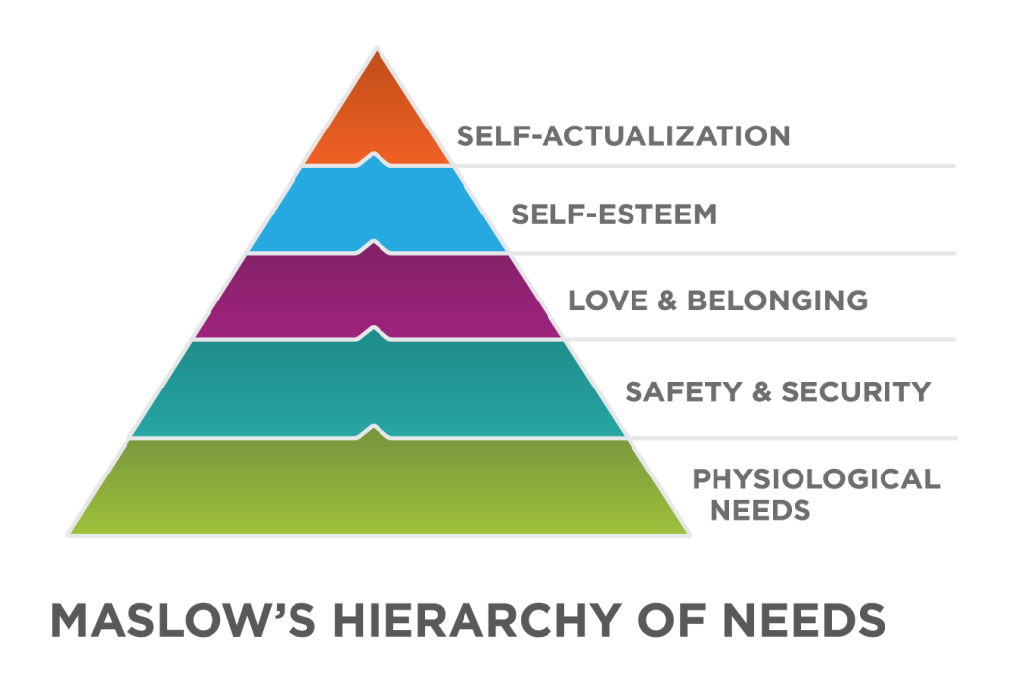
Psychological Factors
Notes:
Motivation starts with an unmet need, as does all consumer problem solving. One of the best-known theories about individual motivation is the work of A. H. Maslow, known as the hierarchy of needs. Maslow developed a model that lays out five different levels of human needs. These needs relate to one another other in a “need hierarchy,” with basic survival-oriented needs at the lower levels of the hierarchy, building up to higher emotional needs associated with love, self-esteem, and self-fulfillment. This hierarchy is shown in the figure below:
Physiological needs are at the first level of Maslow’s hierarchy: hunger, thirst, and other basic drives. All living beings, regardless of their level of maturity, possess physiological needs. Physiological needs are omnipresent and recur throughout nature.
Safety and security are second in Maslow’s hierarchy. Safety and security needs imply a continued fulfillment of physiological needs, as well as the absence of the threat of physical harm. Safety and security encompass both physical and financial security, because financial security is linked to a person’s ability to have her physiological needs met. Health and physical well-being and protection from accidents are also associated with this level of need. This is considered an extension of the more basic needs.
Love and belonging are third in Maslow’s hierarchy of needs. Love encompasses the needs for belonging, friendship, human intimacy, and family. They involve a person’s interaction with others and the need to feel accepted by social groups, large or small.
Self-esteem is the fourth level. Self-esteem includes the need to feel good about oneself, to be respected and valued by others, and to have a positive self-image.
Self-actualization is the fifth and highest level in Maslow’s needs hierarchy. Also described as “self-fulfillment,” this is the need humans feel to reach their full potential and to accomplish all that they can with their talents and abilities. Different people may express this need in very different ways: for one person, self-actualization might involve musical or artistic pursuits, for another, it’s parenting, and for a third the focus might be athletics. At different points in their lives, individuals may express this need through different pursuits.
Revision and adaptation. Provided by: Lumen Learning. License: CC BY: Attribution

Slide 17
Class Activity
Divide into groups, each group will be assigned a level.
Task: Find a product that markets on the basis of the need from Maslow’s hierarchy of needs.

Slide 18
Social Factors
Social Factors in Marketing (Canada, 2025)
Family Multigenerational households, Gen Z influence, busy parents drive demand for convenience.
Reference Groups Peers, influencers, and professional/workplace groups shape tastes and purchases.
Roles & Status Life roles and social identity influence buying; status symbols (e.g., eco-conscious choices).
Culture Canadian values: inclusivity, sustainability, bilingualism, collective action.
Subculture Regional, ethnic, religious, and occupational identities create unique preferences.
Customs Everyday habits, seasonal/holiday traditions, and digital shopping rituals guide spending.
Social Class Education, occupation, lifestyle, and income levels shape affordability and aspirations.
Social factors—the influences people experience from family, friends, groups, and society—play a major role in shaping purchasing decisions.
Notes:
Diagram of Social Factors Influencing Consumer Behaviour. Created using ChatGPT.

Slide 19

Culture
: A person's culture is represented by a large group of people with a similar heritage. Culture exerts a strong influence on a person's needs and wants because it is through culture that we learn how to live, what to value, and how to conduct ourselves in society. Canadian values include:
fairness
diversity
equity
inclusion
health
safety
economic security
democracy
sustainability

Slide 20
Subculture
Subcultures are cohesive groups that exist within a larger culture. Subcultures develop around communities that share common values, beliefs, and experiences. They may be based on a variety of different unifying factors. For example, subcultures exist around the following:
Geography: Western Canadians, Quebecois, Atlantic Canadians, etc.
Ethnicity: Latinos, Asian Canadians, African Canadians, etc.
Religion: Catholics, Jews, Mormons, Baptists, Muslims, etc.
Nationality: Italians, Koreans, Hungarians, Japanese, Ethiopians, etc.
Occupation: military, technology worker, government employee, clergy, educator, etc.

Slide 21
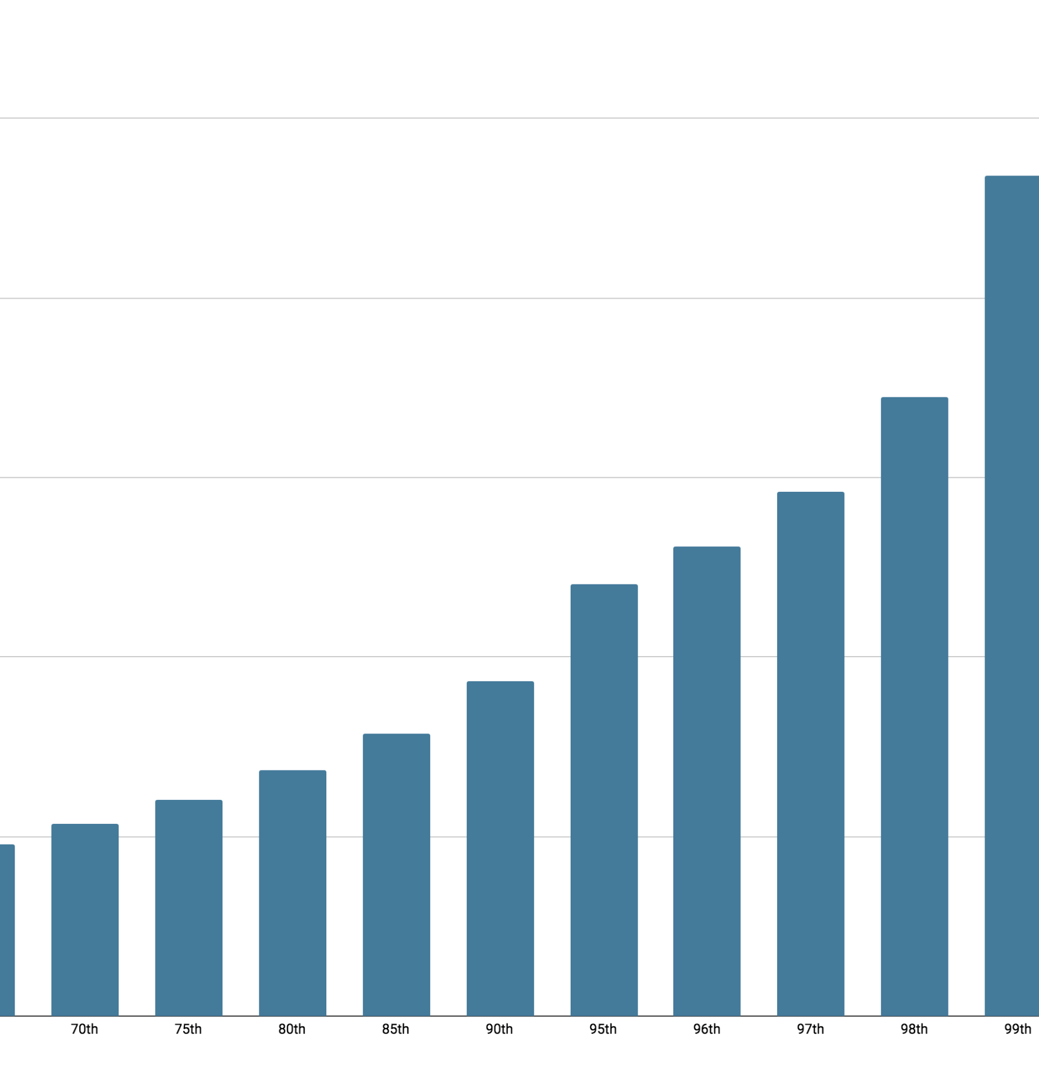
Social Factors: Class
Upper Class makes up 1% of the population.
Upper Middle Class makes up 15% of the population.
Lower Middle Class makes up 32% of the population.
Working class makes up 32% of the population.
Lower Class makes up 20% of the population
http://behindthenumbers.ca/2017/09/15/canadas-1-still-flying-high/
http://behindthenumbers.ca/wp-content/uploads/2017/09/TI-by-perc.png
Notes:
Revision and Adaptation. Authored by: Lumen Learning. License: CC BY: Attribution

Slide 22

Reference Groups
A reference group is any group that a person looks to for guidance in behaviour, values, or attitudes.
Can influence an individual in several ways:
Role expectations
Conformity
Group communications through opinion leaders
Word of mouth influence
Notes:
End here for group C
Jeff Phillips SK8 Party. Authored by: Scott Lumley. Located at: https://www.flickr.com/photos/scottlumley/10692510614/. License: CC BY: Attribution
In Canada’s highly connected and multicultural society, reference groups take many forms:
Friend groups and peers: Especially important for teenagers and young adults in shaping tastes in fashion, food, and entertainment.
Workplace and professional associations: Increasingly relevant as Canadians spend much of their time in hybrid work settings, where “Zoom-ready” attire and home office setups have become part of workplace norms.
Digital communities and influencers: In 2025, social media platforms such as TikTok, Instagram, and YouTube remain powerful drivers of consumer behaviour. Micro-influencers with fewer but more engaged followers are particularly effective in Canada, where consumers tend to value authenticity and relatability over celebrity.

Slide 23
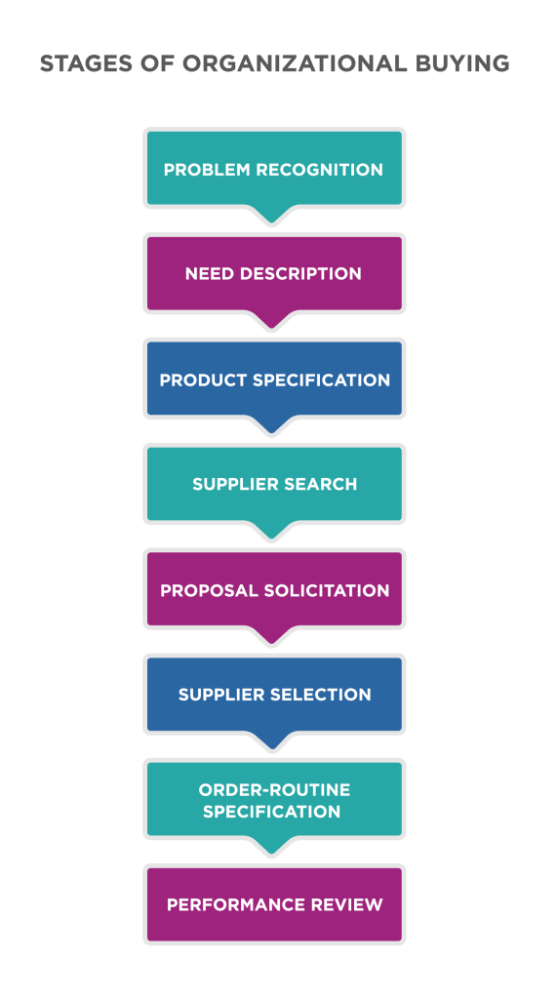
B2B Decision Making Stages
Notes:
Problem Recognition
The process begins when someone in the organization recognizes a problem or need that can be met by acquiring a good or service.
General Need Description
Once they recognize that a need exists, the buyers must describe it thoroughly to make sure that everyone understands both the need and the nature of solution the organization should seek.
Product Specification
Technical specifications come next in the process. This is usually the responsibility of the engineering department. Engineers design several alternatives, with detailed specifications about what the organization requires. These specifications align with the priority list established earlier.
Supplier Search
The buyer conducts a standard search to identify which providers offer what they need, and which ones have a reputation for good quality, good partnership, and good value for the money. This step virtually always involves using the Internet to research providers and sift through product and company reviews. Buyers may consult trade directories and publications, look at published case studies (written or video), seek out guidance from opinion leaders, and contact peers or colleagues from other companies for recommendations.
Proposal Solicitation
During the next stage of the process, qualified suppliers are invited to submit proposals. Depending on the nature of the purchase, some suppliers send only a catalog or a sales representative. More complex purchases typically require submission of a detailed proposal outlining what the provider can offer to address the buyer’s needs, along with product specifications, timing, and pricing. Proposal development requires extensive research, skilled writing, and presentation.
Supplier Selection
At this stage, the buyer screens the proposals and makes a choice. A significant part of this selection involves evaluating the vendors under consideration. The selection process involves thorough review of the proposals submitted, as well as consideration of vendor capabilities, reputation, customer references, warranties, and so on. Proposals may be scored by different decision makers using a common set of criteria. Often the selection process narrows down vendors to a short list of highest-scoring proposals. Then the short-listed vendors are invited to meet with the buyer(s) virtually or in person to discuss the proposal and address any questions, concerns, or gaps. At this stage, the buy may attempt to negotiate final, advantageous terms with each of the short-listed vendors. Negotiation points may cover product quantity, specifications, pricing, timing, delivery, and other terms of sale. Ultimately the decision makers finalize their selection and communicate it internally and to the vendors who submitted proposals.
Order-Routine Specification
The buyer now writes the final order with the chosen supplier, listing the technical specifications, the quantity needed, the warranty, and so on. At this stage, the supplier typically works closely with the buyer to manage inventories and deliver on agreement terms.
Performance Review
In this final stage, the buyer reviews the supplier’s performance and provides feedback. This may be a very simple or a very complex process, and it may be initiated by either party, or both. The performance review may lead to changes in how the organizations work together to improve efficiency, quality, customer satisfaction, or other aspects of the relationship.
Revision and Adaptation . Authored by: Lumen Learning. License: CC BY: Attribution

Slide 24
Low-involvement B2B Decisions
For rebuys and routine purchases, organizations use abridged versions of the process
Some stages may be bypassed completely when a supplier has already been selected

Slide 25
Considerations in B2B Marketing
Who will take part in the buying process?
What criteria does each person use to evaluate prospective suppliers?
What level of influence does each member of the process have?
What interpersonal, psychological, or other factors about the decision team might influence this buying process?
How well do the individuals work together as a group?
Who makes the final decision to buy?

Slide 26
Complexity of B2B Buying
Timing
Technical specifications of the physical products, or complex technical specifications associated with services, timing, and terms of delivery and payment.
Organizational complexities

Slide 27

Unique Factors that Shape B2B
B2B purchasing decisions are influenced by a variety of factors that are unique to organizations, the people they employ, and the broader business environment
Notes:
Untitled. Authored by: StartupStockPhotos. Provided by: Pixabay. Located at: https://pixabay.com/photos/entrepreneur-startup-start-up-man-593358/. License: CC0: No Rights Reserved. License Terms: Pixabay License

