Slide 1
Introduction to Marketing
Module 8: Positioning
Notes:
All text in these slides is taken from https://courses.lumenlearning.com/wmopen-principlesofmarketing/, where it is published under one or more open licenses.
All images in these slides are attributed in the notes of the slide on which they appear and licensed as indicated.
Cover Image: "Shopping freak." Provided by: freestocks.org. Located at: https://unsplash.com/photos/_3Q3tsJ01nc. Content Type: CC Licensed Content, Shared Previously. License: CC0: No Rights Reserved.

Slide 2

Positioning
Positioning is a strategic process that marketers use to determine the place or “niche” an offering should occupy in a given market, relative to other customer alternatives. When you position a product or service, you need to understand
Place: What place does the offering occupy in its target market?
Rank: How does the product or service fare against its competitors in the areas evaluated by customers deciding what to buy?
Attitude: How do we want customers to think about this offering and the benefits it offers them?
Outcomes: What must we do to ensure the product or service delivers on the positioning we select?

Slide 3

Differentiation
To make a product or service stand out from its competitors in ways that provide unique value to the customer
Identifies a set of characteristics and benefits that make a product different and better for a target audience that:
Customers value when they are evaluating choices
Competitors cannot easily copy
Notes:
Macy's Flower Show. Authored by: Stephen Rees. Located at: https://www.flickr.com/photos/stephen_rees/4499802916/. License: CC BY-NC-ND: Attribution-NonCommercial-NoDerivatives

Slide 4
Positioning vs. Differentiation
Name | Positioning | Differentiators
Walmart Canada | Everyday low prices across a wide selection of essentials, groceries, and general merchandise | “Everyday Low Price” guarantee; omnichannel shopping with online + store integration
Costco | Bulk savings for households and small businesses, emphasizing value and quality | Membership model; private-label Kirkland brand; bulk pricing
Loblaws / PC Express | A one-stop destination for groceries, wellness, and household needs, blending physical stores with strong digital convenience | Strong private labels (President’s Choice, No Name); PC Optimum loyalty program; grocery pickup/delivery
Canadian Tire | Trusted, national go-to retailer for home, auto, outdoor, and sporting goods | Deep category expertise; owned brands (Mastercraft, MEC partnership); CT Money rewards
Simons | Canadian fashion retailer offering stylish, curated apparel and home goods, with a growing focus on sustainability | Exclusive fashion lines; sustainability initiatives (eco-responsible collections); strong Quebec brand heritage
Notes:
Revision and Adaptation. Authored by: Lumen Learning. License: CC BY: Attribution

Slide 5

Steps of the Positioning Process
Confirm your understanding of market dynamics
Identify your competitive advantages
Choose competitive advantages that define your market “niche”
Define your positioning strategy
Communicate and deliver on the positioning strategy
Positioning can also be useful at any stage of the product life cycle (PLC)
Notes:
Lightbulbs. Provided by: Pixabay. Located at: https://pixabay.com/en/light-bulbs-light-bulb-light-energy-1125016/. License: CC0: No Rights Reserved

Slide 6
Step 1: Confirm Your Understanding of Market Dynamics
A firm understanding of your target market and answers to the following questions:
In which product, service, or market category (also called the “frame of reference”) do you plan to use this positioning?
Which target segment is your focus for the positioning you are developing?
What factors do these buyers evaluate when they make a purchasing decision?
How do these buyers view your competitors in the category?

Slide 7
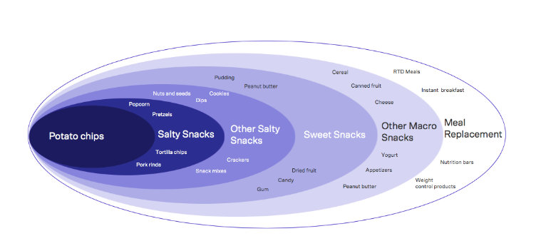
What is Your Frame of Reference or Category?
“A frame of reference approach engages an outside-in perspective to generate a better understanding of a business’s customers and what they need, creating a market or context in which a brand is positioned.”
Notes:
Source: https://vivaldigroup.com/en/blogs/frame-of-reference/#:~:text=A%20frame%20of%20reference%20approach,which%20a%20brand%20is%20positioned.

Slide 8
Step 2: Identify Your Competitive Advantages
A trait, quality, or capability that allows you to outperform the competition. A useful tool to determine competitive advantages (or not) is Porter’s Five Forces to determine the three attributes below
Gives your product, service, or brand an advantage over others in purchasing decisions comes from any or all of the following:
Price
Features
Benefits

Slide 9
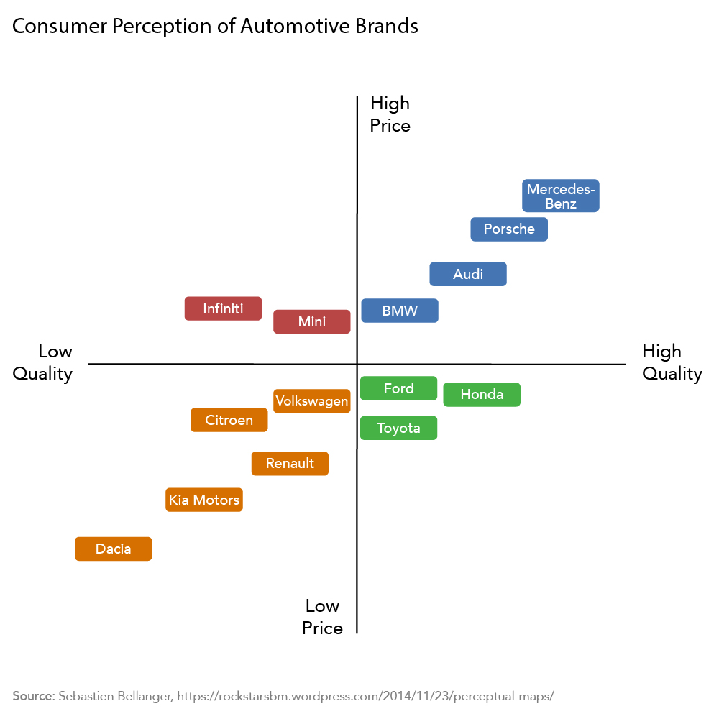
Step 3: Choose
Competitive Advantages That Define Your Niche

Slide 10
Class Activity- Create a perceptual map for your brands. Choose what you put in the table for your competitive differentiation.
Brand | price (1-7) | taste (1-7)
Your Brand | 4 | 2
Competing Brand #1 | 1 | 8
Competing Brand #2 | 3 | 4
Competing Brand #3
Competing Brand #4
Competing Brand #5
Competing Brand #6
Brand | price (1-7) | taste (1-7)
Your Brand | 4 | 2
Competing Brand #1 | 1 | 8
Competing Brand #2 | 3 | 4
Competing Brand #3
Competing Brand #4
Competing Brand #5
Competing Brand #6

Slide 11
Class Activity- Create a perceptual map for your brands.
Safety
7
Competing Brand 3
Competing Brand 4
Competing Brand 5
Your Brand
price 2
1
7
Competing Brand 2
Competing Brand 6
Competing Brand 1
1

Slide 12
Step 3: Choose
Competitive Advantages That Define Your Niche

Slide 13
Step 4: Implement:
Common Positioning Strategies
Differentiator | Positioning Strategy | Examples
Category Benefit | Position yourself as “owning” an important benefit and delivering it better than anyone else | Volvo = Safety Hallmark = Caring shared Hawaii = Aloha spirit
Best fit for the Customer | Position yourself as an ideal fit for the customer’s personality, style, and approach | Red Bull = Extreme Guess Jeans = Sexy chic Virgin Atlantic = Ultra cool fun
Business Approach | Position yourself with a distinctive approach to doing business | Jimmy John’s = Unbelievably fast TurboTax = Easy DIY
Anti-Competition | Position yourself as a preferred alternative to the competition | Apple = Think different Seven-Up = The Uncola
Price | Position yourself according to pricing: lowest cost, best value for the money, luxury or premium | Wal-Mart = Lowest prices Old Navy = Affordable fashion
Quality | Position yourself according to a quality standard: high quality or else reliably good quality at a reasonable price | Hearts on Fire = Perfection Ritz Carlton = luxury
Notes:
Provided by: Lumen Learning. License: CC BY: Attribution

Slide 14

Positioning Statement
One sentence that concisely identifies the target market and what you want customers to think about your brand Includes:
The target market
The brand name
The key points of differentiation
The product or service category (the frame of reference in which the brand competes)
The reasons to believe the positioning claims
Notes:
Kia GT4 Stinger. Authored by: Chad Horwedel. Located at: https://www.flickr.com/photos/chorwedel/12613017214/. License: CC BY-NC-ND: Attribution-NonCommercial-NoDerivatives

Slide 15
Formula for Positioning Statement
To [target audience], Product X is the only [category or frame of reference] that [points of differentiation/benefits delivered] because [reasons to believe].
Notes:
Target audience: A short description of the customer segment you are trying to reach with this positioning strategy. For example, young urban males, managing partners in law firms, or small business owners in the Pacific Northwest.
Product X: The name of your product, service, or brand.
Category or frame of reference: The market or category in which you compete. For instance, spectator sporting events, virtual assistant services, or employer pension plans.
Points of differentiation/benefits delivered: A clear explanation of both the problem you solve and how you solve it in a way that is different from—and better than—competitors. This highlights the competitive advantage(s) that anchor your positioning strategy. Make sure to articulate not only what sets you apart, but also why those differences matter to customers.
Reasons to believe: Proof points or evidence that demonstrate how you deliver on your claims of being different and better.

Slide 16
Example: Tesla (Model 3)
Company | Target Audience | Category / Frame of Reference | Points of Differentiation / Benefits Delivered | Reasons to Believe
Tesla (Model 3) | Environmentally conscious professionals | Electric vehicle (mid-size sedan) | High performance, cutting-edge tech, zero-emission driving | Tesla’s battery innovation, Supercharger network, proven leadership in EVs
To environmentally conscious professionals,
Tesla Model 3 is the only electric vehicle in the mid-size sedan category
that delivers high performance, cutting-edge technology, and zero-emission driving
because it is backed by Tesla’s industry-leading battery innovation, Supercharger network, and track record of redefining sustainable mobility.

Slide 17



Criteria to Evaluate Positioning Statements
Is it tailored to the target market?
Is it simple, focused, and memorable?
Does it provide an unmistakable picture of your product, service, or brand?
Can you deliver on the promise you make?
Does it provide helpful direction for designing the marketing mix and other decisions?
Notes:
Wieden+Kennedy door. Authored by: Sebastian Oehme. Located at: https://www.flickr.com/photos/iamseb/1581319503. License: CC BY-SA: Attribution-ShareAlike

Slide 18
Sample Positioning Statements
Company | Positioning Statement
Walmart Canada | For price-sensitive Canadian families, Walmart offers a wide range of household and grocery essentials at everyday low prices, combining affordability with convenience so families can save money and live better.
Costco | For households that can afford to buy in bulk and small businesses, Costco provides exclusive access to high-quality products at lower unit prices, reinforced by its trusted Kirkland brand and membership model that drives loyalty and value.
Loblaws / PC Express | For busy Canadian families seeking convenience and value, Loblaws delivers fresh groceries and household products seamlessly integrated with digital services, loyalty rewards (PC Optimum), and flexible delivery or pickup options.
Canadian Tire | For Canadian homeowners, do-it-yourselfers, and outdoor enthusiasts, Canadian Tire is the trusted destination for products that keep cars, cottages, and families ready for every season, blending tradition with innovation.
Simons | For fashion-conscious Canadians, especially younger generations, Simons offers curated, design-forward collections that emphasize sustainability, Canadian identity, and a personalized shopping experience both online and in-store.

Slide 19
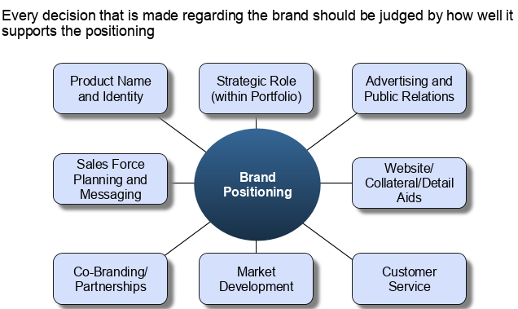
Step 5: Communicate and Deliver on Your Positioning

Slide 20
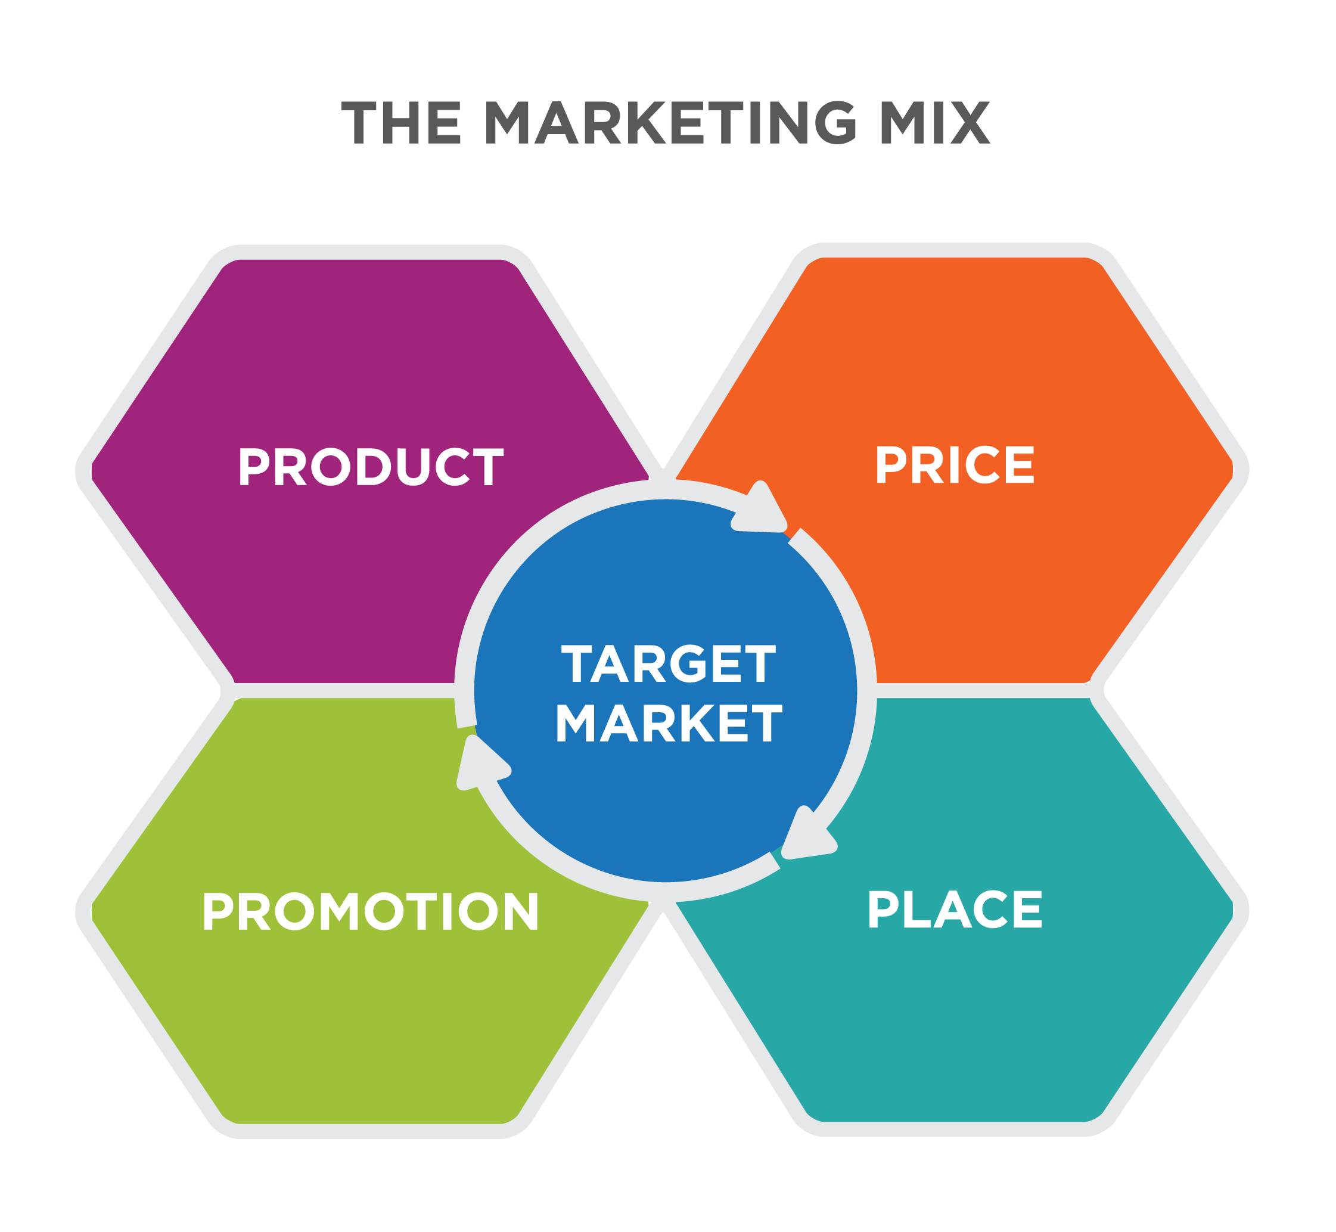
Implementing a Positioning Strategy
How can each part of the marketing mix fulfill the positioning statement?
Notes:
Implementing Positioning Strategy. Authored by: Lumen Learning. License: CC BY: Attribution

Slide 21
Your marketing mix must align with your brand positioning
Notes:
Source: http://equibrandconsulting.com/templates

Slide 22

Product
Is your product, service, or brand capable of delivering everything your positioning statement claims?
Are any competitors doing it better than you?
How should you adjust your offering to ensure that it lives up to the promises?

Slide 23
Place
Are any distribution-related themes like convenience or availability part of your positioning strategy or competitive advantage?
If so, what are you doing to ensure that you can live up to what you promise?
How are you communicating your new positioning approach to distribution and channel partners, and how does it impact them?

Slide 24
Price
When it comes to pricing, how are you positioning your offering relative to competitors?
If pricing is part of your positioning strategy, is your offering well aligned with the price you’re asking customers to pay?
What pricing strategies should you consider in order to compete more effectively?

Slide 25
Promotion
How are you translating your positioning strategy into communications with your target audiences?
What behavioral shift are you trying to create as you launch your new positioning?
What types of campaigns will you use to introduce the new positioning?
Which communication tools will be most effective at reaching target audiences?
What are you doing to coordinate marketing messages and activities across different channels?

Slide 26


Reasons to Consider Repositioning
Competition
New competitors entering or leaving the market; competitors joining forces
Competitor’s innovation that threatens to make your offering obsolete; competitive pricing strategies
Market environment
Economic slow-down or recovery
Changes in consumer confidence, the political climate, or social forces like the movement around social responsibility and sustainability
WHAT has changed with the Amazon logos shown?
Notes:
Wieden+Kennedy door. Authored by: Sebastian Oehme. Located at: https://www.flickr.com/photos/iamseb/1581319503. License: CC BY-SA: Attribution-ShareAlike

Slide 27

More Reasons to Consider Repositioning
Consumer trends
Changing tastes and preferences
Evolving attitudes and behaviors
New segments emerging as targets
Internal environment
Changes in organizational leadership and strategy
Acquisition or development of new technology
Introduction of innovation that offers new competitive advantages and differentiators

Slide 28

Repositioning and Market Perceptions
The repositioning process evaluates the established position of a product, service, or brand and focuses on how to redefine an offering so it continues to remain relevant and competitive.
Notes:
Suitcases Stacked to the Ceiling. Authored by: Laura Gilmore. Located at: https://www.flickr.com/photos/genbug/3529776320/. License: CC BY-NC-ND: Attribution-NonCommercial-NoDerivatives

Slide 29
When to Reposition
Common triggers include:
Competition: New entrants disrupting the market, rivals joining forces, breakthrough innovations, or aggressive pricing strategies.
Market environment: Economic shifts, changes in consumer confidence, political or regulatory changes, or social forces such as the rise of sustainability.
Consumer trends: Evolving tastes, changing behaviors (like digital adoption), or the emergence of new customer segments.
Internal environment: Leadership changes, new technology, acquisitions, or innovations that alter competitive advantages.

Slide 30

Repositioning can fail
Key pitfalls include:
Insufficient research: Not fully understanding how the market or target segment will respond.
Going too far: Making changes so radical they break credibility.
Forgetting the basics: Overcomplicating messaging when clarity around core benefits is what matters most.
Overpromising: Creating expectations the organization cannot realistically deliver.
Mixed signals: Allowing old and new messages to conflict, creating confus

Slide 31
Measuring Implementation
Sales/revenue
Number of new/returning customers
Average spending per transaction
Brand/product awareness or perceptions
Favorability toward product/service/brand
New leads or inquiries from inside and outside your target segments
Web site traffic or social media “buzz”
Media attention
Customer Satisfaction
Return on investment (ROI) for marketing campaigns and other activities

